Slide 1

Student Details
Name : ASHISH KUMAR
SkillsBuild Email id : ashket980@gmail.com
College Name : ITER, SOA University
College State : Odisha
Internship Domain : Cyber Security
Internship Start Date : 12-06-2023
Internship End Date : 24-07-2023
STU ID : STU640f6569342ce1678730601

Slide 2
Keylogger - capturing key stokes

Slide 3
AGENDA
Project Overview
End Users
Solution and its Value Proposition
Modelling
Results
Links

Slide 4
PROJECT OVERVIEW
This Python program implements a keylogger, which is a type of software that records the keystrokes made by a user on their computer. It utilizes the pynput library to monitor and capture key events. Each key event is stored in a list called key_list, which is later converted to JSON format and saved to a file named 'logs.json'. The keylogger differentiates between key press, key hold, and key release events.

Slide 5
END USERS
In the context of cybersecurity, keyloggers are primarily used by the following user groups:
Security Professionals
Penetration Testers
Incident Responders
Law Enforcement Agencies
Corporate Security Teams

Slide 6
SOLUTION AND ITS VALUE PROPOSITION
Keyloggers can be used for various purposes, including cybersecurity, digital forensics, and system monitoring. In the context of cybersecurity, keyloggers can be employed for legitimate purposes such as monitoring employee activities within an organization or detecting and preventing unauthorized access.

Slide 7
Customization of the Project
Record keystroke activity
Record any websites visited as well as snapshots of the website
Logs around instant messages and emails sent or received
Applications opened by the user in a certain period of time

Slide 8
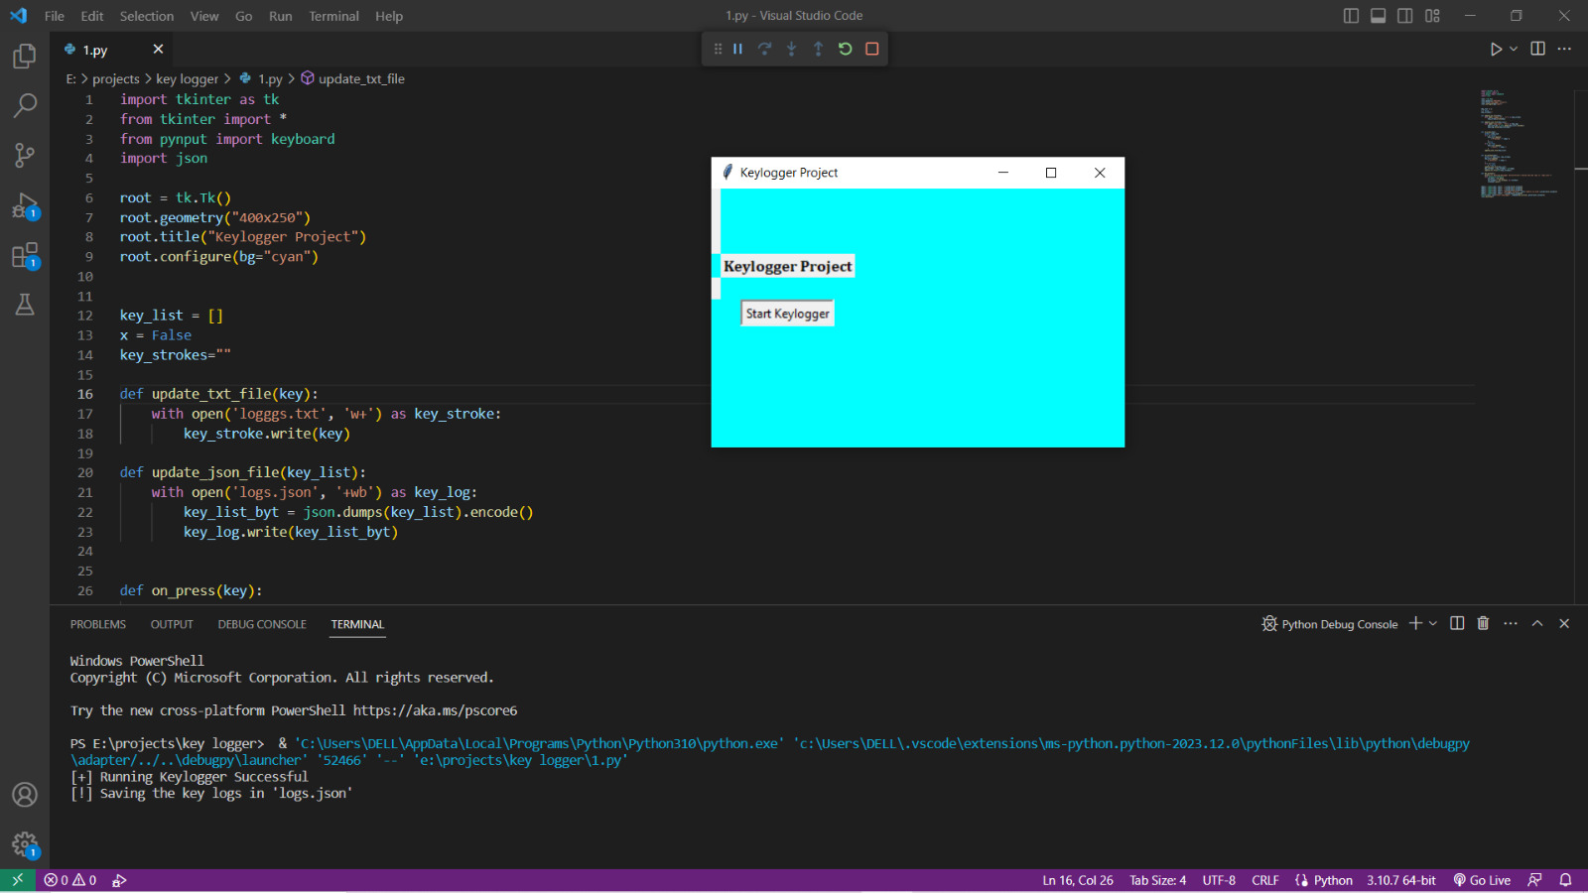
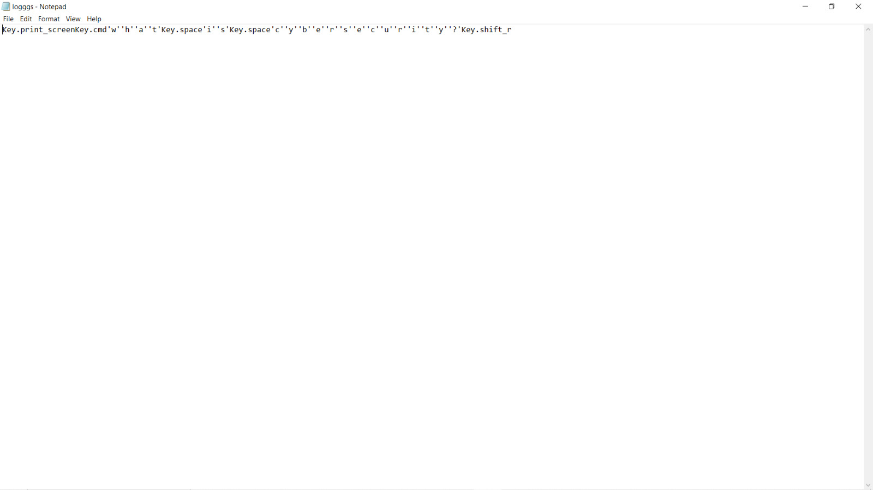
MODELLING

Slide 9
Results
Captured Keystrokes: The keylogger would record and store the keystrokes made by users on the targeted computer or device. This information could include text inputs, passwords, commands, and other keyboard-based actions.
Data Logging: The keylogger would create logs or records of the captured keystrokes, typically organized by time and user activity. These logs may contain timestamps, application or website names, and other contextual information.

Slide 10
links
For code learning : https://skillsbuild.edunetworld.com/courses/cs/keylogger-capturing-key-strokes/
For downloading python idle exe file use the link : https://www.python.org/downloads/
Github link for project code: https://github.com/Ashket980/Keylogger

