Slide 1



Slide 2
FAKE NEWS ANALYSIS PROJECT GUIDE – RAHUL AMBEKAR
Group Members: Moodle ID:
1. Shubham Padte 16102058
2. Pankit Khimasiya 16102034
3. Ashish Kothari 16102045

Slide 3
Contents
INTRODUCTION
PROBLEM DEFINITION
LITERATURE REVIEW
OVERVIEW
PROCESS FLOW
USE CASE DIAGRAM
PROPOSED SOLUTION
TECHNOLOGY STACK
METHODOLOGY/ALGORITHMS
REFERENCES

Slide 4
INTRODUCTION
These days’ fake news is creating different issues from sarcastic articles to a fabricated news and plan government propaganda in some outlets. Fake news and lack of trust in the media are growing problems with huge ramifications in our society.
As an increasing amount of our lives are spent interacting online through social media platforms and other online platforms , more and more people tend to seek out and consume news from social media rather than traditional news organizations.
Fake news is one of the biggest scourges in our digitally connected world. That is no exaggeration. It is no longer limited to little squabbles – fake news spreads like wildfire and is impacting millions of people every day.

Slide 5
INTRODUCTION
The reasons for this change in consumption behaviors are inherent in the nature of these social media platforms:
(i) It is often more timely and less expensive to consume news on social media compared with traditional news media, such as newspapers or television;
(ii) It is easier to further share, comment on , and discuss the news with friends or the other reader on social media.
Our economies are not immune to the spread of fake news either, with fake news being connected to stock market fluctuations and massive trades.
For example, fake news claiming that Barack Obama was injured in an explosion wiped out $130 billion in stock value

Slide 6
PROBLEM Statement
A large body of recent works has focused on understanding and detecting fake news stories that are disseminated on social media.
To accomplish this goal, these works explore several types of features extracted from news stories, including source and posts from social media.
we propose a general data mining framework for fake news detection which includes two phases: (i) feature extraction and (ii) model construction
Our proposed application will be implemented to verify the gentility of news.

Slide 7
LITERATURE REVIEW
In this paper, we propose a method for “fake news” detection and ways to apply it. Received results will be concluding that fake news detection problem can be addressed with methods of Natural Language Processing.[1]
We need to include auxiliary information, such as user social engagements on social media, to help make a determination. [2]

Slide 8
OVERVIEW
A model will be trained by letting it read millions of documents of news.
These documents included journalism and scientific journal articles, satire articles, narrative fiction, opinion pieces, blogs, politically leaning news and even hate speech examples.
The model still learning all the time.
If you think the model’s opinion wasn't quite right then we will include that feedback as a training dataset for the model which will continue to learn and develop using the new data.
The model will never tell you if an article is True or Not. That’s not the model’s job.

Slide 9
PROPOSED SOLUTION
The major objective is to analyze the online news , which is a classic text classification problem with a straight forward proposition.
It is needed to build a model that can classify “ fake” or “real” news.
To deliver user our opinion on news and make them classify the news is fake or real. To make user easier to differentiate news
Our philosophy is that the best judge of Truth from Fiction is you.
Model’s job is to read what you give us carefully and to let you know what kind of article it is.

Slide 10
PROPOSED SOLUTION(CONTD)
Is the article biased or does it give a measured assessment? Is the article written in a way that focuses on facts, or is it written with an agenda? Does the writing style use manipulative persuasion or is written in a way that provides you with the information to draw your own conclusions? Our model will make it easier to sort out the truth yourself.
Along with learning which articles correspond to which labels, the model also learns which part of the article to pay the most attention to in context with the other sentences. If Model thinks that the articles shows high Opinion, Sensational, Agenda, or Satire, then you can see the sentences that most influenced these labels here.

Slide 11
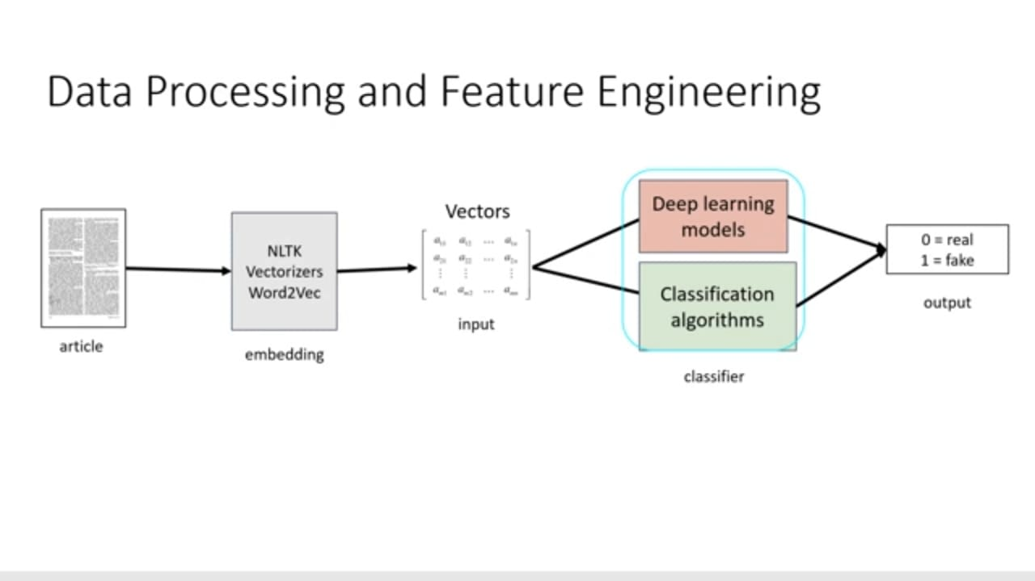
Process flow

Slide 12
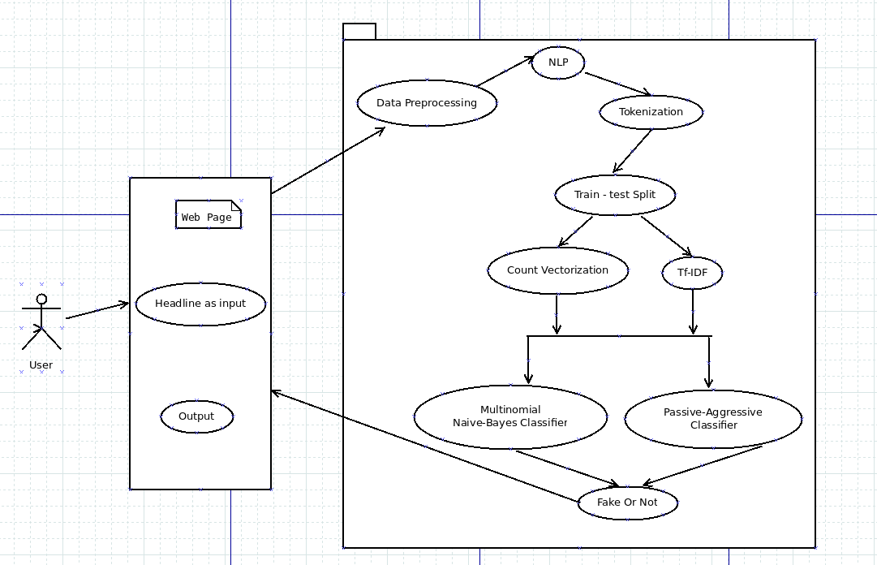
Use case diagram

Slide 13
TECHNOLOGY STACK
The language used for this whole project will be python since it’s the most effective where data analysis is concerned
• The Ide used will be jupyter notebook which is a great tool for data analysis.
• The jupyter notebook is available in anaconda, also spyder will be used for some data visualization which is also available in the same.

Slide 14
METHODOLOGY / ALGORITHMS
Algorithms:
Passive Aggressive Classifier
Multinomial Naïve Bayes Classifier
Natural Language Processing
Deep learning approaches:- Vectorization (word2vec)
NLTK (Natural Language Toolkit) for preprocessing and tokenization.

Slide 15
REFERENCES:
[1] www.ieeexplore.ieee.org :: Julio.C.S. ,Andrew Correia, “Supervised learning for fake news detection ”. In 1541-1672 @ March-April 2019
[2] www.ieeexplore.ieee.org :: Kai Shu, Amy Sliva, Suhang Wang, Jiliang Tang and Huan Liu, “Fake News Detection on Social Media:A Data Mining Perspective”.In arXiv:1708.01967v3 [cs.SI] 3 Sep 2017
[3] www.ieeexplore.ieee.org :: Akshay Jain, Amey Kasbe, “Fake News Detection”. In 2018 International Students Conference on Electrical, Electronics and Computer Science.
[4] Facebook’s BloomsburyAI
[5] www.fakenewschallenge.org
[6] www.fakerfact.org
[7] www.ODSC.com conference of Open Data Science by Sihem Romdhani

Slide 16
THANK YOU

