Slide 1
Youtube Data Analysis
By - Akash Chandel

Slide 2
CONTENTS
Youtube Data Analytics
Youtube ashboard for Data Analytics by Google
Purpose - Scope - Objective
Youtube API v3
About Dataset
Storing Data in Database
Time Series Analysis
Random Forest Regressor
NLTK Library
Conclusion

Slide 3
Youtube Data Analytics
YouTube is one of the most popular and premier video-sharing platforms by Google that allows content creators, be it individuals or companies to create a channel and upload videos of all different kinds. With YouTube in place, you can create content and share it with the world for entertainment, business, or welfare purposes as well.
YouTube Analytics Data can be used to draw informative & data-driven insights about your channel’s performance & viewers.
YouTube Analytics and its numerous functionalities are used to optimize and refine your content, promotion, and viewer engagements strategies.
A model that can help analyze the channel data using Machine Learning Techniques can be useful to gain insights and have a data backed approach towards the content and can help you garner more views by developing more engaing content.

Slide 4
YouTube Dashboard for Data Analytics by Google
We can use channel’s dashboard to keep track of YouTube Analytics Data such as the performance of your latest video using metrics such as the number of likes, views, view duration, watch time, etc. With the dashboard in place, you can also keep track of the overall channel analytics data such as subscribers, most popular videos, total views in the last 28 days, watch time, etc.
It divides the YouTube Analytics Data across three different sections:
Views: It shows the total number of channel & videos-based views.
Watch Time: It represents the watch time of your channel.
Subscribers: It shows the total number of subscribers across all your channels.
But Youtube Dashboard is personal for every person and cannot be accessed by only one’s id also google only provides limited insights and has tracking avialable for last 28 days, for a budding content creator Data and Analysing data can help a very long way by knowing the correct path and statergies rather than Hit and Miss Opportunities.

Slide 5
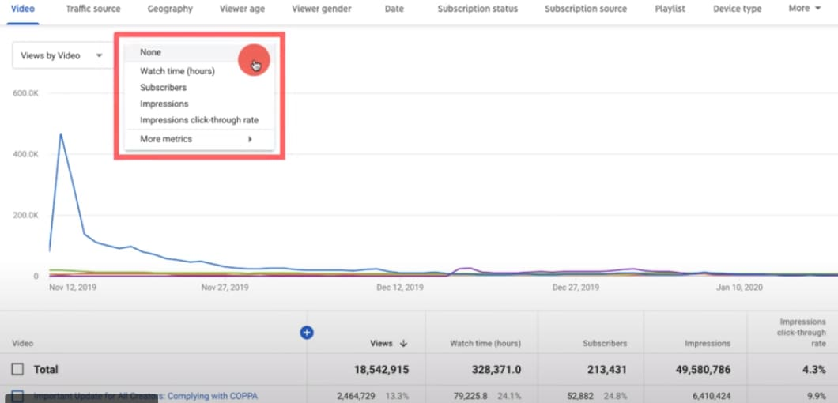
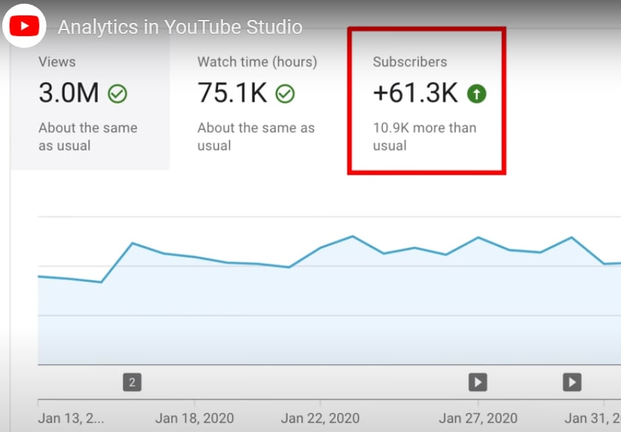
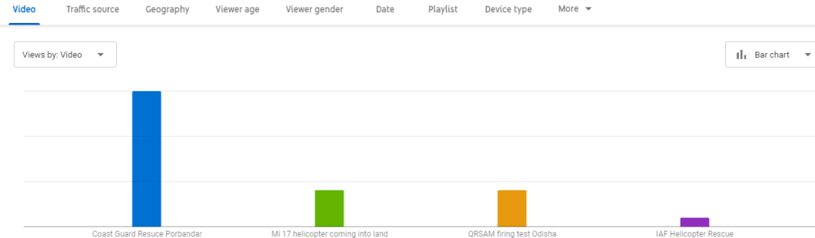
YouTube Dashboard for Data Analytics by Google

Slide 6
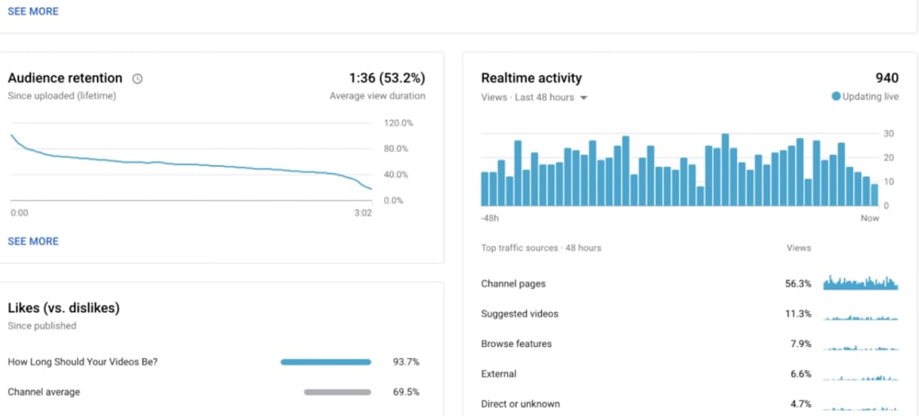
YouTube Dashboard for Data Analytics by Google

Slide 7
Purpose Scope and Objective
Good Content
Revenue
Good engaging content to retain already gained subs and viewers.
To gain more revenue by creating a very precise content for the audience.
Investing in the eqipment and content creation for the audience.
Doctoring title and clickbait titles to gain newer audience and retaining watch time.
month 1-3
More Clicks

Slide 8
Fetching Data via API
In this project i have used Youtube Data Api v3 to extract data about any channel with their channel key.
Firstly we need to create a project in Google Cloud Platform from where you we can access Api and Services of google.
Then by enabling the Api and then generating an Api key which is needed to access the Data.
Documentaion for Accesssing is avialable at -
https://developers.google.com/youtube/v3
Services, Libraries and Method to call can be accessed via this link.

Slide 9
About the Dataset
Dataset can be divided into 4 sections:
Channel: It shows the name of the channel.
Views: It shows total number of channel & videos-based views.
Subscribers: It shows the total number of subscribers of the channel.
Playlist_Id: It represents the an ID which can be used to access data of all the videos on the channel.
Further using Playlist_Id we can access the stats of all the videos of the channel has published whose Dataset can be divided into 5 sections:
Title: Title of the video when published.
Published_Date : Date of the video upload.
Views: It shows the total number of views on the particular video.
Likes: It shows the total number of likes on the particular video.
Comments: It shows the total number of comments on the particular video.

Slide 10
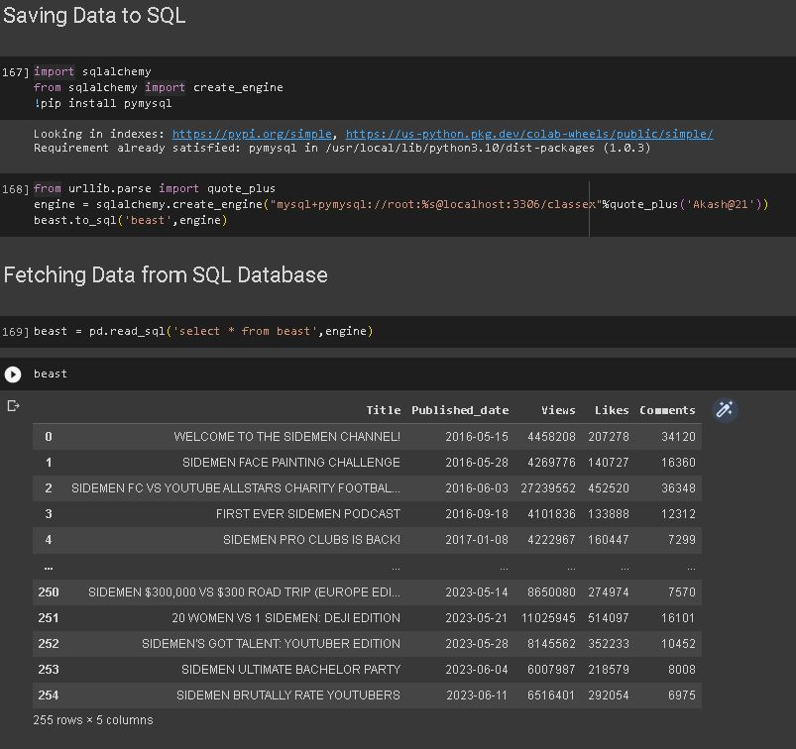
Storing Data in MySQL Database using SQL Alchamey
SQL Alchamey: It is an open-source Python library that provides a SQL toolkit for interacting with databases. It simplifies database operations by abstracting away the underlying database-specific details and providing a unified API for working with different database systems.

Slide 11
Time Series Analysis

Slide 12
Time Series Analysis
Time Series Analysis of the views has been performend in respect to the trend and seasonality.
Time series analysis is a specific way of analyzing a sequence of data points collected over an interval of time. In time series analysis, analysts record data points at consistent intervals over a set period of time rather than just recording the data points intermittently or randomly. However, this type of analysis is not merely the act of collecting data over time.
What sets time series data apart from other data is that the analysis can show how variables change over time. In other words, time is a crucial variable because it shows how the data adjusts over the course of the data points as well as the final results. It provides an additional source of information and a set order of dependencies between the data.
Time series analysis helps organizations understand the underlying causes of trends or systemic patterns over time. Using data visualizations, business users can see seasonal trends and dig deeper into why these trends occur. With modern analytics platforms, these visualizations can go far beyond line graphs.

Slide 13
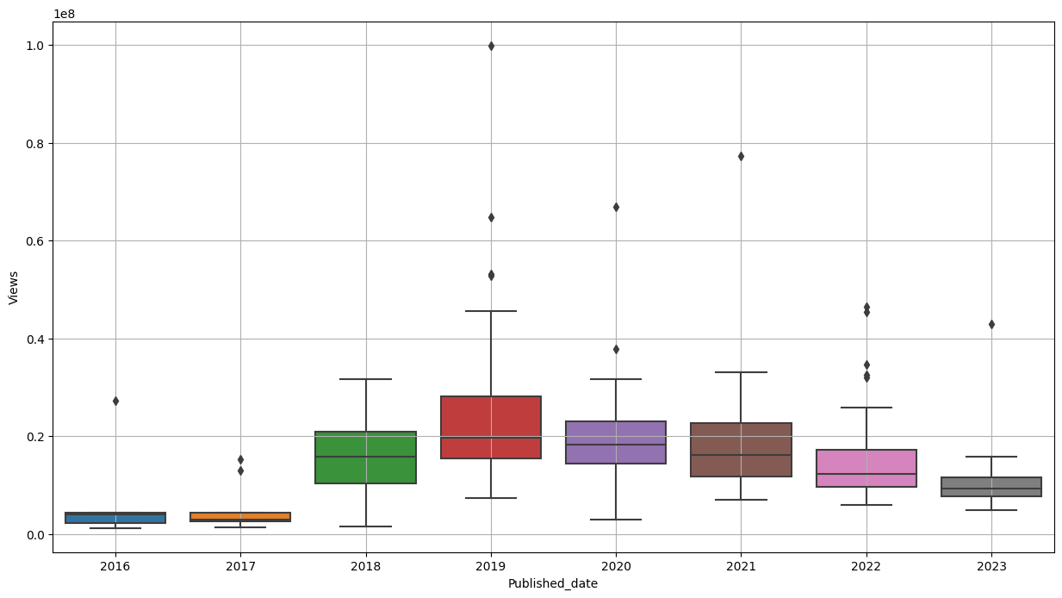
Time Series Analysis
Boxplot of Views gained on the channel videos in each year

Slide 14
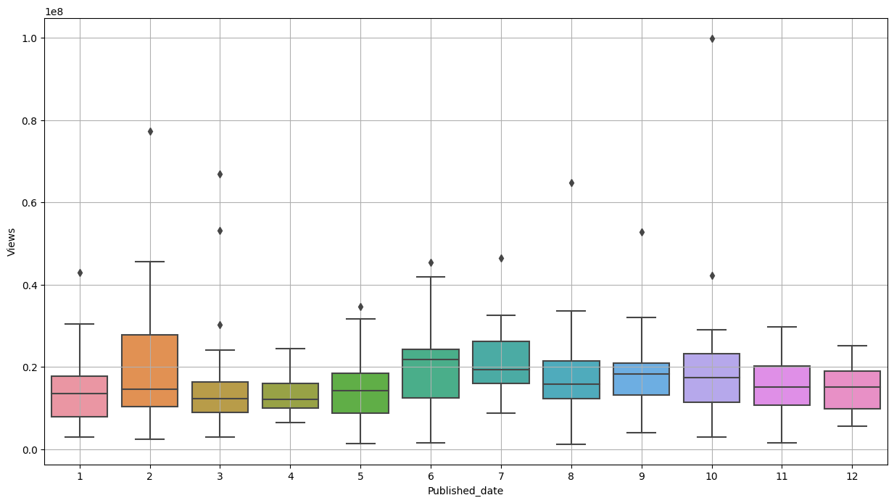
Time Series Analysis
Boxplot of Views gained on the channel videos in each month in all years

Slide 15
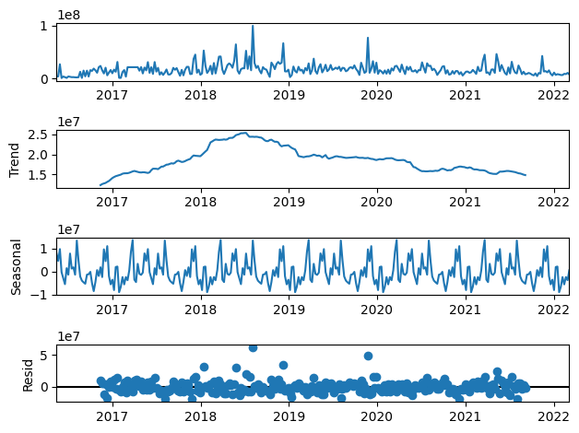
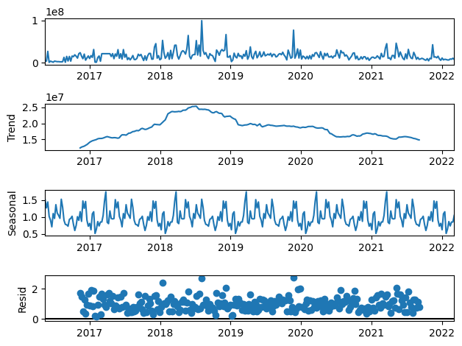
Decomposition of the Time Series
Additive Time Series Decomposition Multiplicative Time Series Decomposition

Slide 16
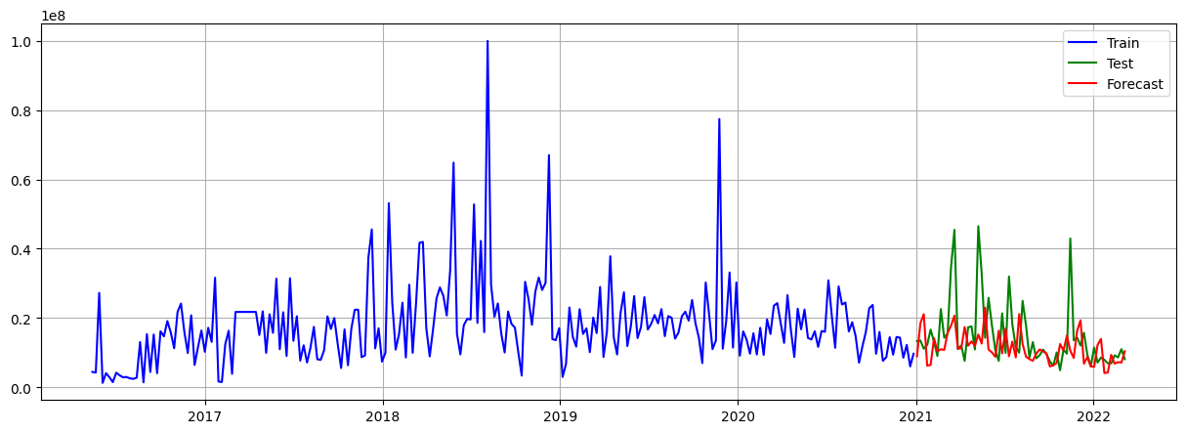
Triple Exponential Smoothing - Holt Winters
Triple exponential smoothing applies exponential smoothing three times, which is commonly used when there are three high frequency signals to be removed from a time series under study. There are different types of seasonality: 'multiplicative' and 'additive' in nature, much like addition and multiplication are basic operations in mathematics.
The holtwinters module of the statsmodels package allow for simple, double and triple exponential smoothing.

Slide 17
Model Evaluation Metrics
MAPE: Mean Abs Percentage Error
RMSE: Root Mean Squared Error
MAPE measures the average percentage deviation between the predicted values of a model and the actual observed values. It provides a way to quantify how well a model's predictions match the true values, taking into account the relative magnitude of the errors.
MAPE is expressed as a percentage, making it easier to interpret the error. A lower MAPE indicates a better fit between the model's predictions and the actual data.
It is a commonly used metric for evaluating the accuracy of a predictive model, particularly in the field of regression analysis.
RMSE measures the average deviation between the predicted values of a model and the actual observed values. It provides a way to quantify how well a model's predictions match the true values.

Slide 18
Random Forest Regressor

Slide 19
Random Forest Regressor
Random Forest Regressor is an ensemble learning algorithm that combines multiple decision tree regressors to create a more accurate and robust predictive model.
Ensemble Learning: It combines the predictions of multiple decision tree regressors, each decision tree is trained on a random subset of the training data and uses a random subset of features. By averaging the predictions of these trees, It improves its accuracy and reduces overfitting.
Decision Tree Regression: Each tree in the random forest regressor is built using a variant of the decision tree algorithm specifically designed for the regression tasks. Decision trees splits on the feature space based on the values of features and creating a tree-like structure of decisions and predictions.
Bagging Technique: Random Forest Regressor employs a technique called bootstrap aggregating or bagging. It randomly selects a part of the original training data with replacement to create multiple training sets for each decision tree. This sampling strategy ensures diversity among the trees and reduces the variance of the predictions.

Slide 20
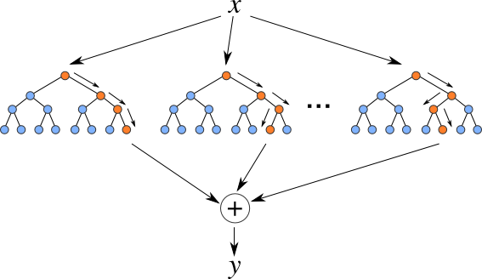
Random Forest Regressor
Robustness: Random Forest Regressor is known for its robustness against overfitting, noise, and outliers. By averaging predictions from multiple trees, it reduces the impact of individual trees that might be biased or overfit to the training data.
Hyperparameters: Random Forest Regressor has several hyperparameters that can be tuned to optimize its performance. Some commonly tuned hyperparameters include the number of trees in the forest, the maximum depth of each tree, the number of features considered at each split, and the criterion for splitting nodes.

Slide 21

NLTK : Natural Language Toolkit
NLTK (Natural Language Toolkit) is a powerful Python library widely used for natural language processing (NLP) tasks. It provides a comprehensive set of tools and resources for processing and analyzing text data. NLTK offers a wide range of functionalities, including tokenization, stemming, lemmatization, part-of-speech tagging, parsing, semantic reasoning.
It involves the process of Tokenization, Stemming and Lemitiation etc to convert wonds into vectors for a machine to analyze and understand it and is able to perform any specific tasks.

Slide 22
Text Processing using NLTK
Tokenization: Tokenization is the process of dividing a text or document into smaller units called tokens. These tokens can be words, sentences, or even smaller subword units, depending on the specific tokenization technique used. Tokenization is an essential step in natural language processing (NLP) as it forms the basis for further analysis and processing of text data.
Stopwords Removal: Stopwords are words that are often considered to be insignificant or less informative in natural language processing tasks. These words are typically removed from text data during preprocessing to improve the efficiency and accuracy of NLP algorithms and models.
Stemming: Stemming is a technique used in natural language processing to reduce words to their base or root form, known as the stem. It helps to normalize words and group together variations of a word that share the same core meaning. Stemming is particularly useful in tasks such as information retrieval, search engines, text mining, and sentiment analysis.

Slide 23
Text Processing using NLTK
Lemmatization: Lemmatization is the process of reducing words to their base or dictionary form, known as the lemma. Unlike stemming, which applies simple rules to remove affixes from words, lemmatization takes into account the context and part of speech (POS) of a word to determine its lemma.
Padding: Padding is a technique used in natural language processing and machine learning to ensure that all input sequences in a dataset have the same length. It involves adding additional elements, often with a specific value, to the sequences to make them equal in length.

Slide 24
Optimizing Model Parameters using GSCV
Grid Search CV (Cross-Validation) is a technique used to systematically search for the optimal combination of hyperparameters for a machine learning model. It is particularly useful when there are multiple hyperparameters to tune and their interactions need to be evaluated.
Grid Search CV automates the process of hyperparameter tuning, saving time and effort compared to manually testing different combinations. It helps to find the best hyperparameters that optimize the model's performance and generalization ability.
Grid Search CV is a powerful tool for hyperparameter tuning and model optimization, ensuring that the chosen hyperparameters are fine-tuned to maximize the model's performance on the given dataset.

Slide 25
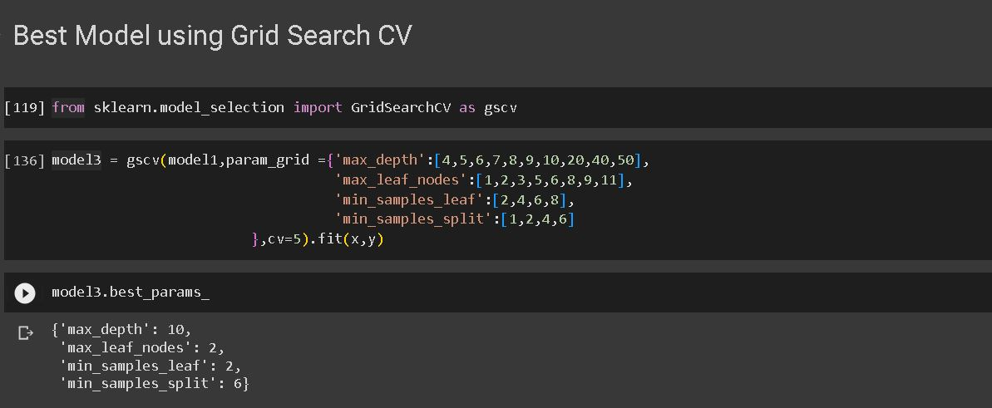
Optimizing Model Parameters using GSCV

Slide 26
Model Evaluation Metrics
R2 Score: R squared value
Adj R2 Score: Adjusted R squared value
R2 score, also known as the coefficient of determination, is a statistical measure used to evaluate the performance of regression models.
It indicates the proportion of the variance in the dependent variable that can be explained by the independent variables in the model. The R2 score ranges from 0 to 1, with higher values indicating a better fit of the model to the data.
The adjusted R2 score is a variation of the R2 score that takes into account the number of independent variables in a regression model.
It addresses a limitation of the R2 score by penalizing the addition of irrelevant variables to the model, providing a more reliable measure of the model's explanatory power.

Slide 27
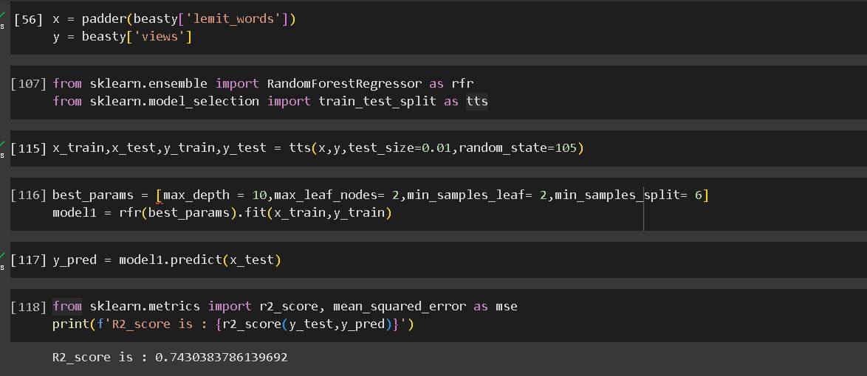
Model Evaluation Metrics

Slide 28
Conclusion
This presentation on YouTube Data Analysis using Time Series and Random Forest model highlighted the power and applicability of these techniques in understanding and predicting views on basis of the title and channels dependance on time, I have ideas to further this project by adding CNN model to classify each the image of the video and understanding the impact it can have on the number of views and i also am looking towards into techniques to combine learnings of all these models into one holistic model that can enable us to uncover patterns, make predictions, and derive actionable insights that can drive the success of YouTube channels and content creators. By leveraging these techniques, we can make informed decisions and optimize our strategies for reaching and engaging the YouTube audience effectively.

Slide 29
THANK YOU
Notes:
模板来自于 http://docer.wps.cn

