Slide 1

World Happiness Index
Vs.
Various Socioeconomic Data
(Health, GDP, Suicide Rate, Refugee Numbers, Pop. Growth)

Slide 2


Getting the Data
Kaggle World Happiness Index
Gapminder.org
Suicide Rates
Refugee Numbers
Military Expenditures
Children out of school
Population growth

Slide 3
Cleaning the Data
Removing empty cells
Removing columns of years with no happiness index to compare to
Experimenting with different formats to more easily read data into PostgreSQL (yearly tables vs one master table with yearly columns)

Slide 4
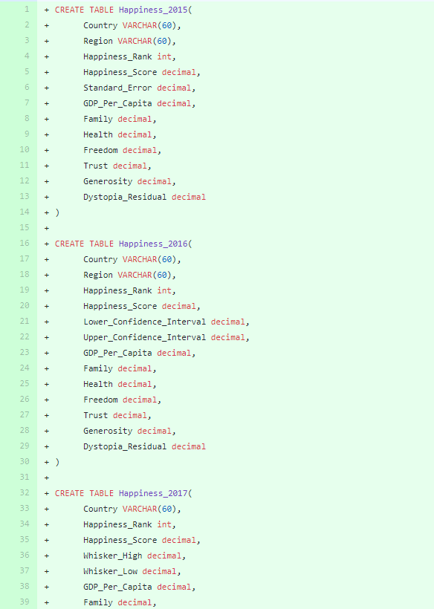
Putting the data into SQL
Import into PostgreSQL database
Create tables for each year of happiness
Create tables for other values
Suicide
Refugee rates
Military budget
Population growth

Slide 5
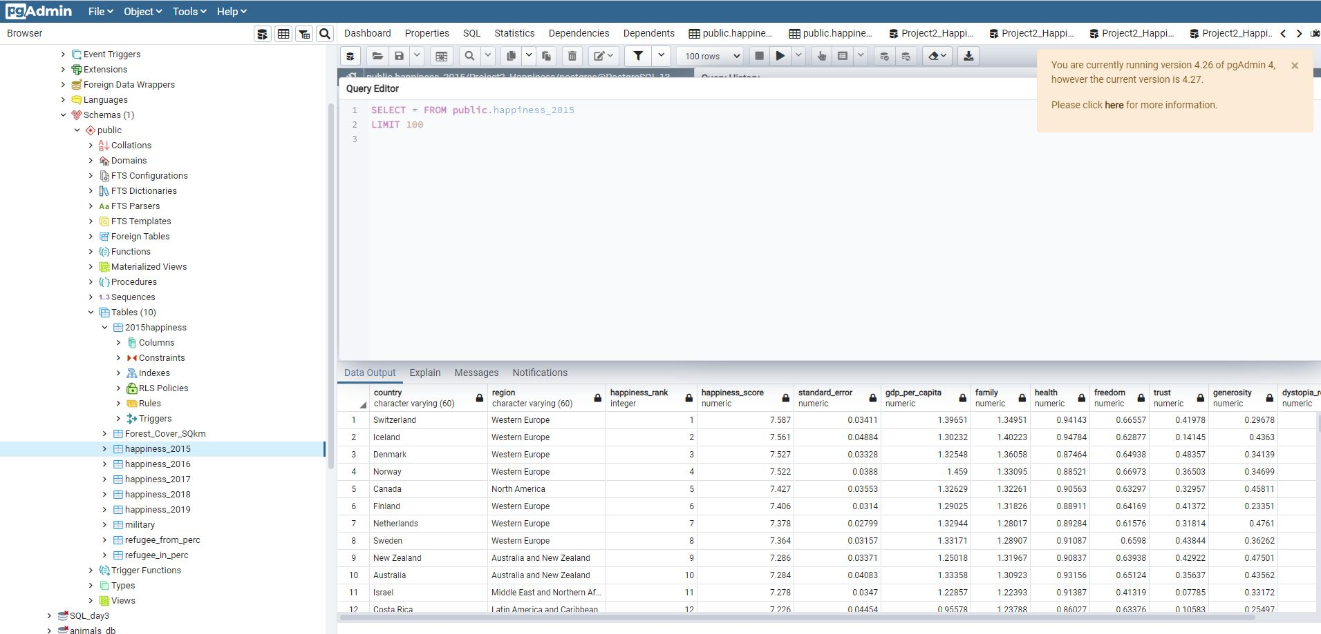
Creating Tables for happiness etc.

