Slide 1
Improving Low Biometric Quality of Face Images
Iqbal Nouyed,
Advanced Image Processing Project
WVU, 2015

Slide 2
Outline
Why assess biometric quality ? Approaches
Chosen Face Quality Assessment Method
Description of training method and datasets
Low quality image creation
Improving quality score using image denoising techniques
Results
Conclusion

Slide 3
Why Assess Face Image Quality
The effectiveness of automatic face recognition is challenged by variations in illumination, pose, occlusion and expression in captured face images.
Selecting high quality face images for recognition is a promising strategy to improve system performance.
Reduce overall computation load.

Slide 4
Quality Assessment Approaches
Empirically use certain facial properties, such as the resolution, pose angle, or illumination parameters, to quantify face image quality.
Compare a face to selected 'standard' faces and use their discrepancies for measuring face qualities

Slide 5
Patch based probabilistic Quality Assessment
Wong, Yongkang, et al. "Patch-based probabilistic image quality assessment for face selection and improved video-based face recognition." Computer Vision and Pattern Recognition Workshops (CVPRW), 2011 IEEE Computer Society Conference on. IEEE, 2011.
Two phases:
Train patch models using standard images.
Test using trained models.
Notes:
<number>

Slide 6
Training phase
Train data: training images are
well aligned,
centered faces,
frontal face images
under appropriate lighting with
neutral facial expression.
We have used the ‘fa’ subset of FERET dataset.
training method:
the method is initialized by constructing a generic face model.
One single model is constructed based on the multiple training faces.
firstly an image patch is moved in single steps accross the image along a predefined path.
The size of the image is 64x64 pixels, size of the patch is 8x8 , with overlap by 7 pixels (in both row and column).
As a result there are 64-8+1=57 patches in each line of the image and 57*57=3249 patches in the entire image.
For each of the patch of each training images a 2D-DCT is applied and 8x8 coffecients are determined.
Only the frequences of a 2x2 square at the top left of the matrix is considered because lower frequency components lie towards the upper left of the matrix and they characterise the coarse appearance and descriptive properties of a face.
Ignoring the DC component , the top left 2x2 element of matrix results in a feature vector of dimension 3.
From all the training images of this patch location mean vector and 3x3 covariance matrix of the set of vectors is determined.
This is done for all the patch locations for all the training images.
These mean vector and mean covariance matrix is used as the trained model at test phase.

Slide 7
Testing Phase
Test data: Unlike train images, images in test data will have pose variations, varying shadow conditions, blurring as well as alignment errors to show quality variations from the ideal state. We have used 100 images from LFW dataset.
Viola-Jones Haar-based face detector is used to detect face, then resized to 64x64 to match with training image dimension. Image log transformed to normalize intensity.
Now, the image is segmented into patches in the same way as training phase. Each patch is normalized to zero mean and unit variance. DCT coefficients are extracted.
Now to determine the similarity of each patch of the face image to the corresponding patch of the generic face model a posterior probability for each patch is determining by vector into a Gaussian probability density function based on the generic face model.
The aim is not to recognize an individual face but to determine close the patch of the face from the test set is to an average patch at the same location represented by the generic face model. The formula assigns a low probability to patches with DCT coefficients far from the mean of the probabilistic model and a high probability to patches with DCT coefficients close to the mean of the probabilistic model.
The quality of the image is determined by combining all the posterior probabilities of the patches.

Slide 8






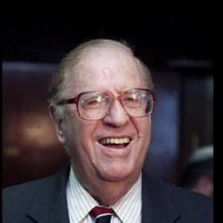


Sample Images
Training set (Preprocessed, 1000 images, FERET database):
Test set (Raw, 100 images, LFW database):

Slide 9
Creating low quality face images
Target of study:
Effect of presence of different degrees of white noise on quality score.
Effect of different degrees of blurriness on quality sore.
Two approaches:
Apply Gaussian noise of different variance
Range of Sigma_w = 0, 5, 10, 15, 20
Apply heat_diffusion with different number of iterations
Iteration = 0 , 1, 2, 4, 8, 16

Slide 10
Denoising techniques
For denoising Gaussian white noise:
BM3D
NLM (t=11, f=7)
Bilateral filter (w=2, sigma=[2 .2])
Wavelet (bior4.4, th=100)
DCT
TV (50 iteration)
PM (50 iteration)
Weiner
BLS-GSM
For deblurring:
Shock
Unsharp masking (lambda=0.1)
Histogram equalization

Slide 11
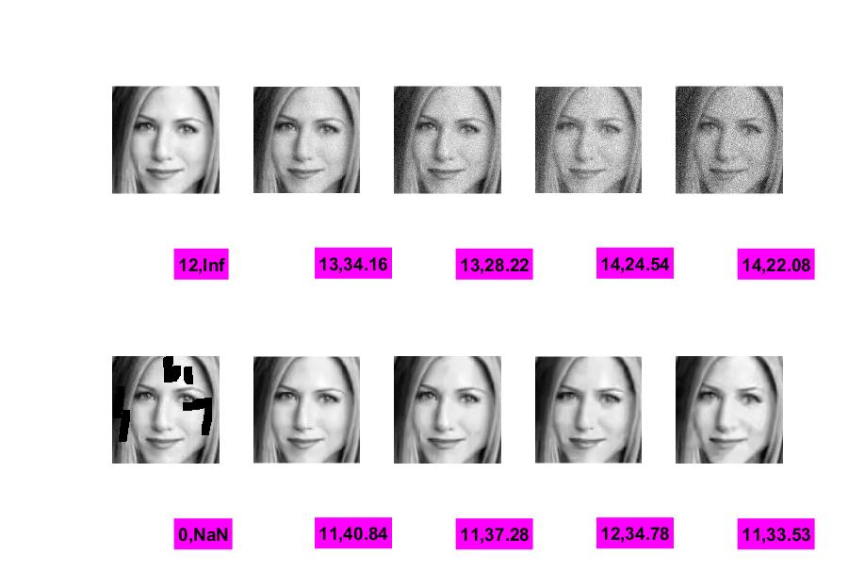
Results on a single image (BM3D)
Sigma_w = 0
Sigma_w = 5
Sigma_w = 10
Sigma_w = 15
Sigma_w = 20
Q, PSNR=>
Q, PSNR=>

Slide 12
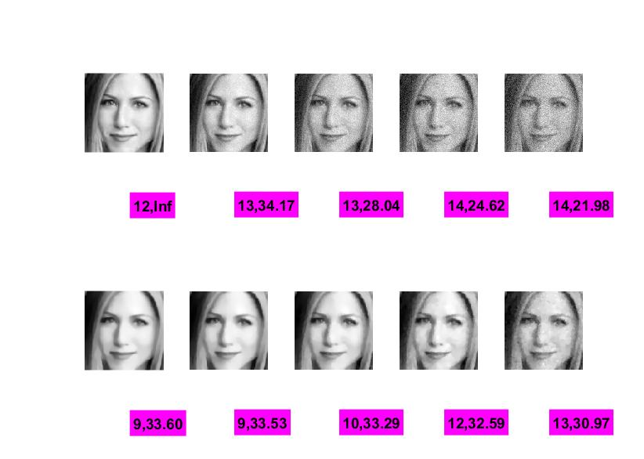
Results on a single image (Perona-Malik)
Sigma_w = 0
Sigma_w = 5
Sigma_w = 10
Sigma_w = 15
Sigma_w = 20
Q, PSNR=>
Q, PSNR=>

Slide 13
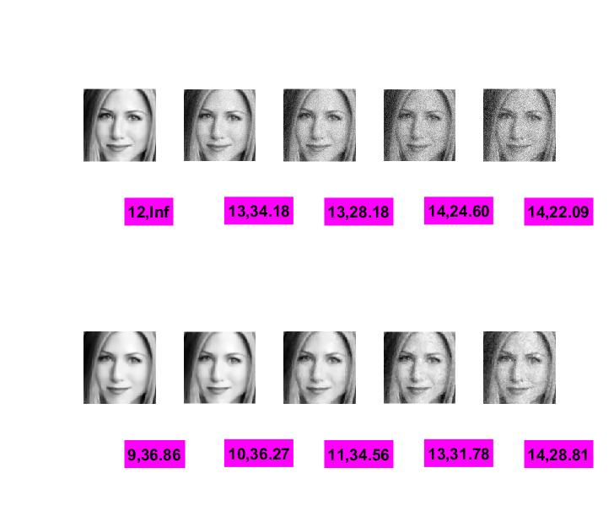
Results on a single image (Total variance)
Sigma_w = 0
Sigma_w = 5
Sigma_w = 10
Sigma_w = 15
Sigma_w = 20
Q, PSNR=>
Q, PSNR=>

Slide 14
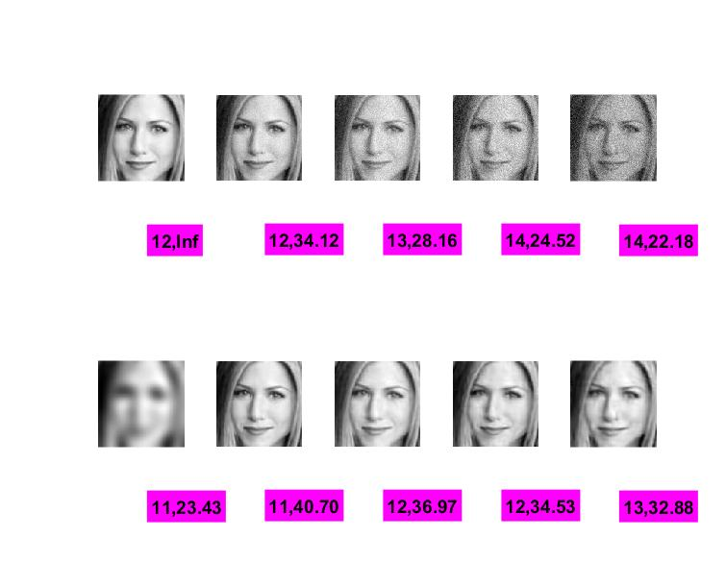
Results on a single image (BLS-GSM)
Sigma_w = 0
Sigma_w = 5
Sigma_w = 10
Sigma_w = 15
Sigma_w = 20
Q, PSNR=>
Q, PSNR=>

Slide 15
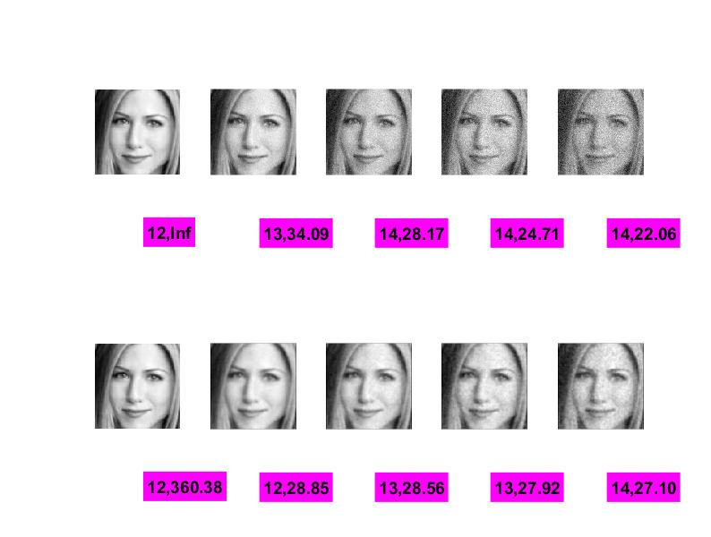
Results on a single image (Wiener)
Sigma_w = 0
Sigma_w = 5
Sigma_w = 10
Sigma_w = 15
Sigma_w = 20
Q, PSNR=>
Q, PSNR=>

Slide 16
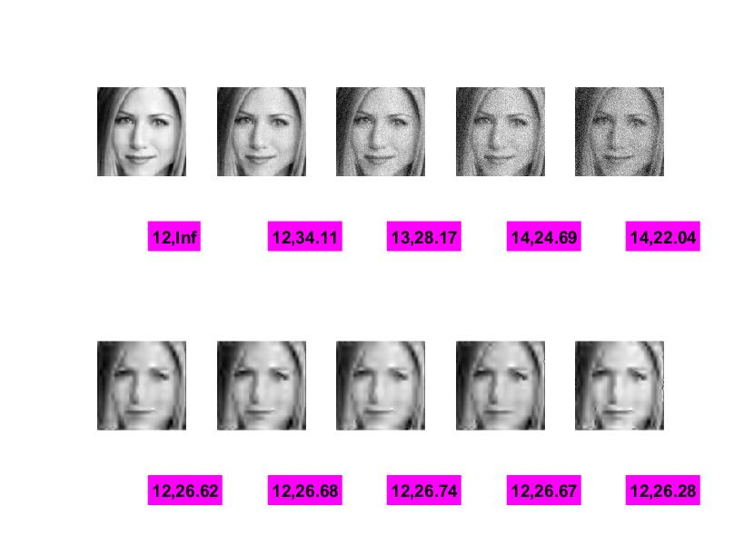
Results on a single image (Wavelet, bior4.4)
Sigma_w = 0
Sigma_w = 5
Sigma_w = 10
Sigma_w = 15
Sigma_w = 20
Q, PSNR=>
Q, PSNR=>

Slide 17
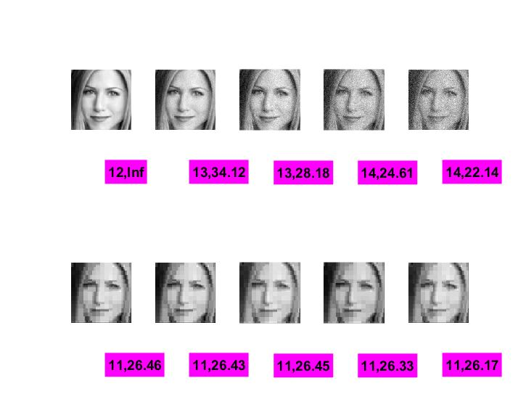
Results on a single image (DCT)
Sigma_w = 0
Sigma_w = 5
Sigma_w = 10
Sigma_w = 15
Sigma_w = 20
Q, PSNR=>
Q, PSNR=>

Slide 18
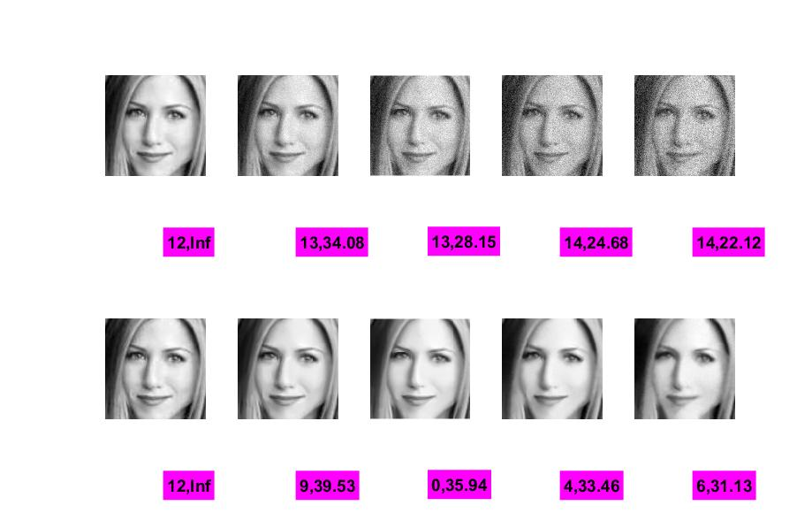
Results on a single image (NLM)
Sigma_w = 0
Sigma_w = 5
Sigma_w = 10
Sigma_w = 15
Sigma_w = 20
Q, PSNR=>
Q, PSNR=>

Slide 19
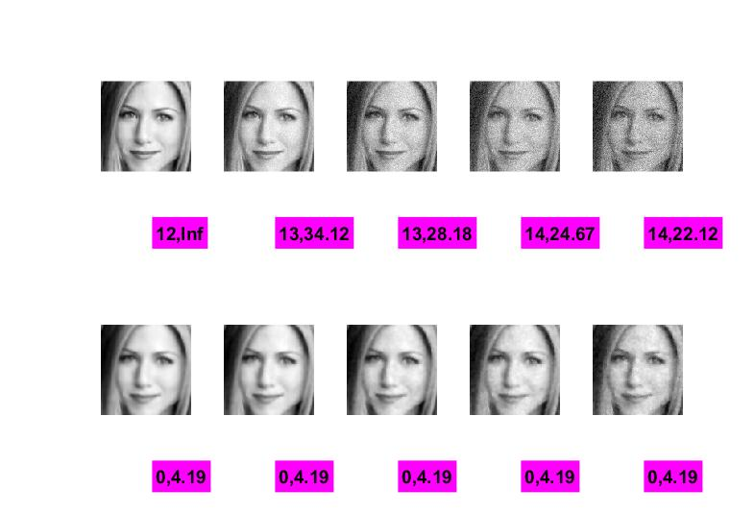
Results on a single image (Bilateral filter)
Sigma_w = 0
Sigma_w = 5
Sigma_w = 10
Sigma_w = 15
Sigma_w = 20
Q, PSNR=>
Q, PSNR=>

Slide 20
Results on a single image (Bilateral filter)
Sigma_w = 0
Sigma_w = 5
Sigma_w = 10
Sigma_w = 15
Sigma_w = 20
Q, PSNR=>
Q, PSNR=>

Slide 21
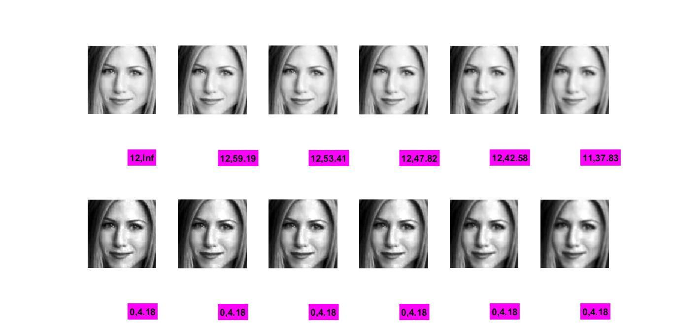
Blur effect on a single image (Histeq)
itr = 0
itr = 1
itr = 2
itr = 4
itr = 8
itr = 16
Q, PSNR=>
Q, PSNR=>

Slide 22
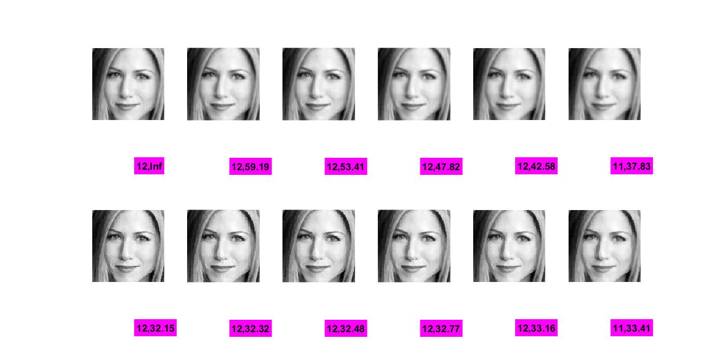
Blur effect on a single image (Shock filter)
itr = 0
itr = 1
itr = 2
itr = 4
itr = 8
itr = 16
Q, PSNR=>
Q, PSNR=>

Slide 23
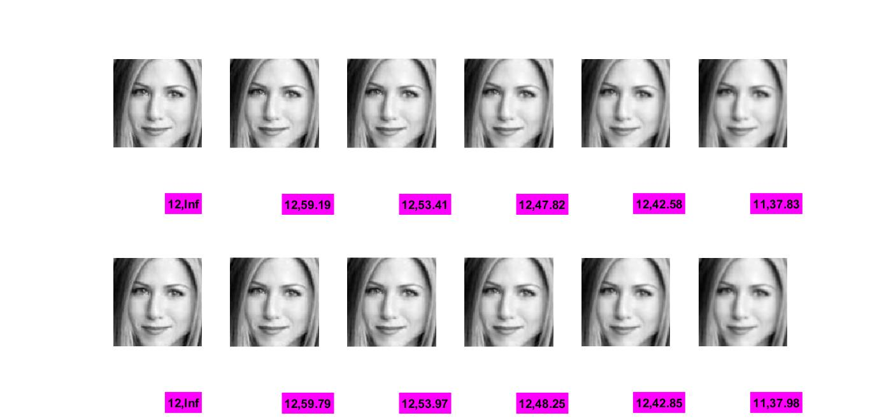
Blur effect on a single image (unsharp mask)
itr = 0
itr = 1
itr = 2
itr = 4
itr = 8
itr = 16
Q, PSNR=>
Q, PSNR=>

Slide 24
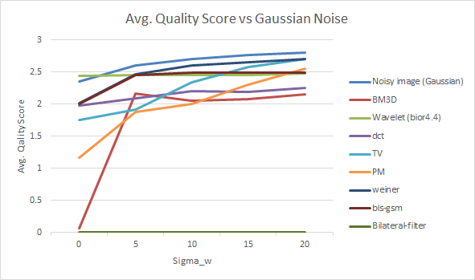
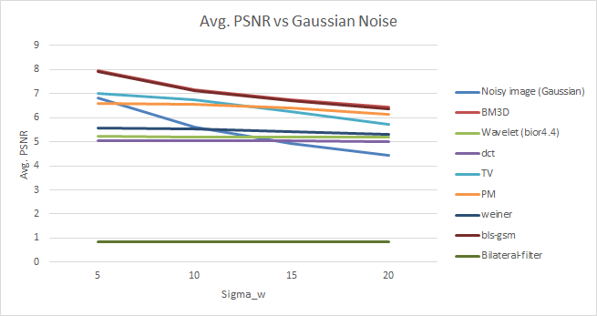
Result on LFW Dataset (Gaussian noise)

Slide 25
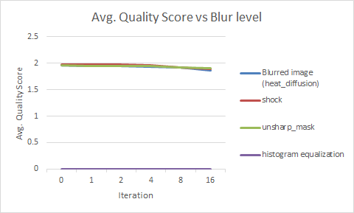
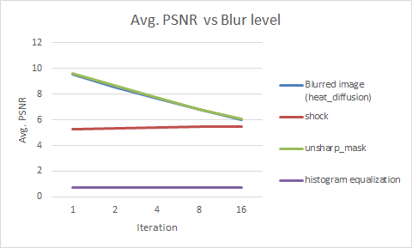
Result on LFW Dataset (Blurred image)

Slide 26
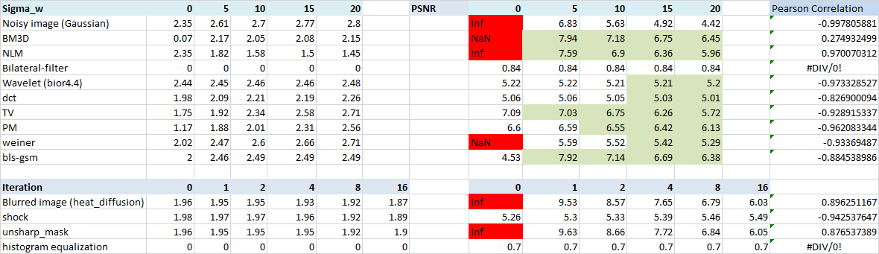
Result on LFW Dataset (100 image)
Total No. of detected faces = 570

Slide 27
Conclusion
Gaussian noise
BM3D and BLS-GSM found to be most effective on LFW dataset.
But improvement in PSNR has not affected the quality score.
Blur effect
Unsharp masking works but very little improvement.
Improvement in PSNR has not affected the quality score.
An inverse relationship observed between the Probabilistic path based FIQA and noise (or blur) level.
Further investigation is required to further understand the issues.

Slide 28
Thank you.

