Slide 1

AI Chatbot - Architecture
If user not satisfied with the answer
User Feedback
Feedback and Chat Stats aggregator
Answer
Question Asked
If match Found
Answer
Low Entropy – Lookup DB
Sentiment Analysis for Sensitivity Check
(word2vec + Logistic Regression)
Intent Parsing
(LSTM – Recurrent neural network)
Entity Parsing
( Bag of words entity parsing)
Decision making Module
Low Entropy – Knowledge base
If not
sensitive
If entity parsed
Medium Entropy – Query RDBMS
High Entropy- Crowdsource
If sensitive
Professional Development
Manager
If entity/entity not parsed
If no decisions found for given intent and entity
If PDM is the best person to answer
Learning

Slide 2

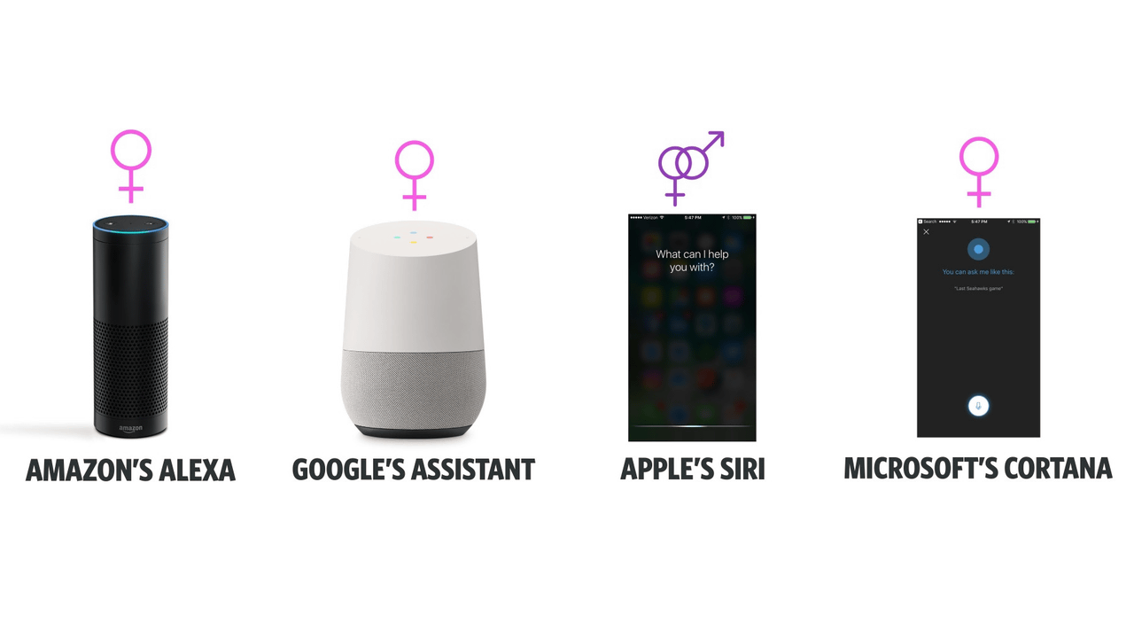

Positioning of our AI Chatbot
NLTK
Bag of Words
Spacy
Wordnet
Our AI-Chatbot
Text Matching Algorithms
NLP +
NLU +
NLG
NLP +
NLU
NLP

Slide 3
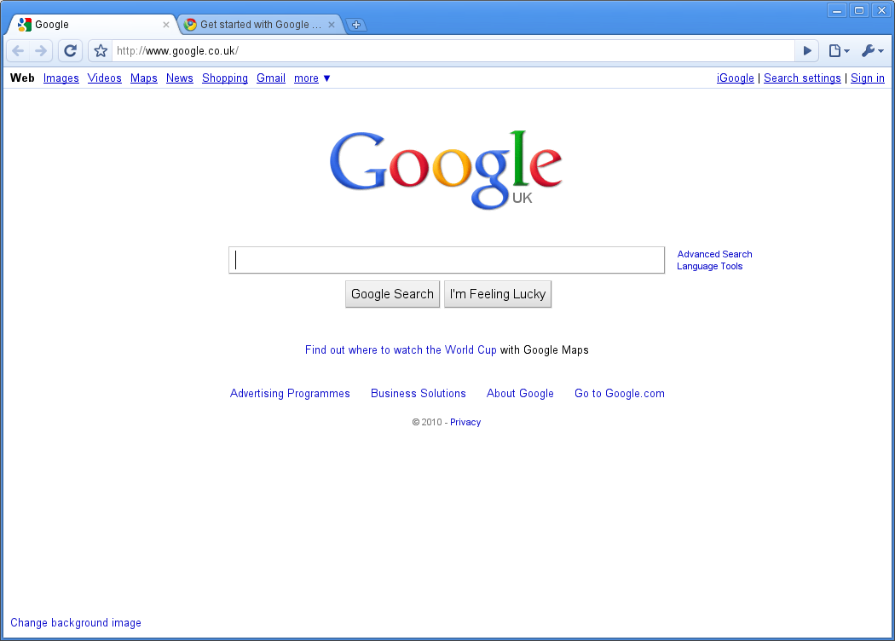

Future AI-Chatbot Statistics tracker dashboard for PDMs
AI-Chatbot Statistics Tracker Dashboard
Potential areas for new knowledge base creation

