Slide 1


Image Classification on Intel Dataset using CNN and Transfer Learning
Guided By:
Submitted by:
Ms. Trupti Joshi
Mr. Prasad Deshmukh
Mangesh Jadhav
Sahil Kale
Swarada Pathak
Ashlesha Purandare
Notes:
Links:
https://www.pexels.com/photo/people-discuss-about-graphs-and-rates-3184292/

Slide 2
Introduction
In this presentation, we'll delve into the exciting world of image processing using the Intel Image Classification dataset, Convolutional Neural Networks (CNNs) and transfer learning.
We'll explore the dataset, understand CNNs' power in image recognition and see how transfer learning helps build efficient models.

Slide 3

Problem Statement
The task is to develop an image classification system utilizing Convolutional Neural Networks (CNN) and Transfer Learning techniques to classify images from the Intel Image Dataset.

Slide 4
Abstract
Image classification is a fundamental task in computer vision with wide variety of applications.
The goal of this project is to classify images from the Intel Dataset using Convolutional Neural Networks (CNNs) and transfer learning.
The dataset contains a diverse set of natural scene images across six categories: buildings, forests, glaciers, mountains, sea, and streets.
The methodology involves data preprocessing, CNN model design and training, evaluation and implementing transfer learning models to examine the further enhancements in the CNN model and compute accuracy metrics on Intel dataset.
With the help of deep learning, our model aims to accurately detect and classify various types of natural scene images.
The developed solution will assist in environmental monitoring such as monitoring deforestation, tracking changes in Glaciers, urban planning, and effectively contribute to environmental conservation.

Slide 5
About the Dataset:
The dataset contains around 25,000 images of size 150X150
distributed under 6 categories namely:
Buildings
Forest
Glacier
Mountain
Sea
Street

Slide 6
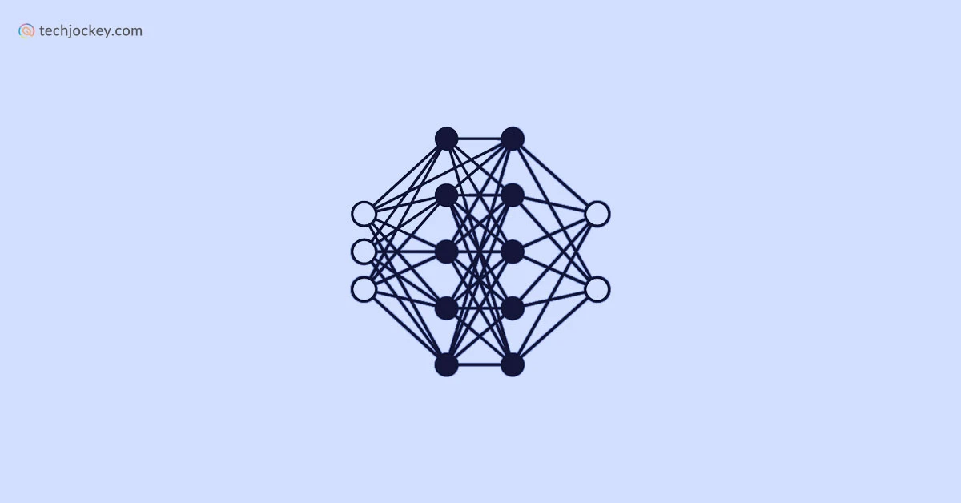


Architecture
CNN
Feature Extraction
using CNN
Kaggle
Acquisition of data from Public dataset
Google Colab
Data Preprocessing
Classification
Transfer Learning
Predict the output class

Slide 7
Extracting data from Public Source such as Kaggle for the train, test and prediction dataset.
Data preprocessing and implementation on Google Colab.
Feature Extraction Using CNN(Convolution Neural Network).
Classification of dataset into desired categories.
Prediction of the output.

Slide 8
Thank
You

