Slide 1

UX RESEARCH DELIVERABLE
User Persona for the OWASP Website
Based on UX Research and Critical Interface Analysis
Student: Ashlesha Gawkar · University: MIT WPU

Slide 2
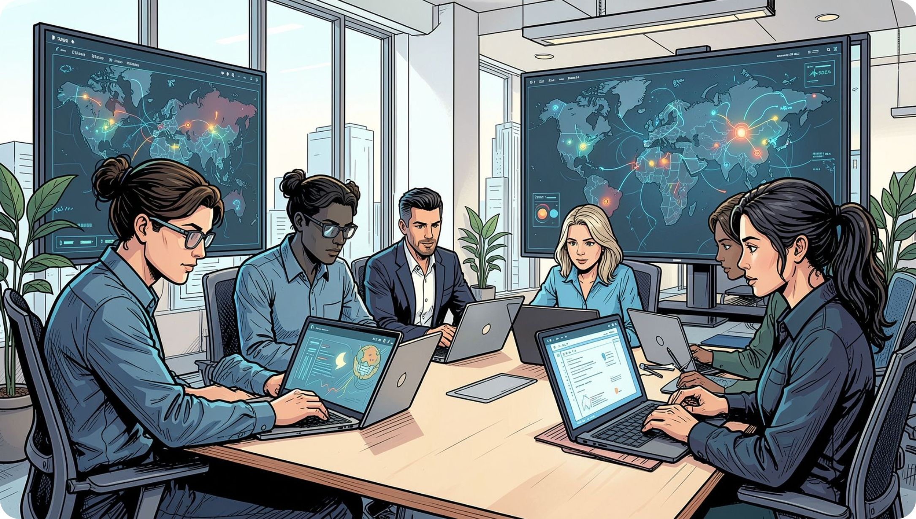
BACKGROUND
About OWASP
The Open Web Application Security Project (OWASP) is a nonprofit foundation dedicated to improving software security. Its website serves as a global hub for open-source security resources, documentation, and community collaboration.
🎓 Students
💻 Developers
🔒 Security Engineers
🔬 Researchers
🏢 Organizations

Slide 3



PRIMARY PERSONA
Meet Aarav Sharma
Demographics
Context
Age: 21 · Location: Pune, India
Occupation: Final Year B.Tech CSE Student
Tech Level: Intermediate
Devices: Laptop + Mobile
Usage Frequency: Weekly
Aarav is preparing for a cybersecurity internship and regularly consults OWASP for assignments and secure coding practice. He values efficiency and clear information architecture.

Slide 4
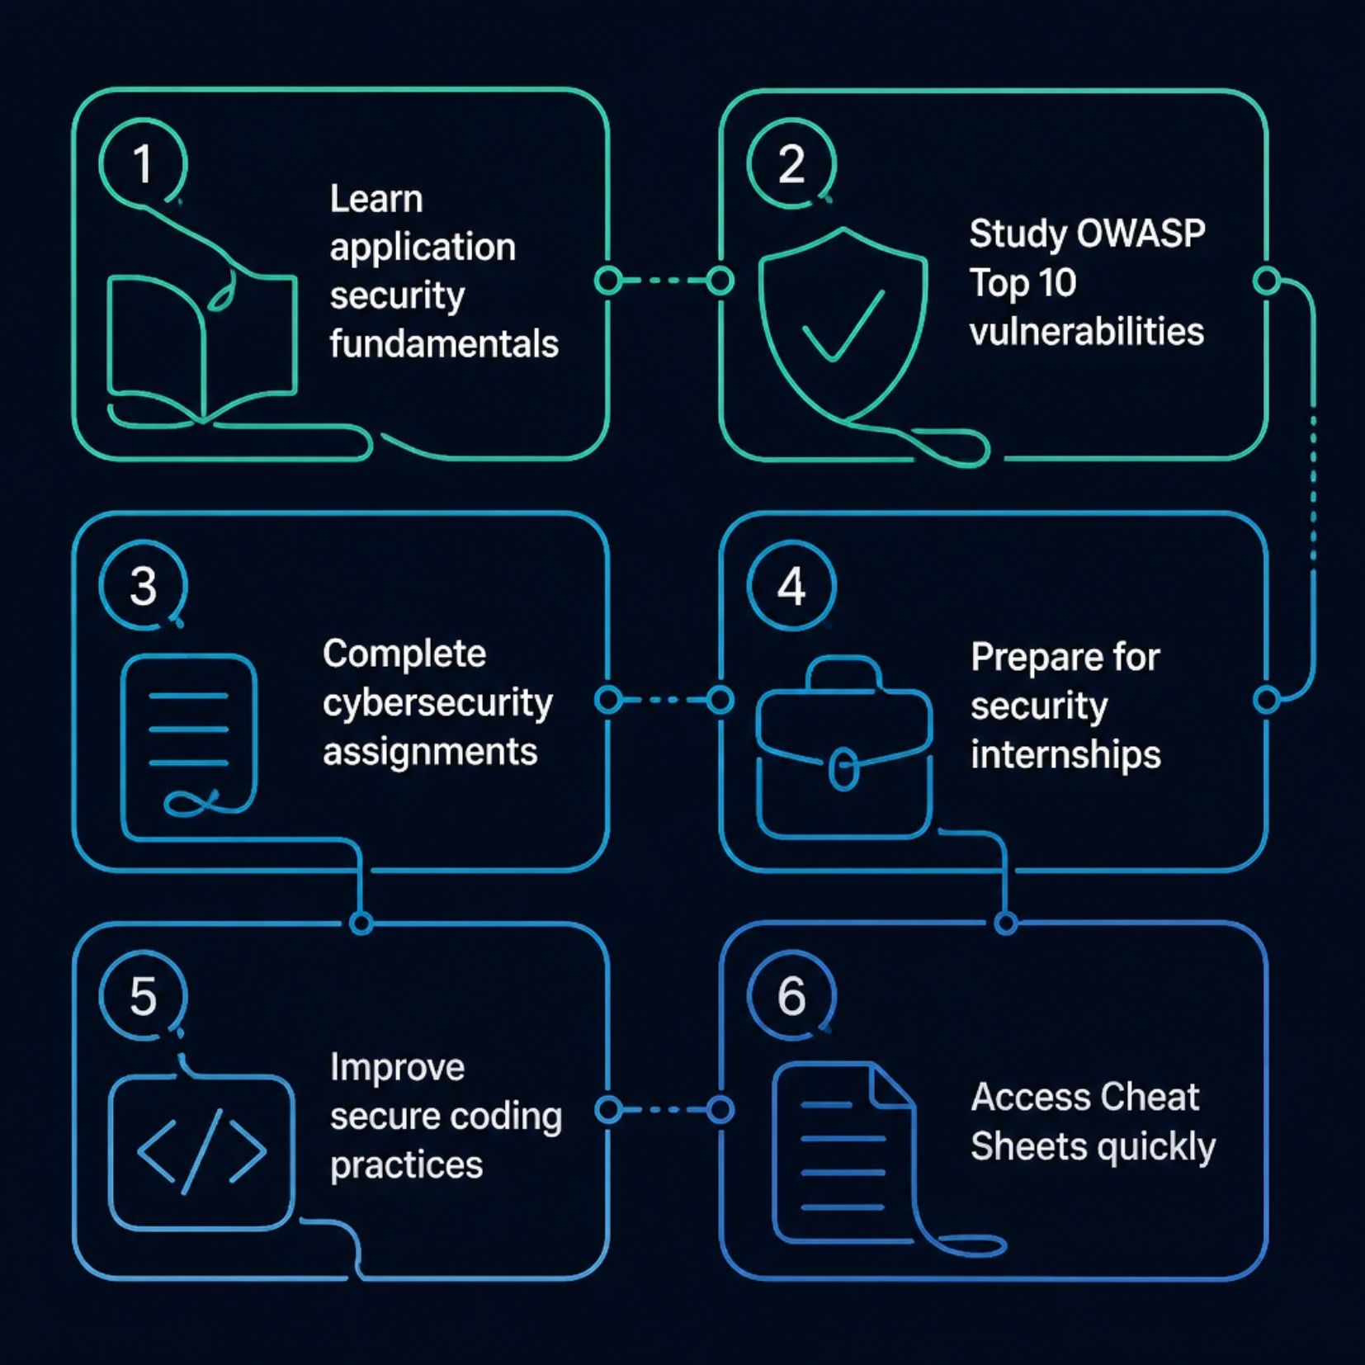



PERSONA PROFILE
Goals & Motivations
What Drives Aarav
Career Growth
Targeting security roles post-graduation
Academic Success
Strong grades in cybersecurity modules
Industry Certifications
Building credentials for the job market

Slide 5
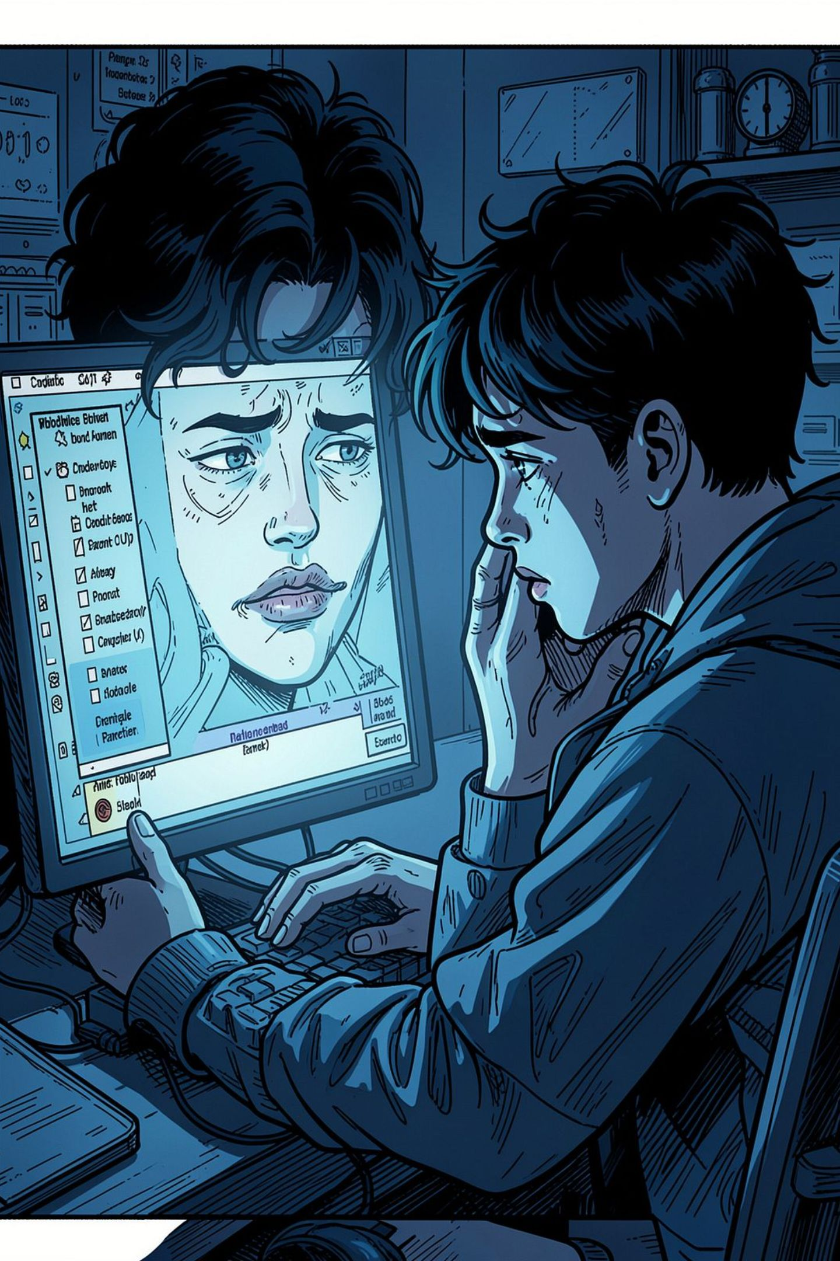




PAIN POINTS
Frustrations & Barriers
⚠️ Hidden Documentation
Core resources are buried beneath promotional event content on the homepage.
⚠️ Poor Search Discoverability
The search function is difficult to locate, slowing task completion.
⚠️ Inconsistent Navigation
Menu structures vary across project pages, causing disorientation.
⚠️ Accessibility Gaps
Limited options for contrast, text resizing, and keyboard navigation.

Slide 6

USER JOURNEY
Aarav's Journey on OWASP.org
🔍 Discover
🏠 Browse Homepage
📄 Find Documentation
Finds OWASP via search. Emotion: Hopeful.
Encounters events, not docs. Emotion: Confused.
Eventually locates Top 10. Emotion: Relieved.
1
2
3
4
5
6
📋 Search Top 10
😕 Experience Confusion
🎓 Learn Concepts
Looks for OWASP Top 10. Emotion: Focused.
Struggles to locate resources. Emotion: Frustrated.
Studies security material. Emotion: Satisfied.
Key Opportunity: Surface core documentation above promotional content to reduce friction.

Slide 7





PERSONA DEPTH
Behavior, Quote & Scenario
Personality Traits
In His Own Words
"I just want quick access to OWASP documentation without spending time searching through event pages."
Curious
Self-Learning
Real-World Scenario
Aarav visits OWASP to study for a cybersecurity assignment. Promotional content dominates the homepage, and he struggles to quickly locate the OWASP Top 10 — a critical resource he needs within minutes.
Analytical
Goal-Oriented
Tech-Savvy

Slide 8







HEURISTIC ANALYSIS
UX Insights: Strengths vs. Weaknesses
✅ Strengths
⚠️ Weaknesses
Highly Credible
Rich Documentation
Poor Visual Hierarchy
Weak Discoverability
Trusted globally in cybersecurity
Extensive, high-quality technical resources
Promotional content obscures key resources
Search and navigation are hard to find
Strong Community
Inconsistent Navigation
Limited Personalization
Active global network of contributors
Menu structures vary across pages
No role-based entry points for users

Slide 9





RECOMMENDATIONS
Design Recommendations
Prioritize Core Resources
Visible Search Bar
Consistent Navigation
Move OWASP Top 10 and Cheat Sheets above promotional content on the homepage.
Add a persistent, prominent search function across all pages.
Standardize menu structures across all OWASP project pages.
Improve Accessibility
Role-Based Entry Points
Introduce contrast toggle, text resizing, and keyboard navigation support.
Create tailored landing paths for Students, Developers, and Organizations.

Slide 10

CONCLUSION
Key Takeaways
The persona analysis reveals that while OWASP provides exceptional cybersecurity resources, first-time users — particularly students like Aarav — encounter significant usability friction.
Addressing these areas would significantly enhance the learning experience for OWASP's next generation of security professionals.
Thank You
Information Hierarchy
Navigation Consistency
Discoverability
Core docs must be surfaced above promotional content
Unified menus reduce cognitive load
Search and role-based paths improve first-time experience

