Slide 1

CMR College of Engineering & Technology
(UGC Autonomous)
Accredited by NAAC with “A+” Grade
Kandlakoya, Medchal Road, Hyderabad-501401
Department of Computer Science and Engineering
Major Project
GRIEVANCE CENTRAL HUB
Under esteemed guidance of
Mr. J. Ranjith
Assistant Professor
Team Members ( batch no. 59 ) :
A. Ashlesha (20H51A0501)
G. Rohith Reddy (20H51A05E0)
A. Ujwala (20H51A05M8)

Slide 2
Outline
Abstract
Introduction
Literature survey
Existing system
- Problems in existing system
Research Objective of Presentation
Problem Definition
Research work
- Proposed system architecture
- Methods
Performance Measure
Results
Conclusion
Future Work
References

Slide 3
ABSTRACT

Slide 4
ABSTRACT
The aim of this portal is to handle grievances raised by an individual in an organization efficiently and transparently.
The portal contains a user friendly interface that is accessible to all.
The portal aims at providing confidentiality and security.
The portal focuses on transparency by offering real-time tracking and updates on the status of grievances, ensuring that both students and faculty are informed throughout the resolution journey

Slide 5
INTRODUCTION

Slide 6
INTRODUCTION
A centralized grievance system portal is an online platform designed to facilitate the management and resolution of complaints across different departments or organizations.
It provides a single point of contact for individuals within an organization to file grievances related to any issues within the organization.
The portal manages grievances efficiently by registration, tracking, monitoring of complaints.

Slide 7
LITERATURE SURVEY

Slide 8
EXISTING SYSTEMS
S.NO | TITLE | TECHNOLOGIES/ METHODS | LIMITATIONS
1. | Traditional paper-based Grievance system | Paper forms, manual processing | Inefficient data management, Limited data analytics
2. | Email & phone-based Grievance system | Email, phone calls, manual tracking | Potential overload, Limited automation
3. | Fragmented digital Grievance system - by Karan Gulati from university of Hamburg | Web Form(JS, NodeJs, MongoDB), Email integration(python, exchange server), Phone server(Twilio) | Lack of centralization, Interoperability issues

Slide 9
RESEARCH OBJECTIVE

Slide 10
OBJECTIVE OF THE PROJECT
The aim of this portal is to handle grievances raised by an individual in an organization efficiently and resolve them.
The portal should contain a user-friendly interface that is accessible to all.
The portal should provide confidentiality and security.

Slide 11
PROBLEM DEFINITION

Slide 12
PROBLEM DEFINITION
Inefficient Grievance Handling: The current grievance management processes are inefficient, causing delays in resolving complaints and eroding public trust in government services.
Lack of Transparency: Without a centralized system, there's a lack of transparency, hindering the government's ability to analyze grievance data for service improvements.

Slide 13
RESEARCH WORK

Slide 14
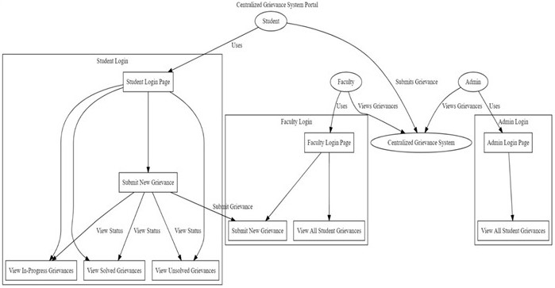

Slide 15
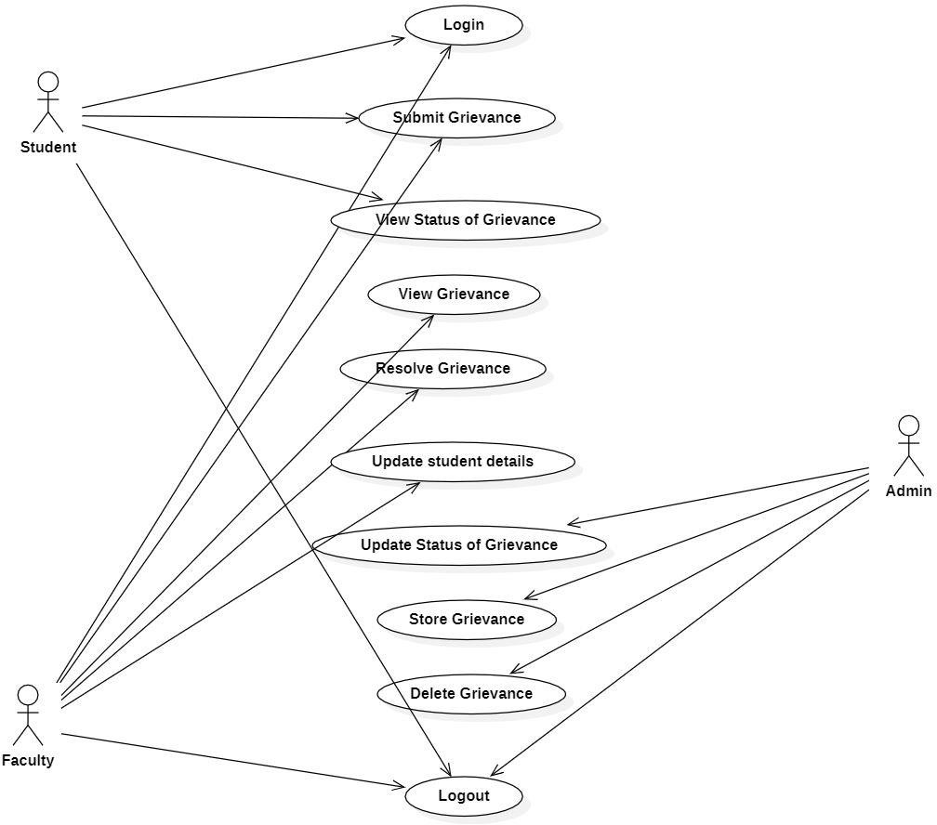
PROPOSED SYSTEM FLOW DIAGRAM

Slide 16
MODULES
User Authentication Module: Handles login process for students, faculty and admins.
Student Dashboard Module: Students can view their submitted grievances and their status in this module.
Faculty Dashboard Module: Faculty can view the submitted grievances and help resolve them.
Admin Dashboard Module: This module has the ability to change the status of grievances and manage the student and faculty lists.
Database Module: Stores user information, login credentials.
Keeps records of all submitted grievances, including details and statuses.

Slide 17
PROPOSED METHOD
The portal provides two different types of accounts, one for users to submit their grievances and the other for the authorities/officials of different departments.
Any user can create an account on our portal and then submit grievances.
Grievances will then be submitted to the accounts of the appropriate officials, who will then try to resolve the issues.
During this period, there will be constant updates of the status of the grievance on the user portal.

Slide 18
PERFORMANCE MEASURE

Slide 19
PERFORMANCE MEASURE
Resolution Time: Measure how quickly grievances are resolved from start to finish.
Resolution Rate: Track the percentage of grievances that are successfully resolved.
Customer Satisfaction: Evaluate stakeholder satisfaction with the resolution process and outcome.

Slide 20
RESULTS

Slide 21
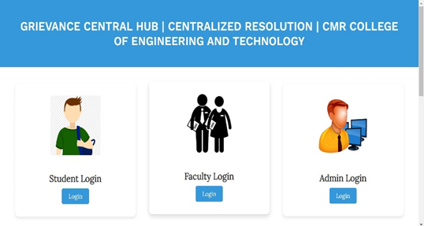
RESULTS
Fig 1: Login Page - login interface catering to students, faculty, and admin, streamlining access and management of grievances

Slide 22
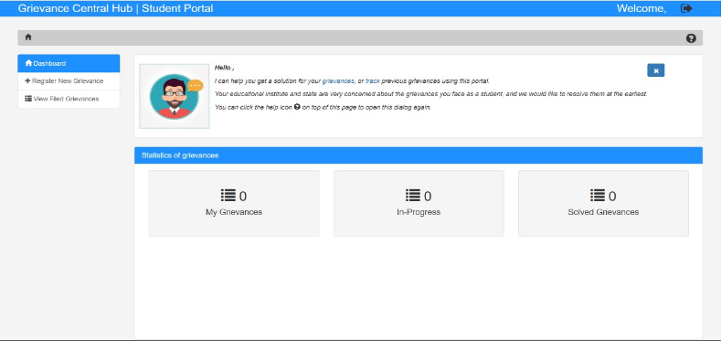
Fig 2: Student Login Dashboard - offers students a user-friendly interface to submit and track grievances.

Slide 23
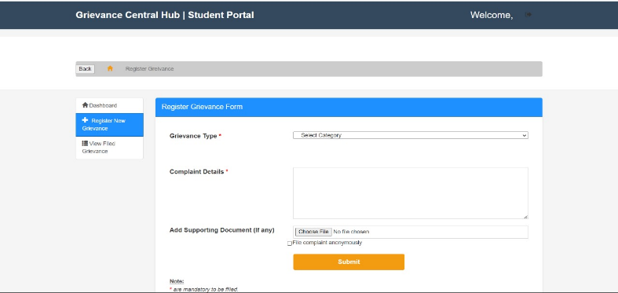
Fig 3: Register New Grievance - interface for registering new grievances, enabling users to efficiently document and submit their concerns for resolution within the system.

Slide 24
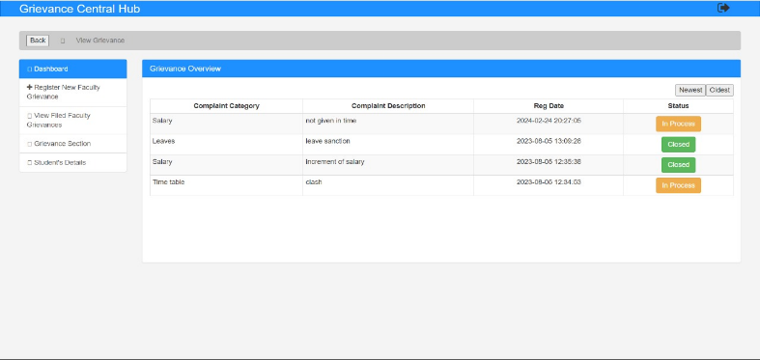
Fig 4: View Filed Grievance - interface allowing users to conveniently view all filed grievances.

Slide 25
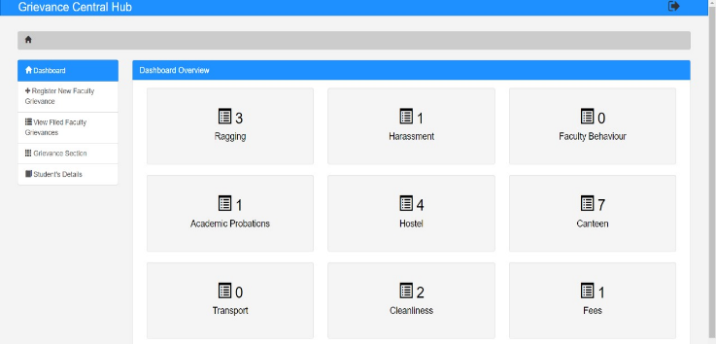
Fig 5: Faculty Dashboard - presenting faculty members with an organized overview of grievances assigned to them, facilitating timely review and response to student concerns within the grievance system.

Slide 26
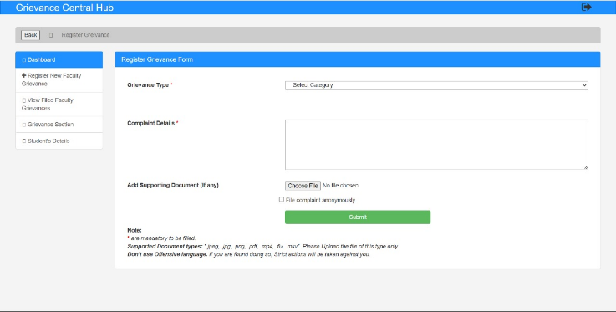
Fig 6: Register New Faculty Grievance - interface for faculty members to register new grievances, facilitating efficient documentation and resolution of faculty-related issues within the system.

Slide 27
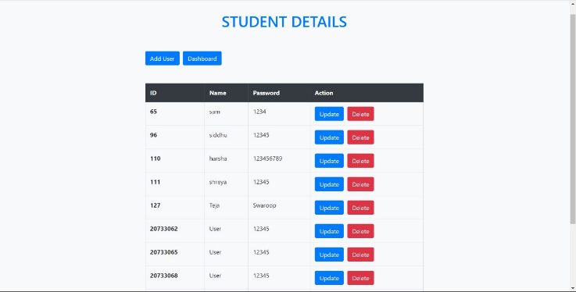
Fig 7: Student Details Update Page - offering students a user-friendly platform to update their personal information, ensuring the accuracy and completeness of their records within the system.

Slide 28
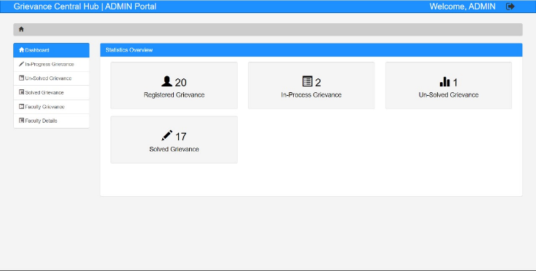
Fig 8: Admin Login Dashboard - providing administrators with comprehensive access to manage and oversee the grievance system.

Slide 29
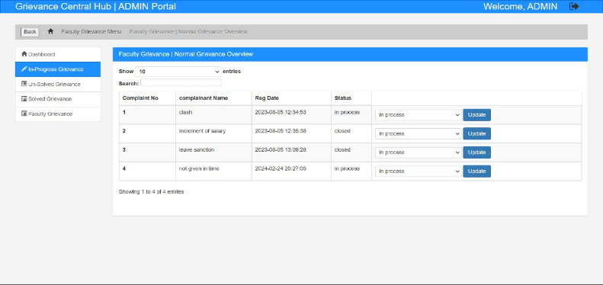
Fig 9: Status of Grievances - provides an overview of the status of grievances, categorizing them as pending, unsolved, or solved.

Slide 30
CONCLUSION

Slide 31
CONCLUSION
The centralized grievance system portal we develop provides an efficient and transparent approach to grievance redressal.
With more personal interaction for grievance resolution, this portal has the potential to improve the way grievances are handled.
The user friendly interface of the portal ensures anyone can submit their grievances easily.

Slide 32
FUTURE WORK

Slide 33
FUTURE WORK
The future scope for a centralized grievance system portal is quite promising, especially as technology continues to advance and societies become more digitally interconnected. Such a portal can serve as a vital tool for efficient complaint handling, transparency, and accountability in various sectors, including government, business, education, healthcare, and more.

Slide 34
REFERENCES

Slide 35
REFERENCES (BASE PAPERS)
[1] J. Denny, R. Chanda, S. R. Lenka, A. S. Reddy, & Vallabhaneni. "A Web Portal for Grievance Support System." In: Proceedings of the National Conference on Advancement of Technologies—Information Systems & Computer Networks (ISCON—2018), vol. 1, pp. 1–2, (2018).
[2] Prajapat, S., Sabarwal, V., Wadhwani, V. "Developing a Prototype for Grievance Redressal System." In: Proceedings of the National Conference on Advanced Computing Technologies, vol. 1, pp. 1–2, (2018)
[3] Buldak, M., Pandhekar, S., Gigani, A., Kachwah, A. "Design and Implementation of an Online Grievance Redressal System." Journal of Digital Governance, vol. 5, no. 2, pp. 123–136, (2019)
[4] Misha, P.M., Sunny, R., Rahul, S. Shaligram, P.: "Challenges associated with automation of NPO"-requirement engineering phase. In: Qi, E., Shen, J., Dou, R. (eds.) Proceedings of the 21st International Conference on Industrial Engineering and Engineering Management 2014. pp. 665-669. Atlantis Press, Paris (2015).
[5] Singh, C.P... “Ragging: a human rights abuse”. Indian J. Dev. Res. Soc. Action 7(1-2), 17-30 (2011)

Slide 36
THANK YOU

