Slide 1



FHE-STREAM
Characterizing Memory Access Behavior in
Fully Homomorphic Encryption Workloads
Ashlesha Malla, Yash Kumar, Michael Beebe, Yong Chen
Texas Tech University
Wendy Poole, Steve Poole
Los Alamos National Laboratory
SC26 PMBS Workshop · November 2026
Notes:
Good Afternoon everyone. My name is Ashlesha Malla, and I am a PhD student at Texas Tech University and I will be the last presenter at this workshop today.
In this talk I will present FHE-STREAM, a benchmark suite for characterizing the memory access behavior of fully homomorphic encryption workloads on CPUs.

Slide 2
Background
Notes:
TRANSITION: First, some background on fully homomorphic encryption and how its data is represented.

Slide 3
Fully Homomorphic Encryption
Data owner
encrypts the data
Untrusted server
computes on ciphertexts
Data owner
decrypts the result
never holds the secret key
Applications
Encrypted ML inference
models evaluated on private inputs
Healthcare
analysis of patient records
Finance
computation on transaction data
Cloud and HPC
operator outside the trust boundary
Notes:
Fully homomorphic encryption lets a server compute on data while it stays encrypted. The owner encrypts it, sends the encrypted data to the untrusted server where they can perform computations on the ciphertexts without the secret key, and only the owner can decrypt the result after. This way FHE protects the data itself at every stage of execution.
This is relevant wherever computation must be outsourced but the data cannot be disclosed: inference over medical or financial records, and multi-tenant cloud and HPC systems where the operator is outside the trust boundary. Encrypted machine learning is the most developed of these applications. However, adoption remains limited by computational and memory overheads.
TRANSITION: To see where these overheads come from, we look at how FHE data is represented.

Slide 4
RLWE and the Residue Number System
N coefficients →
Ciphertexts are polynomials (RLWE)
coefficients are reduced modulo a ciphertext modulus Q
Q is far wider than a machine word
and grows with multiplicative depth
RNS splits Q into L word-sized moduli
each polynomial becomes an N × L grid of 64-bit limbs
The NTT enables fast multiplication
data moves repeatedly between coefficient and evaluation domains
L limbs ↓
one polynomial in RNS form
(each cell is a 64-bit integer)
Notes:
Modern FHE schemes are based on Ring Learning With Errors. Data is encoded as polynomials whose coefficients are reduced modulo a ciphertext modulus Q. Every operation adds noise so Q grows with circuit depth and can reach thousands of bits.
Since CPUs operate on 64-bit words, libraries use the Residue Number System to split Q into L word-sized moduli. Each polynomial is then stored as L independent limbs, giving the N by L grid shown on the right. The limbs are independent, so operations vectorize well.
Multiplication goes through the Number Theoretic Transform, which is an FFT over a finite field. Because key switching requires the coefficient form, real workloads move data between the two domains repeatedly.
TRANSITION: This representation addresses the arithmetic problem, but it affects how memory is accessed.

Slide 5
Motivation
Notes:
TRANSITION: This brings us to the motivation for this work.

Slide 6
Memory Access Behavior of RNS-Based FHE
1
Fragmented data layout
2
Strided NTT access
DCRTPoly
wrapper
ptr
ptr
ptr
ptr
limb arrays on the heap
stride N/2
N/4
N/8 …
Each limb is a separate heap allocation
Early-stage strides span beyond a cache line
Notes:
[Left.] In OpenFHE, this grid is not stored as one block. A DCRTPoly keeps a list of pointers, and each one points to a limb stored separately on the heap. That way the library can drop a limb when the modulus shrinks, without copying the others. Following a pointer costs little, because it happens once per limb. The bigger effect is that the limbs end up scattered in memory.
[Right.] The NTT adds a second problem. Each stage pairs coefficients that are a fixed distance apart, and that distance halves every stage. In the early stages it is much larger than a cache line, so each line fetched is only partly used and the prefetcher has little to work with.
TRANSITION: That leads to our question.

Slide 7
Research Objective and Contributions
How many bytes should an FHE kernel move, and how many does the memory system actually transfer?
Contributions
1
A benchmark suite that reproduces the fragmented RNS memory layout of production FHE libraries
2
Validation of algorithmic byte counts against hardware DRAM counters
3
Evidence that the measured ordering tracks the cost of real OpenFHE operations
4
Separation of raw data-movement cost from object-abstraction cost
Notes:
Our question is how many bytes an FHE kernel needs to move, and how many the memory system actually transfers. STREAM measures contiguous arrays, and FHE results are usually reported as operations per second, so we built a benchmark to measure this directly.
We have four contributions. First, a benchmark suite with the same fragmented memory layout as production FHE libraries. Second, we check its byte counts against hardware DRAM counters. Third, we show that the results match the cost of real OpenFHE operations. Fourth, we separate the cost of moving data from the cost of the library's objects.

Slide 8
Design
Notes:
TRANSITION: Next is the design of the benchmark suite.

Slide 9
Foundations of FHE-STREAM
STREAM
Sustained-bandwidth kernels: COPY, SCALE, ADD, TRIAD
RaiderSTREAM
Irregular access patterns: gather, scatter, scatter-gather
OpenFHE
Production RNS data structures: DCRTPoly and Ciphertext
LIKWID
Per-channel hardware DRAM counters
FHE-STREAM
memory behavior measured on the data structures FHE libraries actually allocate
Notes:
FHE-STREAM builds on four existing components. From STREAM, we take the sustained-bandwidth kernels Copy, Scale, Add and Triad. From RaiderSTREAM, we adopt the gather, scatter and scatter-gather access patterns which we apply to FHE's pointer-based RNS structures instead of flat arrays. OpenFHE provides those data structures; we chose it because it is well established, and its modular design separates the cryptographic components from the interface. Finally, LIKWID provides the hardware DRAM counters used to validate our byte counts.

Slide 10
Dual-Track Benchmark Design
Hardware routing limits
Library abstraction overhead
DCRTPoly Backend
Ciphertext Backend
Operates directly on RNS limb arrays
STREAM kernels under all four access patterns
NTT round-trip and key-switch mock kernels
Fully instantiated OpenFHE objects (BFV)
Sequential STREAM kernels
Homomorphic multiply, relinearize and in-place add
Comparing both backends under sequential access isolates the cost added by the library.
Notes:
The suite is organized into two tracks. [Left.] The DCRTPoly backend works directly on the RNS limb arrays. It runs the four STREAM kernels under all four access patterns, plus an NTT round-trip kernel and a key-switch mock, and shows the hardware's routing limits.
[Right.] The Ciphertext backend runs on fully instantiated OpenFHE objects using BFV scheme. It includes the sequential STREAM kernels, homomorphic multiplication, relinearization and an in-place add.
Because both backends run the sequential kernels on matched payloads, comparing them isolates the overhead of the object representation.
TRANSITION: The access patterns are applied at two granularities.

Slide 11
Access Patterns and Shuffle Granularity
Sequential
Gather
Scatter
Scatter-Gather
i →
i →
b
0
1
2
3
4
5
b
0
1
2
3
4
5
b
0
1
2
3
4
5
b
0
1
2
3
4
5
1
2
3
2
1
3
1
2
3
2
3
1
a
0
1
2
3
4
5
a
0
1
2
3
4
5
a
0
1
2
3
4
5
a
0
1
2
3
4
5
i →
i →
a[i] = b[i]
a[i] = b[idx[i]]
a[idx[i]] = b[i]
a[idx1[i]] = b[idx2[i]]
Applied at two granularities
Polynomial level
shuffles whole multi-megabyte polynomial blocks
Coefficient level
shuffles individual 64-bit coefficients
Notes:
We use the four RaiderSTREAM patterns. Sequential access is the baseline; gather performs random reads, scatter random writes, and scatter-gather both. Scatter-gather uses uniformly random indices, so it admits no prefetching or cache-line reuse; We use it as a worst case
We apply each pattern at two granularities. At the polynomial level we shuffle whole polynomials, each several megabytes. At the coefficient level we shuffle individual 64-bit values, which is much closer to the fine-grained routing inside FHE kernels.

Slide 12
Methodology
Notes:
TRANSITION: Next, the measurement methodology.

Slide 13
Byte Accounting and Hardware Validation
Algorithmic model
Amplification factor
BW = k × B × V_poly / t
measured bytes / algorithmic bytes
V_poly = N × L × 8 bytes; k = arrays touched per kernel
measured bytes from DRAM counters; per kernel and direction
DRAM traffic read from per-channel counters with LIKWID
Each kernel run at two widely separated iteration counts
Differencing the two runs cancels setup and fixture costs
Notes:
[Left.] Our bandwidth numbers come from a model: arrays touched, times batch size, times polynomial size, over elapsed time. That's the bytes the kernel has to move. The memory system moves more, because of cache-line granularity, prefetching and write-allocate.
[Right.] So we define the amplification factor as the bytes the DRAM counters saw, divided by the bytes the model predicts, per kernel, for reads and writes separately.
[Bullets.] We read per-channel DRAM counters with LIKWID. Its region markers weren't reliable in our code, so we count whole-process traffic at two very different iteration counts and subtract, which cancels the setup cost.

Slide 14
Experimental Setup
Platforms
Configuration
Dual-socket AMD EPYC 9754
primary platform for all experiments
Dual-socket Intel Xeon Gold 6448Y
Intel HEXL experiments (AVX-512 IFMA)
Texas Tech REPACSS cluster
exclusive node allocation
Ring dimension N = 131,072, RNS depth L = 40
working set far exceeds last-level cache
OpenMP threads pinned with spread policy
first-touch allocation
OpenFHE 1.5.0, LIKWID 5.4.1
Google Benchmark timing, GCC 11.5.0
Notes:
This is the Experimental Setup we used. Our main platform is a dual-socket AMD EPYC 9754 node on Texas Tech's REPACSS cluster. The HEXL experiments ran on a dual-socket Intel Xeon Gold 6448Y.
We use ring dimension 131,072 and RNS depth 40, which is deep enough for neural network inference and bootstrapping. The working set is far larger than the last-level cache, so all the results here reflect DRAM behavior.
Threads are pinned with the spread policy, each run has the node to itself, and Google Benchmark times only the kernel loop.

Slide 15
Results
Notes:
Now onto the Results.

Slide 16
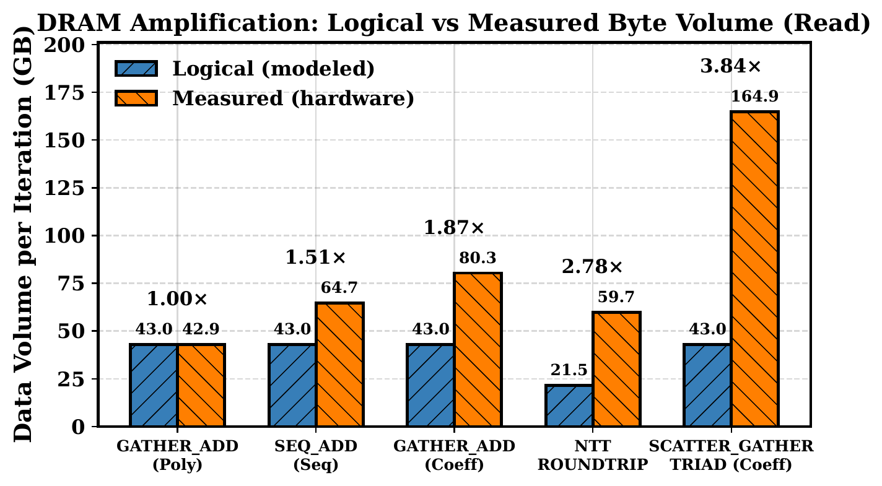
DRAM Traffic Amplification
One 64-byte cache line
8 B used · 56 B unused
1.00× polynomial-level gather
1.87× coefficient-level gather
3.84× scatter-gather triad (read)
Fig. 1 — logical vs. measured DRAM read volume per iteration (AMD EPYC). Sequential ADD reads 1.51×, matching the 3/2 read-for-ownership ratio.
Notes:
This graph compares the algorithmic byte count, in blue, with the measured DRAM traffic, in orange. The amplification factor is shown above each pair.
First, amplification is driven by cache-line utilization rather than irregularity. Polynomial-level gather is random at block granularity, but each block is read sequentially, so every fetched line is fully used and traffic matches the model at 1.00. Randomizing the same data at coefficient granularity raises this to 1.87, because each 8-byte access discards the rest of its 64-byte line.
Second, sequential Add reads 1.51 times its requirement, due to read-for-ownership on the output array. This matches the predicted three-halves ratio and serves as a check on the methodology.
On the right, scatter-gather triad wastes cache lines on both reads and writes and reaches 3.84 on reads. The NTT round-trip sits in between, at 2.78.

Slide 17
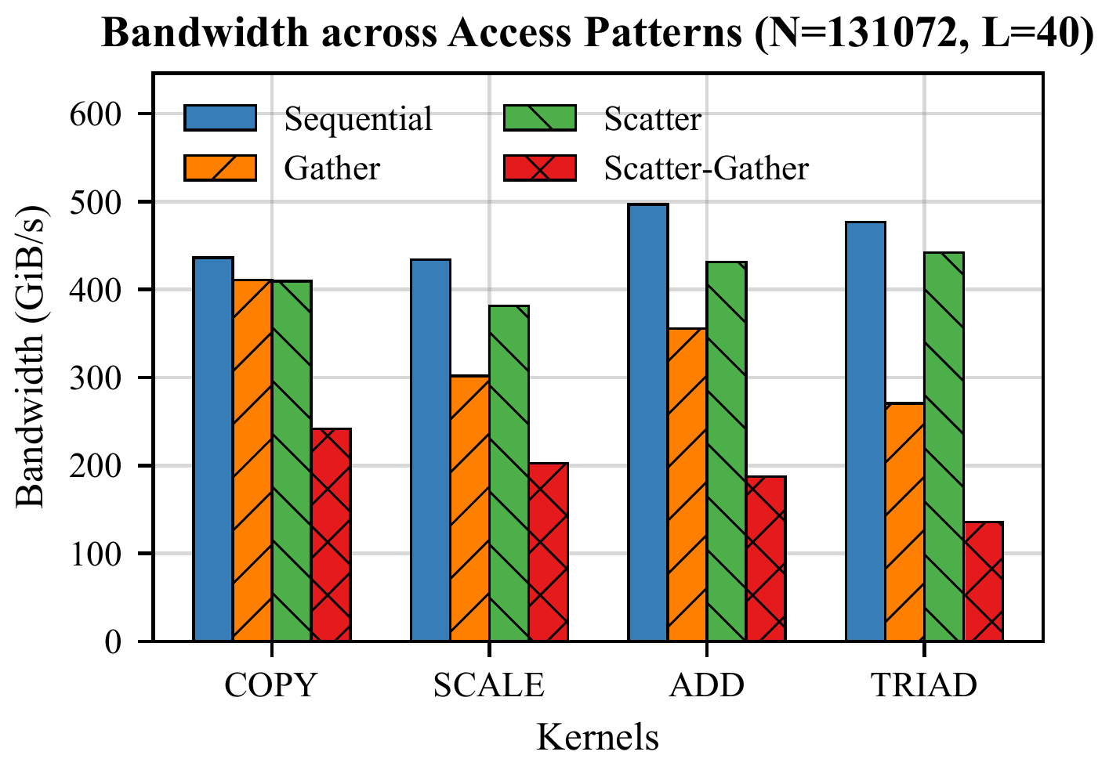
Bandwidth Across Access Patterns
58%
of peak for sequential ADD
−62%
ADD under scatter-gather
−71%
TRIAD under scatter-gather
Fig. 3 — measured bandwidth across the four access patterns, DCRTPoly backend, coefficient mode (AMD EPYC)
Notes:
These bars show bandwidth across the four access patterns in coefficient mode. Sequential add reaches 58 percent of peak, so with linear access raw bandwidth is not the limit.
Under scatter-gather, Add drops 62 percent and Triad 71 percent. That is the cost of the access pattern alone, with no library objects involved. Note that these are algorithmic bandwidths; as the previous slide showed, the physical traffic behind them is up to 3.84 times higher.

Slide 18
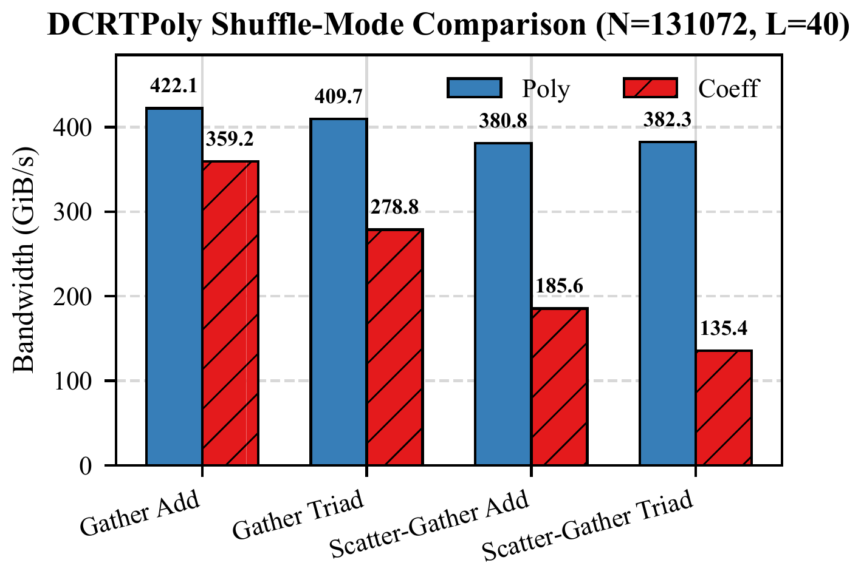
Effect of Shuffle Granularity
−65%
scatter-gather triad
polynomial → coefficient level
−32%
gather triad
polynomial → coefficient level
Fig. 4 — DCRTPoly bandwidth under polynomial-level (Poly) and coefficient-level (Coeff) shuffling (AMD EPYC)
Notes:
To isolate granularity, we compared the two shuffle modes.
This graph compares polynomial-level shuffling, in blue, with coefficient-level shuffling, in red. Coefficient-level shuffling gives lower bandwidth in every case. Gather triad drops by about a third, and scatter-gather triad by 65 percent.
This is consistent with the amplification results as whole polynomials use every byte of each cache line, and 8-byte accesses use only a small part of it.

Slide 19
Correlation with OpenFHE Operations
Operation | Mean time | Relative | Access regime
EvalAdd | 176 ms | 1× | sequential, element-wise
EvalMultNoRelin | 4,988 ms | 28× | NTT
Relinearize | 32,106 ms | 182× | NTT and key streaming
57%
of Relinearize time stalled
32.1 s wall vs. 13.9 s CPU
(evaluation keys exceed LLC)
Table III — unmodified OpenFHE operations, N = 131,072, L = 40, B = 256, 256 threads (AMD EPYC)
1 : 28 : 182 follows the amplification ordering
Notes:
We then checked whether this ordering holds for real homomorphic operations. We timed three OpenFHE operations at matched parameters on the same node.
EvalAdd is an element-wise sequential operation, with the lowest amplification, while EvalMult and Relinearize run the NTT and stream evaluation keys, where we measured much more. The cost of real operations therefore follows the amplification ordering.
Relinearize also takes 32.1 seconds of wall time but only 13.9 seconds of CPU time, so about 57 percent of its time is spent stalled. At this depth the evaluation keys don't fit in the last-level cache. Because this is the library's own code, it supports the memory-bound result independently of our kernels.
Next, the overhead of the library's object abstractions.

Slide 20
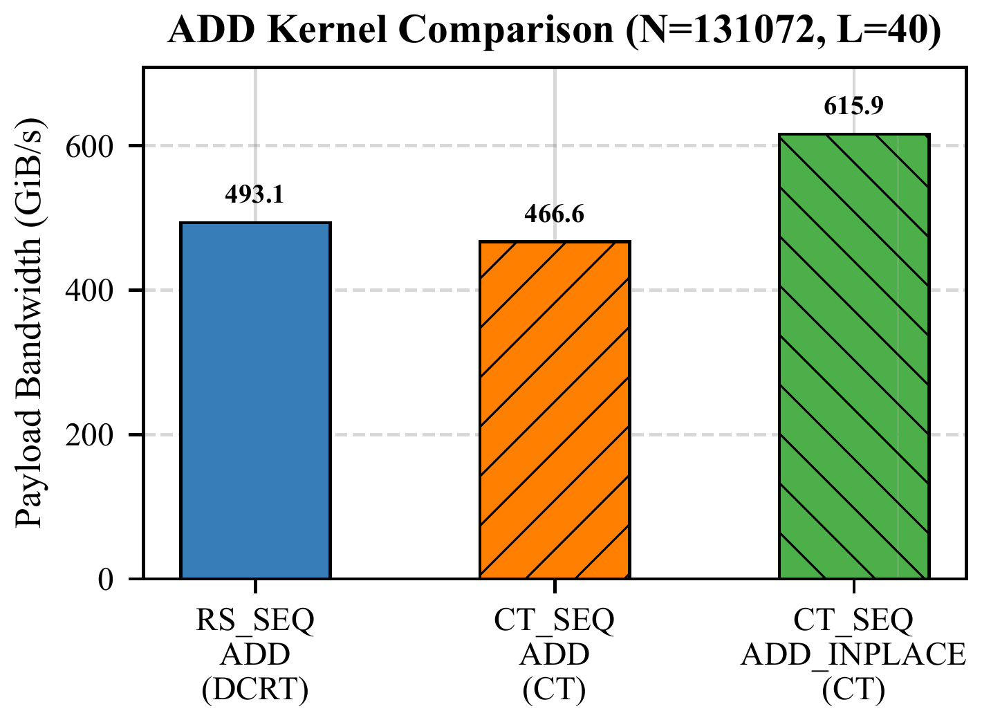
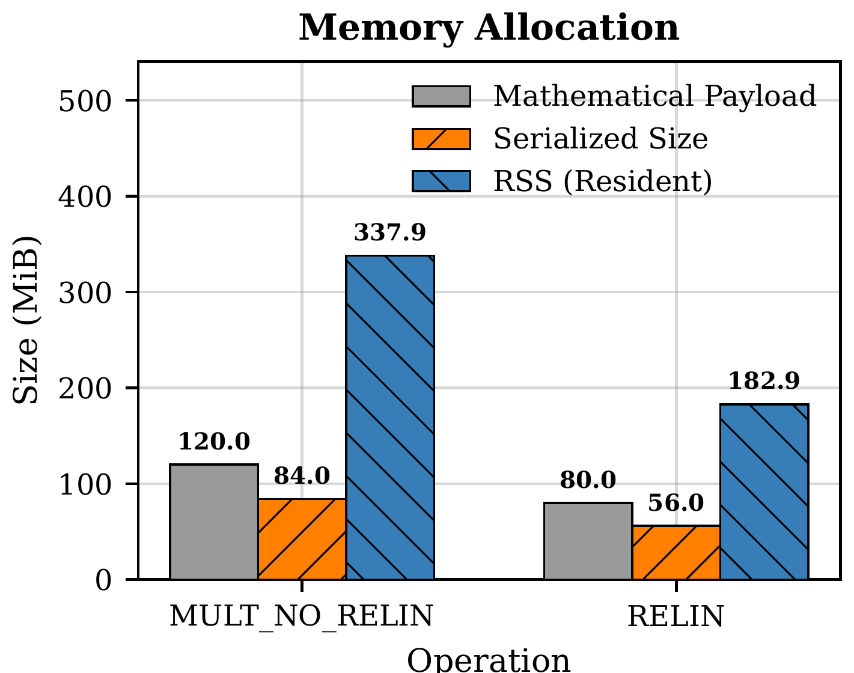
Abstraction Overhead and Memory Expansion
−5% Ciphertext vs. DCRTPoly sequential ADD
2.29–2.82× resident memory vs. payload
Notes:
Next, the overhead of the library's object abstractions.
[Left.] Under sequential access, the Ciphertext add is about 5 percent slower than raw DCRTPoly, so the software overhead on bandwidth is small. The in-place add looks faster than both, but that comes from our byte model, which counts one more array than the kernel actually touches.
[Right.] Memory footprint is where the objects cost more. Resident memory is 2.29 times the payload for a degree-1 ciphertext and 2.82 times for degree 2. This overhead grows faster than the payload itself as ciphertext degree increases.

Slide 21
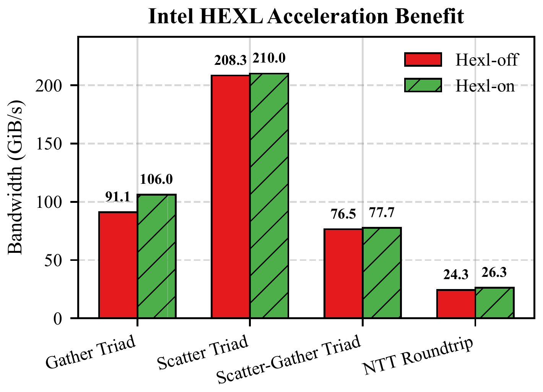
Hardware Acceleration and Multi-Node Scaling
+16%
gather triad with HEXL
other kernels: within 2% or small gains
MPI, up to 64 nodes
30.9 TiB/s
aggregate at 16,384 cores
scales with memory controllers
Fig. 8 — bandwidth with and without Intel HEXL (Intel Xeon)
Notes:
Finally, hardware acceleration and multi-node scaling.
[Left.] With Intel HEXL turned on, gather triad improves by 16 percent. The other kernels stay within 2 percent or gain slightly. HEXL speeds up the arithmetic, but the kernels are still waiting on memory.
[Right.] With MPI across up to 64 nodes, aggregate bandwidth reaches 30.9 tebibytes per second at 16,384 cores. It grows with the number of memory controllers rather than with cores, so the plateau on a single node is a memory-subsystem limit.

Slide 22
Conclusion
Notes:
Now to wrap up.

Slide 23
Conclusion
DRAM traffic amplification is governed by cache-line utilization, not by access irregularity alone
1.00× – 3.84×
1
The amplification ordering tracks the measured cost of real OpenFHE operations
1 : 28 : 182
2
On-chip buffering or batching sized to whole cache lines targets the dominant cost
3
Artifact: doi.org/10.5281/zenodo.22882262
Notes:
To summarize, FHE-STREAM reproduces the fragmented layout of production RNS-based libraries and validates its byte counts against hardware DRAM counters.
First, the extra DRAM traffic depends on how much of each cache line an access uses. Access at cache-line size or larger costs little extra, while 8-byte access costs up to 3.84 times the algorithmic bytes.
Second, that ordering matches what real OpenFHE operations cost, and Relinearize is both the most expensive and the most stalled.
Third, for accelerator and library designers, buffering or batching data in whole cache lines targets the cost we measured.
These results come from one parameter point on our AMD node. Next, we're extending the suite to bootstrapping and to the CKKS, BGV and TFHE schemes, and adding per-cache-level counters to find where in the hierarchy the extra traffic comes from.

Slide 24

Thank You
Ashlesha Malla · asmalla@ttu.edu
This work is funded in part by LANL / US DoD SOW #19537 and NSF awards OAC-2404438 and CNS-1939140.
Code, Paper and Results
https://github.com/AshleshaMalla/FHE-STREAM
Notes:
Thank you. I am happy to take questions.

Slide 25
Limitations and Future Work
Limitations
Future Work
Future Work
Single parameter point (N, L)
Counter results from one platform
BFV scheme for the Ciphertext backend
Bootstrapping and end-to-end FHE workflows
Per-cache-level counters (L1, L2, L3, TLB)
CKKS, BGV and TFHE backends
Additional microarchitectures
Notes:
All measurements use a single parameter point, and the amplification and correlation results come from one platform, so the specific ratios characterize that configuration. The mechanism, which depends on cache-line geometry, should generalize more readily. The Ciphertext backend currently uses BFV only.
In future work, we plan to extend the suite to end-to-end workflows including bootstrapping, to use per-cache-level counters to attribute amplification to a specific level of the hierarchy, and to add CKKS, BGV and TFHE and additional microarchitectures.
Thank you. I am happy to take questions.

Slide 26
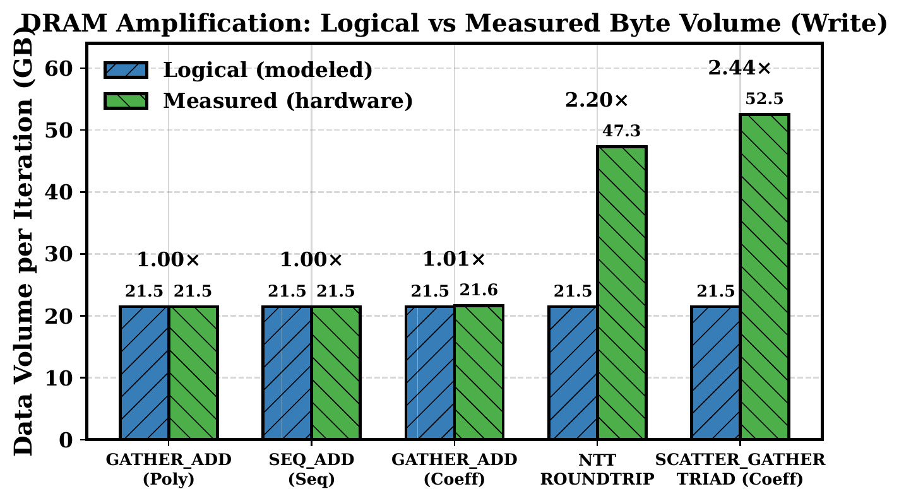
Backup: Write Amplification
2.44×
scatter-gather triad writes
NTT round-trip: 2.20×
other kernels: ≈ 1.00×
Fig. 2 — logical vs. measured DRAM write volume per iteration (AMD EPYC)
Notes:
Backup. Write traffic matches the model (about 1.00x) for polynomial-level gather, sequential add and coefficient-level gather, since each writes one array sequentially. Writes are amplified only when the write side is itself sub-cache-line or strided: 2.20x for the NTT round-trip and 2.44x for scatter-gather triad.

Slide 27
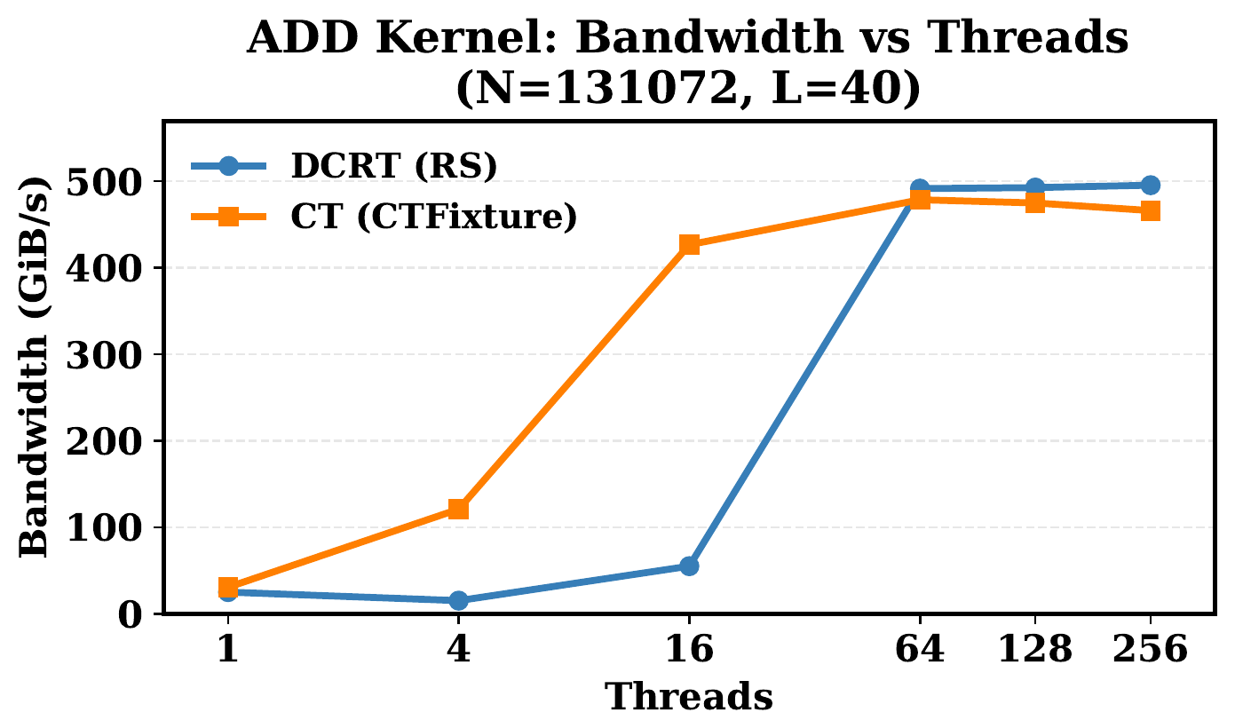
Backup: Thread Scaling
64
threads to saturate bandwidth
both backends plateau
Fig. 5 — ADD kernel bandwidth vs. threads (AMD EPYC); DCRTPoly B = 512, Ciphertext B = 256
Notes:
Backup. The DCRTPoly backend (B = 512, 60 GiB) remains low below 16 threads, then saturates by 64 threads. The Ciphertext backend (B = 256) rises through 16 threads and plateaus at the same point. The batch sizes differ, so the earlier Ciphertext plateau reflects its larger per-thread memory pressure rather than an unequal comparison. Because both plateau rather than scaling with threads, DRAM bandwidth, not core count, limits throughput.

