Slide 1
Quiz Bot
Ashlesha Malla
Pawan Paudel
Nisseem Rana Magar
Daniel Benedict
Naga Anusha Chadarasupalli

Slide 2
Project Statement
Introduction:
Implementation of a personalized bot with question-answering capabilities.
Designed to address network security concerns related to data transmission over the internet.
Objective:
The objective is to develop a Q&A bot that feds on the content of presentation slides and assignments of our network security course.
Another objective is to run the bot on local machine to address security concerns related to data transmission over the internet.
Use Cases:
Answers multiple-choice questions, true/false questions, and open-ended questions from user input.
Engages with network security documents, including presentation slides and a comprehensive course outline.

Slide 3
Proposed Solution
Solution Overview:
Local implementation of the bot running on local machine.
GPT-4 All for language understanding and generation.
Hugging Face InstructEmbeddings for document embeddings.
Faiss-based retrieval system for pulling relevant documents from an extensive repository.
Context-aware responses by intelligently combining language models, embeddings, and FAISS-based retrieval.
Knowledge Base:
Comprehensive repository includes network security course materials in PDF format. Enables the bot to provide informed and relevant responses.

Slide 4
System Requirements for Software Prototype Implementation
OS, programming language, Hardware, Database package, Data collection
Operating System:
Compatible with Windows, Linux, and macOS.
Programming Language:
Primarily developed in Python for its extensive libraries and compatibility with AI frameworks.
Hardware Requirements:
Standard laptop/desktop configurations with modern processors and sufficient RAM (8GB+).

Slide 5
Database:
Faiss Vector Database for efficient document retrieval.
Packages and Libraries:
Langchain, OpenAI GPT-4 All, Hugging Face Transformers, Faiss, and other necessary dependencies.
Data Collection:
Network security course materials in PDF format, including presentation slides and a compre

Slide 6
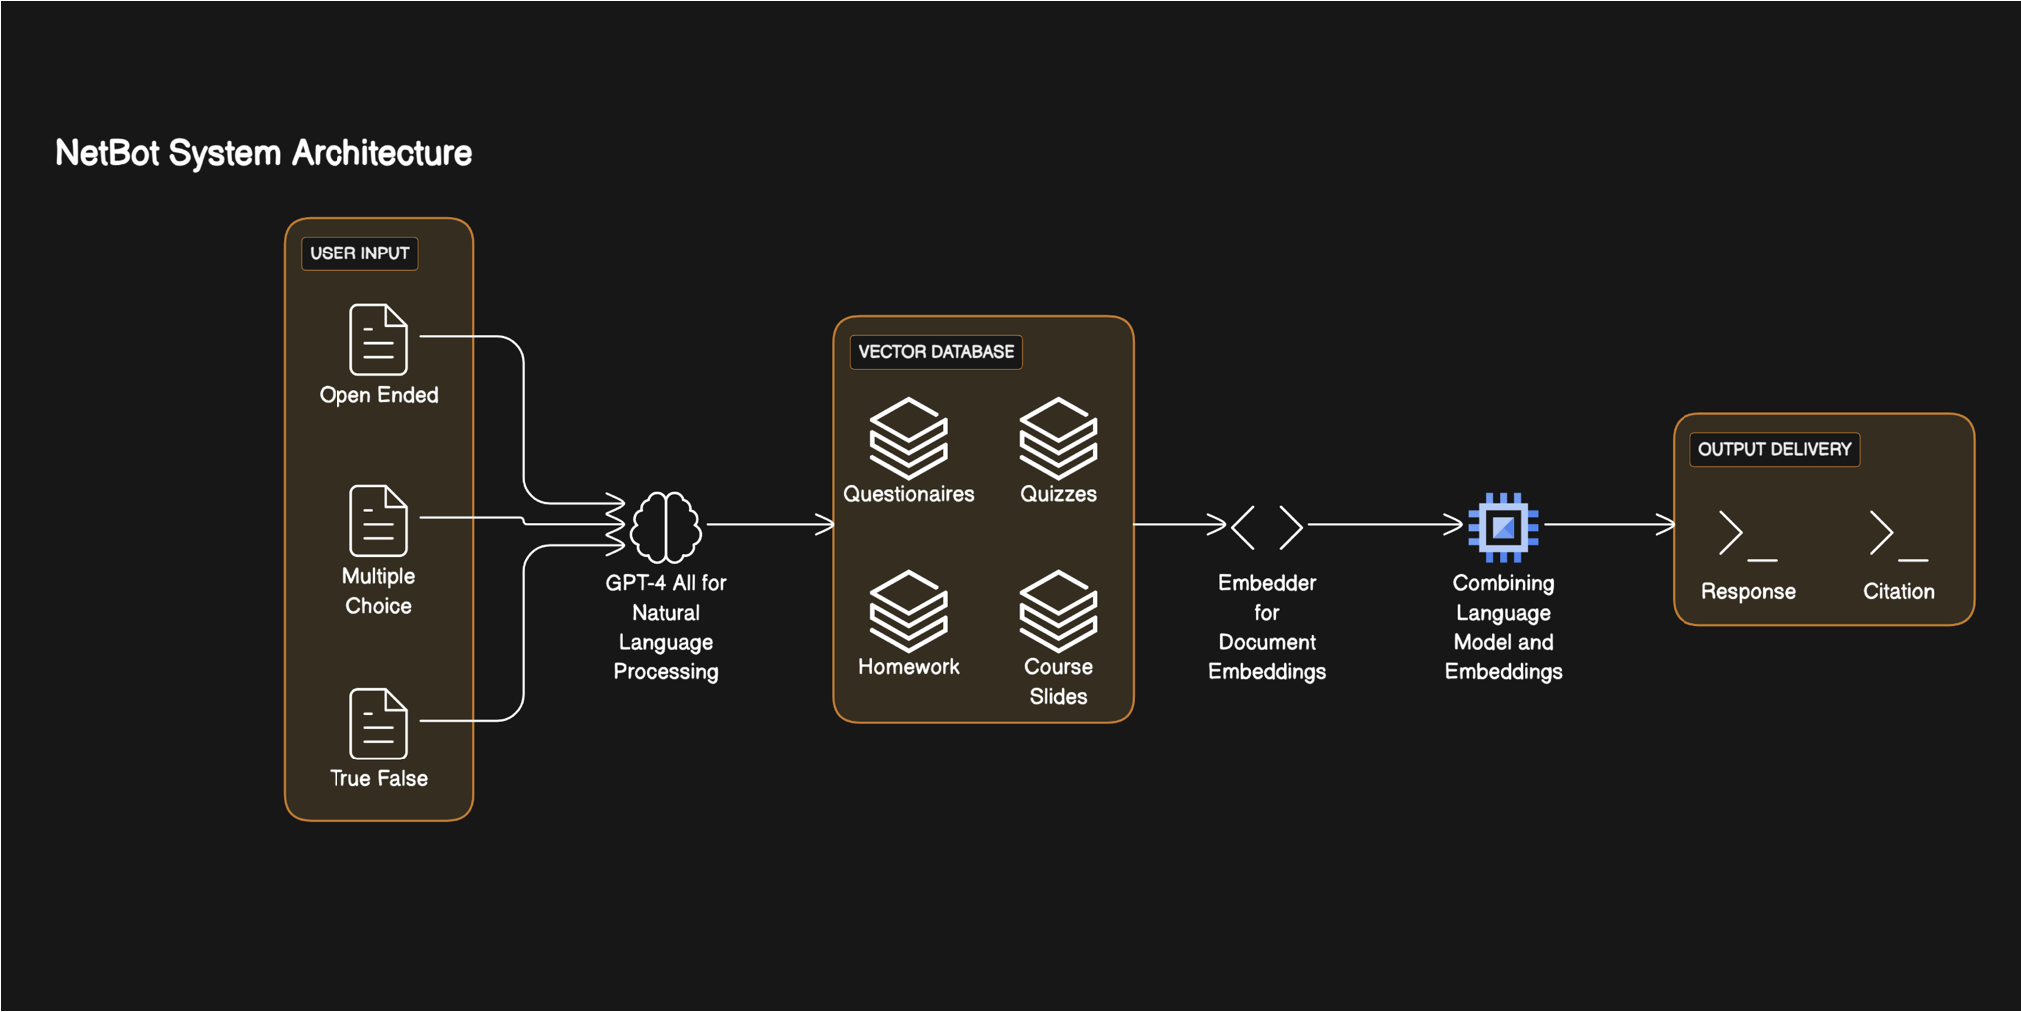
Software Architecture Diagram

Slide 7
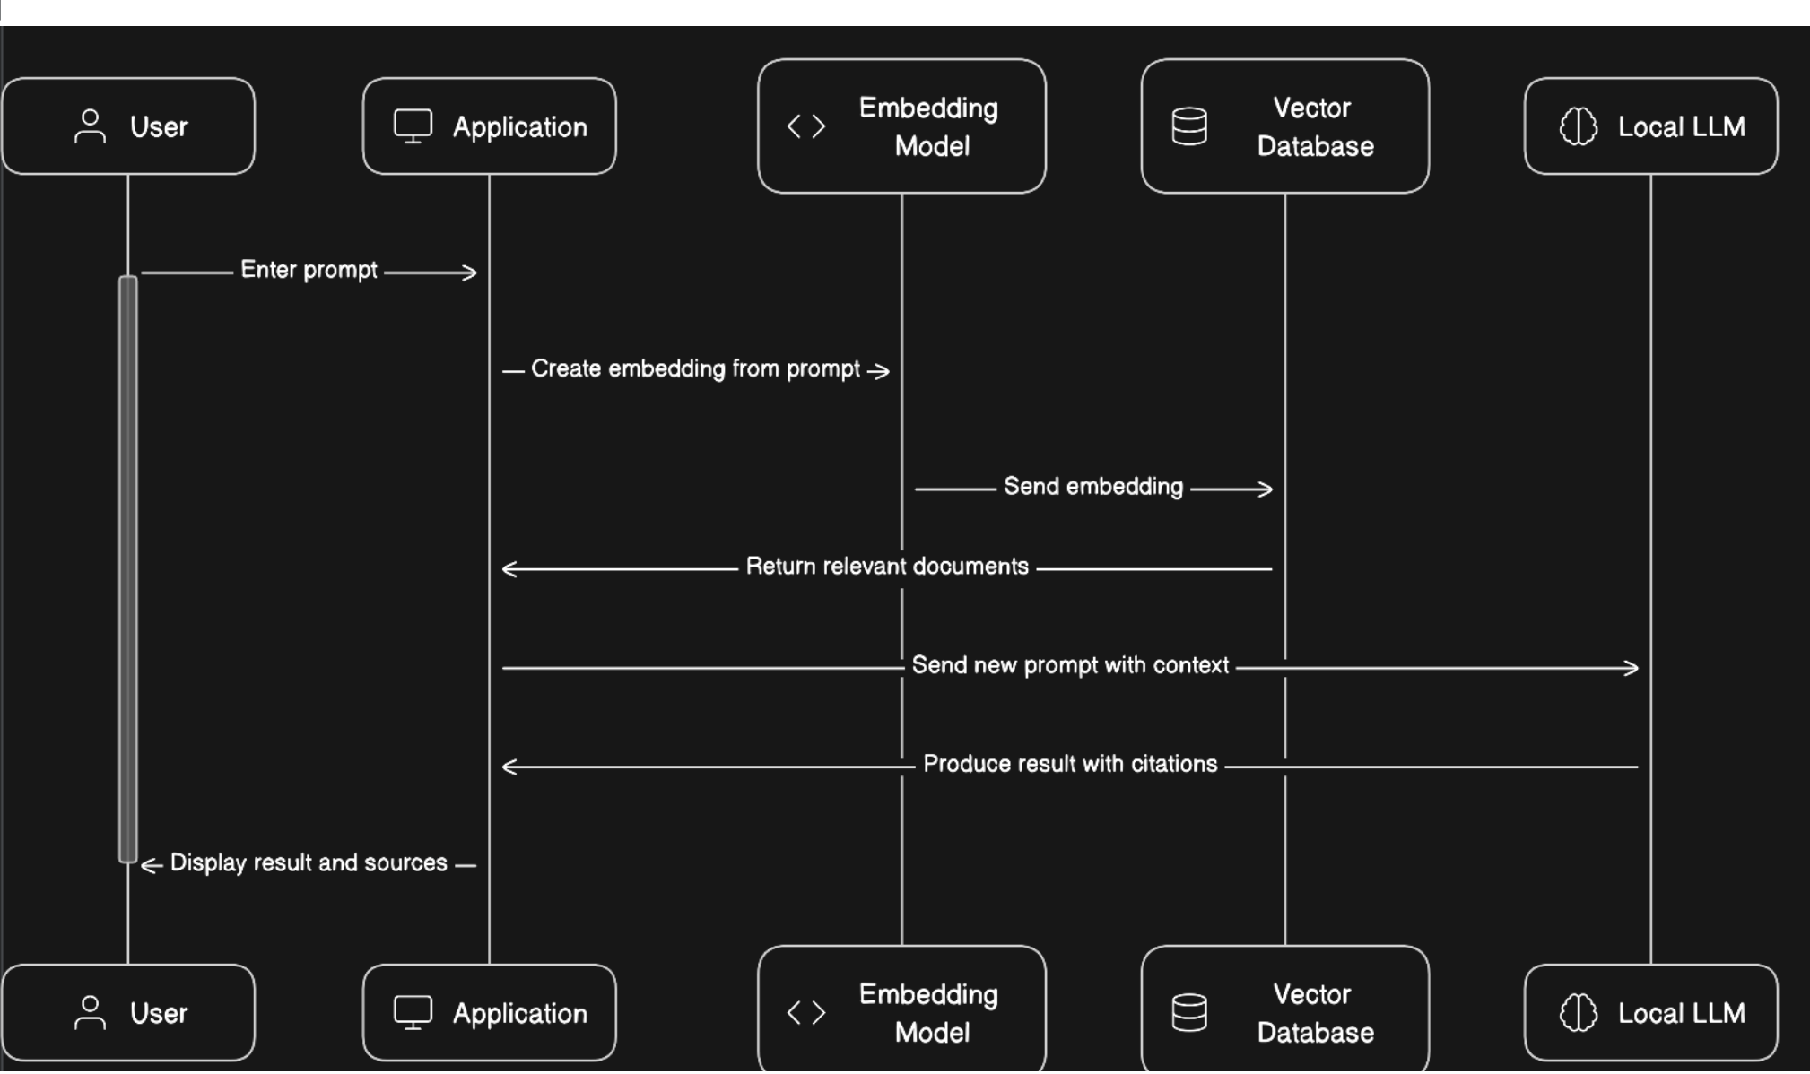

Slide 8
Issues Experienced and Solutions
Training Data Quality: Ensuring high-quality and diverse training data for both the language model and document embeddings.
Performance Optimization: Optimizing the performance of document retrieval using Faiss for larger document repositories.

Slide 9
Pros and Cons
Pros
Can operate without an internet connection
We have complete control over the bot including how it is trained and what to train the bot.
Privacy and security is maintained since the documents, data remain within our control

Slide 10
Cons
May not be as scalable as cloud based bot since it requires huge computing resources to handle large volume of traffic
Since it is run locally, it has the limit in its availability to answer the questions
The bot might not be available if there are problems with the local infrastructure.

Slide 11
Conclusion
The bot demonstrates an effective fusion of language models, document embeddings, and efficient document retrieval mechanisms.
The integration of GPT-4 All, Hugging Face InstructEmbeddings, and Faiss contributes to the bot's ability to deliver context-aware responses, addressing user queries related to network security with precision.
Ongoing improvements can be made by refining the training data and optimizing performance for scalability.

Slide 12
Future Direction
Optimizing the bot’s performance to provide response instantly
Developing graphical user interface to make it more user friendly
Implementing mechanism for collecting and learning from users’ feedback
Implementing mechanisms for continuous learning and updates by involving regular model retraining and deploying new versions with improved capabilities.

Slide 13
References

