Slide 1
Developing a Classification Model for American Sign Language
Pratik Narendra Borse - A20492023
Ashlesh Khajbage - A20517913
Nikhil Singh Thakur - A20528528

Slide 2
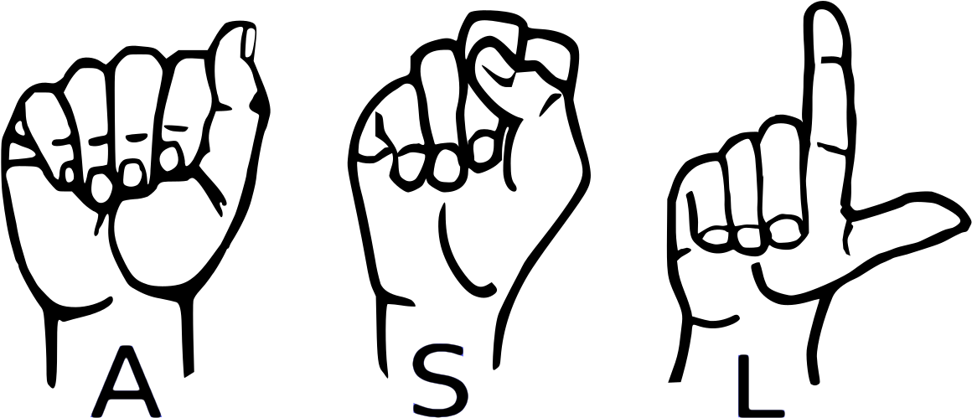
Introduction
American Sign Language (ASL), is a natural language that serves as the predominant sign language of deaf communities in the United States of America and Canada.
ASL is a complete and organized visual language.
The goal of developing an American Sign Language (ASL) classification model is to enable a computer to recognize and understand ASL signs automatically.
This can be used for a variety of purposes, including
Assisting deaf people in communicating,
Translating sign language,
In developing educational tools for learning ASL.

Slide 3
Problem Statement
The objective of our project is to design and develop a highly accurate real-time classification model capable of recognizing and interpreting American Sign Language (ASL) gestures from video data.
ASL signs may involve multiple visual features, such as handshape, movement, and location.

Slide 4
Data Source
 | Features
Dataset 1 | The training data set contains 87,000 images. Dimension of images - 200x200 pixels. - There are 29 classes, of which 26 are for the letters A-Z and 3 classes for SPACE, DELETE and NOTHING.
Dataset 2 | This dataset contains 27000 images of the alphabet signed in ASL. Each image is 512 x 512. Within each set, there are 27 folders, one for each letter and an extra folder of random backgrounds. Each training folder contains 900 examples while each testing folder contains 100 examples.
All datasets are sourced from Kaggle.
We created an additional test dataset which is similar to the testing dataset Dataset 1.

Slide 5
Data Preprocessing
Data Cleaning
Data Transformation
Data Encoding
This step involves removing any irrelevant or redundant data from the dataset.
We removed outlier images that contain objects but not hand-gestures.
ASL signs may involve multiple visual features, such as handshape, movement, and location.
In Data transformation we converted these visual features into a numerical format that can be easily processed by machine learning algorithms.
After Data Transformation, we converted images or videos into numerical arrays or tensors.
We encoded any temporal or spatial information for sequential or spatial modeling.
In our project we have implemented One-hot-encoding.

Slide 6
Algorithms
K-Nearest Neighbors
Logistic Regression
Decision Tree
CNN

Slide 7
Project Timeline and Workflow
Gather and review existing research on ASL recognition using machine learning techniques.
Perform Data Preprocessing
Optimize the model’s hyperparameters to return an even better accuracy.
Implement CNN Model and compute accuracy.
Gather Existing Techniques
Preprocessing
Increase Accuracy
ASL Dataset
ML Model
Real Time Data
Collect a diverse dataset of ASL gestures and
pre-process the data.
Implement ML Algorithm Logistic regression KNN, decision-Tree
Accept real time video input
and classify the hand gesture into the alphabets of the ASL.

Slide 8
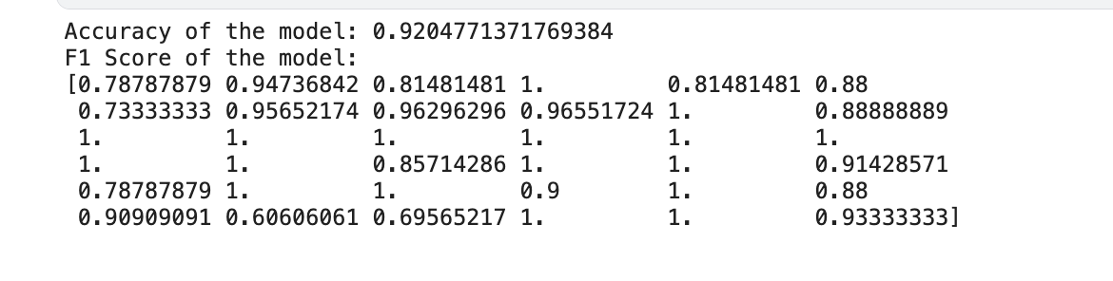
Output for K–Nearest Neighbor Model
.

Slide 9
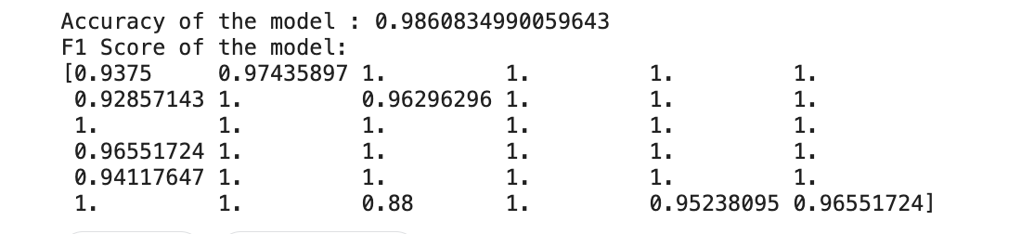
Output for Logistic Regression Model

Slide 10
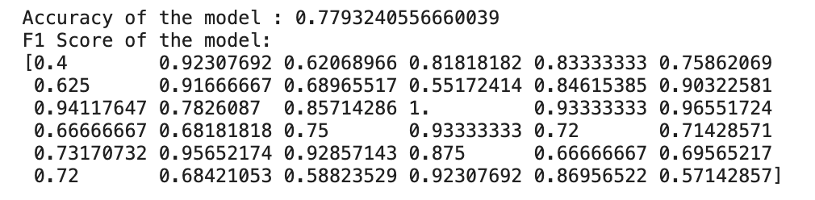
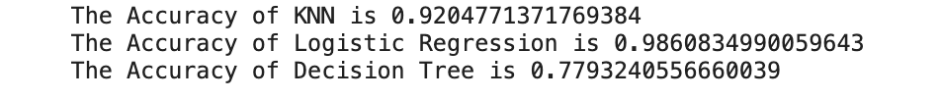
Output for Decision Tree

Slide 11
NEXT STEPS
1. Perform comparative analysis of the classification models.
2. Implement a CNN model and compare its accuracy with the previous models.
3. Get real-time video input and perform real-time classification of hand gestures.

Slide 12
Thank you
Any Questions

