Slide 1
JDBC – Java Database Connectivity
Prepared by :
ASHLESH U KHAJBAGE
2508

Slide 2
JDBC - Java Database Connectivity
The objectives of this chapter are:
To describe the architecture of JDBC
To outline the classes in the java.sql package
To understand the use of JDBC

Slide 3
What is JDBC?
used to connect Java application with Database.
The architecture and API closely resemble Microsoft's ODBC
JDBC is used to interact with various type of Database such as Oracle, MS Access, My SQL and SQL Server.
JDBC can also be defined as the platform-independent interface between a relational database and Java programming.
It allows java program to execute SQL statement and retrieve result from database.
JDBC classes are contained within the java.sql package
There are few classes
There are several interfaces

Slide 4
Database Connectivity History
Before APIs like JDBC and ODBC, database connectivity was tedious
Each database vendor provided a function library for accessing their database
The connectivity library was proprietary.(marketed under registered trade name)
If the database vendor changed for the application, the data access portions had to be rewritten
If the application was poorly structured, rewriting its data access might involve rewriting the majority of the application
The costs incurred generally meant that application developers were stuck with a particular database product for a given application

Slide 5
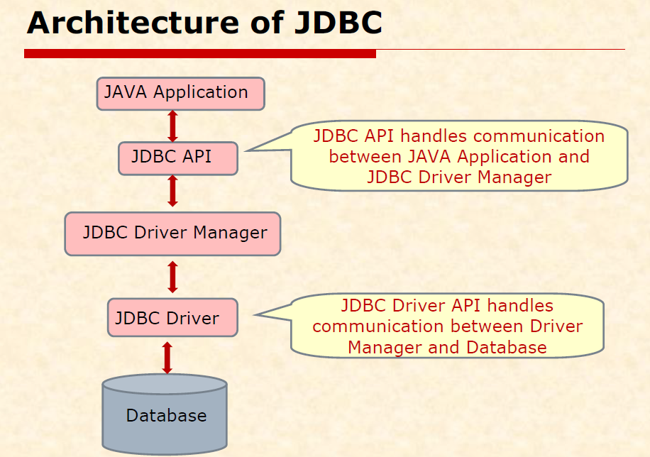
JDBC Architecture
With JDBC, the application programmer uses the JDBC API
The developer never uses any proprietary APIs
Any proprietary APIs are implemented by a JDBC driver
There are 4 types of JDBC Drivers
Java Application
JDBC API
JDBC DriverManager
JDBC Driver
JDBC Driver
databases

Slide 6
classes used for database connectivity
1.Driver Manager Class :
Acts as a interface between user and drivers.
It keeps a track of drivers that are available and handles establishing a connection between a database and appropriate drivers.
returns a Connection Objects.
2.Connection interface:
The JDBC Connection class manages the communications between a java client application & a specific database (e.g. MYSQL database
This is factory of statement, preparedstatement ,resultset etc.
Connection is used to get a object of statement and preparedstatement.

Slide 7
3.Statement interface:
it is an interace.
The JDBC Statement class contains SQL string that are submitted to the DBMS
Also it provides methods to execute queries with database.
Methods:
Statement Connection.createStatement();
Execute methods:
there are 4 major execute() methods of this interface.

Slide 8
Public Resultset executeQuery(String sql)
use to execute SELECT query . It return the object of resultset.
Public int executeUpdate(String sql)
use to CREATE,UPDATE,INSERT,DELETE
Public Boolean execute(String sql)
use to execute that may return multiple results
Public int[] executeBatch(String sql)
use to execute batch of commands.

Slide 9
4.Result set class: The JDBC Result Set class provides predefined methods to access, analyze,& convert data values returned by an executed SQL select statement.
methods:
1. public int getInt( int columnIndex);
2. public String getInt( String columnName);
3. public String getString( int columnIndex);
4. public String getString(String columnName);

Slide 10
Prepared statement interface:
It is subInterface of statement.
Used to execute parameterized query.
Paramerterized query:
String sql= "insert into studentdata value(?,?,?,?,?,?,?)"

Slide 11
JDBC Drivers
There are 4 types of JDBC Drivers
Type 1 - JDBC-ODBC Bridge
Type 2 - JDBC-Native API Partly Java Bridge
Type 3 - JDBC-Network protocol Bridge
Type 4 - Direct JDBC Driver/Thin driver

Slide 12
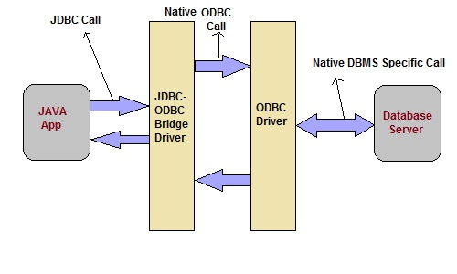
TYPE -1
JDBC-ODBC bridge
Type-1 Driver act as a bridge between JDBC and other database connectivity mechanism(ODBC).
This driver converts JDBC calls into ODBC calls and redirects the request to the ODBC driver.

Slide 13
Advantage
Easy to use
Allow easy connectivity to all database supported by the ODBC Driver.
Disadvantage
Slow execution time
Dependent on ODBC Driver.

Slide 14
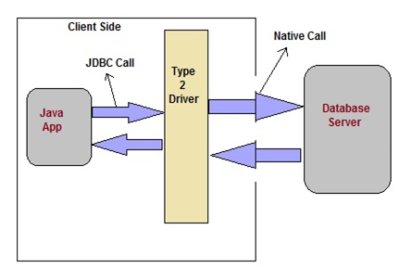
Native API Driver
This type of driver make use of Java Native Interface(JNI) call on database specific native client API. These native client API are usually written in C and C++.
JNI is a framework enables java code running in JVM to call
and be called by native applications .
Advantage
faster as compared to Type-1 Driver
Contains additional features.
Disadvantage
Requires native library
Increased cost of Application

Slide 15
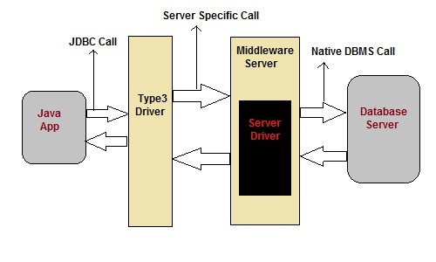
Network Protocol Driver
This driver translate the JDBC calls into a database server independent and Middleware server-specific calls. Middleware server further translate JDBC calls into database specific calls.

Slide 16
Advantage
Does not require any native library to be installed.
Database Independency.
Provide facility to switch over from one database to another database.
Disadvantage
Slow due to increase number of network call.

Slide 17
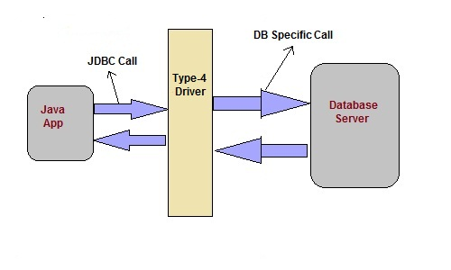
Thin Driver
This is Driver called Pure Java Driver because. This driver interact directly with database. It does not require any native database library, that is why it is also known as Thin Driver.

Slide 18
Advantage
Does not require any native library.
Does not require any Middleware server.
Better Performance than other driver.

Slide 19
JDBC 4.0 API
JDBC 4.0 API is mainly divided into two package
1. java.sql
javax.sql
java.sql package
This package include classes and interface to perform almost all JDBC operation such as creating and executing SQL Queries.

Slide 20
Important classes and interface of java.sql package
classes/interface | Description
java.sql.BLOB | Provide support for BLOB(Binary Large Object) SQL type.
java.sql.Connection | creates a connection with specific database
java.sql.CallableStatement | Execute stored procedures
java.sql.CLOB | Provide support for CLOB(Character Large Object) SQL type.
java.sql.Date | Provide support for Date SQL type.
java.sql.Driver | create an instance of a driver with the DriverManager.
java.sql.DriverManager | This class manages database drivers.
java.sql.PreparedStatement | Used to create and execute parameterized query.
java.sql.ResultSet | It is an interface that provide methods to access the result row-by-row.
java.sql.Savepoint | Specify savepoint in transaction.
java.sql.SQLException | Encapsulate all JDBC related exception.
java.sql.Statement | This interface is used to execute SQL statements.

Slide 21
javax.sql package
This package is also known as JDBC extension API. It provides classes and interface to access server-side data.
javax.sql package
classes/interface | Description
javax.sql.ConnectionEvent | Provide information about occurence of event.
javax.sql.ConnectionEventListener | Used to register event generated by PooledConnection object.
javax.sql.DataSource | Represent the DataSource interface used in an application.
javax.sql.PooledConnection | provide object to manage connection pools.

Slide 22
Steps to connect a Java Application to Database
The following 7 steps are the basic steps involve in connecting a Java application with Database using JDBC.
Create a query ..
Establish the connection
Register the Driver or Associate SQL with the connection
Fire the query
Get the result(set of rows)
Process the result
Closing the connection

Slide 23
1. Create a query
QUERY?
it is statement written in high language to communicate with your database.
Database understand queries.
Queries contain CLAUSES written in proper “syntax”.
what are clauses? ………………..coming soon
Jump to mysql

Slide 24
2. Establish a connection and 3. Associate SQL with the connection
import java.sql.Connection;
import java.sql.DriverManager;
import java.sql.PreparedStatement;
import java.sql.ResultSet;
import java.sql.SQLException;
Load the vendor specific driver
Class.forName(“com.mysql.jdbc.Driver");
Dynamically loads a driver class, for mysql database
Make the connection
Connection con = DriverManager.getConnection( "jdbc:mysql://localhost:3306/database_name", “username”, “pwd”);
con=DriverManager.getConnection("jdbc:mysql://localhost:3306/data","root","root");
Establishes connection to database by obtaining a Connection object

Slide 25
4. Create JDBC statement(s) and fire the query
Statement st =(Statement) con.createStatement();
Creates a Statement object for sending SQL statements to the database
Fire the query
ResultSet re =st.executeQuery(query);
st.executeUpdate(query);

Slide 26
5.Get ResultSet
ResultSet rs = St.executeQuery(query );
6.Process the result
while (rs.next()) {
int ssn = rs.getInt(“ID");
String name = rs.getString("NAME");
int marks = rs.getInt("MARKS");
}

Slide 27
6.Close connection
st.close();
con.close();

Slide 28
SHOW HOW TO INSTALL CONNECTOR
DRIVER
DEMO PROGRAM- DATABASE
JAVA PROGRAM

