Slide 1

Pune Institute of Computer Technology, Pune Dept. of E&TC
304196: Employability Skills and Mini Project (ESMP) (2015 Course)
“MULTIPLE LANGUAGE
DISPLAY UNIT”
Guided By: Dr. R.Sreemathy
By:
1) ADITI DORLE (3503)
2) AKHIL RANE(3506)
3) ASHLESH KHAJBAGE(3508)

Slide 2
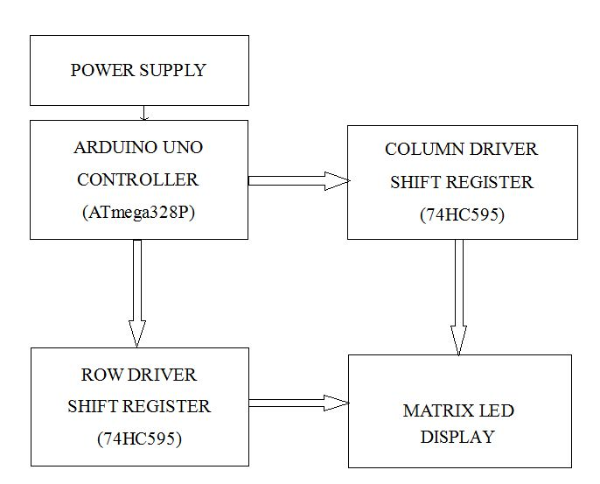
Block Schematic

Slide 3
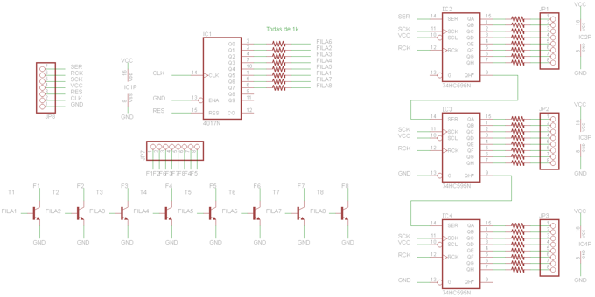

Slide 4
resources Required
144 RED LEDs.
24 Resistors
4017 Decade Counter
6 1k-Resistances
6 2N3904 Transistors
A Long Perf Board
Arduino356
3 74HC595 shift register
Some pin headers

Slide 5


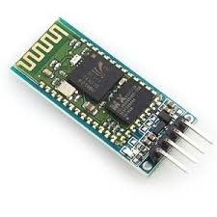
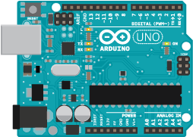
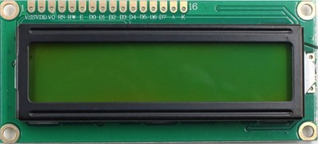
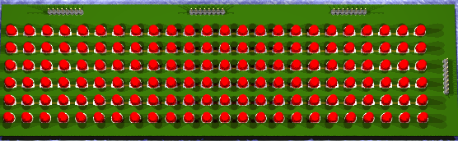
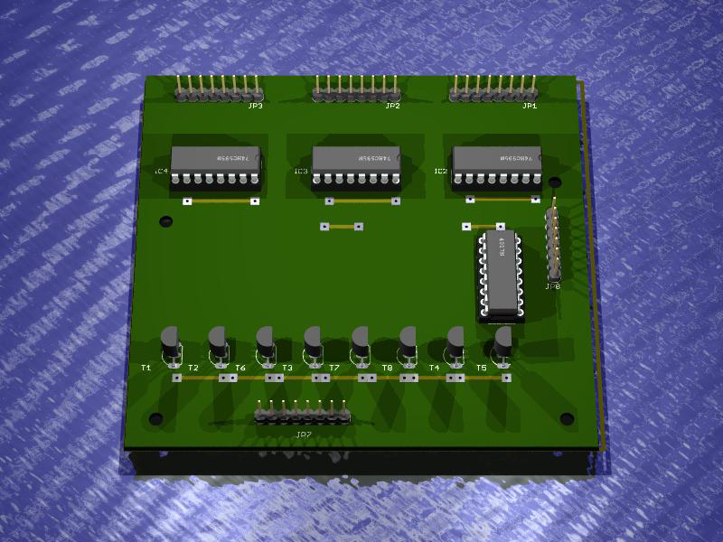
Working model Animation
Satyamev Jayte
सत्यमेव जयते
Input: Satyamev Jayte
String recieving
Bluetooth device
Connected
Satyamev Jayte
सत्यमेव जयते

Slide 6
Features, future Scope
This project focuses on displaying messages of multiple languages.
It is cost effective.
Easy to build.
It can be used in
Railway stations,
Airports
Colleges And Schools
Bus-stops and any other public places.
Public transport

Slide 7
References
Research paper:
Design & Simulation of Moving Message Display using Microcontroller: Available from: https://www.researchgate.net/
publication/[Accessed: 10th May 2010]
Website References:
Electronics LAB, Santi Rodríguez: 24x6 led matrix control unit[online]. Available from: http://www.electronics-lab.com/project/24x6-led-matrix-control-circuit/
Intructables, karthimech09 : 48x8 Scrolling matrix Display using arduino [online]. Available from: https://www.instructables.com/id/Make-a-24X6-LED-matrix/

Slide 8
Thanks

