Slide 1
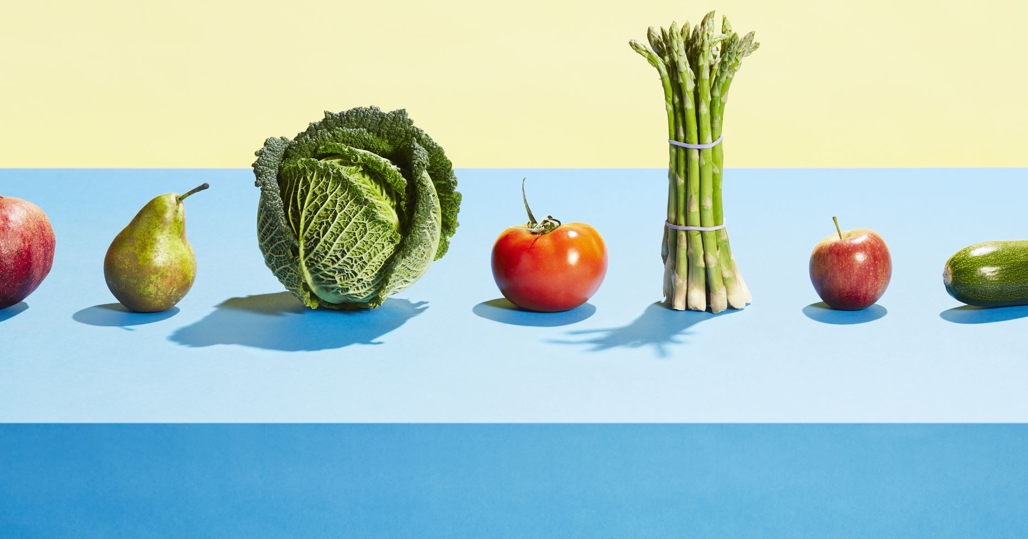
AUTOMATED FOOD IDENTIFICATION AND CALORIE CALCULATION USING DEEP-LEARNING
By –
Aishwary Mocherla
Ashlesh UpganlawarRuth Balaji

Slide 2
CONTENT
Introduction
Block Diagram
Existing System
Proposed System
Working
Output
Conclusion
Reference

Slide 3
INTRODUCTION
Food is the key to a healthy human body. Weight is an illness that shows a high muscle-to-fat ratio. You are probably obese if your BMI is above 30. There are numerous potential causes of weight increase. One of these causes is burning a lot of calories. A diet that is too high in calories implies that you are consuming more calories than you are burning. The extra calories are stored by the body in a proportion of fat to muscle. To get in shape or maintain a healthy weight, people must monitor their caloric intake. However, this interaction can be tiring and irritating. People usually eat uncontrollably since they generally shy away from demanding activities that can make them stout. The volume, object location computation, and calorie evaluation approach are the three main factors of the precision change in these experiments. In order to become in shape or maintain a healthy weight, people must pay attention to their calorie intake. This investigation was carried out to make the following simpler. Instead of only focusing on how the dish looks in pictures, people will genuinely want to know how many calories are in the food they are eating. In this investigation, the food is identified, described, and its volume is estimated. Finally, we calculate the food's calorie content using the volume that the models have projected.

Slide 4
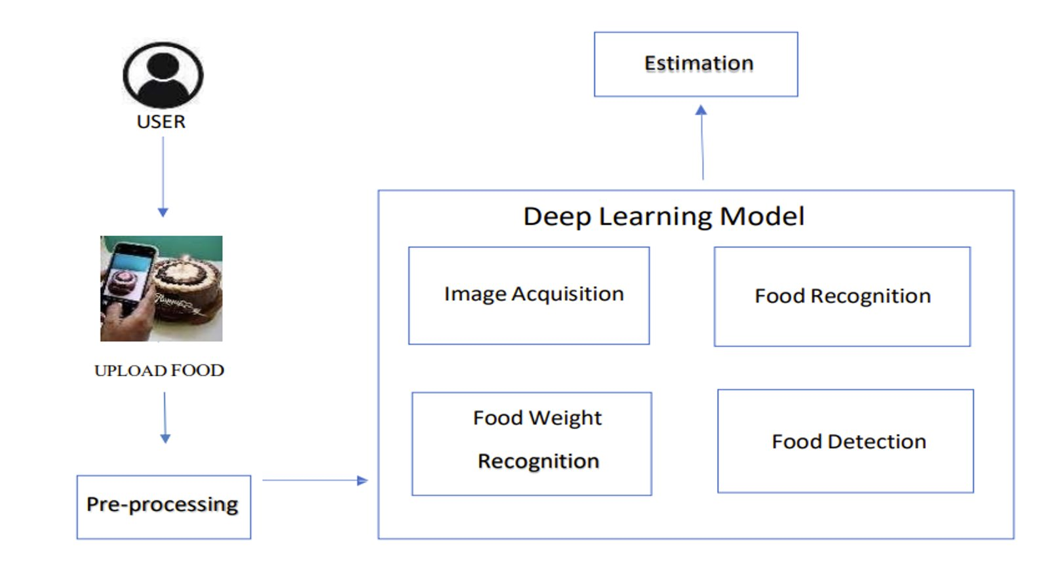
BLOCK DIAGRAM

Slide 5
EXISTING SYSTEM
The majority of frequently used health tracking applications need the user to record the type and amount of food they have ingested. Due to the time, it takes, consumers frequently submit an estimated number rather than actually weighing it, which often results in incorrect measurements. Additionally, consumers avoid inputting each and every food item they've eaten because using the app and then remembering to add the data can take time. It would be much more convenient to simply open the app, click a picture, and upload it. This will not only save time, but also provide accurate results. Additionally, the existing systems are fed predetermined standardized calorie values. However, the number of calories for a given dish in actual life may fluctuate from time to time. Hence, the biggest difference in our model will not only be an improvement in accuracy, but also portion size estimation.

Slide 6
PROPOSED SYSTEM
Our approach towards the system uses computer vision and deep learning techniques for food detection, the quantity of it, the number of calories and other nutritional facts.
Data Collection: The dataset used to train and test the model must include large and diverse collection of images with various types of food, especially fruits and vegetables, dishes, and serving sizes with their annotations. We use Kaggle to source the dataset.
Image Preprocessing: Image preprocessing consists of multiple steps. Based on the nature of data obtained, we perform multiple modifications such as noise reduction, contrast enhancement, image resizing, color correction, segmentation, feature extraction, etc.
Food Recognition: We use existing machine learning and deep learning models such as CNN, RNN, SVM, Random Forests and LSTM to develop different models for the food recognition module of the project.
Comparative analysis: Upon developing the various models, we perform a comparative analysis in order to assess which algorithms offer the most accurate and optimal results.
Hyper parameter tuning: Post comparative analysis, based on the model we end up selecting for the project, we proceed to Fine-tune it to improve performance and accuracy.
Calorie Estimation: Once done with the object detection part, we move on to the portion size and calorie estimation. Using regression models or rule-based systems, we train the model to estimate calories, by taking into account the recognized food items and the calories associated with them.
Testing the models: We check the accuracy of the food recognition and calorie estimation models by using a separate test dataset and compare results to their nutritional facts.

Slide 7
Models used:
Convolutional Neural Network (CNN):
A CNN is a deep learning algorithm which can take in an input image, assign importance (learnable weights and biases) to various aspects/objects in the image, and be able to differentiate one from the other. In your project, the CNN is likely structured to process images by applying filters that capture spatial hierarchies of features (like edges in the lower layers, and more complex shapes in the higher layers). After several layers of convolution and pooling operations, the high-level reasoning in the neural network is done via fully connected layers which interpret the features extracted by the convolutional part of the network to make the final classification and regression (for calorie estimation) decisions.
TensorFlow:
TensorFlow is an end-to-end open-source platform for machine learning. It has a comprehensive, flexible ecosystem of tools, libraries, and community resources that lets researchers and developers build and deploy machine learning powered applications. In your project, TensorFlow provides the backend engine powering the CNN. It handles the computation of numerical operations, which includes the multi-dimensional arrays (tensors) that are processed in the neural network layers.
Keras:
Keras is an open-source neural network library written in Python. It is capable of running on top of TensorFlow, and it was developed with a focus on enabling fast experimentation. Keras provides high-level building blocks for developing deep learning models, and it is known for its user-friendliness, modularity, and extensibility. In your project, Keras is used to define the CNN architecture, layer by layer, and it simplifies the training and evaluation of the deep learning models. It also handles the data preprocessing steps, such as loading images from directories, rescaling pixel values, and converting images into tensors that are fed into the CNN.

Slide 8
WORKING
Data retrival and pre-processing:
The data is taken from kaggle the data includes
The Keras tools are used to import the food photos from directories, categorise them into training and validation sets, and preprocess them. The preprocessing include shrinking the photos to a consistent size and standardising the pixel values to ensure interoperability with the neural network.
Building the model:
A sequential CNN model is constructed in a series of steps, using convolutional layers to extract distinctive characteristics, max pooling layers to decrease dimensionality, dropout layers to mitigate overfitting, and dense layers for classification purposes. The softmax activation function in the output layer yields probabilities for each class.
The model is constructed by specifying an optimizer, loss function, and metrics. It is then trained using the preprocessed picture data. The training phase is characterised by iterations, during which the model's weights are modified in order to minimise loss and enhance the accuracy on the training data.

Slide 9
Cont~WORKING
Accuracy:
Following the training process, the model's proficiency is assessed by using accuracy metrics on both the training and validation datasets. This evaluation aims to gauge the model's ability to identify photos and estimate calorie values.
Subsequently, the trained model is used to forecast the category and caloric value of novel food photos. The predictions are shown along with the photographs to provide a clear evaluation of the model's precision.
The trained model is stored in a file for future use, and the training history is documented, enabling the assessment of the training progress over time and the capability to load the model without the need for retraining.
The model undergoes further testing on a distinct collection of photos (test dataset) to verify its ability to apply to fresh data in a broad manner. The accuracy shown on this test dataset serves as a reliable indicator of the model's performance in real-world scenarios.
Ultimately, the algorithm generates predictions for each individual picture, including the categorization and projected calorie content, which are then shown for the user's observation. This exemplifies the model's proficiency in executing its designated function on particular food items.

Slide 10
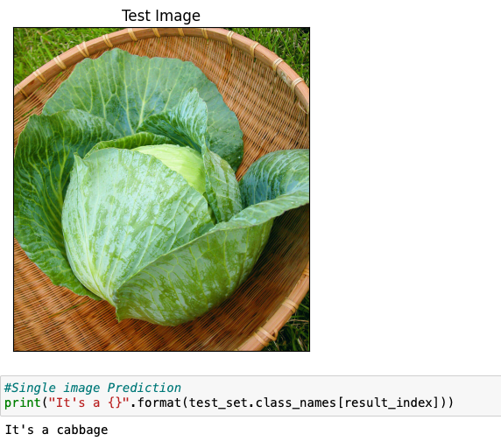
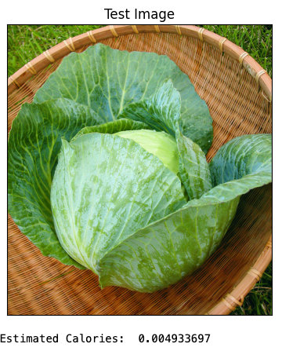
OUTPUT

Slide 11
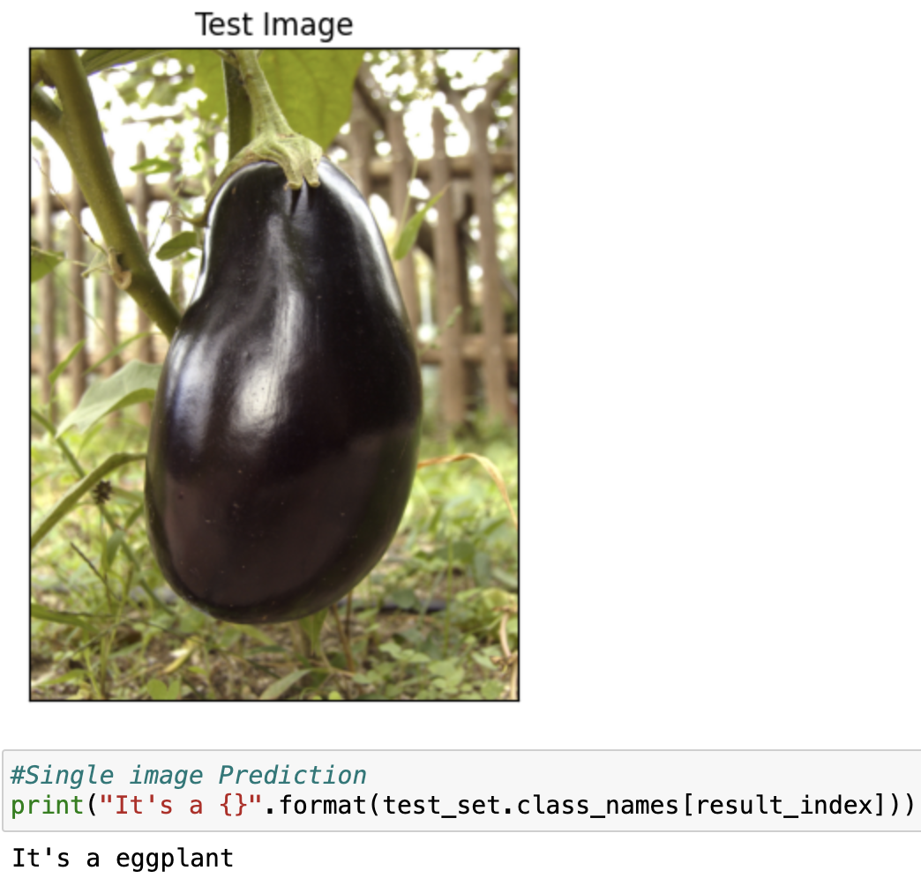
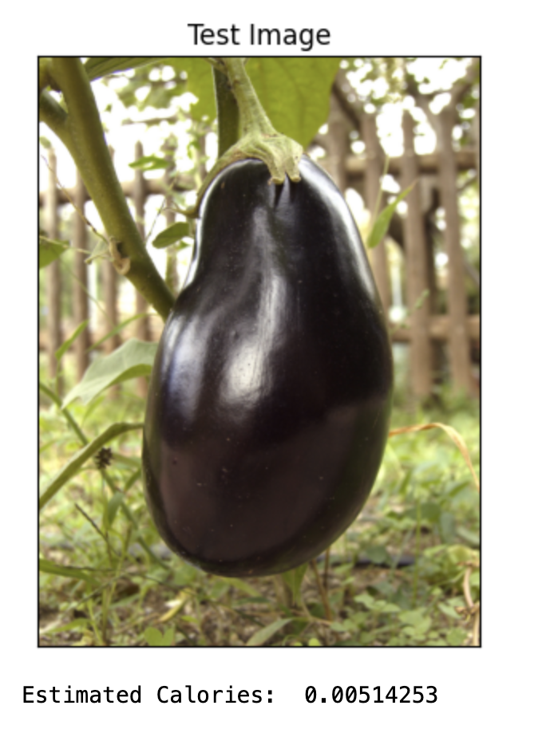
OUTPUT

Slide 12
CONCLUSION
The research effectively showcases the use of a Convolutional Neural Network (CNN) for the purpose of classifying food images and estimating calorie content. We developed and trained a model using TensorFlow and Keras that effectively categorises food items into predetermined groups and also offers a precise estimation of their calorie content.
The CNN's design, which incorporates convolutional layers for extracting features and dense layers for classification, demonstrated its effectiveness in this image-based study. By including dropout layers, the issue of overfitting was addressed, resulting in improved generalisation of the model to unfamiliar pictures.
In summary, the results of the experiment indicate that deep learning, specifically Convolutional Neural Networks (CNNs), have great potential in improving the automation of food identification and nutritional analysis. This technology provides useful tools for developing health and wellness technology solutions.

Slide 13
REFRENECE
https://data.vision.ee.ethz.ch/cvl/datasets_extra/food-101/
https://www.frontiersin.org/articles/10.3389/fnut.2022.875143/full
https://ieeexplore.ieee.org/document/7776769
https://www.ncbi.nlm.nih.gov/pmc/articles/PMC7859960/
https://www.ncbi.nlm.nih.gov/pmc/articles/PMC6246963/
https://ieeexplore.ieee.org/document/10083648

