Slide 1
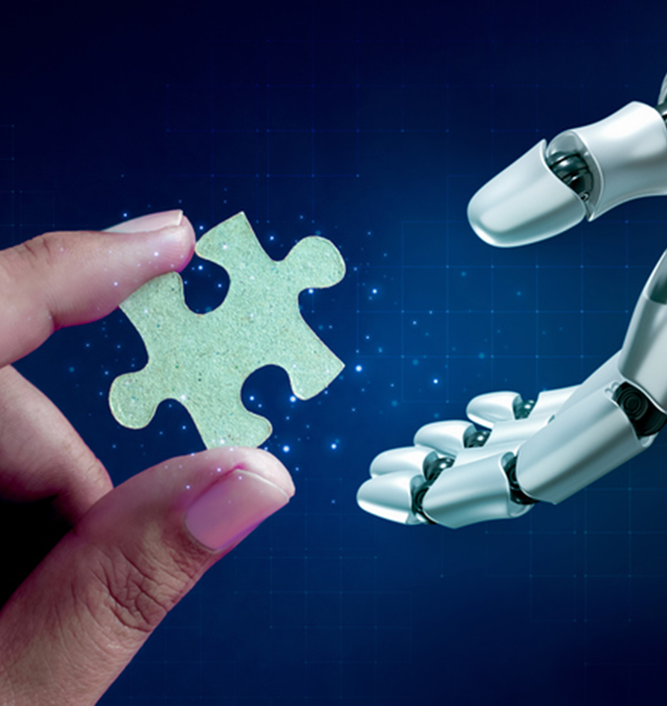
How to Train Your DQN
Ashley Björs
Daniel Rytenberg
Jonas Gerne

Slide 2
Team
Ashley Robotic Student
Daniel Robotic Student
Jonas Robotic Student

Slide 3

Agenda
Introduction
Reinforcement Learning and DQN
Implementation
Results and discussion
Conclusion

Slide 4
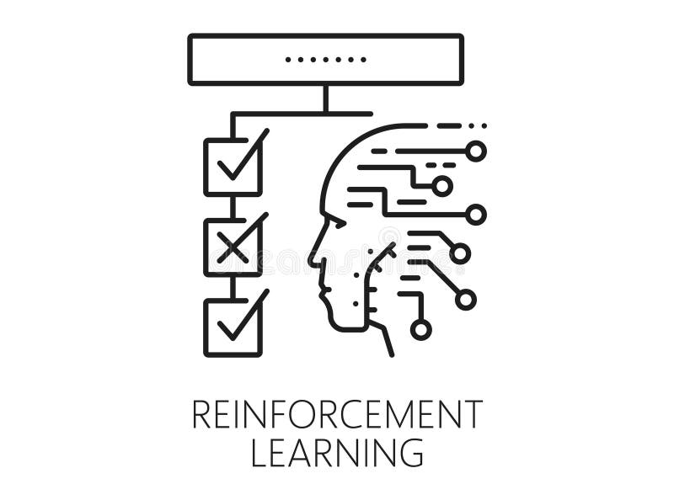
Introduction
Goal: Train DQN to play Connect 4
How: Reinforcement Learning, DQN + CNN
Tools: Matlab toolboxes

Slide 5
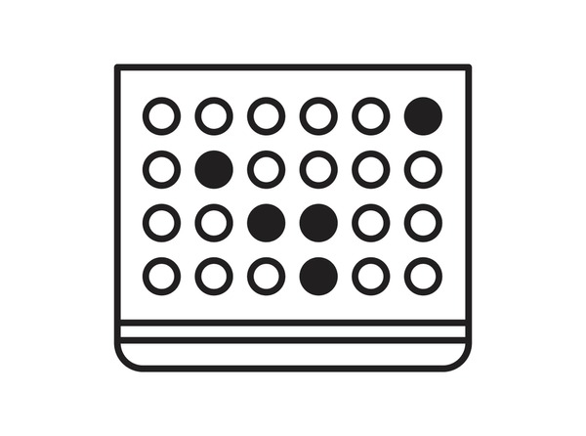
Reinforcement Learning
Agent - AI Player
Environment - Connect 4 game board
Observation - Current state of the board
Action - The columns
Reward - +10 for win, - 10 for illegal move
Trial and Error
Increase long time reward

Slide 6
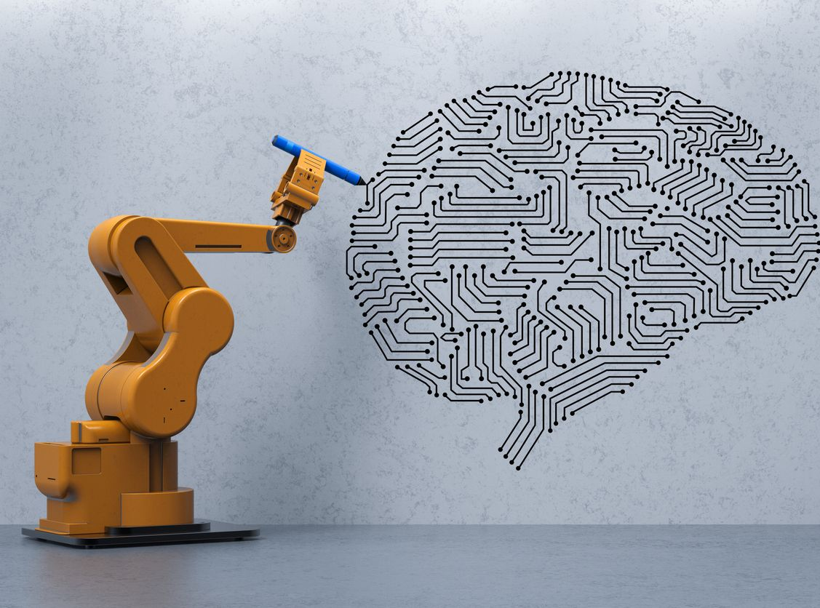
Deep Neural Network (DQN)
Q-learning gives to many numbers 4,5*10¹²
A network to generalize Q-value
CNN for pattern recognision

Slide 7
So how does it work?
Observe
Act
Reward

Slide 8
Implementation in Matlab
Structure of DQN and CNN
Training Process
A single layer
Reinforcement Learning Designer – Reinforcement Learning Toolbox
Growing the database
Illegal moves
Discount Factor

Slide 9
Verification
Winrate Matrix
Summed performance
Every Agent plays against eachother
Deterministic outcomes
Quadratic processing time
Every win & loss counted
First/second mover
Plots over generations

Slide 10
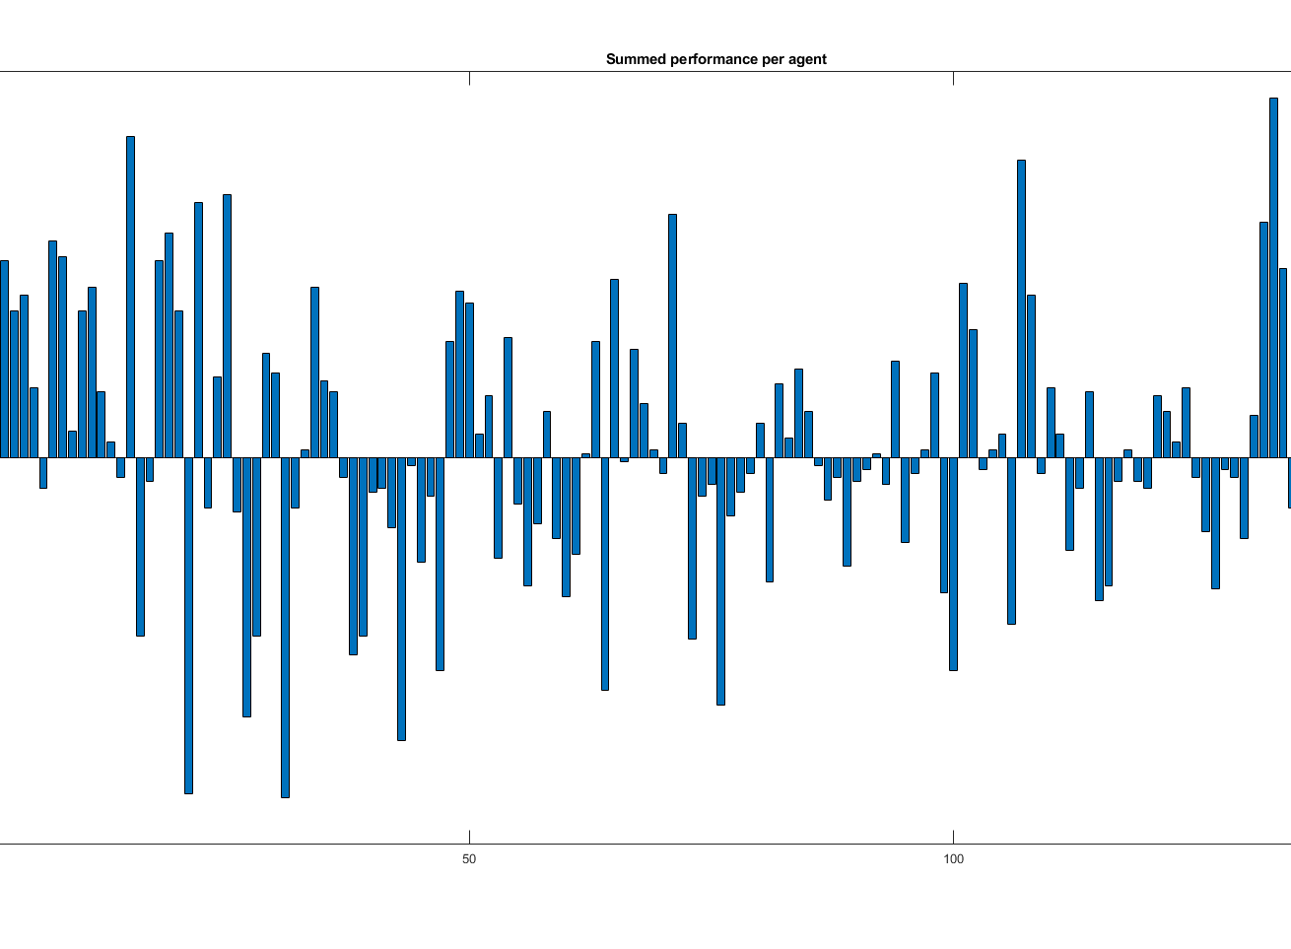
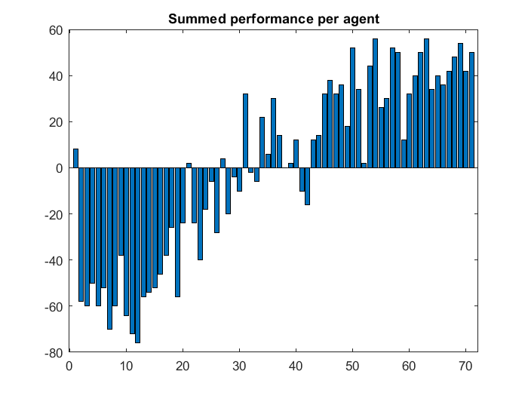
Results

Slide 11
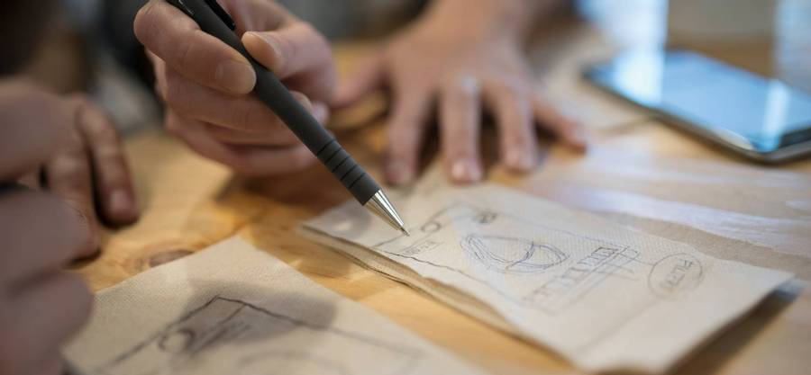
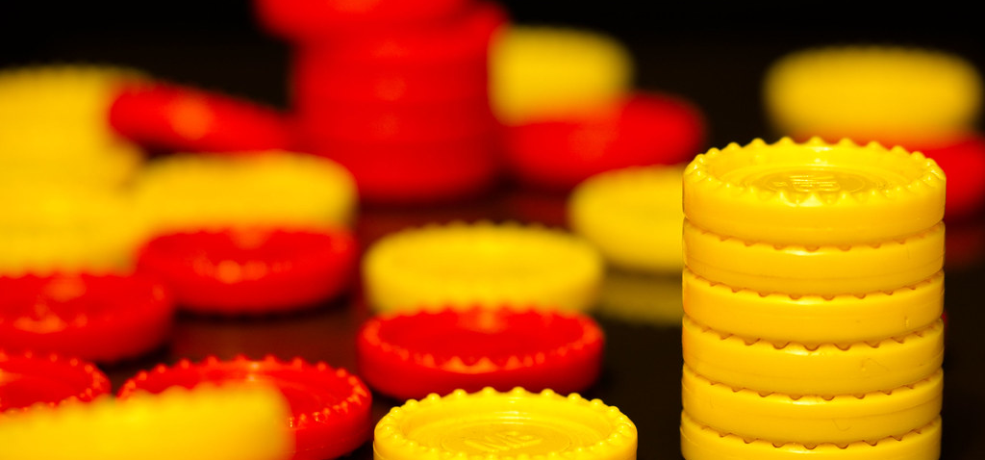
Discussion
Overfitting
Underfitting
Processing power O(n) vs O(n^2)

Slide 12


Conclusion
Very possible
Dynamic episode size
Optimization
Notes:
Possible to get better
Having a constant episode size did absolotuly failed as it was implemented
A more complex reward function for more strategy
Switch up who starts first in training to avoid first move bias

Slide 13

Thanks for listening!
Ashley, Daniel & Jonas
Abs21004@student.mdu.se
Drg21002@student.mdu.se
Jge21002@student.mdu.se

