Slide 1
Handwriting Recognition
By: Ashley Jacob and Brendan Barnett
Notes:
A

Slide 2
Problem
Handwriting recognition
Initial Task
Classify an image of any given capital letter
26 classes
~3.8% accuracy if guessed at random
Originally aimed for 80% accuracy
End Goal
Analyze an image of handwriting and return a string with the correct text
Notes:
A

Slide 3
Division of Work
Model Creation: Brendan, Ashley
Dataset Analysis: Brendan
Image Preprocessing: Ashley, Brendan
Letter Isolation: Ashley
Notes:
B

Slide 4
Datasets
Initial dataset was too small and resulted in overfitting
Only 55 samples per letter
Data augmentation
New dataset had tens of thousands of images
28 x 28
More data improved accuracy
Notes:
A

Slide 5
Literature Review (CNN)
"CNNs are primarily used in the field of pattern recognition within images, allowing for the encoding of image-specific features into the architecture, making the network more suited for image-focused tasks."
An Introduction to Convolutional Neural Networks, source
Notes:
B

Slide 6
Literature Review (Pooling)
"Pooling is a key-step in convolutional based systems that reduces the dimensionality of the feature maps. It combines a set of values into a smaller number of values, i.e., the reduction in the dimensionality of the feature map."
Pooling Methods in Deep Neural Networks, source
Notes:
B

Slide 7
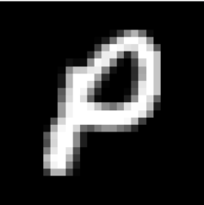

Initial Attempt (MODEL)
1st, we overfit...
Too many epochs, no dropout layers
Then underfit
Too much dropout, batch size too big
And poor preprocessing
Reality (thin, no padding)
Expected
Notes:
B

Slide 8
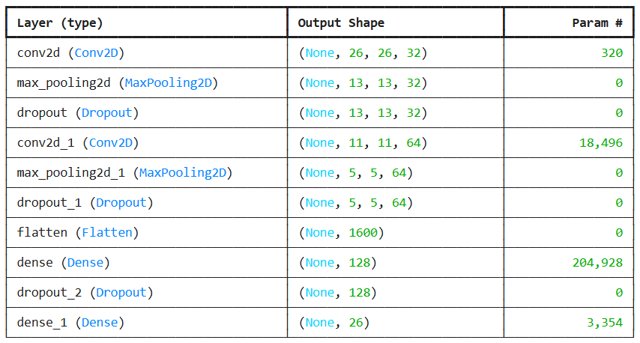
Final Model Architecture
Notes:
B

Slide 9
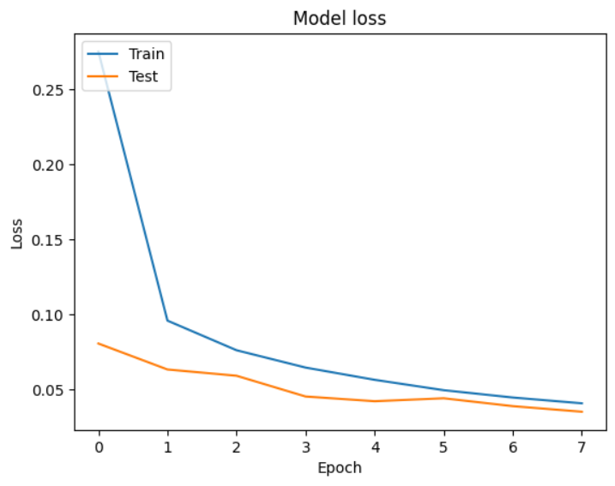
Notes:
B

Slide 10
Model Results (Test Set)
20% holdout for testing:
Accuracy: 0.9918512701
Precision: 0.99186832351
Recall: 0.99185125520
F1-Score: 0.99185087003
Notes:
B

Slide 11
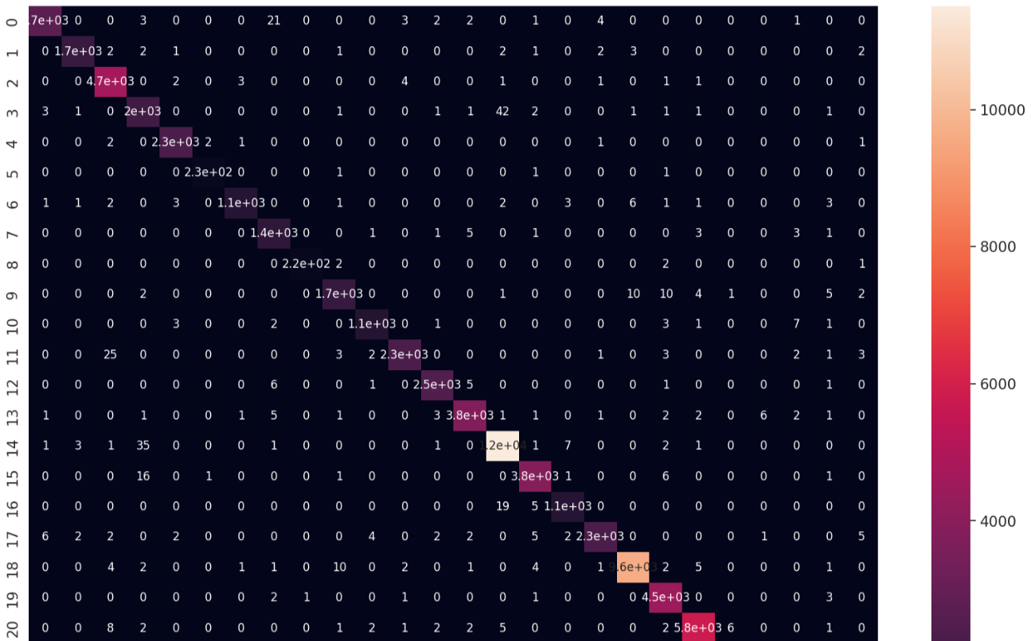
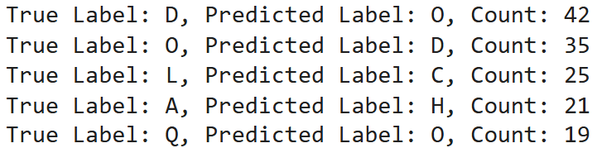
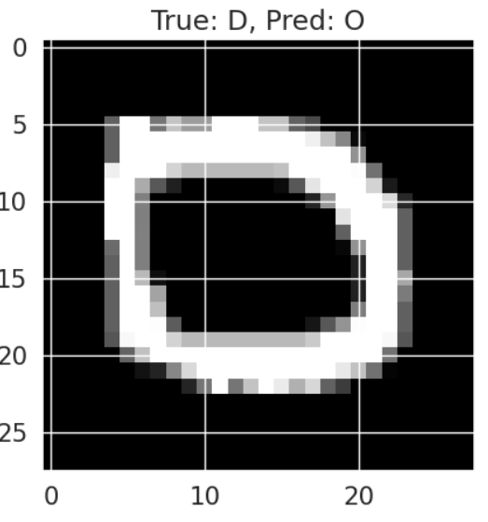
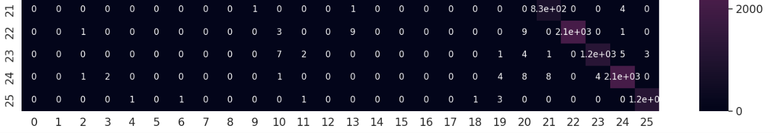
Notes:
B

Slide 12






Model Results (Custom tests)
Using commonly mixed-up letters with my own handwriting (rigid).
Probabilities from softmax output activation.
Notes:
B

Slide 13


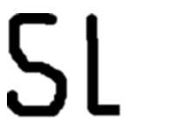

Initial Attempts (Letter Isolation)
Used K-means for clustering
Grouped pixels inaccurately
Inconsistent results
Issues with padding and centering
Notes:
A

Slide 14
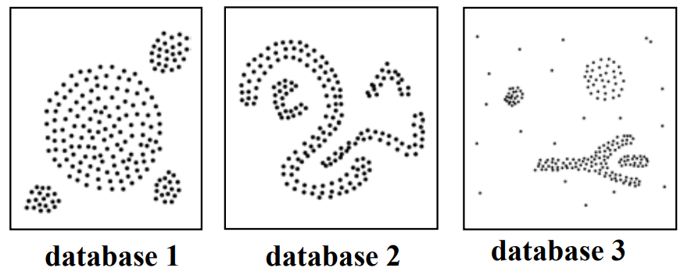
Literature review (DBSCAN)
"...DBSCAN is significantly more effective in discovering clusters of arbitrary shape than the well-known algorithm..."
A Density-Based Algorithm for Discovering Clusters in Large Spatial Databases with Noise, Source
Notes:
B

Slide 15

Letter Isolation
Eventually chose DBSCAN
Always returns the same clusters
Two layers
One isolates words, other isolates letters
Sorted the cluster centers to figure out order
Take points from each cluster and create a new image
Make sure to pad and center letters to match dataset

Slide 16


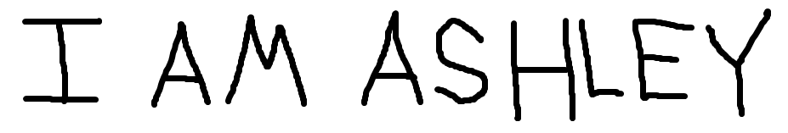

Model Results (Custom Samples)
When writing neatly, the model seems to predict the sentence very well

Slide 17



Errors and Shortcomings
Letters cannot touch
Letters cannot have gaps
Assumes certain distance between letters and words
Some letters look very similar

