Slide 1
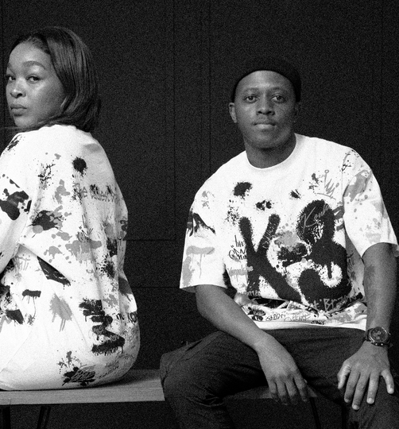

KONKHE IN MOTION
A short-form video proposal for
Instagram Reels, Facebook Reels
and TikTok Shorts.
Prepared by Ashley Ratau
For Konkhe Kuhamba Kahle
SOCIAL MEDIA VIDEO GROWTH

Slide 2
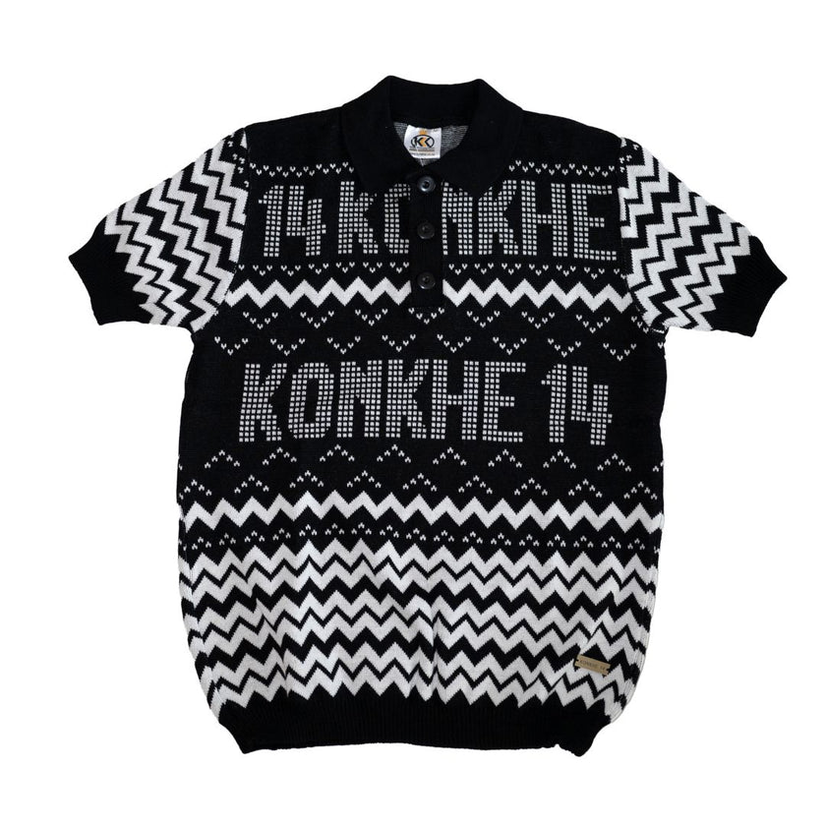
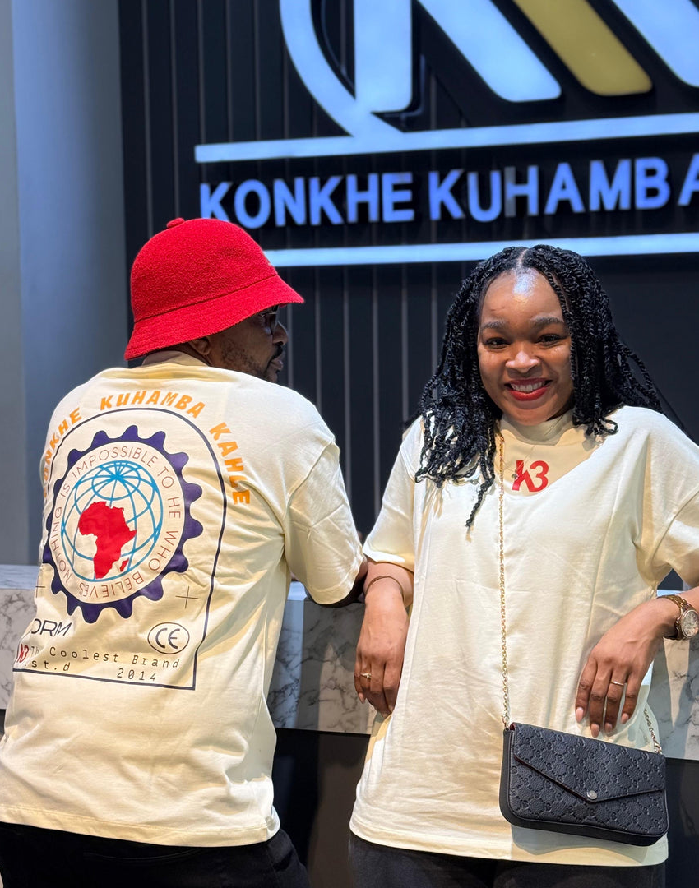
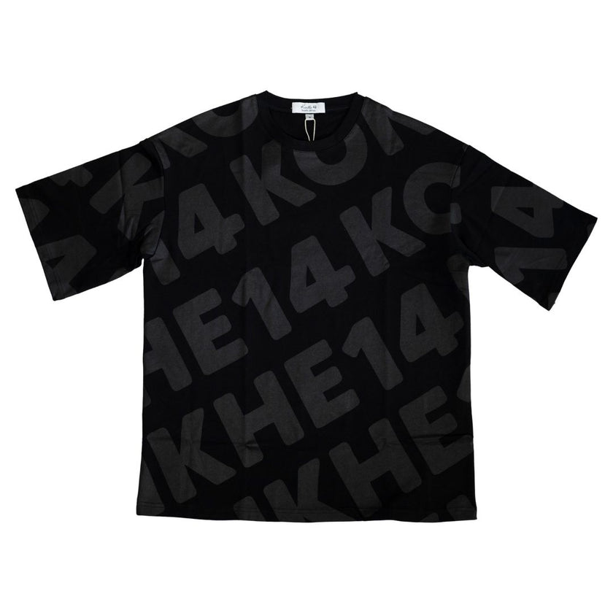
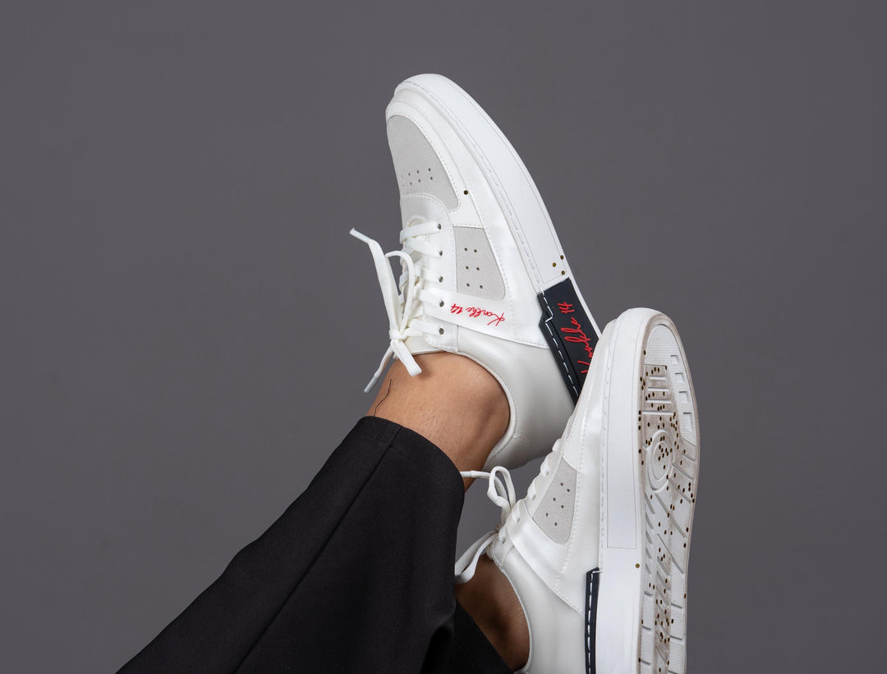
WHAT KONKHE ALREADY HAS
A strong product catalogue that can become daily content.
The website already gives us the foundation: clear product categories, strong imagery, an online shop and social channels.
The opportunity is not to replace images.
It is to make the existing images move, sell the detail,
and create more reasons for people to stop scrolling.
Golfers
Oversized T-Shirts
Sneakers
New arrivals
Proposal by Ashley Ratau
02

Slide 3
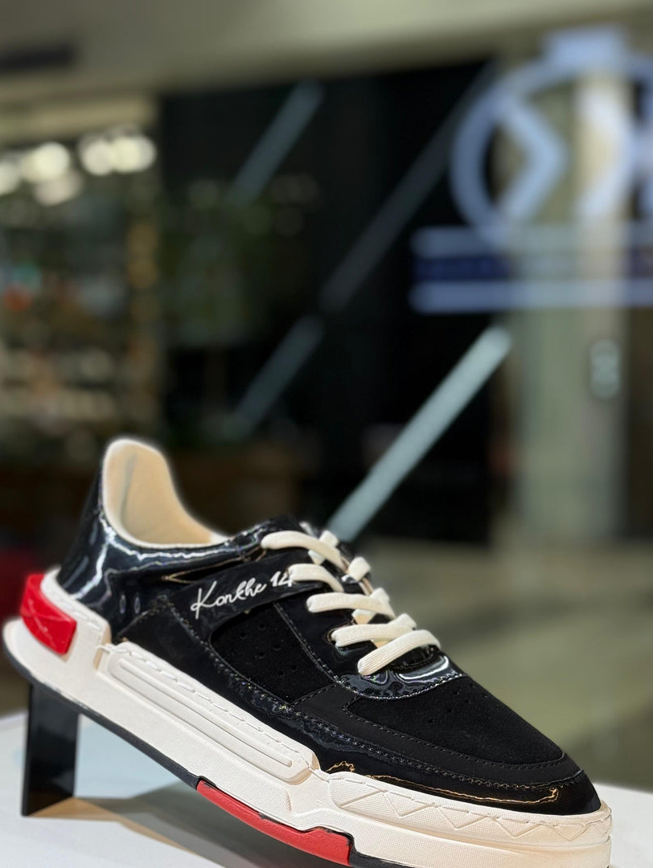
The shift
Images show the product. Short clips create the moment.
Reels and TikTok reward quick, repeatable ideas: a detail shot, an outfit switch, a trending sound, a price reveal, a customer-style try-on, or a new drop teaser.
NEW DROP
More motion in the feed
Tap to shop
More hooks around individual items
More trend-led chances to be discovered
Proposal by Ashley Ratau
03

Slide 4
PHASE 1
Turn the existing catalogue into posting-ready shorts.
I will start by taking product images Konkhe already has and converting them into short clips for Reels and TikTok.
Motion edits
Zooms, pans, cuts and text overlays that make static images feel alive.
Product spotlights
One item at a time: colour, fit, price, size range and shop CTA.
Before we film new content, the catalogue can already start working harder.
Trend formats
Fast adaptations of sounds, captions and visual formats already working on social.
Launch packages
Mini batches for drops, sales, restocks and best sellers.
Proposal by Ashley Ratau
04

Slide 5
Phase 2
Monthly store content days
create a fresh video bank.
Once or twice a month, I will come to one of the stores and capture enough video content to be edited into short clips posted throughout the week.
Try-on clips and outfit combinations
Close-ups of stitching, logos and textures
Shelf, rack and store walk-through shots
Drop announcements, restocks and sale hooks
Quick staff-led recommendations
Proposal by Ashley Ratau
05

Slide 6
CONTENT RHYTHM
A weekly posting system, not random uploads.
The goal is to build a repeatable flow: film in batches, edit into short clips, then post consistently across Instagram, Facebook and TikTok.
Mon
Tue
Wed
Thu
Fri
Weekend
Item spotlight
Trend / sound
Outfit combo
Detail close-up
Drop or sale
Store vibe / recap
Each batch can be cut into multiple versions: 9:16 vertical video, caption-first versions, TikTok-style hooks, and product-specific calls to action.
Proposal by Ashley Ratau
06

Slide 7
What I will bring
Video skills turned into a simple growth service.
Creative direction
Filming
Short ideas, hooks, captions and trend selection.
Store visits once or twice a month to capture bulk content.
Editing
Posting pack
Fast cuts, captions, transitions, product text and music-ready versions.
Files prepared for Instagram/Facebook Reels and TikTok Shorts.
Learning loop
Monthly review of what performs best, then improve the next batch.
Built for consistent weekly visibility
Proposal by Ashley Ratau
07

Slide 8
THE FUNNEL
Short clips should drive traffic back to the online store.
Every video has a job: stop the scroll, create interest in one item, move the viewer to the profile or link, and bring them closer to buying.
Short clips
>
Attention
>
Profile visits
>
Online store
>
Sales + repeat interest
Reels + TikTok
Views + saves
Trust + curiosity
Product page traffic
Checkout, retargeting, community
More short-form content -> more discovery -> more store traffic -> stronger chance of sales.
Proposal by Ashley Ratau
08

