Slide 1
Lesson 3: Basics of Rust
Primary Course of Substrate
Junius Zhou
Engineer @ Parity Technologies Ltd.
junius@parity.io

Slide 2
Content
Rust Basics
Data Types
Control Flow
Pattern Match
Exception Handling
Rust Tools
Substrate Code Walkthrough
Client
Runtime
Pallet

Slide 3
Rust Features
Memory Safety
High Speed
Strong Type
Trait-based Generics
Concurrency

Slide 4
Data Type: Integer
fn main() {
let a = 0_i8;
let b = 0_i16;
let c = 0_i32;
let d = 0_i64;
let e = 0_i128;
let f = 0_u8;
let g = 0_u16;
let h = 0_u32;
let i = 0_u64;
let j = 0_u128;
let k = 0_isize;
let l = 0_usize;
}

Slide 5
Data Type: Float, Boolean, Char, Tuple and Array
fn main() {
let a = 0.0_f32;
let b = 0.0_f64;
let c = true;
let d = false;
let e = 'a';
let f = (0_i32, 0.0_f32, true, ‘a');
let g = [0, 1, 2];
}

Slide 6
Data Type: Enum, Struct
enum Month {
Jan,
Feb,
Mar,
}
struct Person {
name: String,
age: u8,
address: String,
}
fn main() {
let month = Month::Jan;
let person = Person {
name: String::from("Name"),
age: 16,
address: String::from("Address"),
};
}

Slide 7
Data Type: String, &str, slices
fn main() {
let name_1 = String::from("name");
let name_2 = "name";
let name_3 = &name_1[0..3];
}

Slide 8
Flow of Control: if/else, loop, for
fn main() {
let mut i = 0;
if i > 0 {
println!("{i} is positive")
} else {
println!("{i} is negative")
}
loop {
i += 1;
if i > 10 {break}
}
while i < 20 {
println!("i is {i}");
i += 1;
}
for j in 0..10 {
println!("j is {j}");
}
for j in vec![1, 2, 3].iter() {
println!("j is {j}");
}
}

Slide 9
Exception Handling: Option
In C, how to deal with nil
fn get_value() -> Option<String> {
None
}
fn main() {
let a = get_value();
match a {
Some(s) => {},
None => {}
}
}

Slide 10
Exception Handling: Result
In C, how to represent right result, 0 or 1
fn execute() -> Result<(), u8> {
Ok(())
}
fn main() {
let a = execute();
match a {
Ok(_) => {},
Err(_) => {}
}
}

Slide 11
Pattern Match
enum Date {
Jan(u8),
}
fn main() {
let op = Some(0_u8);
match op {
Some(i) => println!("{i}"),
None => println!("it is none"),
}
let re: Result<u8, String> = Ok(0_u8);
match re {
Ok(i) => println!("{i}"),
Err(_) => println!("it is err"),
}
if let Some(v) = op {
println!("{v}");
}
let d = Date::Jan(1_u8);
match d {
Date::Jan(day) => println!("{day}"),
}
}

Slide 12
Rust Tools: Rustup and Cargo
Rust Package Manager for Rust
cargo init, new, build, install
cargo fmt
cargo.toml cargo.lock
cargo test
workspace
Rustup Installer Tool for Rust
rustup update
rustup toolchain
rustup show（列出所有安装的工具）
rustup target add wasm

Slide 13
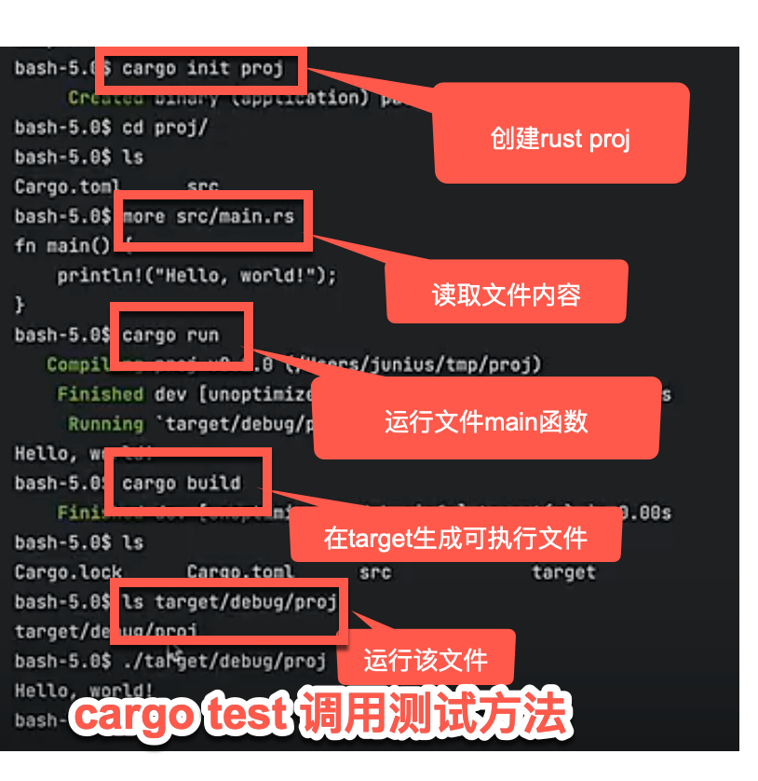

Slide 14
Substrate: architecture
Notes:
How many of you have experience building a layer 1 protocol ?
How long do you think it takes to build it from scratch? 1 year? 1-5 million

Slide 15
Node Template: code walkthrough
Client
Runtime
Pallet
Notes:
How many of you have experience building a layer 1 protocol ?
How long do you think it takes to build it from scratch? 1 year? 1-5 million

Slide 16
Reference Links
https://doc.rust-lang.org/book/
https://docs.substrate.io/fundamentals/architecture/
https://docs.substrate.io/tutorials/get-started/build-local-blockchain/
Notes:
You can keep up to date about events or updates
By subscribing to our newsletter

