Slide 1
Substrate 区块链应用开发
孙凯超
kaichao@parity.io
获取帮助: https://substrate.io
Runtime 宏介绍

Slide 2
内容
Rust 宏
Runtime 常用的宏
cargo expand
其它宏

Slide 3
Rust 宏
宏（Macro）是一种元编程的方式，常见的还有Java里的反射，Rust提供了两种宏：
声明宏
过程宏
https://doc.rust-lang.org/book/ch19-06-macros.html
Notes:
HW:
Substrate provides you with everything you need
to run a blockchain out of the box.
A database layer, networking layer, consensus engine, transaction queue, and libraries of runtime modules
But if you need to, you can choose to customize
Each of these components for your specific needs

Slide 4
Substrate 为什么使用宏
为了简化 Runtime 的开发，Substrate 使用宏建立了一套 DSL (Domain Specific Language)，设计合理的DSL可以：
很好的被用户理解
代码更加简洁，提升效率
解放应用开发者，只需实现业务组件
数据库
点对点网络
密码学
WASM 执行环境
……
Notes:
HW:
Substrate provides you with everything you need
to run a blockchain out of the box.
A database layer, networking layer, consensus engine, transaction queue, and libraries of runtime modules
But if you need to, you can choose to customize
Each of these components for your specific needs

Slide 5
Substrate Runtime 定义
交易
&
Runtime
逻辑
State A
State B

Slide 6
Substrate Runtime 定义
Substrate Module
assets | babe | balances | collective
contract | democracy | elections | grandpa
indices | grandpa | identity | membership
offences | session | staking | sudo
system | timestamp | treasury | and more...
内置的模块也称为
pallet (调色板)

Slide 7
Runtime 模块的组成
使用Substratet进行 Runtime 模块开发的过程中，常用到的宏有：
frame_support::pallet 定义功能模块
pallet::config 定义配置接口
pallet::storage 存储单元
pallet::event 事件
pallet::error 错误信息
pallet::call 包含可调用函数
pallet::hooks 区块不同时期的执行逻辑
construct_runtime 添加模块到 Runtime

Slide 8
storage 宏
不管是 web2.0 传统的互联网应用，还是采用区块链技术的 web3.0 应用，关键数据都需要存起来。
storage 宏，就是用来定义 runtime 模块的存储单元。
Notes:
HW:
Substrate provides you with everything you need
to run a blockchain out of the box.
A database layer, networking layer, consensus engine, transaction queue, and libraries of runtime modules
But if you need to, you can choose to customize
Each of these components for your specific needs

Slide 9
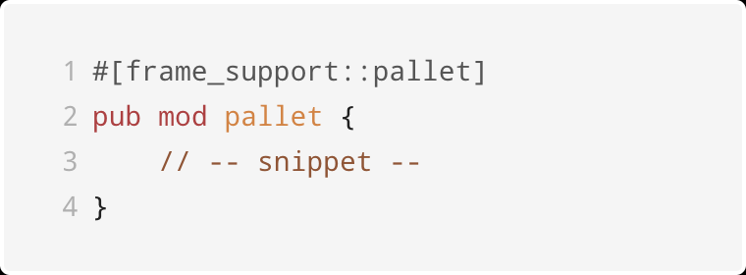
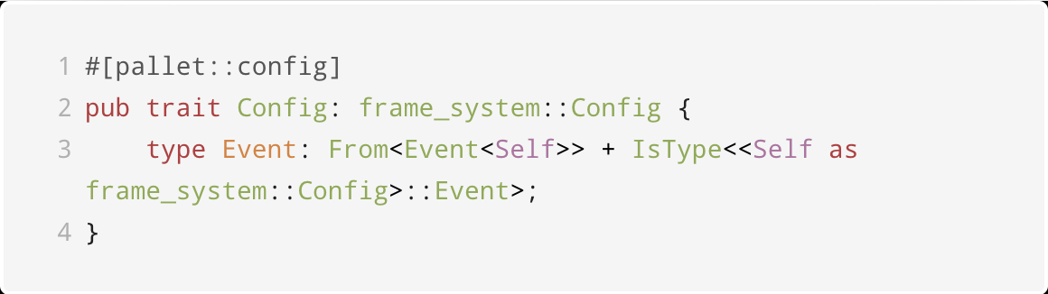
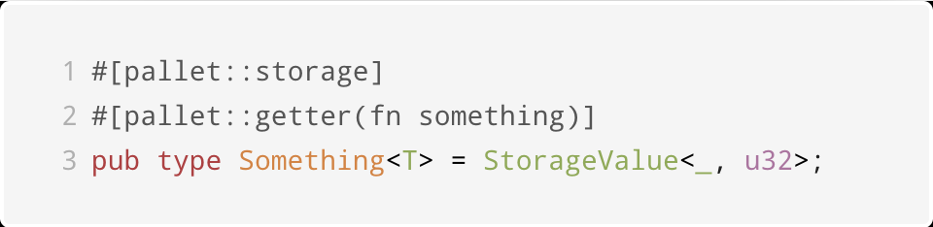
storage 宏举例
Notes:
HW:
Substrate provides you with everything you need
to run a blockchain out of the box.
A database layer, networking layer, consensus engine, transaction queue, and libraries of runtime modules
But if you need to, you can choose to customize
Each of these components for your specific needs

Slide 10
storage 宏举例
数据类型：
单值 StorageValue
映射 StorageMap
双键映射 StorageDoubleMap
多键映射 StorageNMap
https://docs.substrate.io/build/runtime-storage/
Notes:
HW:
Substrate provides you with everything you need
to run a blockchain out of the box.
A database layer, networking layer, consensus engine, transaction queue, and libraries of runtime modules
But if you need to, you can choose to customize
Each of these components for your specific needs

Slide 11
call 宏
区块链的链上状态变化由交易触发，Substrate 不仅支持自定义的存储数据结构，还支持自定义的交易，例如转账、注册身份、投票等等，也叫做 extrinsic 外部交易。
call 用来定义模块里可调用函数，每一个外部交易都会触发一个可调用函数，并根据交易体信息也就是函数参数，更新链上状态。
Notes:
HW:
Substrate provides you with everything you need
to run a blockchain out of the box.
A database layer, networking layer, consensus engine, transaction queue, and libraries of runtime modules
But if you need to, you can choose to customize
Each of these components for your specific needs

Slide 12
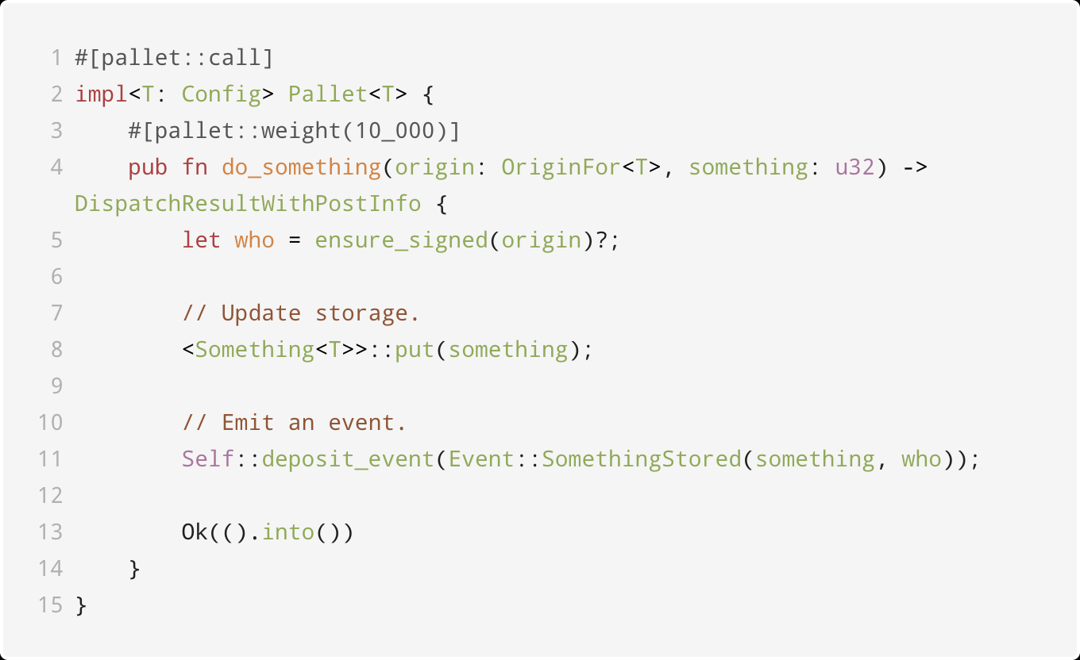
call 宏举例
Notes:
HW:
Substrate provides you with everything you need
to run a blockchain out of the box.
A database layer, networking layer, consensus engine, transaction queue, and libraries of runtime modules
But if you need to, you can choose to customize
Each of these components for your specific needs

Slide 13
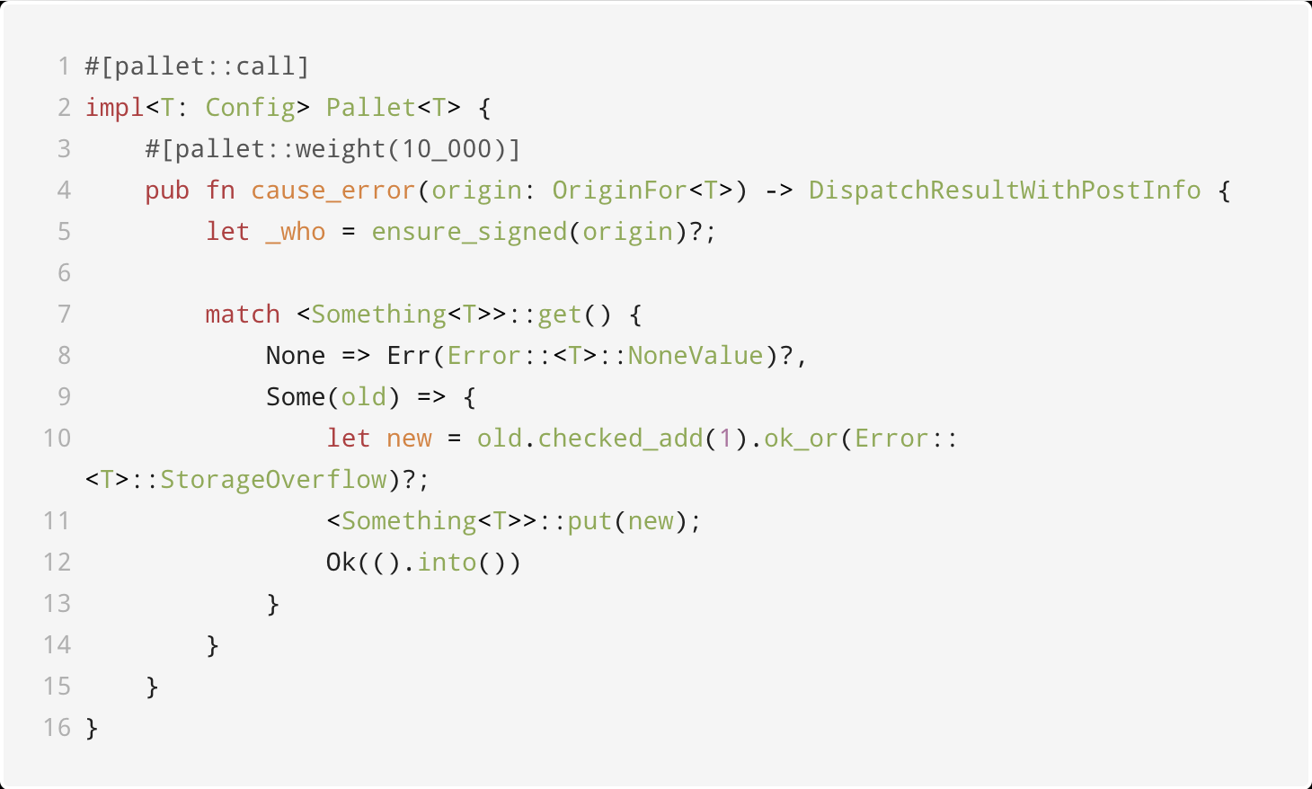
call 宏举例
Notes:
HW:
Substrate provides you with everything you need
to run a blockchain out of the box.
A database layer, networking layer, consensus engine, transaction queue, and libraries of runtime modules
But if you need to, you can choose to customize
Each of these components for your specific needs

Slide 14
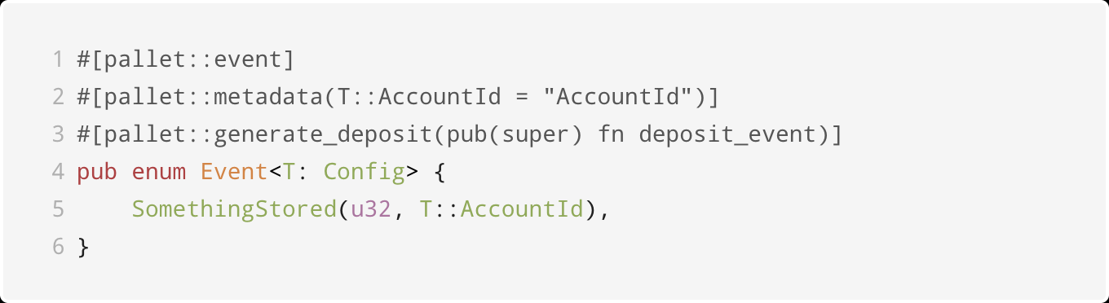
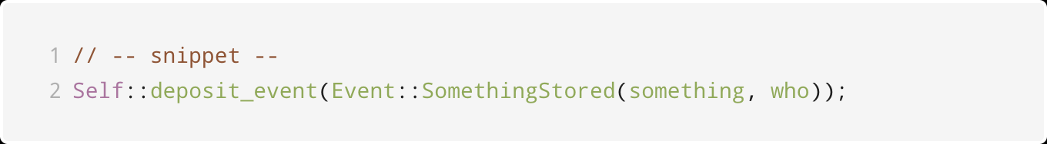
event 宏
区块链是一个异步系统，runtime 通过触发事件通知交易执行结果。
Notes:
HW:
Substrate provides you with everything you need
to run a blockchain out of the box.
A database layer, networking layer, consensus engine, transaction queue, and libraries of runtime modules
But if you need to, you can choose to customize
Each of these components for your specific needs

Slide 15
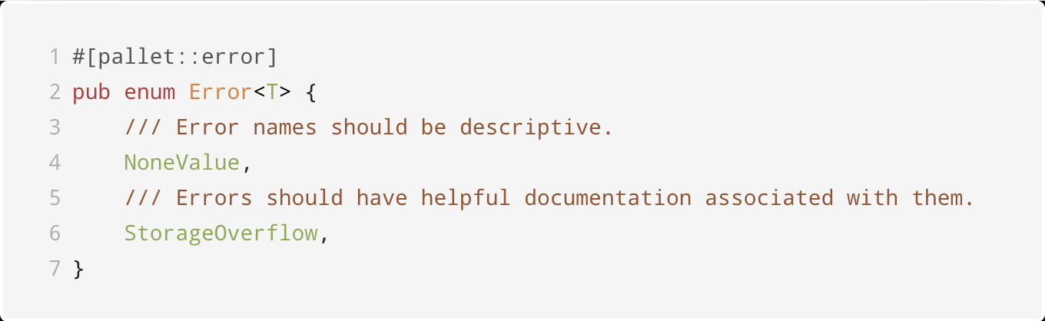
error 宏
当可调用函数执行过程发生错误时，通过error信息通知客户端。
Notes:
HW:
Substrate provides you with everything you need
to run a blockchain out of the box.
A database layer, networking layer, consensus engine, transaction queue, and libraries of runtime modules
But if you need to, you can choose to customize
Each of these components for your specific needs

Slide 16
error 宏
可调用函数里的错误类型，
不能给它们添加数据；
通过 metadata 暴露给客户端；
错误发生时触发system.ExtrinsicFailed 事件，包含了对应错误的索引信息。
Notes:
HW:
Substrate provides you with everything you need
to run a blockchain out of the box.
A database layer, networking layer, consensus engine, transaction queue, and libraries of runtime modules
But if you need to, you can choose to customize
Each of these components for your specific needs

Slide 17
hooks 宏
Runtime 模块里存在保留函数，用于执行特定的逻辑：
on_initialize，在每个区块的开头执行；
on_finalize，在每个区块结束时执行；
offchain_worker：开头且是链外执行，不占用链上的资源；
on_runtime_upgrade：当有 runtime 升级时才会执行，用来迁移数据。

Slide 18
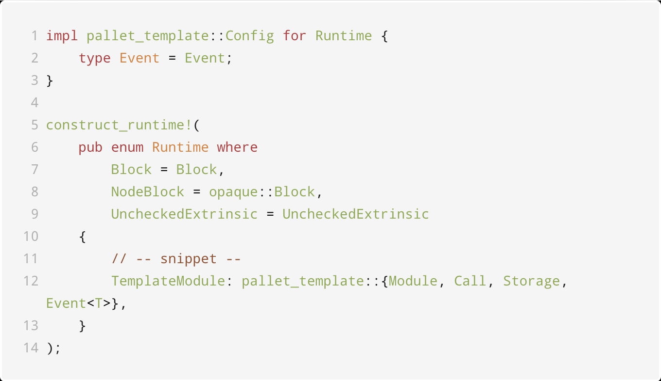
construct_runtime 加载模块
Notes:
HW:
Substrate provides you with everything you need
to run a blockchain out of the box.
A database layer, networking layer, consensus engine, transaction queue, and libraries of runtime modules
But if you need to, you can choose to customize
Each of these components for your specific needs

Slide 19
资料
cargo expand 将宏里的代码展开，得到 Rust 的标准语法，
https://github.com/dtolnay/cargo-expand
https://github.com/kaichaosun/play-substrate/blob/master/pallets/template/expanded.rs
pallet 属性宏参考文档，
https://crates.parity.io/frame_support/attr.pallet.html
Notes:
HW:
Substrate provides you with everything you need
to run a blockchain out of the box.
A database layer, networking layer, consensus engine, transaction queue, and libraries of runtime modules
But if you need to, you can choose to customize
Each of these components for your specific needs

Slide 20
其它宏
decl_runtime_apis & impl_runtime_apis，定义runtime api：
https://docs.substrate.io/reference/runtime-apis/ https://crates.parity.io/sp_api/macro.decl_runtime_apis.html
https://crates.parity.io/sp_api/macro.impl_runtime_apis.html
runtime_interface，定义在 runtime 里可以调用的 Host 提供的函数：
https://crates.parity.io/sp_runtime_interface/attr.runtime_interface.html
Notes:
HW:
Substrate provides you with everything you need
to run a blockchain out of the box.
A database layer, networking layer, consensus engine, transaction queue, and libraries of runtime modules
But if you need to, you can choose to customize
Each of these components for your specific needs

Slide 21
多实例模块
Substrate 的模块在 runtime 里可以有多个实例，例如，可以添加多个内置的 collective 模块实例，分别用来表示理事会和技术委员会，来实现复杂的治理模型。
Notes:
HW:
Substrate provides you with everything you need
to run a blockchain out of the box.
A database layer, networking layer, consensus engine, transaction queue, and libraries of runtime modules
But if you need to, you can choose to customize
Each of these components for your specific needs

Slide 22
多实例模块 - 例子
pub trait Trait<I: Instance = DefaultInstance>: frame_system::Trait {
type Event: From<Event<Self, I>> + Into<<Self as frame_system::Trait>::Event>;
}
decl_storage! {
trait Store for Module<T: Trait<I>, I: Instance=DefaultInstance> as Collective {
// -- snip --
}
}
Notes:
HW:
Substrate provides you with everything you need
to run a blockchain out of the box.
A database layer, networking layer, consensus engine, transaction queue, and libraries of runtime modules
But if you need to, you can choose to customize
Each of these components for your specific needs

Slide 23
多实例模块 - 例子
decl_module! {
pub struct Module<T: Trait<I>, I: Instance = DefaultInstance> for enum Call where origin: T::Origin {
// -- snip --
}
Notes:
HW:
Substrate provides you with everything you need
to run a blockchain out of the box.
A database layer, networking layer, consensus engine, transaction queue, and libraries of runtime modules
But if you need to, you can choose to customize
Each of these components for your specific needs

Slide 24
多实例模块 - 例子
decl_event!(
pub enum Event<T, I: Instance = DefaultInstance> where
<T as frame_system::Trait>::AccountId,
{
// -- snip --
}
);
decl_error! {
pub enum Error for Module<T: Trait<I>, I: Instance> {
// -- snip --
}
}
Notes:
HW:
Substrate provides you with everything you need
to run a blockchain out of the box.
A database layer, networking layer, consensus engine, transaction queue, and libraries of runtime modules
But if you need to, you can choose to customize
Each of these components for your specific needs

Slide 25
多实例模块 - 例子
type CouncilCollective = pallet_collective::Instance1;
impl pallet_collective::Trait<CouncilCollective> for Runtime {
// -- snip --
}
construct_runtime!(
pub enum Runtime where
Block = Block,
NodeBlock = node_primitives::Block,
UncheckedExtrinsic = UncheckedExtrinsic
{
Council: pallet_collective::<Instance1>::{Module, Call, Storage, Origin<T>, Event<T>, Config<T>},
}
);
Notes:
HW:
Substrate provides you with everything you need
to run a blockchain out of the box.
A database layer, networking layer, consensus engine, transaction queue, and libraries of runtime modules
But if you need to, you can choose to customize
Each of these components for your specific needs

Slide 26
Questions?
官网文档：substrate.io 知乎专栏：parity.link/zhihu
kaichao@parity.io
https://parity.link/asia-support

