Slide 1
Substrate 区块链应用开发
孙凯超
kaichao@parity.io
获取帮助: https://substrate.io
Runtime 数据存储的设计

Slide 2
内容
区块链存储的不同点和约束
Substrate 存储单元的类型
存储的初始化
最佳实践

Slide 3
区块链存储的不同点
区块链应用通常几个特点，
开源可审查，对等节点，引入延迟和随机来达到共识
链式、增量地存储数据
区块链应用的节点软件依赖高效的键值对数据库：
LevelDB
RocksDB
Notes:
HW:
Substrate provides you with everything you need
to run a blockchain out of the box.
A database layer, networking layer, consensus engine, transaction queue, and libraries of runtime modules
But if you need to, you can choose to customize
Each of these components for your specific needs

Slide 4
区块链存储的约束
区块链作为业务的载体，存储相关的限制有：
大文件直接存储在链上的成本很高；
链式的区块存储结构不利于对历史数据的索引；
另外一个约束是，在进行数值运算时不能使用浮点数。
Notes:
HW:
Substrate provides you with everything you need
to run a blockchain out of the box.
A database layer, networking layer, consensus engine, transaction queue, and libraries of runtime modules
But if you need to, you can choose to customize
Each of these components for your specific needs

Slide 5
Substrate 存储单元的类型
开发链上存储单元的特点：
Rust原生数据类型的子集，定义在核心库和alloc库中
原生类型构成的映射类型
满足一定的编解码条件
单值
简单映射
双键映射
Notes:
HW:
Substrate provides you with everything you need
to run a blockchain out of the box.
A database layer, networking layer, consensus engine, transaction queue, and libraries of runtime modules
But if you need to, you can choose to customize
Each of these components for your specific needs

Slide 6
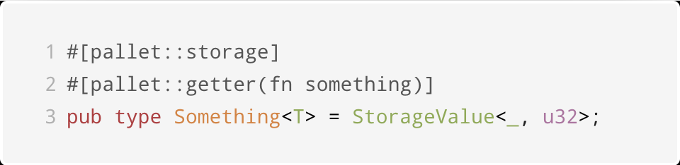
回顾 storage 宏
Notes:
HW:
Substrate provides you with everything you need
to run a blockchain out of the box.
A database layer, networking layer, consensus engine, transaction queue, and libraries of runtime modules
But if you need to, you can choose to customize
Each of these components for your specific needs

Slide 7
单值类型
存储某种单一类型的值，如布尔，数值，枚举，结构体等：
数值：u8,i8,u32,i32,u64,i64,u128,i128
大整数：U128,U256,U512
布尔：bool
集合：Vec<T>, BTreeMap, BTreeSet
定点小数：Percent,Permill,Perbill,FixedU128
定长哈希：H128,H256,H512
其它复杂类型：Option<T>,tuple,enum,struct
内置自定义类型：Moment,AccountId
Notes:
HW:
Substrate provides you with everything you need
to run a blockchain out of the box.
A database layer, networking layer, consensus engine, transaction queue, and libraries of runtime modules
But if you need to, you can choose to customize
Each of these components for your specific needs

Slide 8
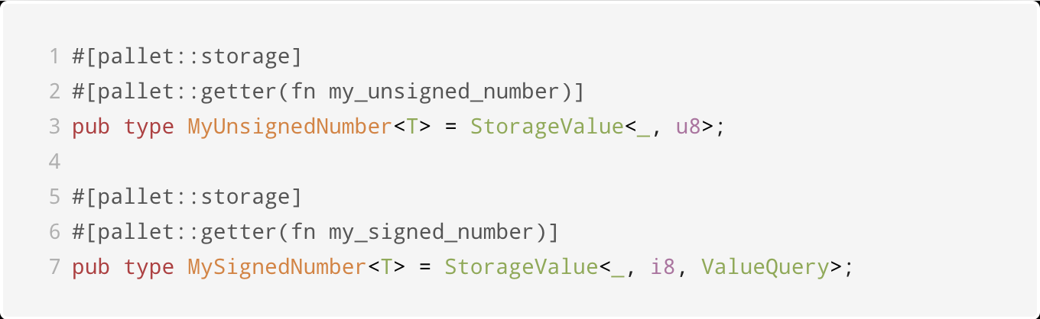
单值类型
数值类型 u8 的定义：
Notes:
HW:
Substrate provides you with everything you need
to run a blockchain out of the box.
A database layer, networking layer, consensus engine, transaction queue, and libraries of runtime modules
But if you need to, you can choose to customize
Each of these components for your specific needs

Slide 9
单值类型
数值类型 u8,i8,u32,i32,u64,i64,u128,i128 的使用：
增：MyUnsignedNumber::<T>::put(number);
查：MyUnsignedNumber::<T>::get();
改：MyUnsignedNumber::<T>::mutate(|v| v + 1);
删：MyUnsignedNumber::<T>::kill();
更多API，请参考文档 https://crates.parity.io/frame_support/pallet_prelude/struct.StorageValue.html
Notes:
HW:
Substrate provides you with everything you need
to run a blockchain out of the box.
A database layer, networking layer, consensus engine, transaction queue, and libraries of runtime modules
But if you need to, you can choose to customize
Each of these components for your specific needs

Slide 10
单值类型
数值类型 u8,i8,u32,i32,u64,i64,u128,i128 的安全操作：
返回Result类型：checked_add, checked_sub, checked_mul, checked_div
// fail the transaction if error
my_unsigned_num.checked_add(10)?;
溢出返回饱和值：saturating_add,saturating_sub,saturating_mul
// result is 255 for u8
my_unsigned_num.saturating_add(10000);
Notes:
HW:
Substrate provides you with everything you need
to run a blockchain out of the box.
A database layer, networking layer, consensus engine, transaction queue, and libraries of runtime modules
But if you need to, you can choose to customize
Each of these components for your specific needs

Slide 11
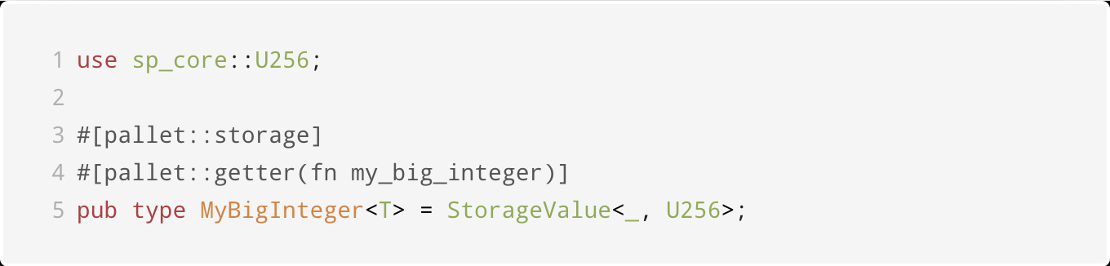
单值类型
大整数 U256,U512 类型定义：
Notes:
HW:
Substrate provides you with everything you need
to run a blockchain out of the box.
A database layer, networking layer, consensus engine, transaction queue, and libraries of runtime modules
But if you need to, you can choose to customize
Each of these components for your specific needs

Slide 12
单值类型
大整数 U256,U512 类型定义：
操作：checked_add,overflowing_mul...
更多API，参考文档
https://crates.parity.io/sp_core/struct.U256.html
Notes:
HW:
Substrate provides you with everything you need
to run a blockchain out of the box.
A database layer, networking layer, consensus engine, transaction queue, and libraries of runtime modules
But if you need to, you can choose to customize
Each of these components for your specific needs

Slide 13
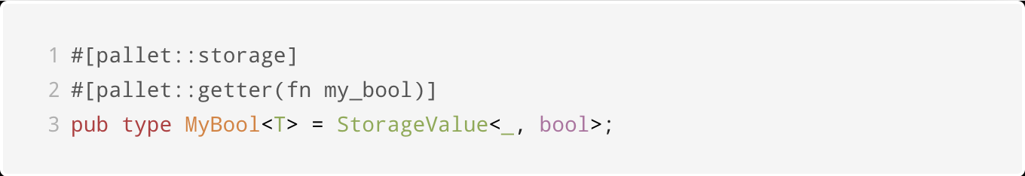
单值类型
bool 类型定义：
If else 逻辑判断
对于 ValueQuery, 默认值为false
Notes:
HW:
Substrate provides you with everything you need
to run a blockchain out of the box.
A database layer, networking layer, consensus engine, transaction queue, and libraries of runtime modules
But if you need to, you can choose to customize
Each of these components for your specific needs

Slide 14

单值类型
BoundedVec<T> 类型定义：
Notes:
HW:
Substrate provides you with everything you need
to run a blockchain out of the box.
A database layer, networking layer, consensus engine, transaction queue, and libraries of runtime modules
But if you need to, you can choose to customize
Each of these components for your specific needs

Slide 15
单值类型
BoundedVec<T> 类型定义：
操作：try_push,remove,iter… https://crates.parity.io/frame_support/storage/bounded_vec/struct.BoundedVec.html
对于 ValueQuery, 默认值为 0x00
Notes:
HW:
Substrate provides you with everything you need
to run a blockchain out of the box.
A database layer, networking layer, consensus engine, transaction queue, and libraries of runtime modules
But if you need to, you can choose to customize
Each of these components for your specific needs

Slide 16
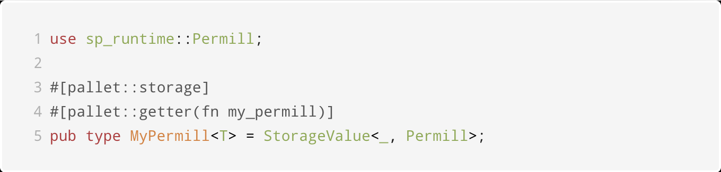
单值类型
Percent,Permill,Perbill 类型定义：
Notes:
HW:
Substrate provides you with everything you need
to run a blockchain out of the box.
A database layer, networking layer, consensus engine, transaction queue, and libraries of runtime modules
But if you need to, you can choose to customize
Each of these components for your specific needs

Slide 17
单值类型
Percent,Permill,Perbill 类型操作：
构造
Permill::from_percent(value);
Permill::from_parts(value);
Permill::from_rational(p,q);
计算
permill_one.saturating_mul(permill_two);
my_permill * 20000 as u32
API文档 https://crates.parity.io/sp_runtime/struct.Permill.html
Notes:
HW:
Substrate provides you with everything you need
to run a blockchain out of the box.
A database layer, networking layer, consensus engine, transaction queue, and libraries of runtime modules
But if you need to, you can choose to customize
Each of these components for your specific needs

Slide 18
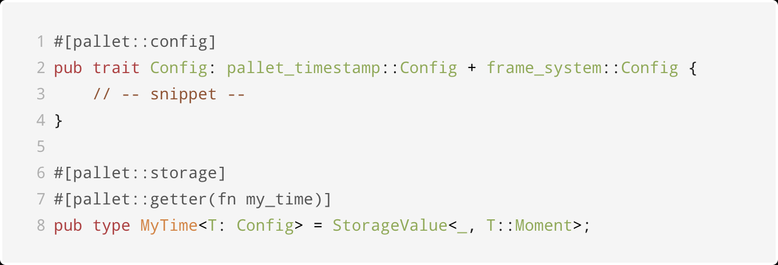
单值类型
Moment 时间类型定义：
Moment 是 u64 的类型别名
获取链上时间：pallet_timestamp::Pallet::<T>::get()
Notes:
HW:
Substrate provides you with everything you need
to run a blockchain out of the box.
A database layer, networking layer, consensus engine, transaction queue, and libraries of runtime modules
But if you need to, you can choose to customize
Each of these components for your specific needs

Slide 19
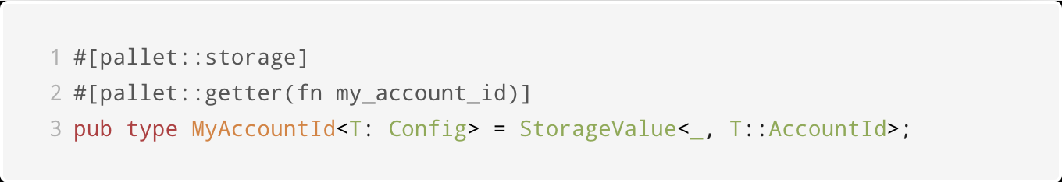
单值类型
AccountId 账户类型定义：
- 定义在 frame_system 中，通常是 Public key
- 获取AccountId: let sender = ensure_signed(origin)?
Notes:
HW:
Substrate provides you with everything you need
to run a blockchain out of the box.
A database layer, networking layer, consensus engine, transaction queue, and libraries of runtime modules
But if you need to, you can choose to customize
Each of these components for your specific needs

Slide 20
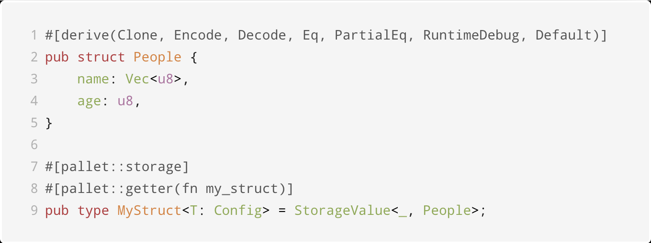
单值类型
struct 类型定义：
Notes:
HW:
Substrate provides you with everything you need
to run a blockchain out of the box.
A database layer, networking layer, consensus engine, transaction queue, and libraries of runtime modules
But if you need to, you can choose to customize
Each of these components for your specific needs

Slide 21
单值类型
enum 类似，还需要实现Default接口
https://github.com/kaichaosun/play-substrate/blob/master/pallets/data-type/src/lib.rs#L97
Notes:
HW:
Substrate provides you with everything you need
to run a blockchain out of the box.
A database layer, networking layer, consensus engine, transaction queue, and libraries of runtime modules
But if you need to, you can choose to customize
Each of these components for your specific needs

Slide 22
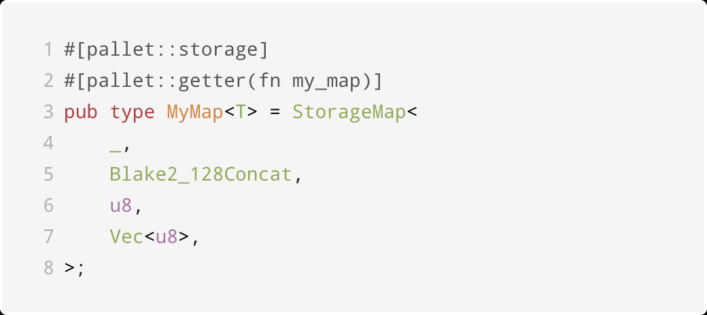
简单映射类型
StorageMap 类型，用来保存键值对，单值类型都可以用作key或者value。
Notes:
HW:
Substrate provides you with everything you need
to run a blockchain out of the box.
A database layer, networking layer, consensus engine, transaction queue, and libraries of runtime modules
But if you need to, you can choose to customize
Each of these components for your specific needs

Slide 23
简单映射类型
StorageMap 类型，用来保存键值对，单值类型都可以用作key或者value。
key的哈希算法：Blake2_128Concat, Twox64Concat, Identity
Notes:
HW:
Substrate provides you with everything you need
to run a blockchain out of the box.
A database layer, networking layer, consensus engine, transaction queue, and libraries of runtime modules
But if you need to, you can choose to customize
Each of these components for your specific needs

Slide 24
简单映射类型
StorageMap 类型，用来保存键值对，单值类型都可以用作key或者value。
插入一个元素：MyMap::<T>::insert(key, value);
通过key获取value：MyMap::<T>::get(key);
删除某个key对应的元素：MyMap::<T>::remove(key);
覆盖或者修改某个key对应的元素
MyMap::<T>::insert(key, new_value);
MyMap::<T>::mutate(key, |old_value| old_value+1);
API 文档：https://crates.parity.io/frame_support/pallet_prelude/struct.StorageMap.html
https://crates.parity.io/frame_support/storage/trait.IterableStorageMap.html
Notes:
HW:
Substrate provides you with everything you need
to run a blockchain out of the box.
A database layer, networking layer, consensus engine, transaction queue, and libraries of runtime modules
But if you need to, you can choose to customize
Each of these components for your specific needs

Slide 25
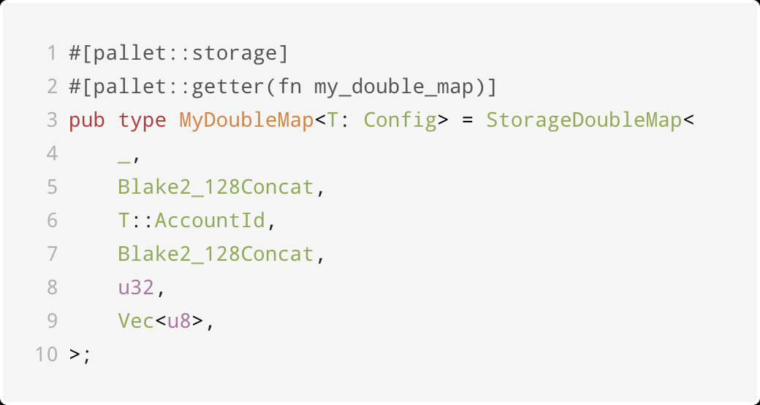
双键映射类型
StorageDoubleMap 类型，使用两个key来索引value，用于快速删除key1对应的任意记录，也可以遍历key1对应的所有记录，定义：
Notes:
HW:
Substrate provides you with everything you need
to run a blockchain out of the box.
A database layer, networking layer, consensus engine, transaction queue, and libraries of runtime modules
But if you need to, you can choose to customize
Each of these components for your specific needs

Slide 26
双键映射类型
StorageDoubleMap 类型，使用两个key来索引value，用于快速删除key1对应的任意记录，也可以遍历key1对应的所有记录，定义：
插入一个元素：MyDoubleMap::<T>::insert(key1, key2, value);
获取某一元素：MyDoubleMap::<T>::get(key1, key2);
删除某一元素：MyDoubleMap::<T>::remove(key1, key2);
删除 key1 对应的所有元素：MyDoubleMap::<T>::remove_prefix(key1, None);
API文档 https://crates.parity.io/frame_support/pallet_prelude/struct.StorageDoubleMap.html
https://crates.parity.io/frame_support/storage/trait.IterableStorageDoubleMap.html
Notes:
HW:
Substrate provides you with everything you need
to run a blockchain out of the box.
A database layer, networking layer, consensus engine, transaction queue, and libraries of runtime modules
But if you need to, you can choose to customize
Each of these components for your specific needs

Slide 27
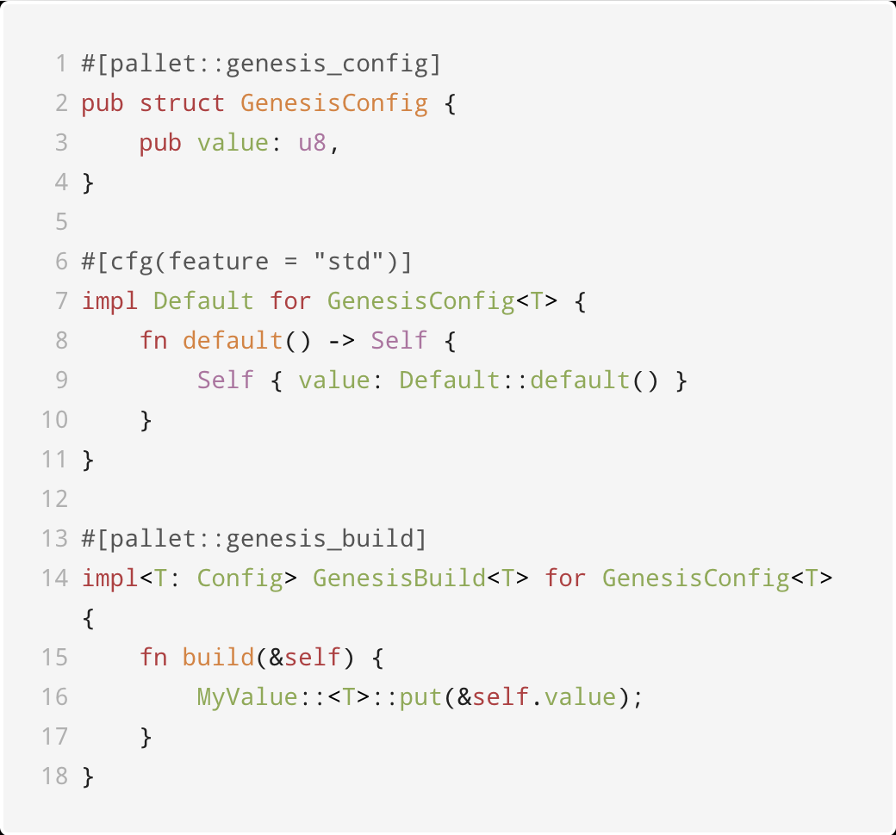
存储的初始化
创世区块的数据初始化：
Notes:
HW:
Substrate provides you with everything you need
to run a blockchain out of the box.
A database layer, networking layer, consensus engine, transaction queue, and libraries of runtime modules
But if you need to, you can choose to customize
Each of these components for your specific needs

Slide 28
存储的初始化
演示:
https://github.com/paritytech/substrate/blob/master/frame/sudo/src/lib.rs
Notes:
HW:
Substrate provides you with everything you need
to run a blockchain out of the box.
A database layer, networking layer, consensus engine, transaction queue, and libraries of runtime modules
But if you need to, you can choose to customize
Each of these components for your specific needs

Slide 29
最佳实践
最小化链上存储
哈希值
设置列表容量
Verify First, Write Last
事务管理：Transactional macro
Notes:
HW:
Substrate provides you with everything you need
to run a blockchain out of the box.
A database layer, networking layer, consensus engine, transaction queue, and libraries of runtime modules
But if you need to, you can choose to customize
Each of these components for your specific needs

Slide 30
其它Tips
可以通过pub关键字设置存储单元的可见范围
ValueQuery 设置默认值，如:
https://github.com/kaichaosun/play-substrate/blob/master/pallets/data-type/src/lib.rs#L42
在frame目录下查找对应的最新用法
pallet::storage 宏的说明文档
Notes:
HW:
Substrate provides you with everything you need
to run a blockchain out of the box.
A database layer, networking layer, consensus engine, transaction queue, and libraries of runtime modules
But if you need to, you can choose to customize
Each of these components for your specific needs

Slide 31
Questions?
官网文档：substrate.io 知乎专栏：parity.link/zhihu
kaichao@parity.io
https://parity.link/asia-support

