Slide 1
Substrate 区块链开发入门
孙凯超
kaichao@parity.io
获取帮助: https://substrate.io
课前导读

Slide 2
内容
课程介绍
讲师介绍
课前准备

Slide 3
课程介绍
由Parity和一块链习社区合作，学员将学习区块链和Substrate的基础知识，以及如何编写一个简单的区块链应用：
拥有一定的开发经验，或对编程感兴趣
在校学生、开发者、创业者
Notes:
HW:
Substrate provides you with everything you need
to run a blockchain out of the box.
A database layer, networking layer, consensus engine, transaction queue, and libraries of runtime modules
But if you need to, you can choose to customize
Each of these components for your specific needs

Slide 4
十五分钟创建一个区块链应用。

Slide 5
课程介绍
视频和在线问答的形式
视频一共6节，每节课45分钟
每周两节课，约在一个月内完成
课会有课后作业
Notes:
HW:
Substrate provides you with everything you need
to run a blockchain out of the box.
A database layer, networking layer, consensus engine, transaction queue, and libraries of runtime modules
But if you need to, you can choose to customize
Each of these components for your specific needs

Slide 6
课程介绍
课程目录介绍
Notes:
HW:
Substrate provides you with everything you need
to run a blockchain out of the box.
A database layer, networking layer, consensus engine, transaction queue, and libraries of runtime modules
But if you need to, you can choose to customize
Each of these components for your specific needs

Slide 7

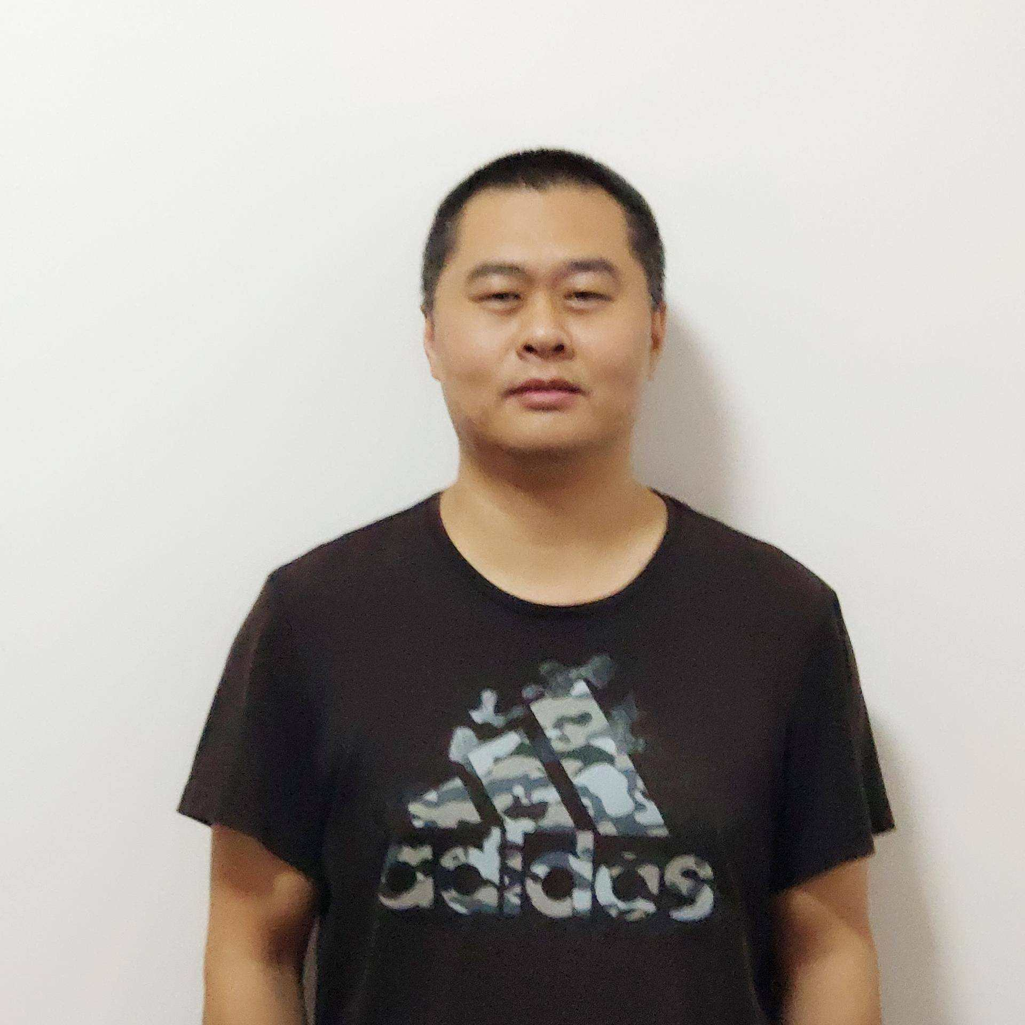

讲师介绍
王大锤
周俊
Kaichao
Notes:
HW:
Substrate provides you with everything you need
to run a blockchain out of the box.
A database layer, networking layer, consensus engine, transaction queue, and libraries of runtime modules
But if you need to, you can choose to customize
Each of these components for your specific needs

Slide 8
课前准备 - 资料
在空闲的时候，
浏览 Substrate 官方文档
学习 Rust 官方网站和官方的书籍
博客文章 如何学习Substrate
必看资料!!
Notes:
HW:
Substrate provides you with everything you need
to run a blockchain out of the box.
A database layer, networking layer, consensus engine, transaction queue, and libraries of runtime modules
But if you need to, you can choose to customize
Each of these components for your specific needs

Slide 9
Questions?
官网文档：substrate.io 知乎专栏：parity.link/zhihu
Email: kaichao@parity.io
Twitter /微信: kaichaosun

