Slide 1

Plan AI
Final Presentation
Team 1
Ashley Kamper, Sophie Kiani, Preston Reuter, Lucas Johnson

Slide 2

Executive Summary
Plan AI is a web application that focuses on statistical analysis and uses AI-based recommendations to enhance the user’s productivity. It provides users with an intuitive platform to create, manage, and track their tasks while also receiving personal insights and recommendations to improve their daily efficiency.

Slide 3
Overview
Access our web application through the Plan AI url http://localhost/To-DoListWebsite/login.php.
The user will use their Google login credentials.
They can then add, edit, complete, and delete tasks as needed.
Tasks are shown in a list view in order from earliest to latest. They can also see their tasks in a calendar view by clicking the “view calendar” button.
The user can also interact with Google Gemini, ask for suggestions and enhance their overall experience.

Slide 4
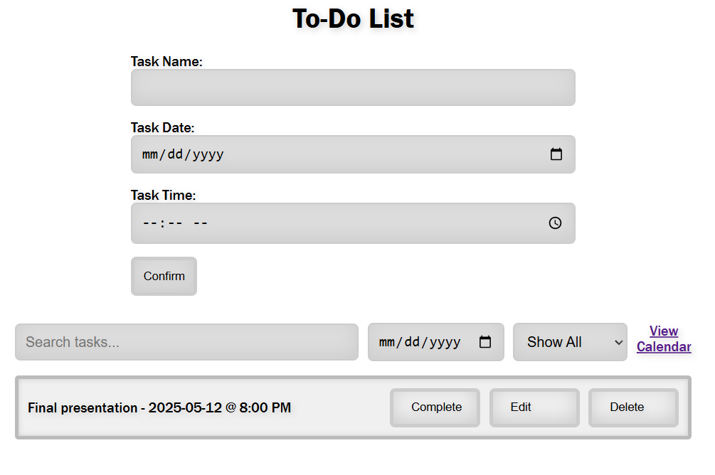
User Interaction
Plan AI is easy to access.
The only required hardware/software is access to internet and a device to access a web browser
As the user adds tasks, they are saved in the Dbeaver database.

Slide 5
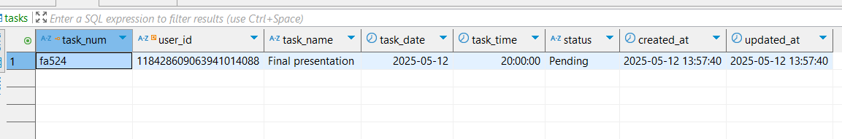
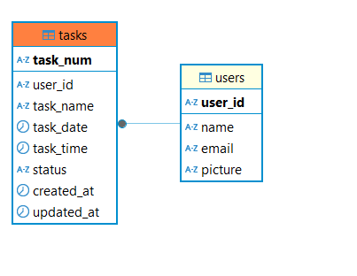
Database
We used Dbeaver as our backend
As a task is entered, it is saved to that specific user’s ID in the task table
This allows for organization and for each user to only see their information when they log in

Slide 6

Technology Used
XAMPP
VS Code
Apache
HTML
DBeaver
PHP
CSS
Google Login API
Google Gemini API
Full Calendar

Slide 7

Live Demonstration
Team 1 Final Presentation

