Slide 1
PlanAI
Team 1 Phase 2
Ashley Kamper, Sophie Kiani, Preston Reuter, Lucas Johnson

Slide 2

PlanAI
When life gets busy, PlanAI is here to help you get and stay organized.

Slide 3
Overview
Home page with user login, logout / account creation
User is directed to personal account
Tasks can be added, viewed, completed, and deleted

Slide 4
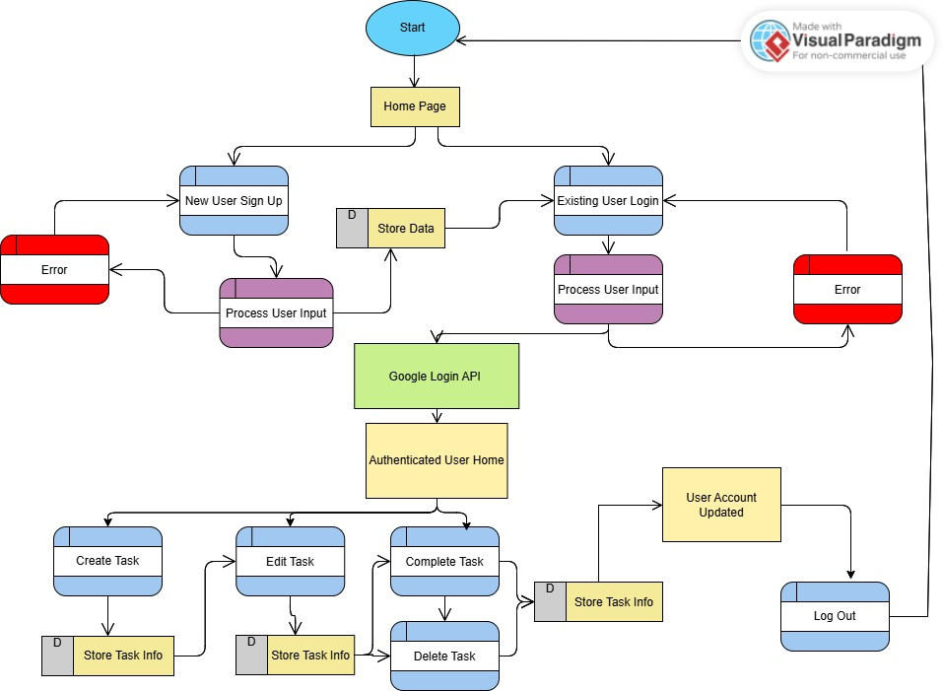
Frontend System Architecture

Slide 5
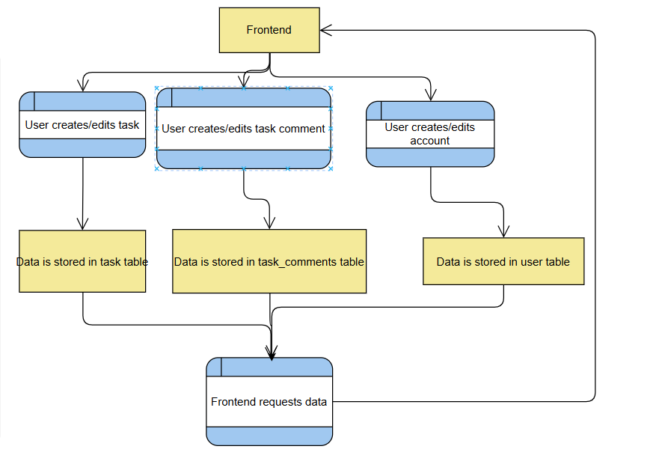
Backend Dataflow

Slide 6
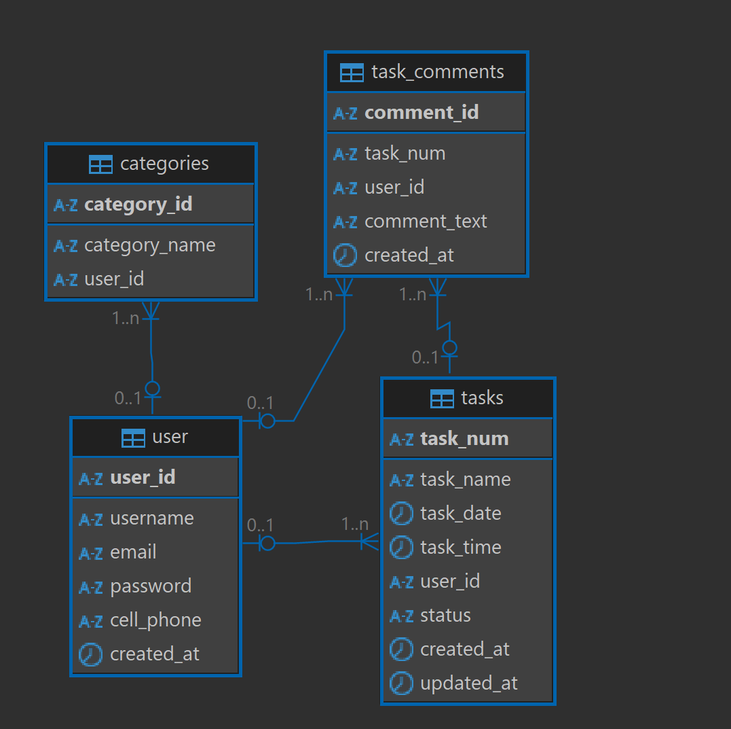
Database Tables

Slide 7
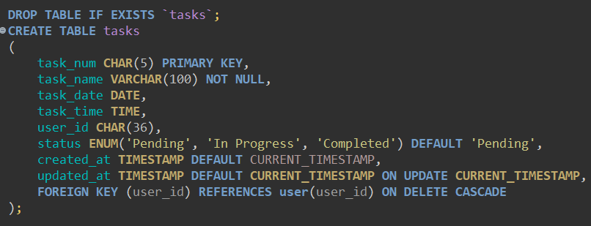
Example MySQL Code

Slide 8
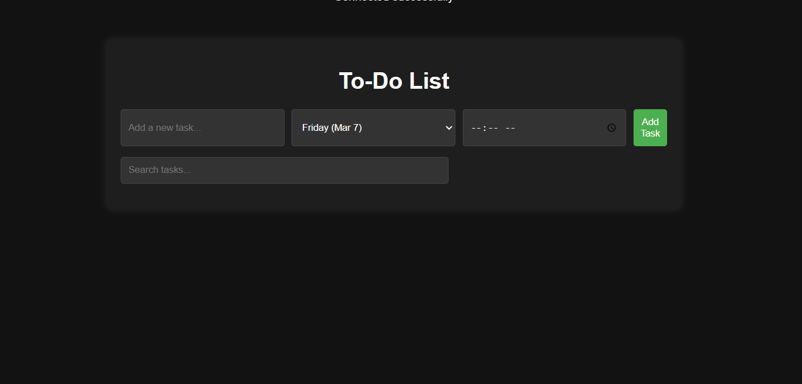
Our Web Application/GUI

Slide 9
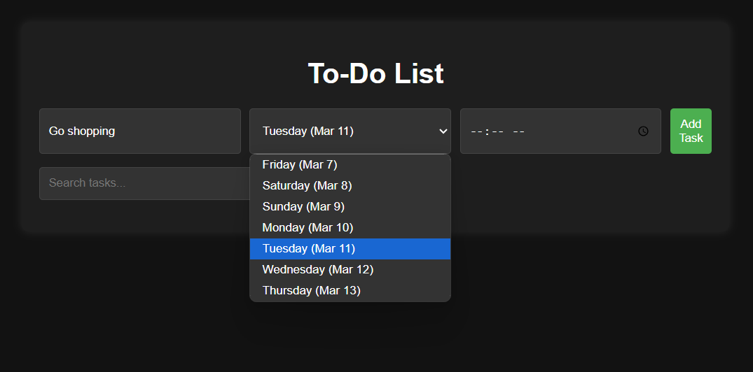

Slide 10
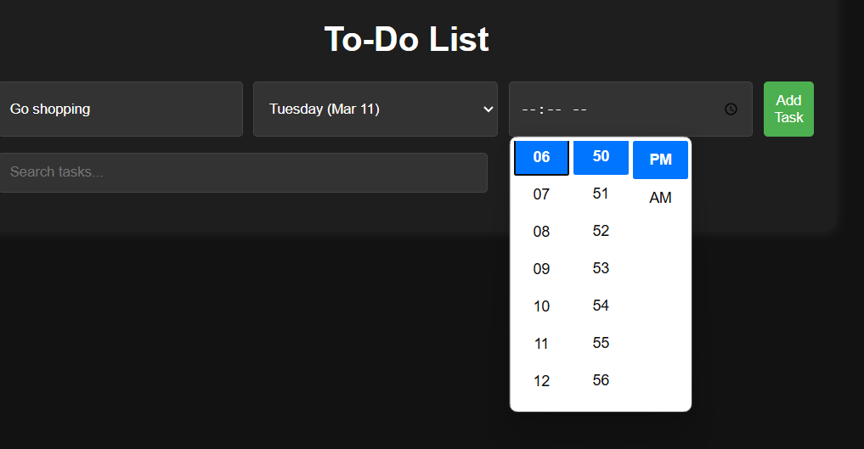

Slide 11
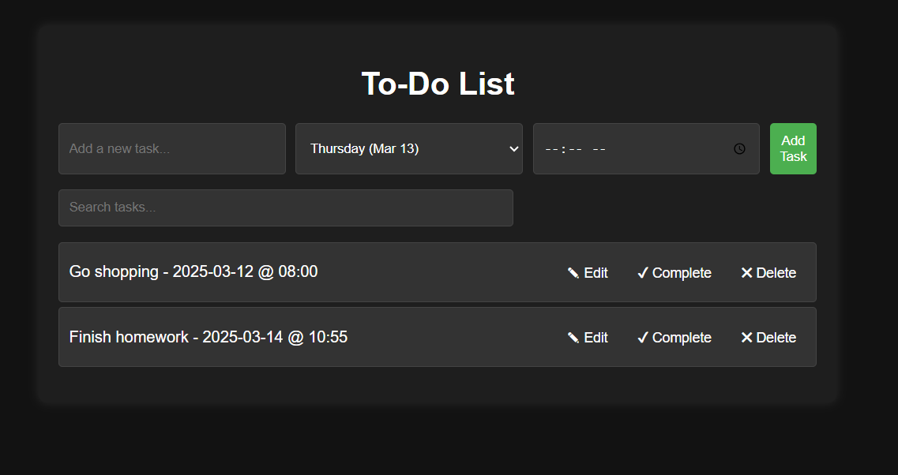

Slide 12

Technology
Front End
Visual Studio Code
HTML
CSS
JavaScript
Google Login API

Slide 13
Technology
Back End
XAMPP
PHP
DBeaver
MySQL

Slide 14

THANK YOU

