Slide 1
PlanAI
Team 1 Phase 2
Ashley Kamper, Sophie Kiani, Preston Reuter, Lucas Johnson

Slide 2

PlanAI
When life gets busy, PlanAI is here to help you get and stay organized.

Slide 3
Overview
Home page with user login, logout / account creation
User is directed to personal account
Tasks can be added, viewed, completed, and deleted

Slide 4
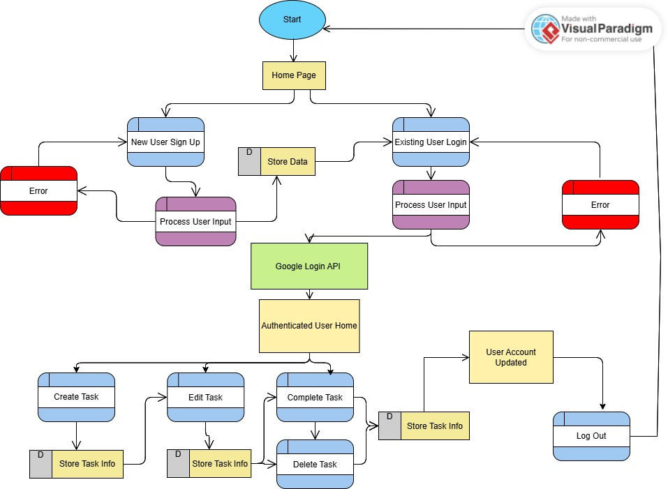
Frontend System Architecture

Slide 5
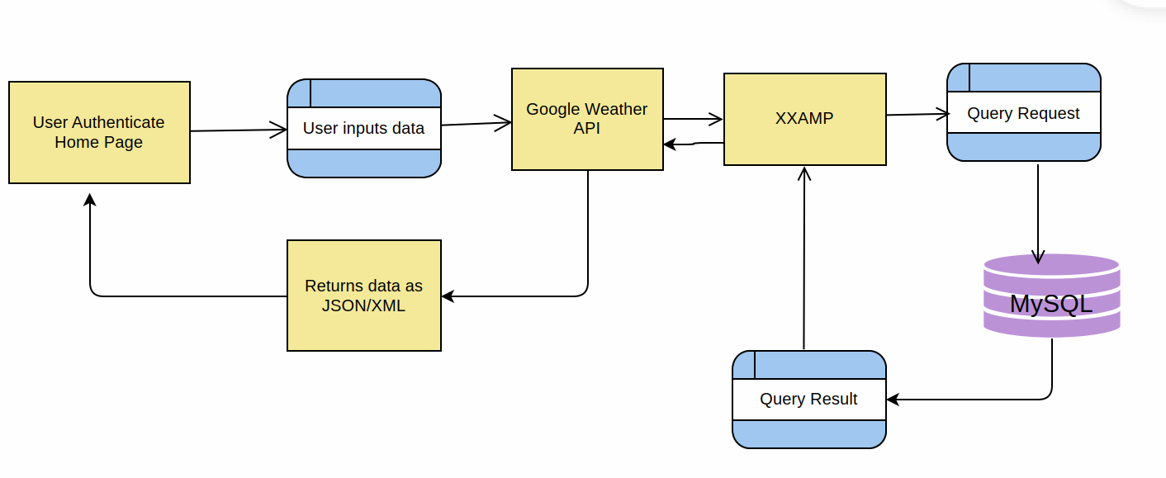
Backend Dataflow

Slide 6
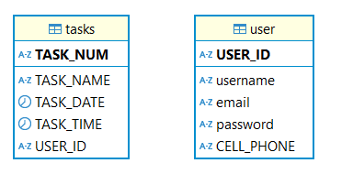
Queries

Slide 7
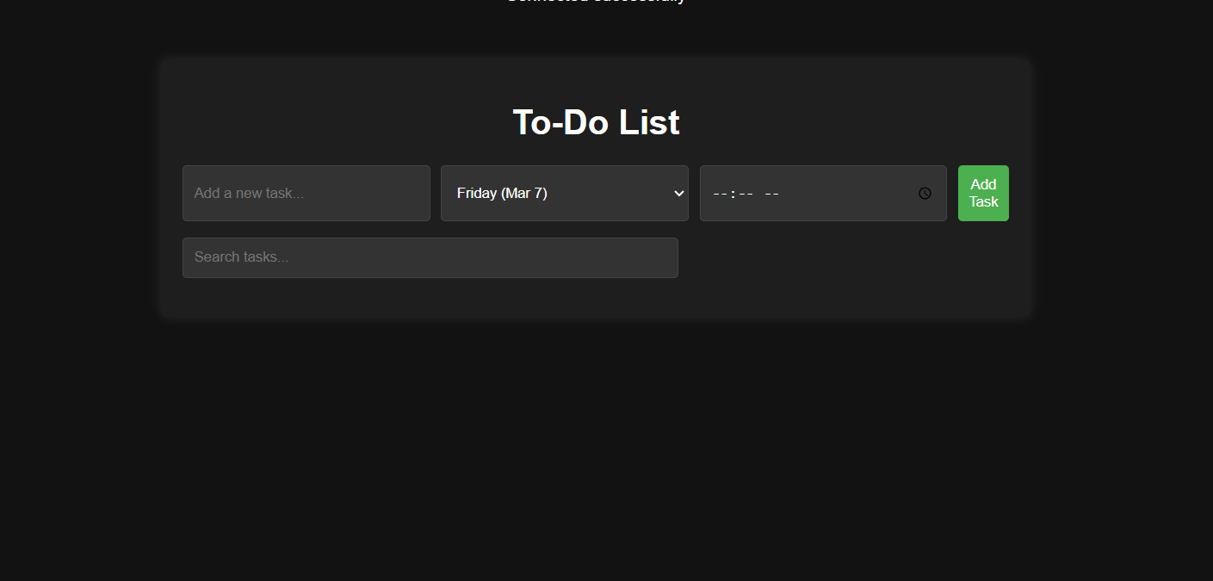
Our Web Application/GUI

Slide 8
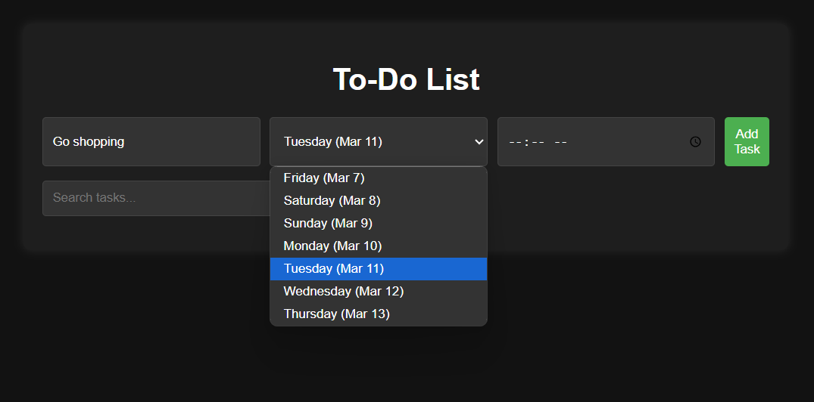

Slide 9
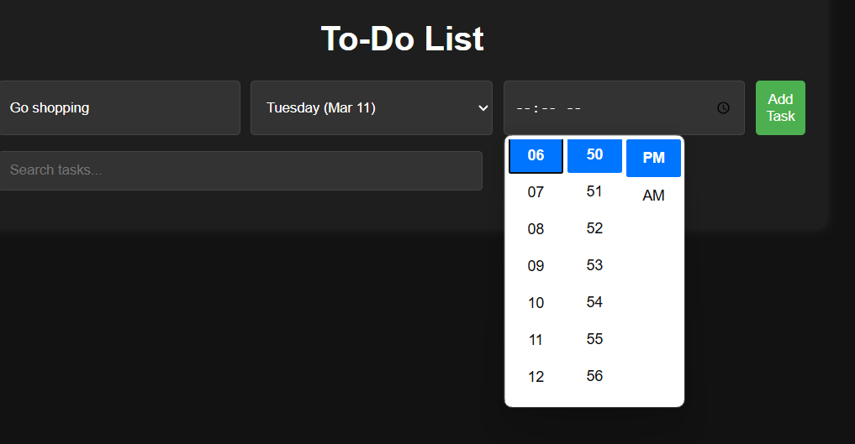

Slide 10
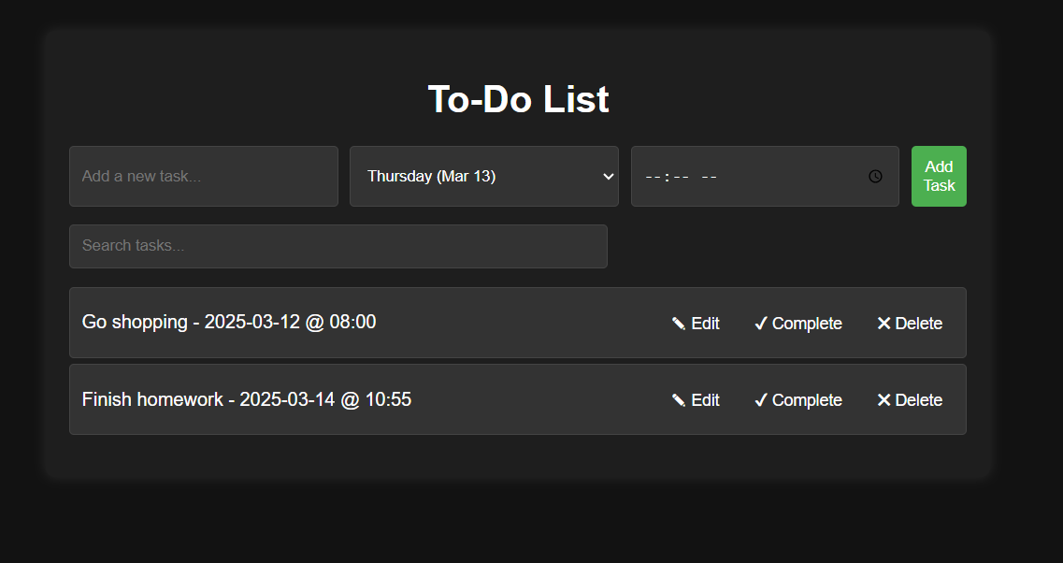

Slide 11

Technology
XAMPP
VS Code
HTML
Javascript
MySQL/DBeaver
Researching the Google Login API

Slide 12

THANK YOU

