Slide 1
Retro Gecko – About Us
Ashley Cheema – Group Leader/Programmer
Ian Hudson - Programmer
Jamie Laurence – Design/Programmer
Lysander Foster - Designer
Jess Barrett - Designer
James Barrett – Designer/Programmer

Slide 2

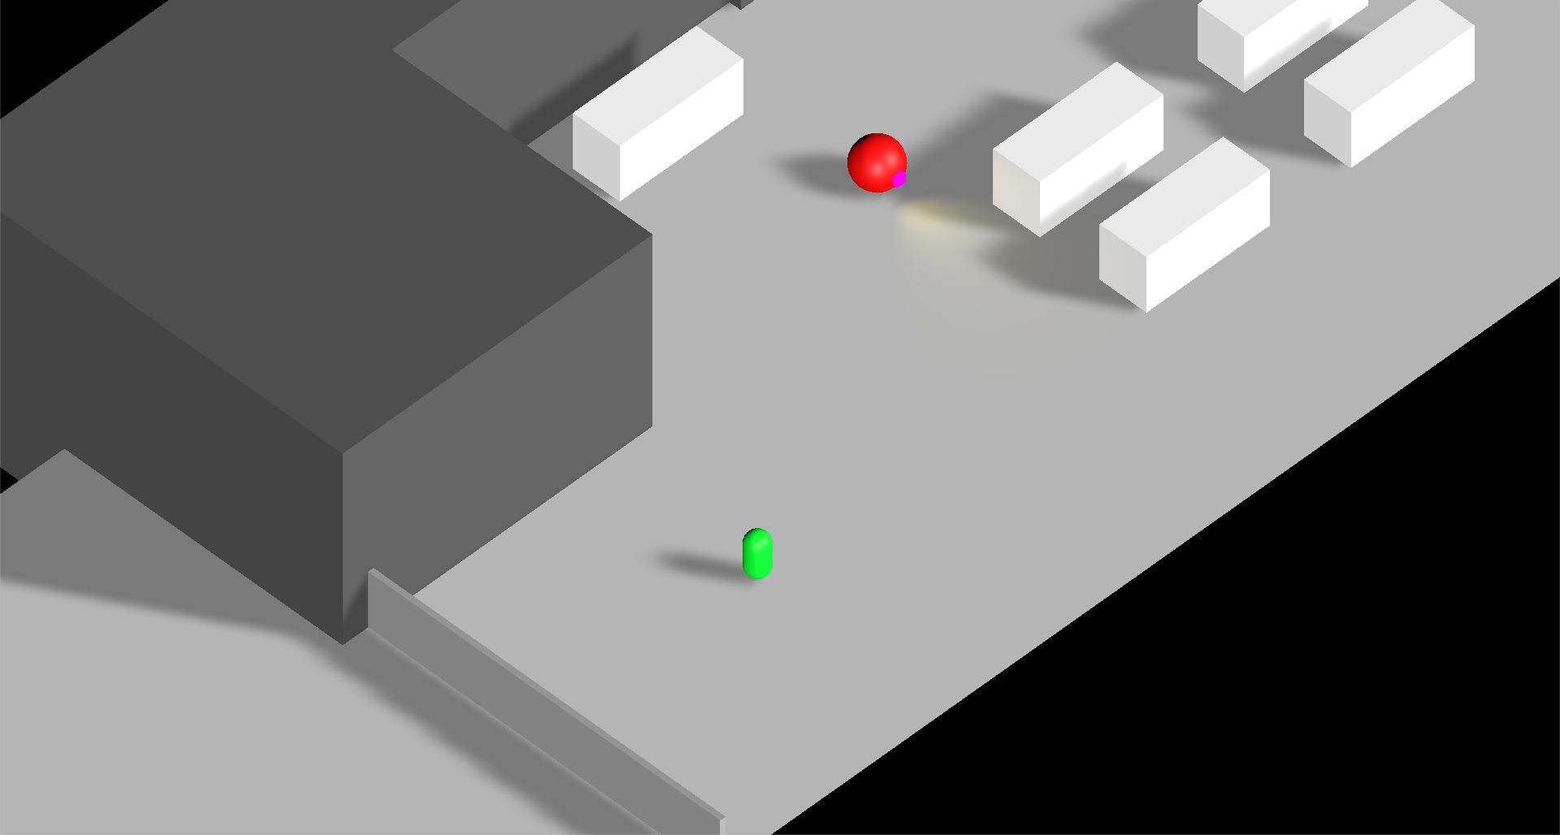
About Our Game ‘Project Stealth’
Stealth Game
Isometric
Platform: PC
Hacking Minigame
Robots
Futuristic

Slide 3
Concept Art

Slide 4
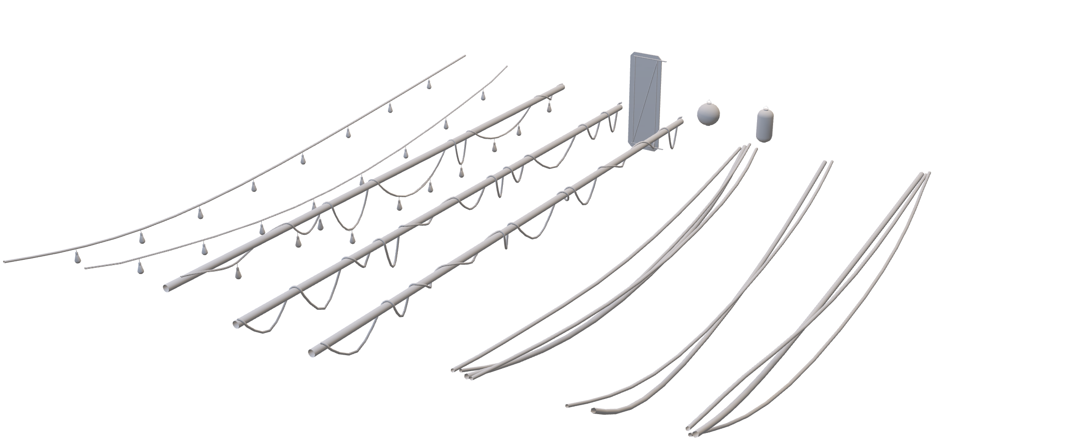
Art Assets

Slide 5
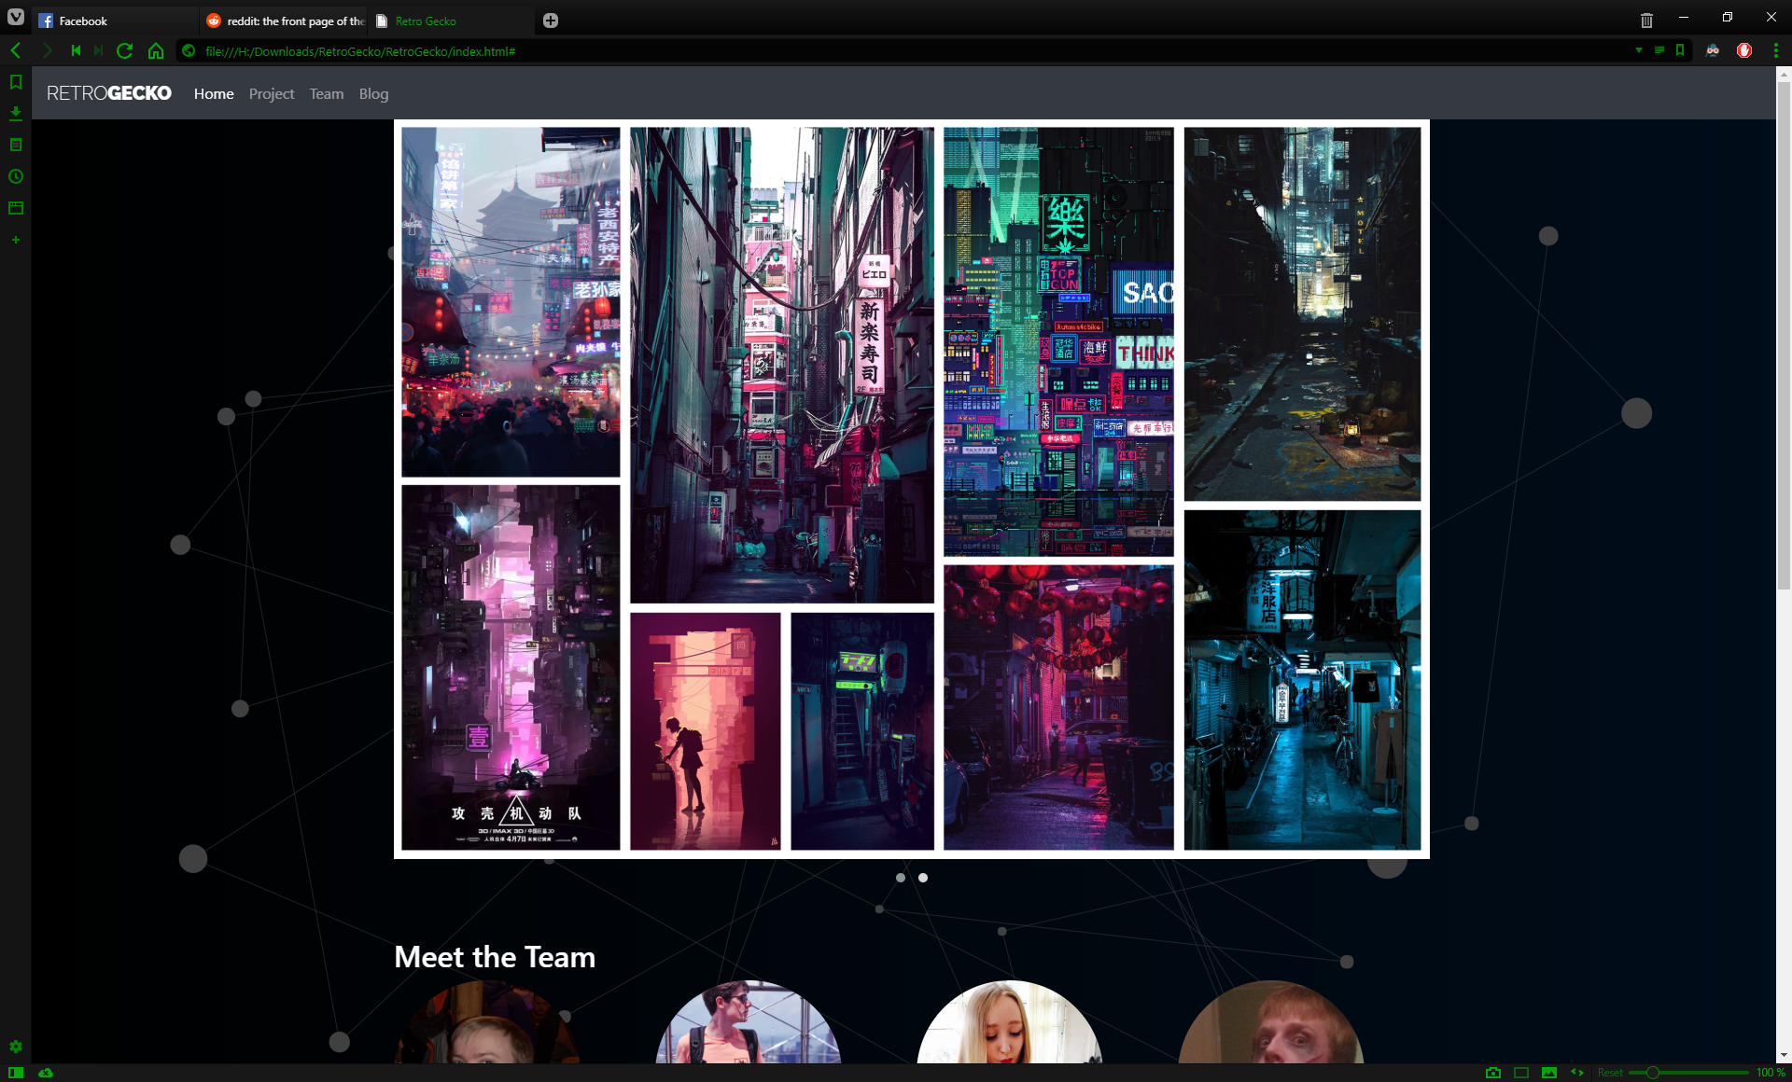
Website

