Slide 1

Target: Customer Segmentation & Shelf Space Optimization
April 27, 2026
UT Austin MSBA Students:
[Names Redacted]

Slide 2







Agenda
Why Shelf Space Matters?
Business Value & Objectives
Data Assets Structure & Breakdown
Our Approach
Operational Execution
Next Steps & Recommendations

Slide 3
Why Shelf Space Strategy Matters?
A single planogram for ~2,000 stores leaves significant revenue on the table
Space Misalignment
Over/under allocation vs. Actual demand
Lost revenue at store level
Silo Management
Categories managed independently
Miss cross-item (halo/cannibalization) effects
No Scalability
One-size-fits-all planogram
Does not adapt across ~2,000 stores

Slide 4





Business Value
Business Outcomes
Maximize store efficiencies
Better customer satisfaction
Increase Revenue & Reduce Costs
Our Analytical Approach
Clustering Stores
by Demographics
Isolated Key Attributes
by Stores
Optimizing Shelf Space
by Brand and Items

Slide 5



Objectives
What Drives Demand?
How Do Drivers Interact?
Where is Space Misaligned?
Identify which store attributes influence demand across item groups and categories.
Assess whether demand is driven by single factors or combinations and how this varies across stores.
Pinpoint where current shelf allocation over or under indexes relative to actual sales share by brand and item type.
How do we test and measure impact?
How do we scale decisions across stores?
Define pilot plans, success metrics, and guardrails before full rollout.
Group stores into 6 to 7 segments and assign clear, repeatable space strategies.

Slide 6
Data Assets & Structure
2024 Revenue by Category
Baby Care
Health & Immune
Meal Essentials
[Redacted]
[Redacted]
[Redacted]
Top Brands in Item Type Disposable Diapers
Top 5 Item Types in Baby Care
Brands | Sales
[Brand A] | [Redacted]
[Brand B] | [Redacted]
[Brand C] | [Redacted]
[Brand D] | [Redacted]
[Brand E] | [Redacted]
Item Type | Sales
Disposable Diapers | [Redacted]
Formula | [Redacted]
Baby Wipes | [Redacted]
Disposable Training Pants | [Redacted]
Baby Snacks | [Redacted]

Slide 7
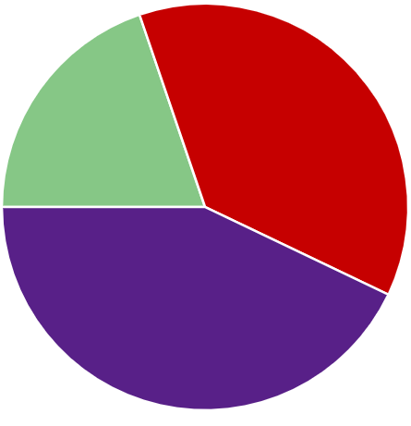
Breakdown/Analytical Framework
LASSO Regression: Feature Selection for relevant attributes for Baby Care
K Means Clustering: Customer Segmentation dividing into 6 individual clusters by relevant attributes
Misalignment & Halo/Cannibalization (ElasticNet): Optimal Shelf Space Metric used per brand x Item Type
Optimization (Gurobi): Utilizing metrics to make optimize shelf space
Meal Essentials
Baby Care
Health Immune

Slide 8

Key Store Attributes Driving Demand
How clusters were created and geographic location elbowchart and us map chart
Lasso – Hiram
K means
Original Features
Feature Expansion
LASSO Regression
70 Census
1 Curbside
1 Facings
1 Format
2 Brand/Item Type
1 Climate
8 Competitor Distance
3 Amex/Snap/Curbside %
70 Census
min $\sum_{i=1}^{n}{{\left(y_{i}−β_{0}−\sum_{j=1}^{p}{β_{j}{∗x}_{ij}}\right)}^{2}+λ}\sum_{j=1}^{p}{\left|β_{j}\right|}$
1 Curbside
% of Store Sales = β₀ + β₁ × Feature₁ + … + β_{n} × Feature_{n}
1 Facings
R² = 0.861
Surviving Features
Do we include the logic/process behind creating this clusters here? If so, do we include this before or after showing what Cluster 1 is?
5 Format
95 Brands
41 Item Types
1 Facings
3 Census
304 Brands/Item Types
1 Climate
8 Competitor Distance
Is demand driven by products or store attributes?
3 Amex/Snap/Curbside %
Elastic Net
K-Means Clustering
393 Total Features

Slide 9
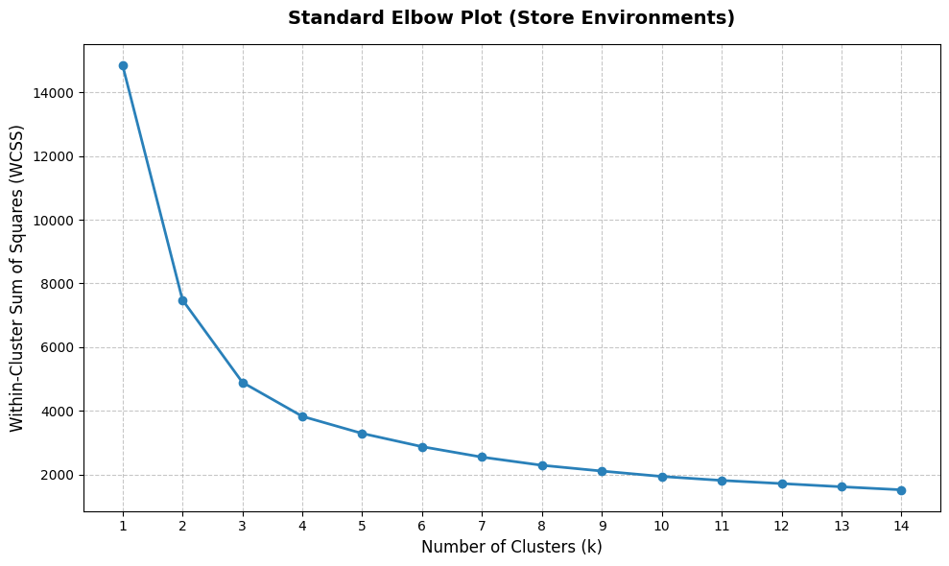
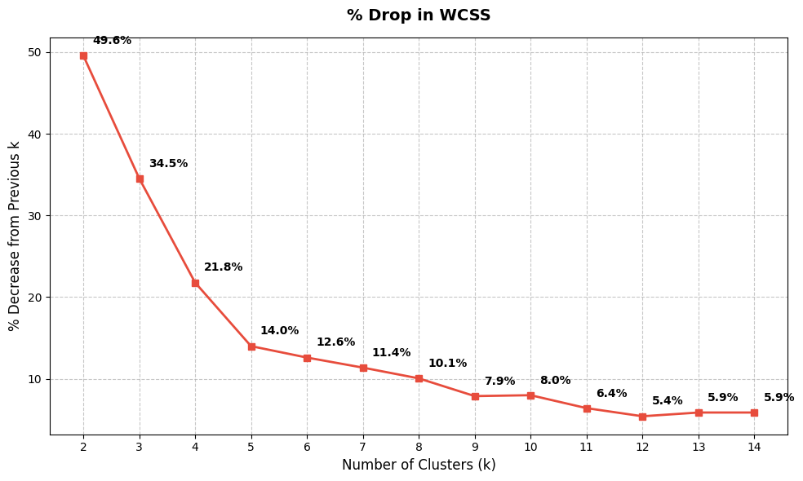

Key Store Attributes Driving Demand
K-Means Clustering
3 Census
Deduplication + Scaling
$$WCSS=\sum_{i=1}^{k}{\sum_{x_{i}εC_{j}}{{\left\|x_{i}−μ_{j}\right\|}^{2}}}$$
Cluster_ID | 1 | 2 | 3 | 4 | 5 | 6
Store_Count | 710 | 263 | 475 | 47 | 392 | 90
news_informed_tv_i | 103.31 | 95 | 99.98 | 89.85 | 97.23 | 87.67
x_multi_20_plus | 5% | 20% | 9% | 76% | 7% | 36%
somewhat_liberal_index | 88.74 | 132.32 | 114.74 | 161.87 | 99.26 | 164.68
Cluster 1 Profile
Consumes information on average through traditional media
Gen X or older Millennial
High Homeownership
Leans slightly or moderately conservative
Customer
Segmentation

Slide 10
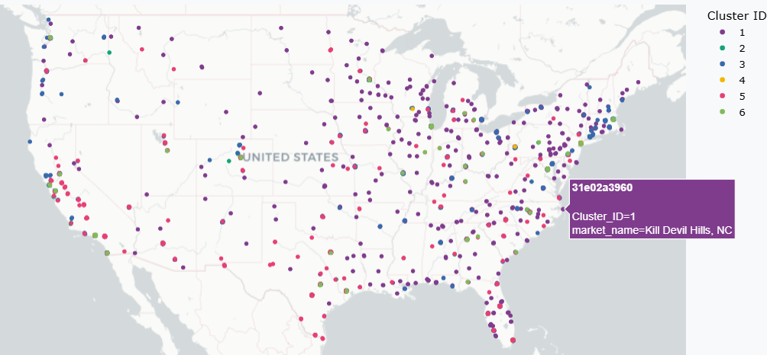
Key Store Attributes Driving Demand

Slide 11
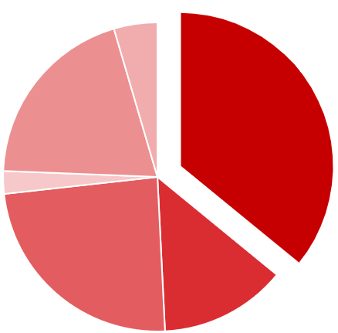
Breakdown/Analytical Framework
Example
Baby Care - Cluster 1
Median HH Income:
[Redacted]
Pop. Density (Sqr. mi):
[Redacted]
Share Age (55+):
[Redacted]
HH with Kids:
[Redacted]
100 = National Average
11

Slide 12
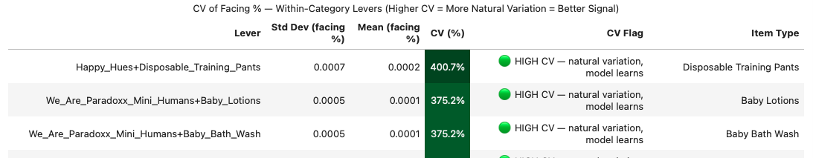
Key Store Attributes Driving Demand
Elastic Net (L1 + L2) Engine
95 Brands + 41 Item Types + Facings
Sparsity Filter (<5% of stores) + Sales Threshold (< 0.1% sales)
$$\text{min}\sum{{\left(y−Xβ\right)}^{2}+λ}[α|β|+ (1−α)β²]$$
DIRECT EFFECT
HALO EFFECT
CANNIBALIZATION
Brand's own facing share
change → its own sales
Growing brand A's space
→ lifts brand B's sales
Growing brand A's space
→ steals sales from B
Reliability Check ↓
1
2
3
4
5
Separate EN per item type
Coefficient of Variance
Beta vs CV
VIF Check
Trust Score
New Sales%(Target Brand) = Current Sales%(Target Brand) + β(Lever→Target) × ΔFacing%(Lever Brand)
[Redacted]
Notes:
~74% of item types have Max VIF < 10
~40% of levers have CV > 30%

Slide 13
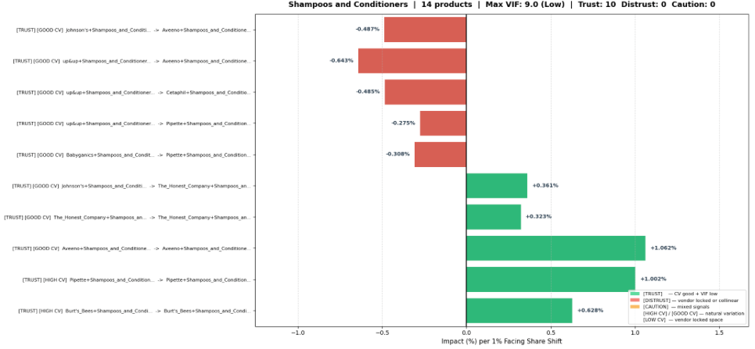
Key Store Attributes Driving Demand
Example
Shampoos and Conditioners:
A 1% facing-share increase is associated with about a xx% sales increase
Self effect or cross-product effect
[Redacted]
Lever | Target | Beta | Interpretation
[Brand C] | [Brand F] | [Redacted] | [Brand C] space steals from [Brand F] (Cannibalization)
[Brand G] | [Brand E] | [Redacted] | [Brand G] space lifts [Brand E] sales (Halo)
[Brand F] | [Brand F] | [Redacted] | Own space → own sales (Direct)
[Redacted]
Notes:
→ Zeroes out irrelevant brands (like LASSO) → Handles correlated brands (like Ridge) → Cross-validated α & λ — no manual tuning → Outputs betas per brand interaction
Within this item type, some products appear to benefit more from added facing share than others.

Slide 14
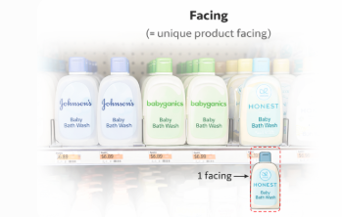
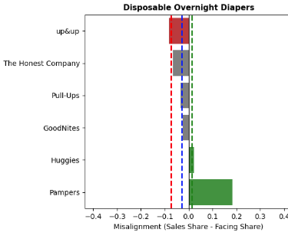
Shelf Space Misalignment
Misalignment = Sales Share – Facing Share
Thresholds = Median ± (k × MAD)
MAD (Median Absolute Deviation) is used instead of standard deviation because it is robust to outliers and better reflects typical variation within each category.
Positive = under spaced (needs more space)
Negative = over spaced (too much space)
[Redacted]
A facing is one visible unit of a product on the shelf
More facings increase visibility, reduce stockouts, and improve conversion directly impacting sales.

Slide 15
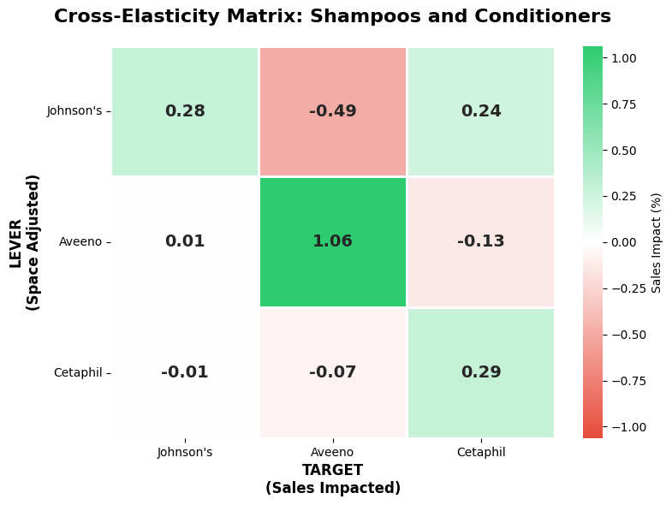
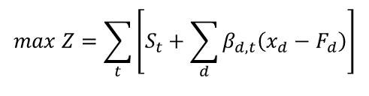
Shelf Space Optimization
Elastic Net Betas
Gurobi
Lever | Target | Beta
[Brand F] | [Brand F] | +1.06%
[Brand G] | [Brand E] | +0.36%
[Brand C] | [Brand F] | −0.64%
Objective Function – Maximize Sales
[Redacted]
$$max Z=\sum_{t}{\left[S_{t}+\sum_{d}{β_{d,t}\left(x_{d}−F_{d}\right)}\right]}$$
Convert into cross-elasticity matrix
New Sales % = Current Sales % + β × (New Facing% − Old Facing%)
Optimized Sales % [Brand F]
= Current Sales % [Brand F]
- [Redacted] x Δ Cetaphil Facing %
+ [Redacted] x Δ [Brand F] Facing %
- [Redacted] x Δ [Brand G] Facing %
+ …
+ β_{n} x Δ Brand_{n} Facing %
Optimized Sales %
= Optimized Sales % [Brand F]
+ Optimized Sales % [Brand G]
+ Optimized Sales % Cetaphil
+ …
+ Optimized Sales % Brand_{n}
[Redacted]
Constraints
Item Type capacity must remain the same
No brand can exceed +/- 3% change in capacity
Facing % cannot drop below 0%

Slide 16
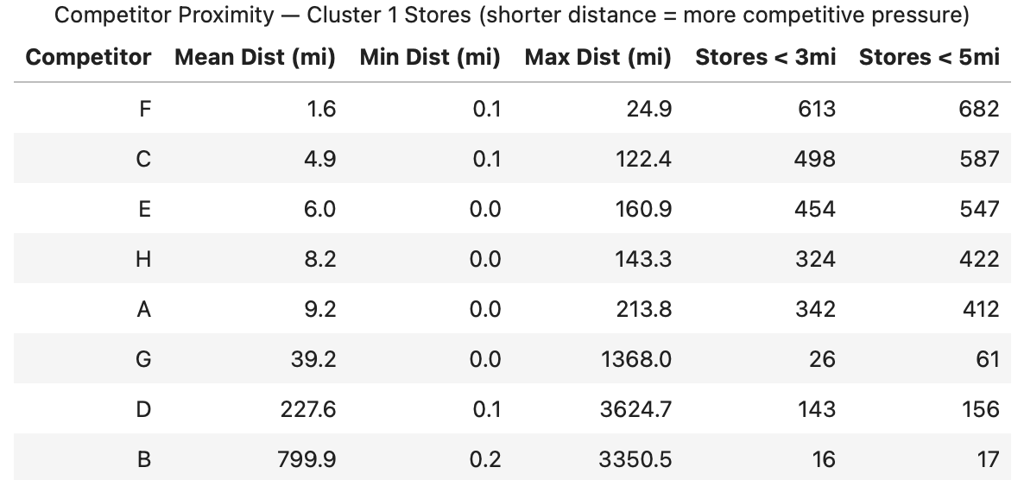
Competitive Signal Analysis
Competitor Distance Data
Apply 8 competitor distance columns to Cleared Item Types only after optimization
Cluster Competition Profile
(710 stores, nearest competitor across all 8)
🔴 HIGH (≤3mi)
691 stores (97%)
🟡 MEDIUM (3–10mi)
16 stores (2%)
🟢 LOW (>10mi)
3 stores (1%)
Pearson Correlation Test
$$\text{r}\text{ = }\text{Σ}\text{[(}\text{Xi}\text{ − }\text{X}\text{̄)(}\text{Yi}\text{ − Ȳ)] / √[}\text{Σ}\text{(}\text{Xi}\text{ − }\text{X}\text{̄)² × }\text{Σ}\text{(}\text{Yi}\text{ − Ȳ)²]}$$
X = competitor_f distance (miles) Y = brand pog_sales $ per store N = 710 stores | threshold: |r|>0.10, p<0.05
✅ r < −0.10, p < 0.05
➖ |r| ≤ 0.10 or p ≥ 0.05
⚠️ r > +0.10, p < 0.05
Sales ↑ when rival is CLOSER
→ Brand beats rival head-to-head
→ Target has competitive strength
No consistent distance pattern
→ Competition not main driver
→ Demographics / price dominates
Sales ↓ when rival is CLOSER
→ Rival takes customers when nearby
→ Cross-shopping risk
→ Caution on shelf expansion

Slide 17
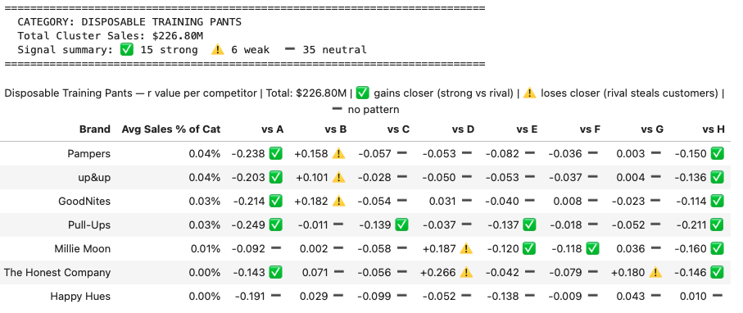
Competitive Signal Analysis
Expand Pearson correlation analysis across all eight competitors (Brand Sales vs. Distance)
[Redacted]
Optimization Action – Final Recommendation Per Brand
🔴 CAUTION — Flag
GROW — Rival Risk
🟡 GROW — Standard
REDUCE — Standard
REDUCE — Rival Risk
🟢 GROW — Confident
GROW — Full Confidence
GROW — Standard
REDUCE — Over-Spaced
Gurobi ↑ but ⚠️ rival steals nearby
Gurobi shift + but ⚠️ signal disagrees
Gurobi ↑ + ➖ no signal
Gurobi ↓ + ➖ no signal
Gurobi ↓ + ⚠️ rival compounds loss
Gurobi ↑ + ✅ beats rival nearby
Gurobi shift + ✅ signal both agree
Gurobi shift + ➖ signal (neutral)
Gurobi ↓ but ✅ brand still strong
› Gurobi increases space
› Gurobi: increase space
› Gurobi increases space
› Gurobi reduces space
› Gurobi reduces space
› Gurobi increases space
› Gurobi: increase space
› Gurobi: increase space
› Gurobi reduces space
› r > +0.10 → rival takes customers
› r > +0.10 → rival steals customers nearby
› No competitive signal
› No competitive factor
› r > +0.10 → rival also hurts brand
› r < −0.10 → strong vs rival
› r < −0.10 → beats rival nearby
› No significant competitive signal
› Brand still beats rival nearby
› → [Brand H], [Brand A]
› → Do NOT execute without review
› → [Brand D], [Brand G]
› → [Brand L], [Brand E]
› VIF ≤ 10 + CV ≥ 10% → beta trusted
› → Do NOT execute without review
› Apply shift — monitor proximity
› → Double pressure — cut space first
› → [Brand A], [Brand I] vs rival A
› → [Brand G], [Brand C]
› → Flag for store-level review

Slide 18

Competitive Signal Analysis
Example
Pearson r: brand sales vs. distance from each competitor · 710 stores · |r| > 0.10, p < 0.05 | ✅ Target stronger when rival closer | ⚠️ Target weaker when rival closer | ➖ no pattern
⚠️ RIVAL TAKES CUSTOMERS WHEN NEARBY
➖ NEUTRAL
✅ TARGET WINS — Stronger When Rival is Nearby
B
D
G
F
H
A
C
E
Online
(e-comm)
Warehouse
(Costco)
Specialty
(Baby)
Mass Retail
(Walmart)
General
Retail
General
Retail
Drug/Conv
Retail
Grocery
Chain
Assume
800mi
228mi
39mi
1.6mi
8.2mi
9.2mi
4.9mi
6.0mi
[Brand A]
⚠️
➖
➖
➖
➖
✅
➖
➖
Gurobi: +[Redacted]
r = +0.158
r = -0.053
r = +0.003
r = -0.036
r = -0.082
r = -0.238
r = -0.057
r = -0.082
GROW
[Brand B]
⚠️
➖
➖
➖
➖
✅
➖
➖
Gurobi: +[Redacted]
r = +0.101
r = -0.050
r = +0.004
r = -0.037
r = -0.053
r = -0.203
r = -0.028
r = -0.053
GROW
[Brand H]
⚠️
➖
➖
➖
➖
✅
➖
➖
Gurobi: —
r = +0.182
r = +0.031
r = -0.023
r = +0.008
r = -0.040
r = -0.214
r = -0.054
r = -0.040
MONITOR
[Brand I]
➖
➖
➖
➖
✅
✅
✅
✅
Gurobi: +[Redacted]
r = -0.011
r = -0.037
r = -0.052
r = -0.018
r = -0.137
r = -0.249
r = -0.139
r = -0.137
CAUTION
[Brand D]
➖
⚠️
➖
✅
✅
➖
➖
✅
Gurobi: +[Redacted]
r = +0.002
r = +0.187
r = +0.036
r = -0.118
r = -0.120
r = -0.092
r = -0.058
r = -0.120
GROW
[Brand E]
➖
⚠️
⚠️
➖
➖
✅
➖
➖
Gurobi: —
r = +0.071
r = +0.266
r = +0.180
r = -0.079
r = -0.042
r = -0.143
r = -0.056
r = -0.042
GROW
SUMMARY PER COMPETITOR →
3 ⚠️ brands
weaker when B
is nearby
2 ⚠️ brands
weaker when D
is nearby
1 ⚠️ [Brand E]
weaker when G
is nearby
1 ✅ [Brand D]
otherwise
neutral
2 ✅ brands
stronger when
H is nearby
5 ✅ brands
stronger when
A is nearby
1 ✅ [Brand I]
stronger when
C is nearby
2 ✅ brands
stronger when
E is nearby
Source: Pearson r — baby_care_sales_df pog_sales vs competitor_ distance | 710 cluster stores | Disposable Training Pants (VIF ≤ 10, CV ≥ 10%) | [Redacted] total
Notes:
Story: Most brands are STRONGER when local rivals (A, C, E, H) are nearby — Target beats them head-to-head. [Brand D] and [Brand E] sell LESS when warehouse D is nearby — customers switch to Costco/Sam's Club. Walmart (F) is surprisingly neutral — proximity alone does not threaten Training Pants sales. GROW: [Brand E], [Brand D], [Brand H] · CAUTION: [Brand I]

Slide 19
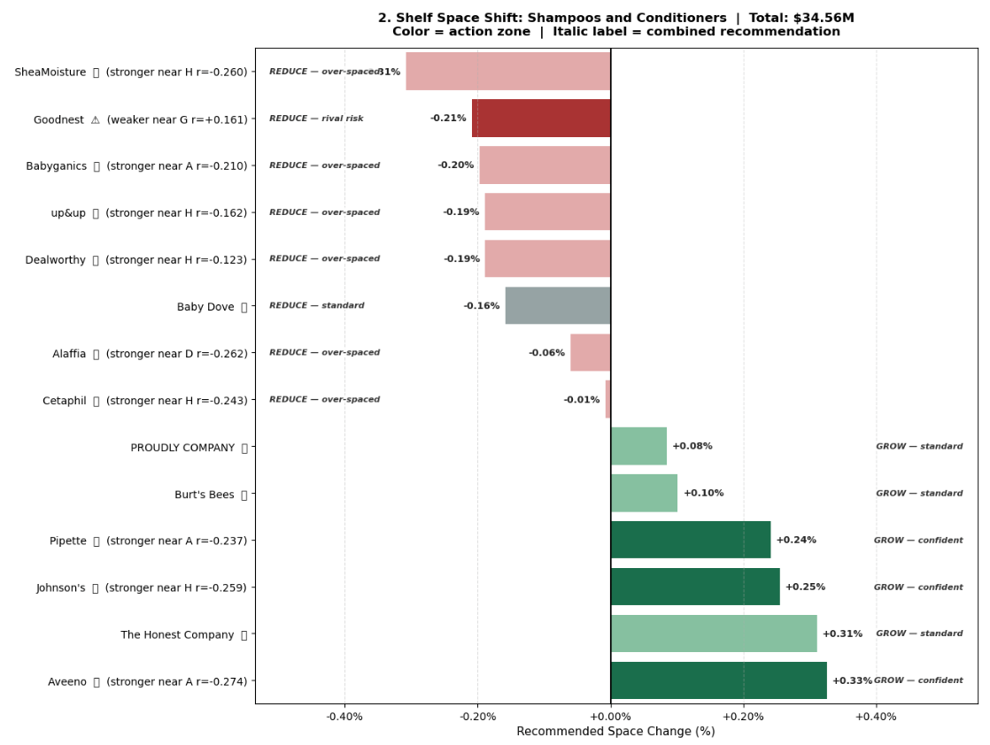
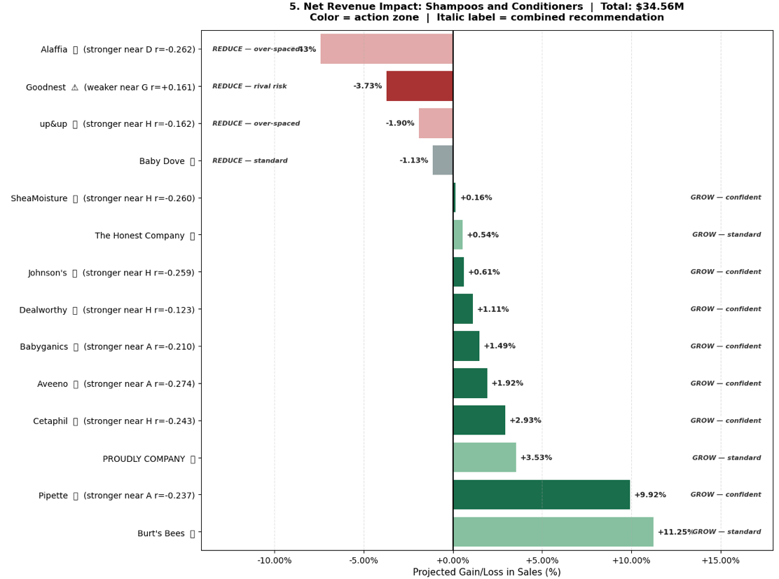


Competitive Signal Analysis
Example
[Redacted]
[Redacted]
[Redacted]
[Redacted]
[Redacted]
Product | Category | Current Space (%) | New Space (%) | Recommended Shift (%) | Sales Growth ($) | Sales Growth (%) | Corr (r) | Competition Signal | Final Action
[Brand F]+Shampoos_ and_Conditioners | Shampoos and Conditioners | [Redacted] | [Redacted] | [Redacted] | [Redacted] | [Redacted] | -0.274 | ✅ stronger near A (r=-0.274) | 🟢 GROW — optimizer + beats rival nearby
[Brand J]+Shampoos_and_Conditioners | Shampoos and Conditioners | [Redacted] | [Redacted] | [Redacted] | [Redacted] | [Redacted] | -0.210 | ✅ stronger near A (r=-0.210) | 🟡 CAUTIOUS — optimizer says cut but brand still strong vs rival
[Brand K]+Shampoos_and_Conditioners | Shampoos and Conditioners | [Redacted] | [Redacted] | [Redacted] | [Redacted] | [Redacted] | +0.161 | ⚠️ weaker near G (r=+0.161) | 🔴 REDUCE — optimizer + rival compounds the loss
Notes:
the model already thinks this item should get less shelf space, and the competitive signal says a nearby rival is already making things worse. So “compound” here just means the downside stacks up.

Slide 20
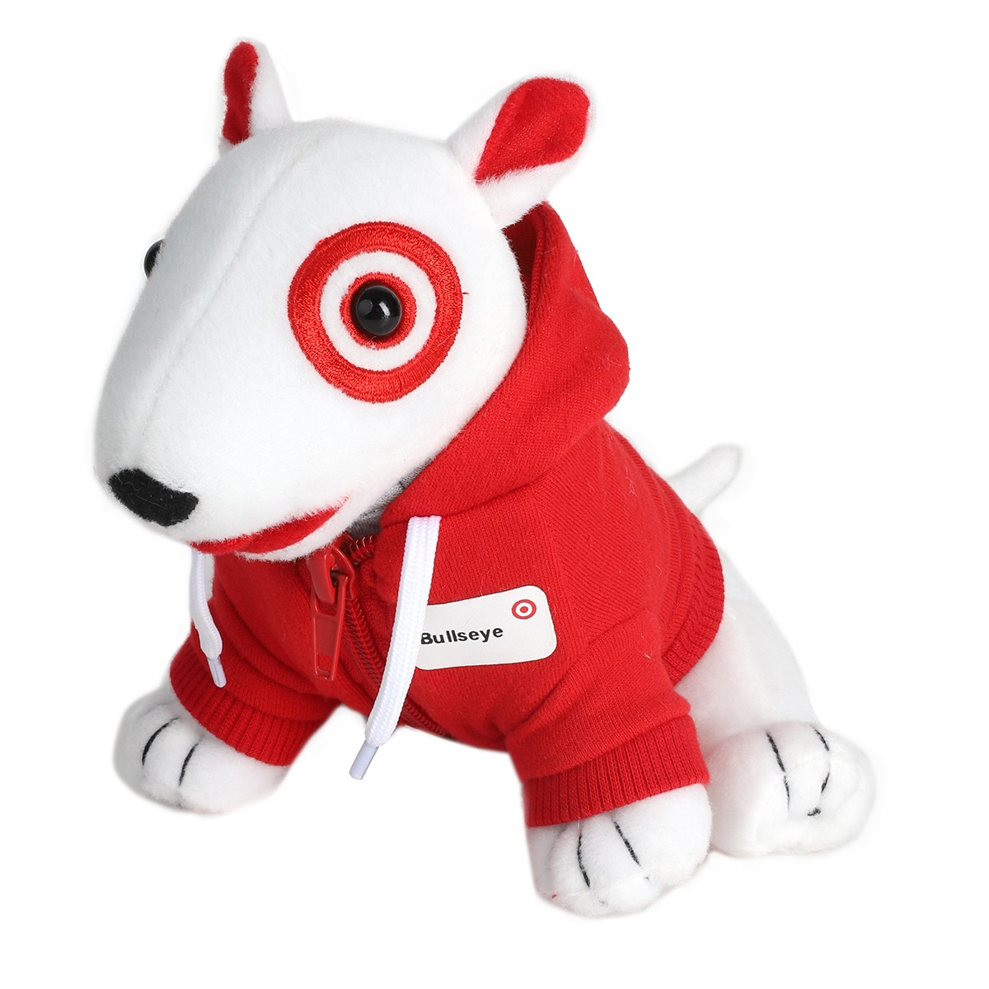
Questions

