Slide 1
MARCUS
Multimodal Autonomous Reasoning and Chat for Ultrasound and Signals
O'Sullivan JW*, Asadi M*, Elbe L, Chaudhari A, Nedaee T, Haddad F, Salerno M, Fei-Fei L, Adeli E, Arnaout R, Ashley EA
STANFORD UNIVERSITY | UCSF

Slide 2
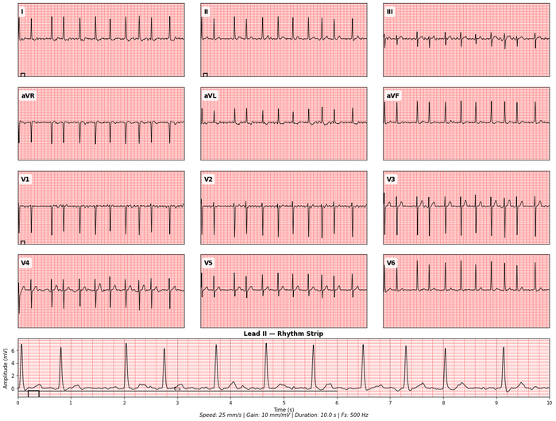
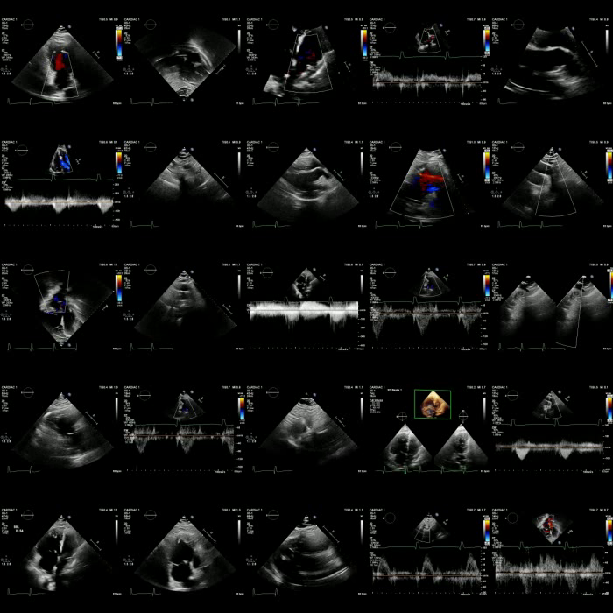
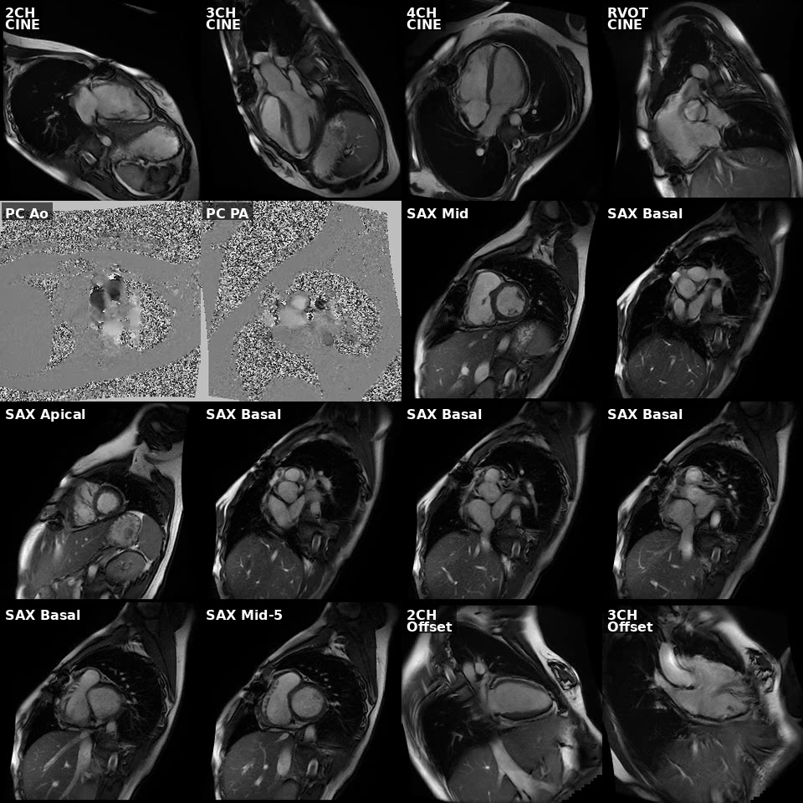
THREE MODALITIES, ONE PATIENT
ECG
Echo
CMR
12-lead Electrocardiogram
Echocardiogram
Cardiac MRI

Slide 3
TRAINING AT SCALE
13.5M
270K
3
Images
Clinical Studies
Expert Models
Physician-verified ground truth across ECG, echocardiography, and cardiac MRI. Group-relative policy optimization (GRPO) and supervised fine-tuning (SFT).

Slide 4
AGENTIC ARCHITECTURE
ECG Expert
Patient Data
Mirage Probe
Orchestrator & Synthesis
Echo Expert
CMR Expert
Input
Specialized Experts
Hallucination Guard
Unified Report

Slide 5
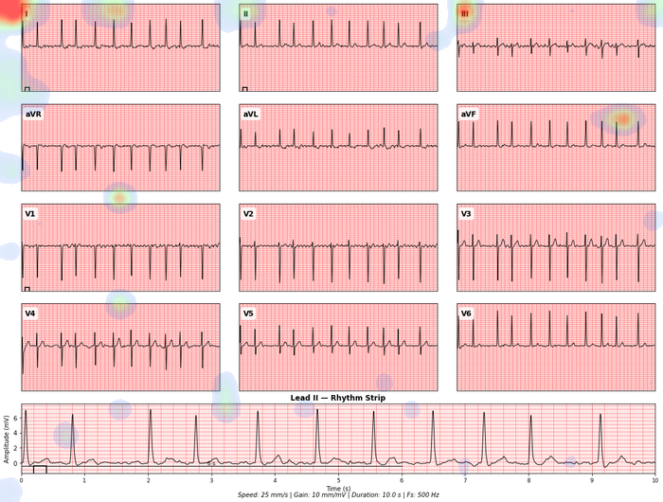
EXPERT ANALYSIS WITH ATTENTION
Input: 12-lead ECG
Attention Map: Where the model looks

Slide 6
MIRAGE DETECTION
Do vision-language models actually see, or just fabricate?
WITH IMAGE
WITHOUT IMAGE (COUNTERFACTUAL)
Original question → Consistent, specific response
Same question → Generic, vague response
Rephrase 1 → Consistent, specific response
Compare responses
Rephrase 2 → Consistent, specific response
High divergence = Grounded analysis (no mirage) MARCUS: 0% mirage rate vs GPT-4o: 38% vs Gemini: 35%

Slide 7
MULTIMODAL ORCHESTRATION
ECG
Echo
CMR
Atrial fibrillation with rapid ventricular response
Reduced LV function EF 35%, moderate mitral regurgitation
Late gadolinium enhancement in inferolateral wall
Synthesized Report "The patient presents with atrial fibrillation, reduced left ventricular function (EF 35%), and evidence of prior myocardial infarction on CMR. These findings together suggest ischemic cardiomyopathy."

Slide 8
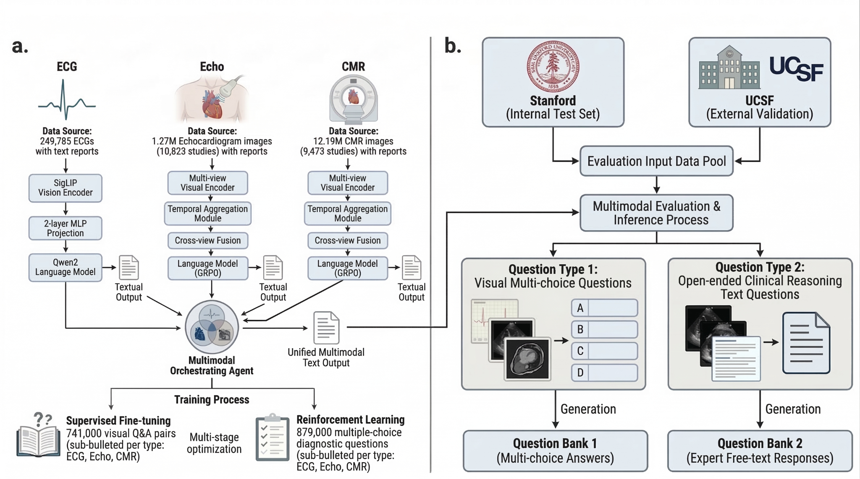
ARCHITECTURE AND TRAINING PIPELINE

Slide 9
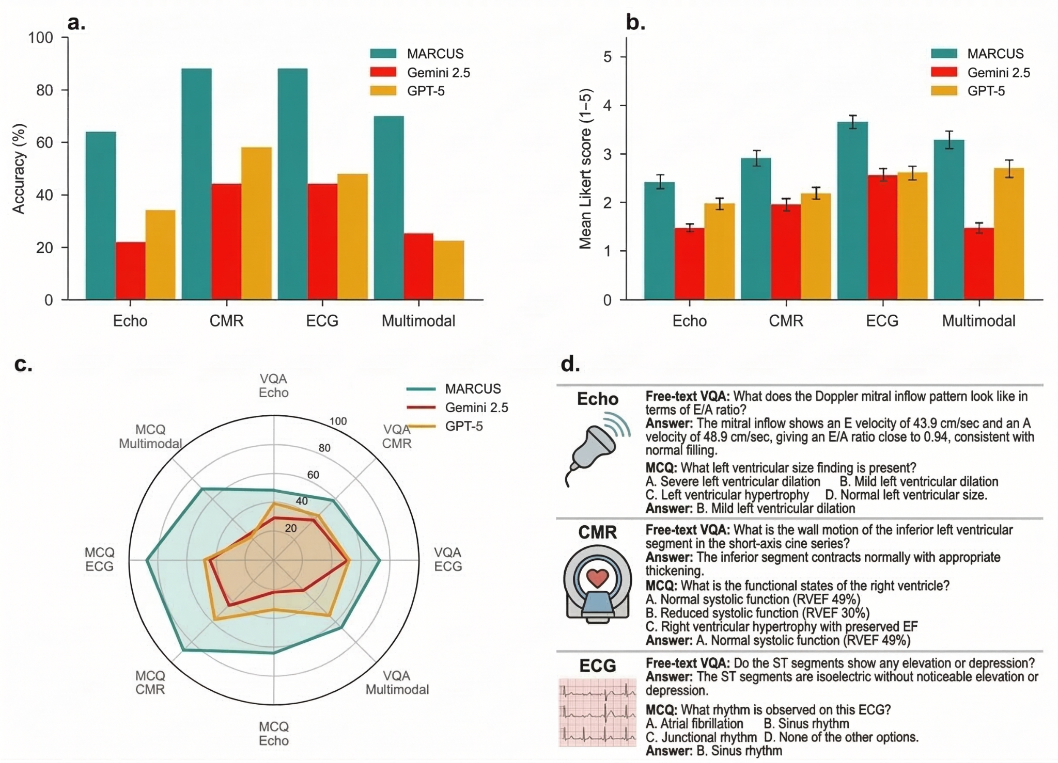
PERFORMANCE

Slide 10
MARCUS
An agentic, multimodal vision-language model for cardiac diagnosis and management
github.com/masadi-99/MARCUS
Stanford University | UCSF

