Slide 1
Heart Rate Data
Health Kit
Apple Watch heart rate for 1538 subjects
Apple Watch samples once every ~10 minutes when subject is inactive
Samples once every minute when subject is active
Heart rate (from any device) for 4577 subjects
combined from “health_kit” & “cardiovascular displacement” tables
6-Minute Walk
6-minute-walk walking HR for 155 subjects
Of these, 118 have known age (for maximum heart rate estimate)
108 subjects with both walking and recovery (rest) data

Slide 2
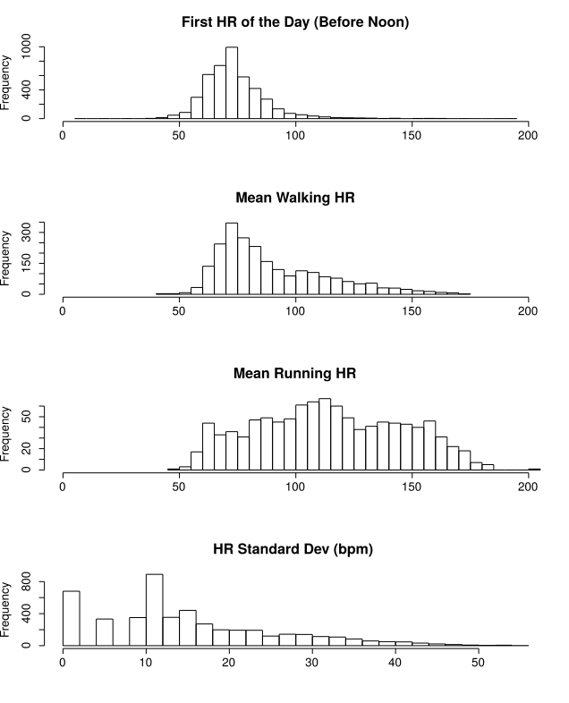
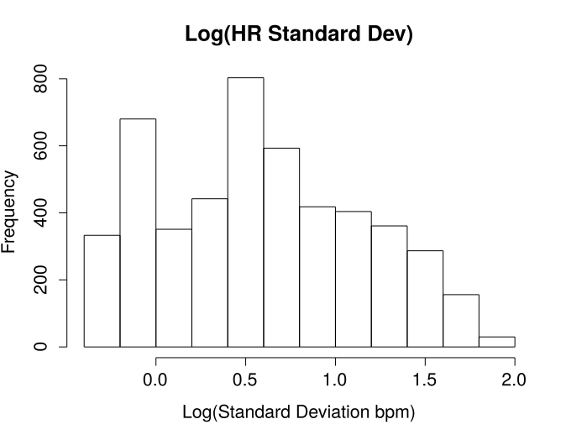

Slide 3
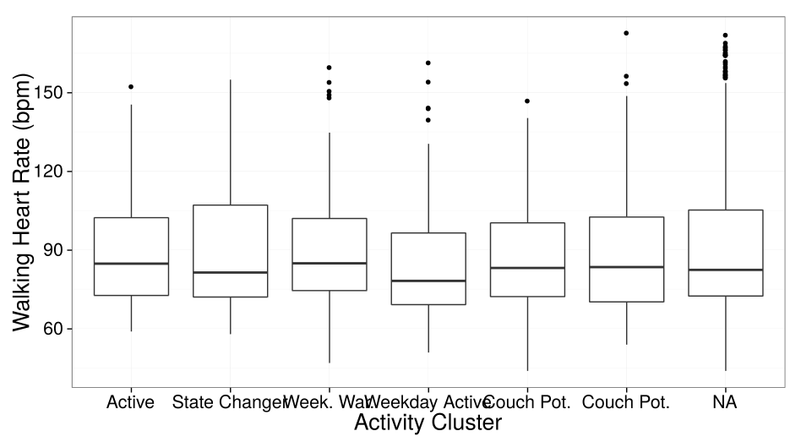
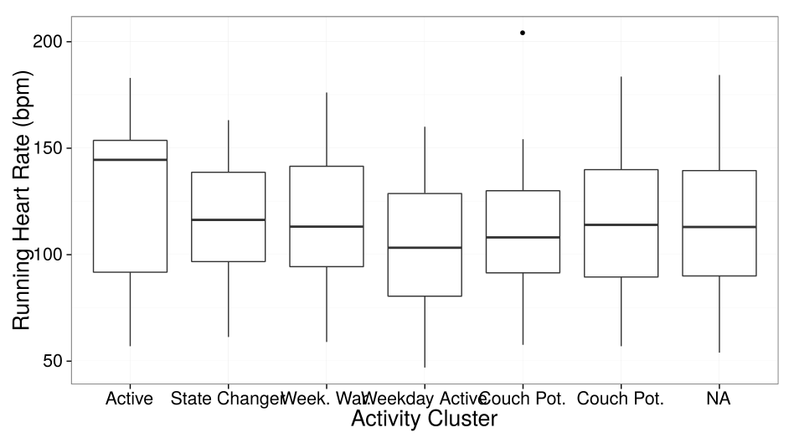
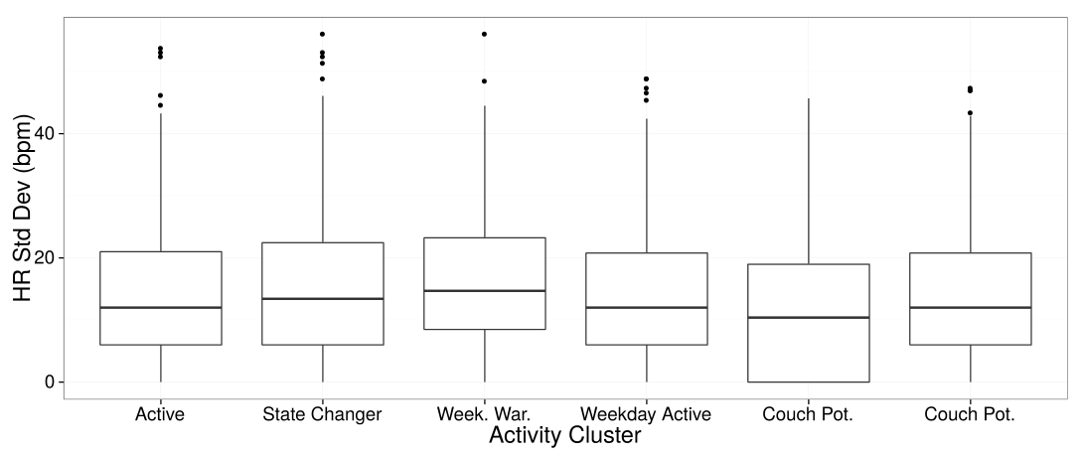
No significant relationship between HR and amount of time spent stationary

Slide 4
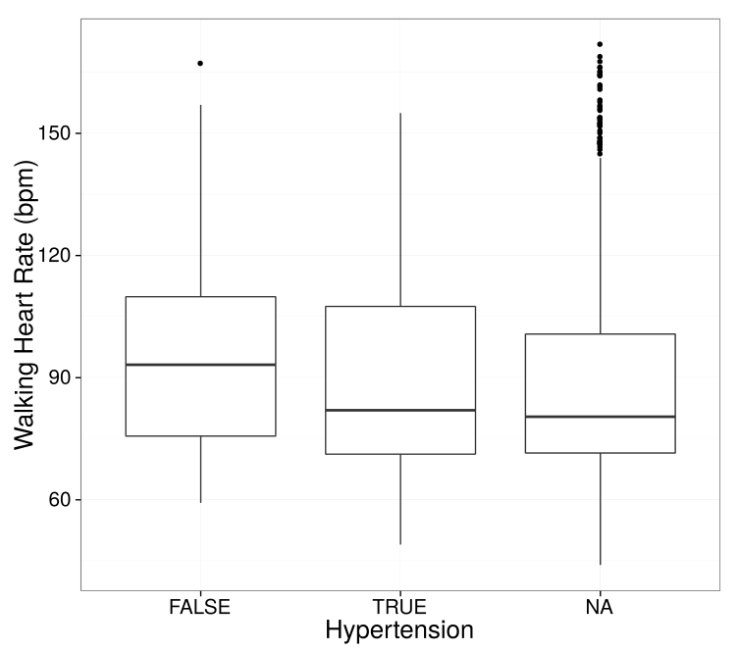
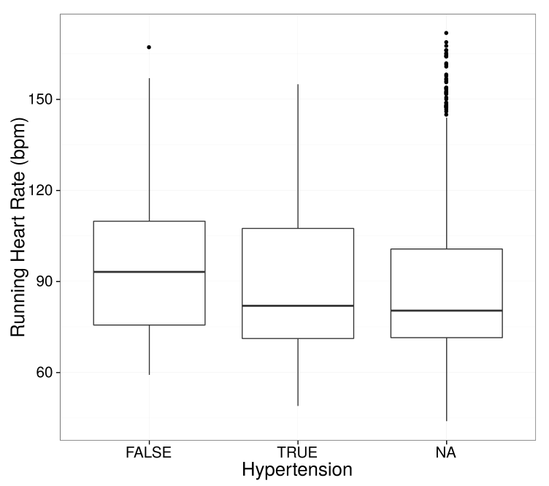
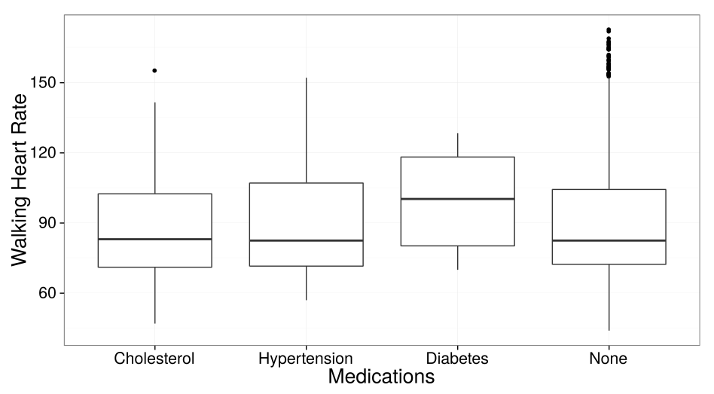
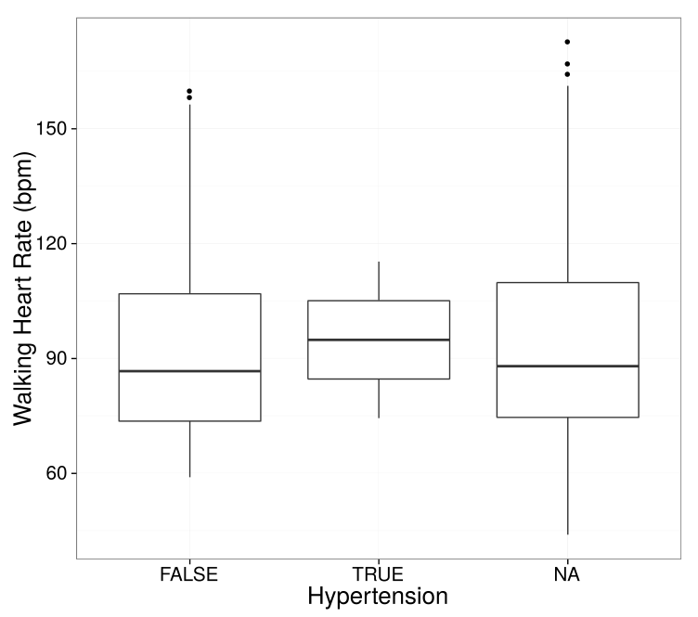
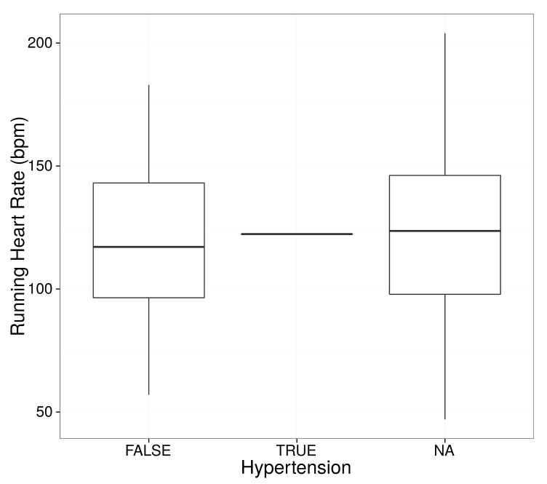
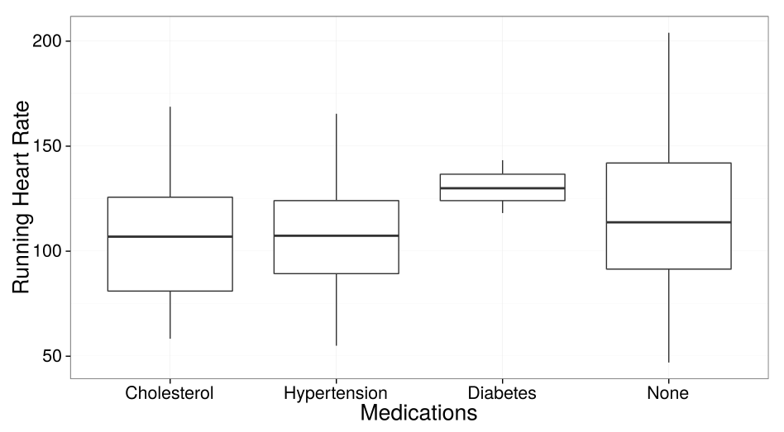
Walking Heart Rate vs. Hypertension: Medication Plays a Huge Role
Use of Medication vs. Exercise Heart Rate
Subjects on Medication (n=2133)
P=0.0465
P=0.15
n=51
Subjects NOT on Medication (P-values not significant)
n=1073
P=0.004
n=51

Slide 5
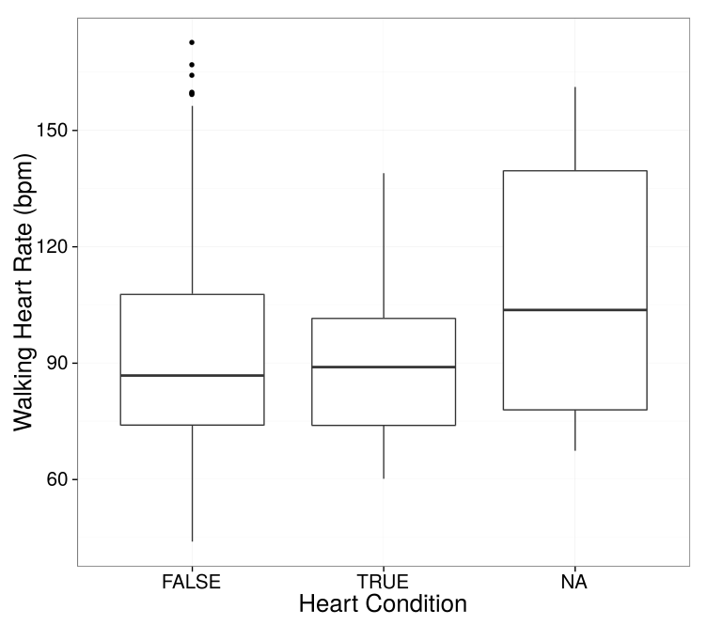
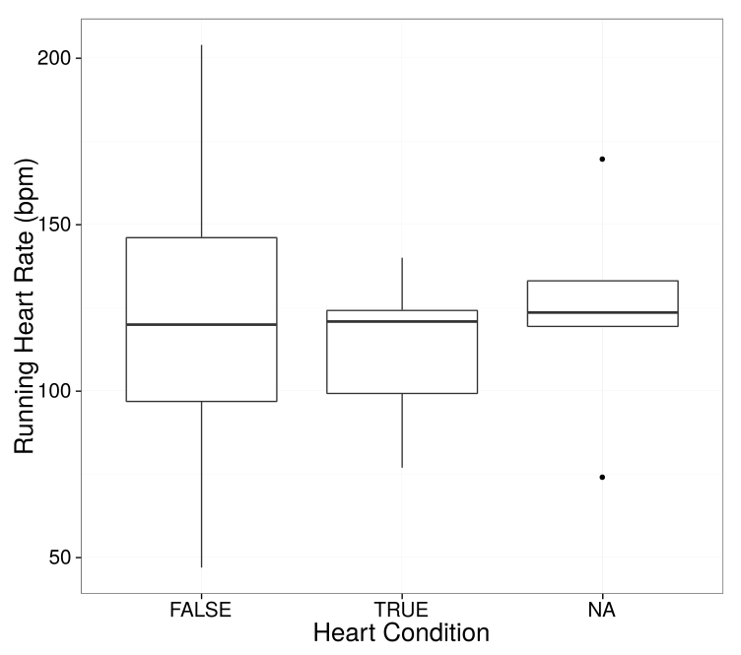
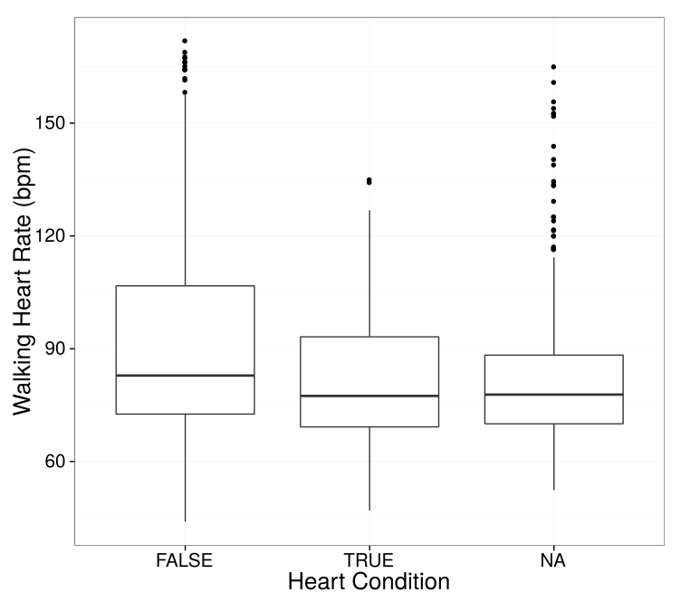
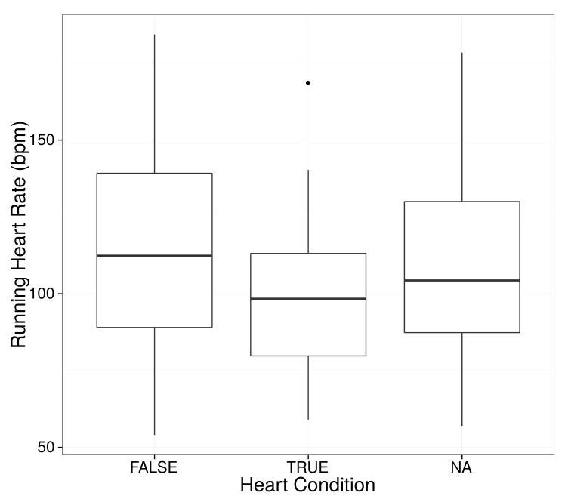
Heart Condition (P-value =0.008 run, 0.002 walk)
No Medication
Medicated

Slide 6
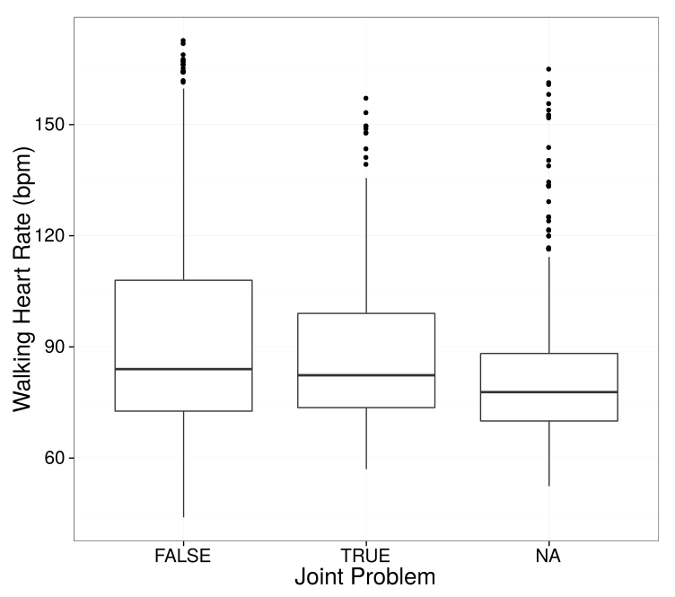
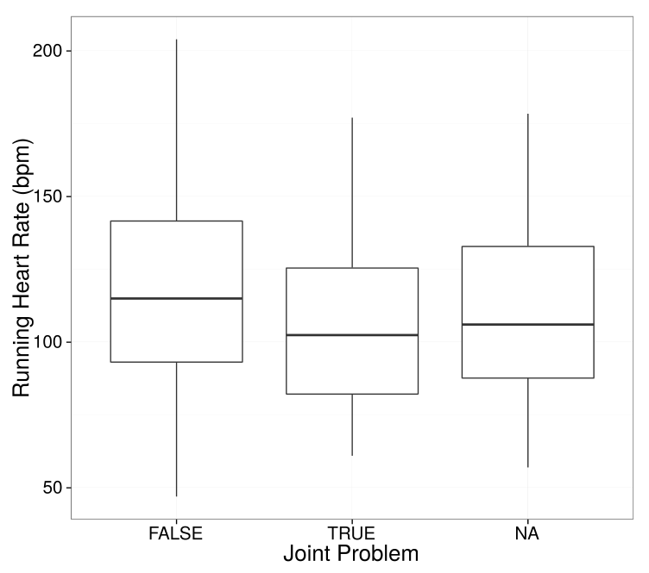
Walking and Running Heart Rate vs. Joint Problems
(Logistic regression model)
Deviance Residuals:
Min 1Q Median 3Q Max
-0.6543 -0.5998 -0.5710 -0.5153 2.1277
Coefficients:
Estimate Std. Error z value Pr(>|z|)
(Intercept) -1.1519 0.2530 -4.553 5.28e-06 ***
walk -0.3829 0.1659 -2.308 0.021 *
Deviance Residuals:
Min 1Q Median 3Q Max
-0.7152 -0.5709 -0.5095 -0.4366 2.2833
Coefficients:
Estimate Std. Error z value Pr(>|z|)
(Intercept) -0.7645 0.3535 -2.163 0.03056 *
run -0.5982 0.1891 -3.163 0.00156 **

Slide 7
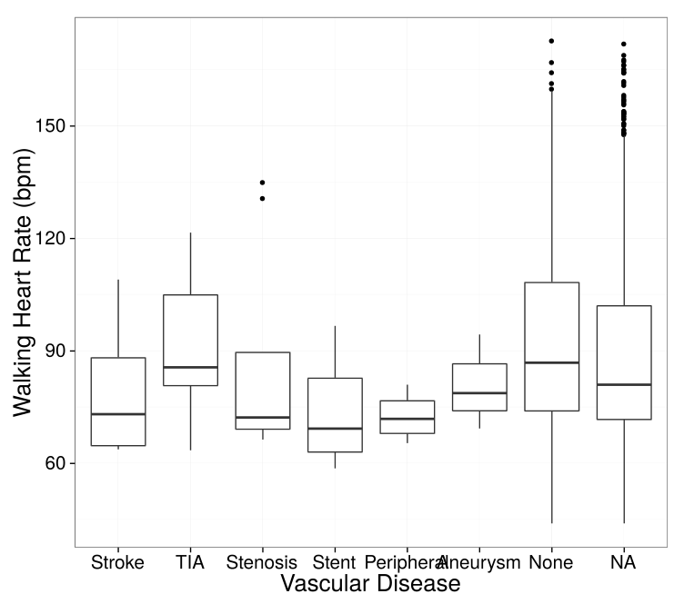
Walking Heart Rate vs. Vascular Disease
Deviance Residuals:
Min 1Q Median 3Q Max
-0.81062 -0.31062 -0.09963 0.24815 1.33230
Coefficients:
Estimate Std. Error t value Pr(>|t|)
(Intercept) 1.20957 0.10984 11.012 < 2e-16 ***
vascular 0.04777 0.01602 2.981 0.00296 **

Slide 8
Total Cholesterol
Total Cholesterol
Deviance Residuals:
Min 1Q Median 3Q Max
-167.824 -29.875 -4.211 23.521 225.934
Coefficients:
Estimate Std. Error t value Pr(>|t|)
(Intercept) 153.82843 8.96546 17.158 <2e-16 ***
run 0.18913 0.07717 2.451 0.0148 *
Deviance Residuals:
Min 1Q Median 3Q Max
-174.855 -33.070 -3.624 25.313 223.284
Coefficients:
Estimate Std. Error t value Pr(>|t|)
(Intercept) 166.10797 7.22202 23.000 <2e-16 ***
walk 0.11378 0.07571 1.503 0.133

Slide 9
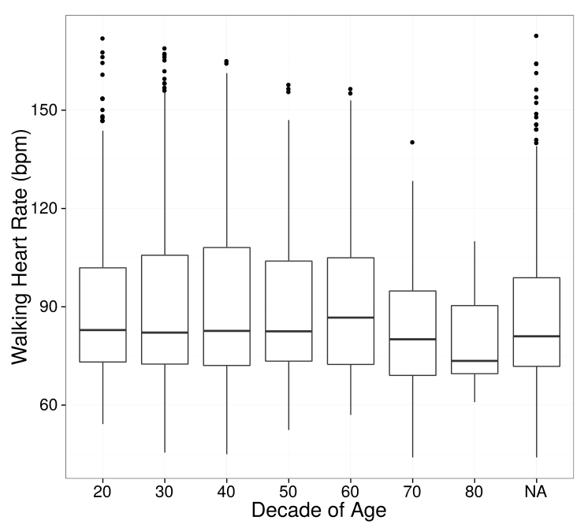
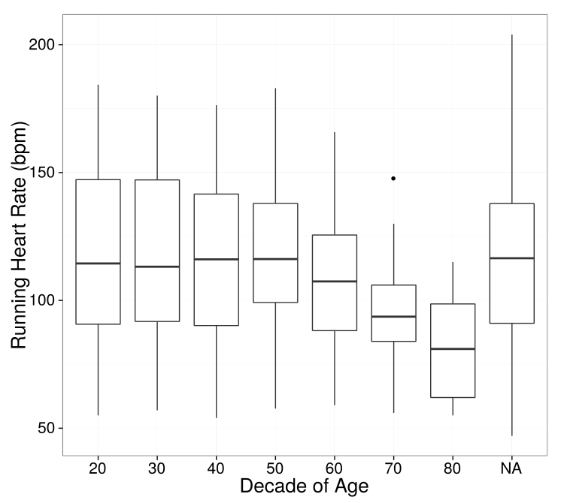
Age vs Heart Rate (p=0.01 walking, 1.67e-7 running)

Slide 10
6 Minute Walk HR

Slide 11
heartAgeDataBloodGlucose ~ Max_hr + Min_hr +
Var_hr + Speed + Steady_state_hr + Recovery_hr
Deviance Residuals:
Min 1Q Median 3Q Max
-70.266 -42.327 7.758 41.597 80.675
Coefficients:
Estimate Std. Error t value Pr(>|t|)
(Intercept) 36.488118 37.929186 0.962 0.3395
Max_hr -0.697751 0.799099 -0.873 0.3857
Min_hr -0.930895 0.400279 -2.326 0.0231 *
Var_hr 0.003749 0.047873 0.078 0.9378
Speed 2.685550 1.550364 1.732 0.0878 .
Steady_state_hr 1.582770 0.965266 1.640 0.1058
Recovery_hr -0.109942 0.378649 -0.290 0.7724
heartAgeDataHdl ~ Max_hr + Min_hr + Var_hr +
speed + Steady_state_hr + Steady_state_hr, data = full
Deviance Residuals:
Min 1Q Median 3Q Max
-59.566 -17.695 -3.039 17.223 191.308
Coefficients:
Estimate Std. Error t value Pr(>|t|)
(Intercept) -1.02235 29.46138 -0.035 0.97242
Max_hr 3.13720 0.62070 5.054 3.57e-06 ***
Min_hr 0.85242 0.31092 2.742 0.00783 **
Var_hr -0.06021 0.03719 -1.619 0.11009
Speed -2.28087 1.20424 -1.894 0.06254 .
Steady_state_hr -3.49688 0.74977 -4.664 1.53e-05 ***
Recovery_hr 0.20564 0.29411 0.699 0.48687

Slide 12
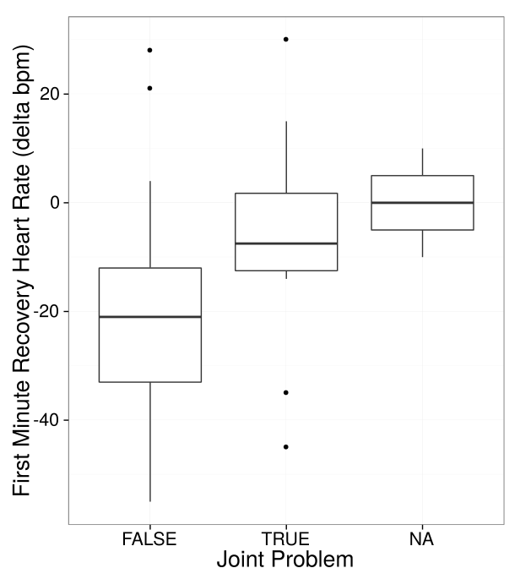
First Minute Recovery Heart Rate vs. Joint Problems
(Logistic regression model)
jointProblem ~ Recovery_hr
Deviance Residuals:
Min 1Q Median 3Q Max
-1.3038 -0.5035 -0.3782 -0.2823 2.7272
Coefficients:
Estimate Std. Error z value Pr(>|z|)
(Intercept) -1.23682 0.38402 -3.221 0.00128 **
Recovery_hr 0.05461 0.01975 2.764 0.00570 **

Slide 13
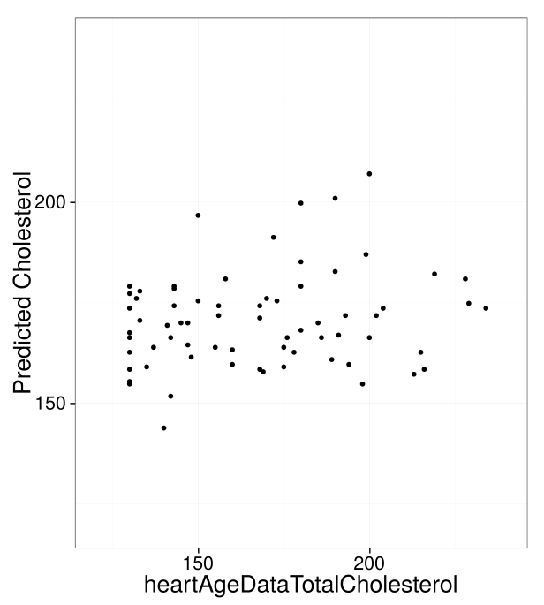
6-Minute Walk Max HR vs. Joint Problems
(Logistic regression model)
glm(formula = full$heartAgeDataTotalCholesterol ~ full$Max.x,
data = full)
Deviance Residuals:
Min 1Q Median 3Q Max
-49.053 -25.250 -5.572 20.856 73.554
Coefficients:
Estimate Std. Error t value Pr(>|t|)
(Intercept) 95.1946 23.4368 4.062 0.000123 ***
full$Max.x 0.6077 0.1838 3.307 0.001475 **

Slide 14
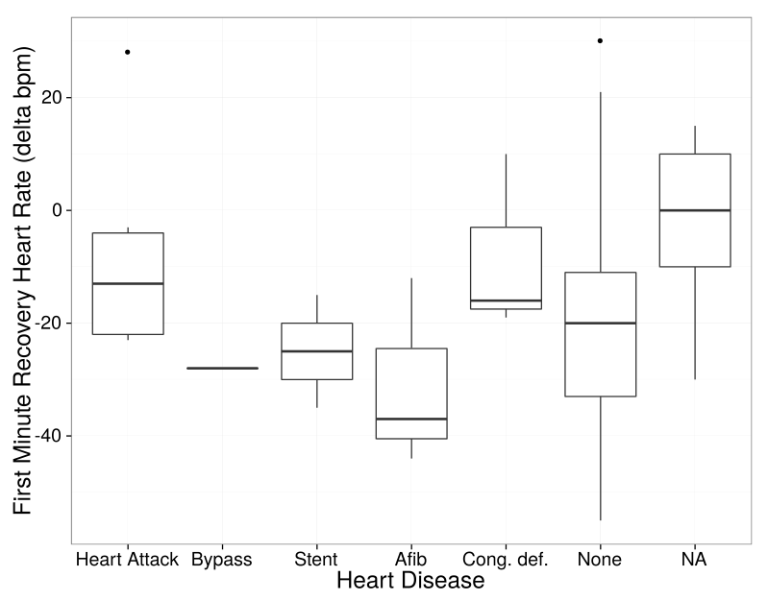
6-Minute Walk Recovery HR vs. Heart Disease
(Logistic regression model)
very small sample sizes for disease cases
heart_disease ~ Recovery_hr
Deviance Residuals:
Min 1Q Median 3Q Max
-2.5305 0.2214 0.3017 0.3700 0.9026
Coefficients:
Estimate Std. Error z value Pr(>|z|)
(Intercept) 2.08714 0.49075 4.253 2.11e-05 ***
full$delta1.y -0.04666 0.02441 -1.911 0.056 .
n=88
n=3
n=5
n=6
n=2
n=3
n=1

Slide 15
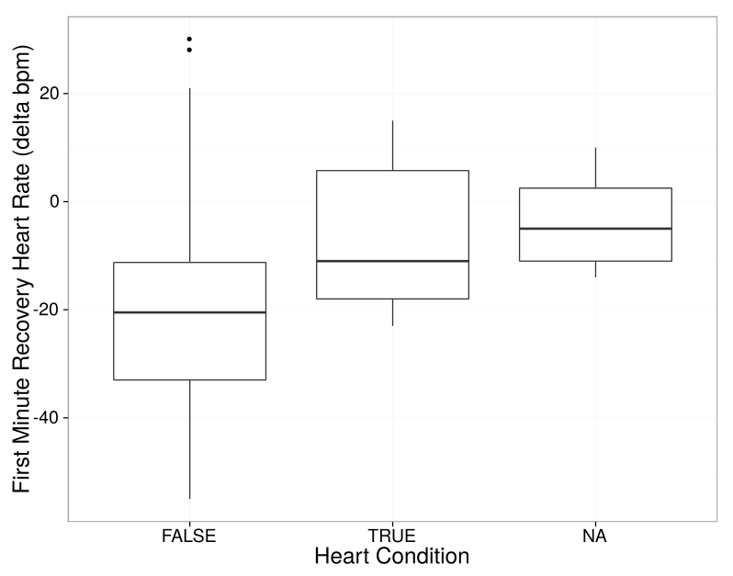
6-Minute Walk Recovery HR vs. Heart Condition
(Logistic regression model)
heartCondition ~ Recovery_hr
Deviance Residuals:
Min 1Q Median 3Q Max
-0.9203 -0.3633 -0.2832 -0.2137 2.5533
Coefficients:
Estimate Std. Error z value Pr(>|z|)
(Intercept) -2.10063 0.47755 -4.399 1.09e-05 ***
Recovery_hr 0.04869 0.02400 2.029 0.0425 *

Slide 16
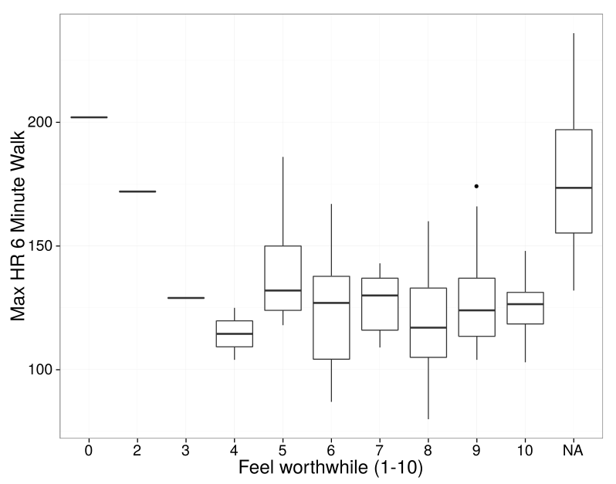
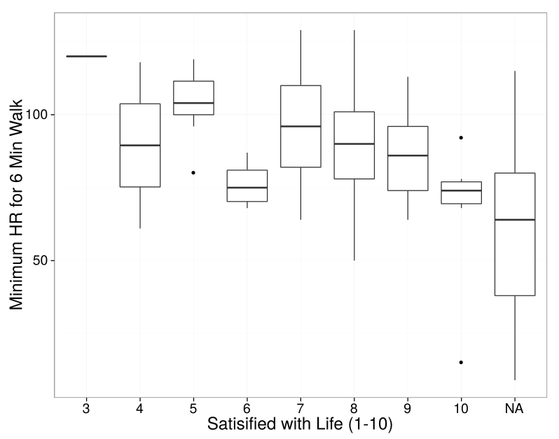
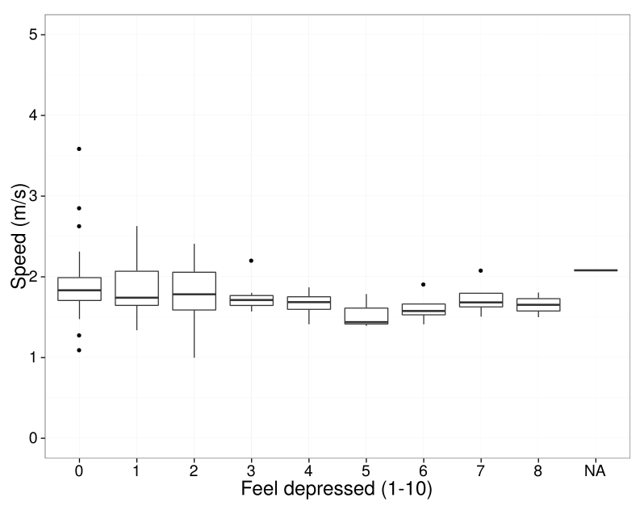
Min/Max HR values vs. Life Satisfaction
(Logistic regression model)
Satisfied_with_life ~ Min_hr
Deviance Residuals:
Min 1Q Median 3Q Max
-4.3417 -0.5732 0.2366 0.8958 2.2985
Coefficients:
Estimate Std. Error t value Pr(>|t|)
(Intercept) 9.60141 0.63313 15.165 < 2e-16 ***
Min_hr -0.02065 0.00690 -2.993 0.00347 **
Feel_worthwhile ~ Max_hr
Deviance Residuals:
Min 1Q Median 3Q Max
-6.1412 -0.5170 0.0734 0.9494 2.7246
Coefficients:
Estimate Std. Error t value Pr(>|t|)
(Intercept) 10.384183 0.957490 10.845 < 2e-16 ***
Max_hr -0.021005 0.007503 -2.799 0.00612 **
Feel_depressed ~ Max_hr + Min_hr +
Var_hr + speed + Steady_state_hr + Recovery_hr
Deviance Residuals:
Min 1Q Median 3Q Max
-2.9898 -1.2861 -0.5460 0.4998 6.8974
Coefficients:
Estimate Std. Error t value Pr(>|t|)
(Intercept) 0.414038 1.396702 0.296 0.767528
Max_hr -0.038725 0.027377 -1.415 0.160415
Min_hr 0.030168 0.016326 1.848 0.067672 .
Var_hr 0.003157 0.001631 1.935 0.055882 .
Speed -0.268146 0.070465 -3.805 0.000248 ***
Steady_state_hr 0.036459 0.033808 1.078 0.283534
Recovery_hr 0.018848 0.013539 1.392 0.167074

Slide 17
HR Variance vs. Health Outcomes

Slide 18
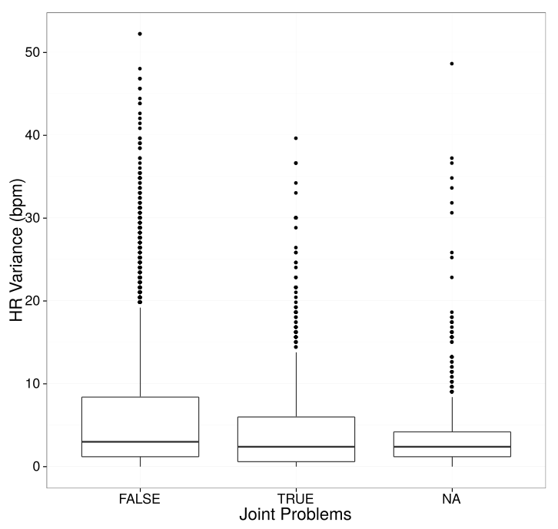
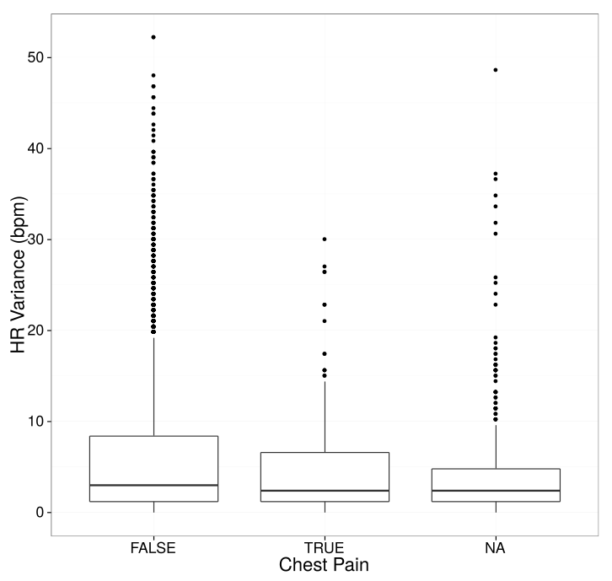
JoinProblem ~Variance
Deviance Residuals:
Min 1Q Median 3Q Max
-0.6483 -0.6294 -0.6050 -0.4894 2.4259
Coefficients:
Estimate Std. Error z value Pr(>|z|)
(Intercept) -1.453141 0.052655 -27.597 < 2e-16 ***
Variance -0.036239 0.006718 -5.394 6.88e-08 ***
ChestPain ~Variance
Deviance Residuals:
Min 1Q Median 3Q Max
-0.04899 -0.04797 -0.04643 -0.04079 0.97663
Coefficients:
Estimate Std. Error t value Pr(>|t|)
(Intercept) 0.048993 0.003979 12.312 <2e-16 ***
Variance -0.051243 0.024628 -2.081 0.0375 *

Slide 19
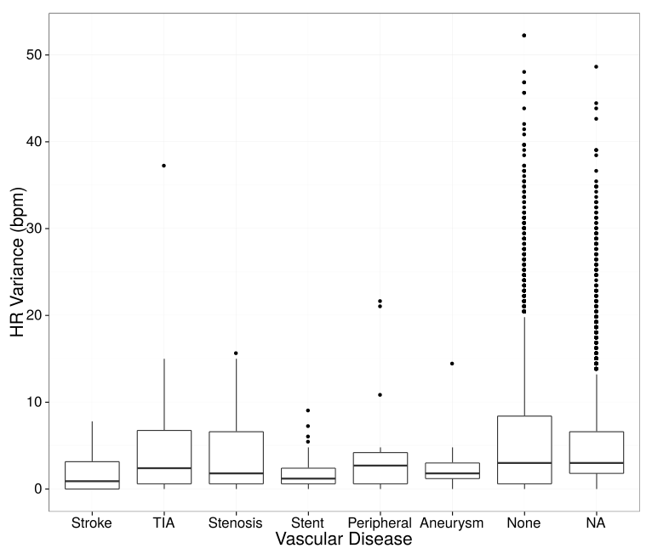
vascular_disease~ firstValue
Deviance Residuals:
Min 1Q Median 3Q Max
-5.9054 0.2130 0.2591 0.2953 0.6176
Coefficients:
Estimate Std. Error t value Pr(>|t|)
(Intercept) 6.339688 0.107180 59.150 < 2e-16 ***
firstValue 0.005481 0.001430 3.833 0.00013 ***
vascular_disease ~variance
Deviance Residuals:
Min 1Q Median 3Q Max
-5.7627 0.2025 0.2861 0.3139 0.3279
Coefficients:
Estimate Std. Error t value Pr(>|t|)
(Intercept) 6.672118 0.024293 274.653 < 2e-16 ***
Variance 0.011613 0.002493 4.658 3.34e-06 ***

Slide 20
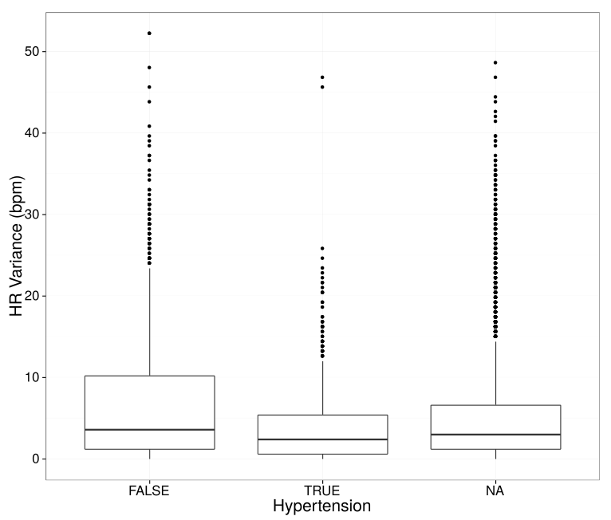
heartAgeDataHypertension ~ variance
Deviance Residuals:
Min 1Q Median 3Q Max
-0.3281 -0.3054 -0.2543 0.6719 1.1147
Coefficients:
Estimate Std. Error t value Pr(>|t|)
(Intercept) 0.328111 0.012938 25.360 < 2e-16 ***
Variance -0.009462 0.001344 -7.042 2.63e-12 ***
heartAgeDataHypertension ~ firstValue
Deviance Residuals:
Min 1Q Median 3Q Max
-0.4282 -0.2801 -0.2581 0.6906 0.9207
Coefficients:
Estimate Std. Error t value Pr(>|t|)
(Intercept) 0.4472133 0.0594803 7.519 8.7e-14 ***
firstValue -0.0024431 0.0008019 -3.047 0.00235 **

Slide 21
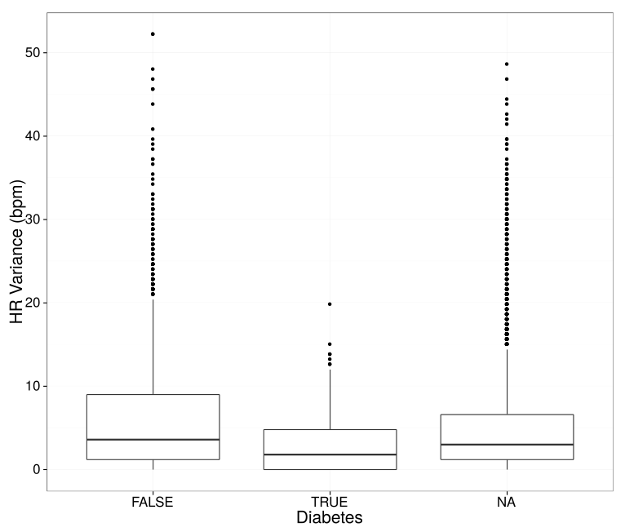
HeartAgeDataDiabetes ~variance
Deviance Residuals:
Min 1Q Median 3Q Max
-0.05843 -0.05584 -0.05065 -0.03638 0.98437
Coefficients:
Estimate Std. Error t value Pr(>|t|)
(Intercept) 0.0584290 0.0061168 9.552 < 2e-16 ***
Variance -0.0021616 0.0006349 -3.405 0.000676 ***

Slide 22
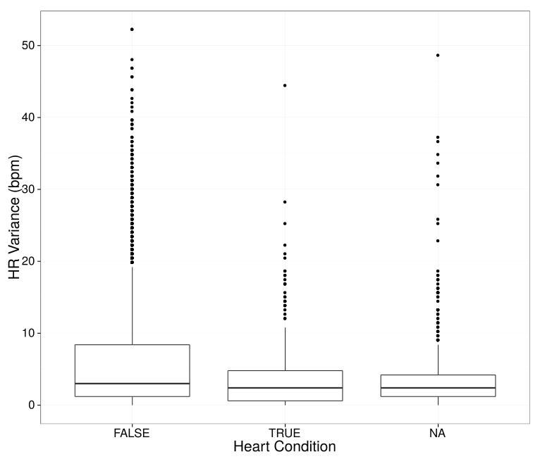
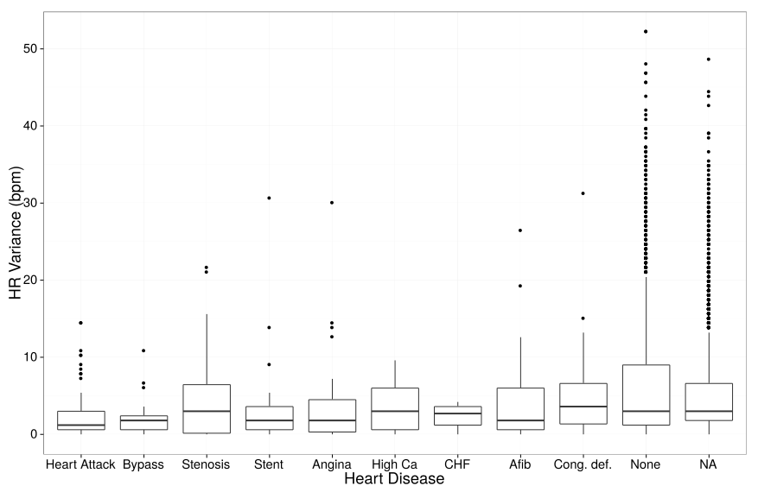
HeartCondition ~variance
Deviance Residuals:
Min 1Q Median 3Q Max
-0.07258 -0.07009 -0.06509 -0.05136 1.01980
Coefficients:
Estimate Std. Error t value Pr(>|t|)
(Intercept) 0.0725819 0.0046095 15.746 < 2e-16 ***
Variance -0.0020807 0.0004749 -4.382 1.21e-05 ***
heart_disease ~variance
Deviance Residuals:
Min 1Q Median 3Q Max
-3.1237 0.1651 0.2453 0.2731 0.2932
Coefficients:
Estimate Std. Error z value Pr(>|z|)
(Intercept) 3.12515 0.14588 21.423 < 2e-16 ***
Variance 0.12126 0.03248 3.734 0.000189 ***

