Slide 1
Treating Your Infrastructure As Code
@AshleyPooleUK
Github.com/ashleypoole
Notes:
Before we jump in, you might be thinking why as a developer would you want to know how to manage infrastructure as that’s for IT Operations right? As developers, most of us don’t know how to rack a server, configure a switch, or configure a virtual machine. Well as developers, we can actually re-use a lot of our skill set to manage infrastructure using code.

Slide 2
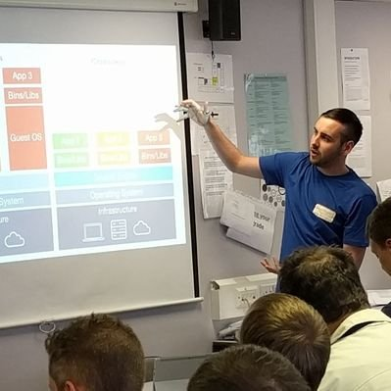

About me
Site Reliability Engineering Advocate
Co-Organiser of Shropshire Devs user group
Senior Software Developer
@AshleyPooleUK
Notes:
Lead developer on the Platform SRE Team at Protolabs.

Slide 3
What’s wrong with traditional infrastructure?
@AshleyPooleUK
Notes:
A lot of companies these days are increasing the number of vendors for logging to monitoring to virtual infrastructure, which is driving a need to effectively manage these multiple vendors.
Traditionally used ad-hoc scripts or configuration via UI
Iterations were slow but we accepted it as VMs previously lived for years
With more smaller servers, and in a throw it away style mind-set, manual configuration isn’t saleable.
Need to be smart in cloud to save costs – someone else's server but your paying for compute.
With increasing complexity of systems, the need to rapidly scale infrastructure and easily stand up new environments. we need something better!

Slide 4

@AshleyPooleUK
Notes:
Previously the bottleneck was allocating servers as needed physically racking but now that’s shifted to how fast we can now configure those servers. Mention theory of constraints? The Goal.
As developers we don’t typically know how to rack a server and I’m not advocating we do unless you’re interested, but we should understand and take more responsibility for our infrastructure.

Slide 5
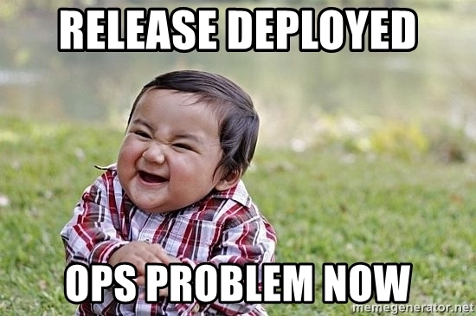
@AshleyPooleUK
Notes:
Gone are the days we throw code over the wall and let Operations deal with the fall our. We’re increasingly being asked to participate in supporting our services (and so we should in my opinion and something I advocate for, using the SRE model). Especially as SREs, we need to understand both sides of the “fence”.
This means gone are the days we can also ignore infrastructure as developers, so we must understand, at least at a basic level, all areas of our infrastructure, in-order to effectively support and triage our services.

Slide 6
Infrastructure As Code (IAC)
@AshleyPooleUK
Notes:
As name implies, it’s managing infrastructure as code, and is often used within “DevOps” space

Slide 7
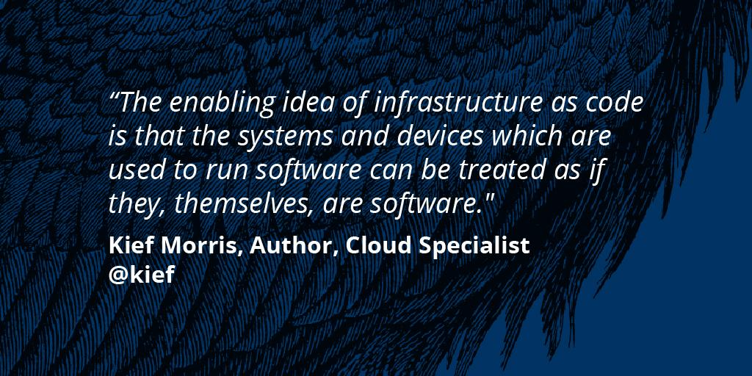
Notes:
Author of Infrastructure As Code book, and consultant at Thoughtworks
https://www.amazon.co.uk/Infrastructure-Code-Managing-Servers-Cloud/dp/1491924357

Slide 8

Image source: https://www.dlt.com/blog/2018/08/01/hybrid-cloud-computing-ai-government-digital-transformation/
Notes:
Common misconception is that infrastructure as code is only for people “in the could”. It’s not. More on premise infrastructure and services now have APIs that we can leverage, including VMWare, Hyper-V, etc.

Slide 9
Advantages to IAC
Repeatability
Versioning
Documentation as Code
Minimise risk
Increased efficiency
@AshleyPooleUK

Slide 10

Image source https://memegenerator.net/instance/82504869/cattle-cattle-not-pets
@AshleyPooleUK
Notes:
Need to change our mind-set, and treat infrastructure, especially virtual machines and cloud services as cattle, not pets. If something isn’t functioning, replace it. If you have a good known configuration, why waste time, drop and recreate! (Of course, always exceptions to that rule and doesn’t mean all investigations should stop.)

Slide 11
Transferable Skills
Inquisitive ✔
Problem Solving ✔
Don’t Repeat Yourself (DRY) Mind-set ✔
Version Control Knowledge ✔
Continuous Deployment (CD) Experience ✔
Lazy (but in a good way!) ✔
Notes:
Lazy as we want to code and automate all the things as we don’t want to repeat tasks over and over again.
Still a developer, just your code creates infrastructure not applications.

Slide 12
Common IAC tools
Cloud- Formation
Ansible
SaltStack
Chef
PowerShell DSC
Puppet
@AshleyPooleUK
Notes:
Some of these are classed as orchestration tools, while some are configuration management tools, though not always mutually exclusive as most configuration management tools can do some degree of provisioning, and most orchestration tools can do some degree of configuration management
It’s important to pick the tool based on your needs and support for vendors / technologies that you require.
Extra: Chef and Ansible encourage a procedural style where you write code that specifies, step-by-step, how to to achieve some desired end state. Terraform, CloudFormation, SaltStack, and Puppet all encourage a more declarative style where you write code that specifies your desired end state, and the IAC tool itself is responsible for figuring out how to achieve that state.
From <https://blog.gruntwork.io/why-we-use-terraform-and-not-chef-puppet-ansible-saltstack-or-cloudformation-7989dad2865c

Slide 13

@AshleyPooleUK
Notes:
Terraform is made by Hashicorp, initially released in 2014, and is written in Go lang. Not a configuration management tool, it instead focus on orchestration of the infrastructure.

Slide 14
Terraform Overview
Vendor agnostic
Common interface over vendors APIs
Uses HashiCorp configuration language (HCL)
Can version configuration in source control (GIT, Subversion, etc)
@AshleyPooleUK
Notes:
Don’t have to learn how to talk to each vendors API, that’s handled for us but will still need to learn about the providers resources.
HCL is declarative in nature, and similar to PowerShell Desired State Configuration (DSC) syntax

Slide 15
Creating & Configuring Resources
Providers
Provisioners
@AshleyPooleUK
Notes:
Providers - create, manage, and update infrastructure resources such as virtual machines
Mostly if not solely will be demonstrating providers during the demo.

Slide 16
Creating & Configuring Resources
Providers
Provisioners
@AshleyPooleUK
Notes:
Provisioners - used to execute scripts on a local or remote machine as part of resource creation or destruction such as bootstrapping virtual machines

Slide 17


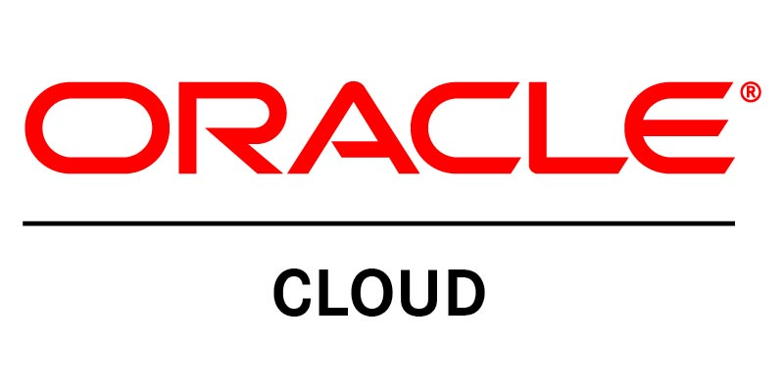
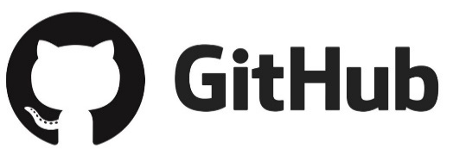

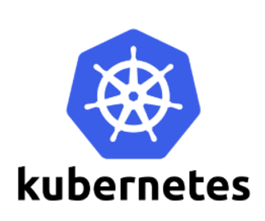

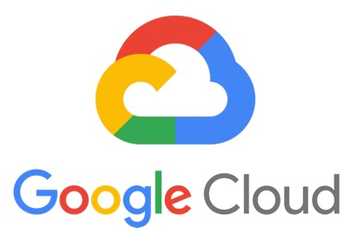

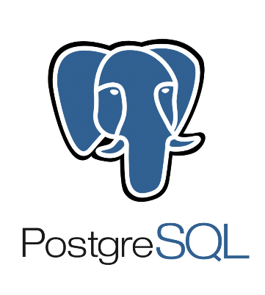
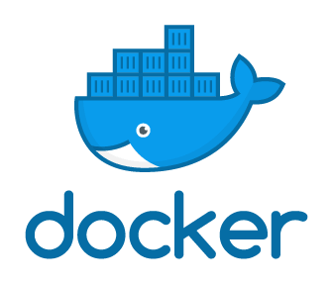
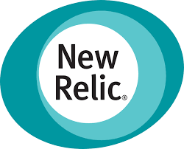


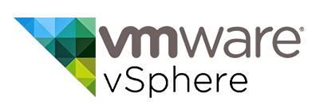


Terraform Providers
Notes:
This is just a sample of the enterprise providers - https://www.terraform.io/docs/providers/
More community providers exist too - https://www.terraform.io/docs/providers/type/community-index.html

Slide 18
HCL Resource
Component Provider Type Name
resource "cloudflare_record" “www" {
domain = “ashleypoole.co.uk"
name = “www"
value = “10.10.10.10"
type = “A"
proxied = true
}
@AshleyPooleUK
Notes:
This is what a HCL resource looks like

Slide 19
Terraform Development Workflow
Write
Plan
Apply
@AshleyPooleUK
Notes:
Write – make our changes
Plan – check with state file and destination API, and generate execution plan
Apply – preform steps in execution plan

Slide 20
Demo Time!
@AshleyPooleUK
Notes:
Example demo 1 will be creating an Azure App Service - https://www.terraform.io/docs/providers/azurerm/r/app_service.html
Talk about state management
Talk about resource definition - Component, provider, type, name

Slide 21
Where to start on your own Terraform journey?
@AshleyPooleUK
Notes:
Choose low hanging fruit, find something simple to start with and then get more complex.
Maybe start with virtual machine creation or something that you do a lot.
Automate your way to better and greater challenges!
Still under very active deployment so some areas require works arounds, but 0.12 should address these which is due out shortly. Sometimes will generate a plan fine but will blow up on an Apply.

Slide 22
Resources
https://www.terraform.io/docs
https://learn.hashicorp.com/terraform
https://www.katacoda.com/courses/terraform
https://github.com/shuaibiyy/awesome-terraform
https://blog.gruntwork.io/how-to-create-reusable-infrastructure-with-terraform-modules-25526d65f73d
@AshleyPooleUK

Slide 23
Thank you!
@AshleyPooleUK
Github.com/ashleypoole

