Slide 1
CLI Intro
HILT 2014

Slide 2
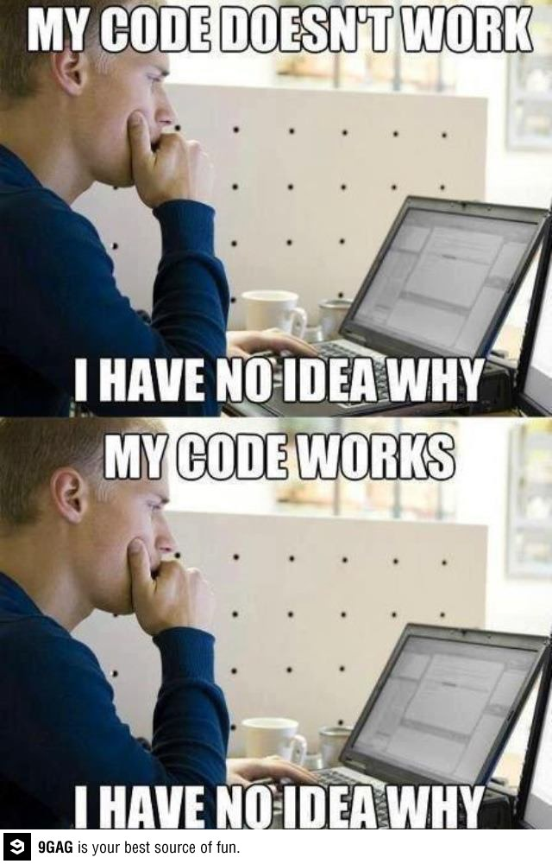
Programming Rules
Expect confusion.
Learn to live with it.
Ask questions.

Slide 3
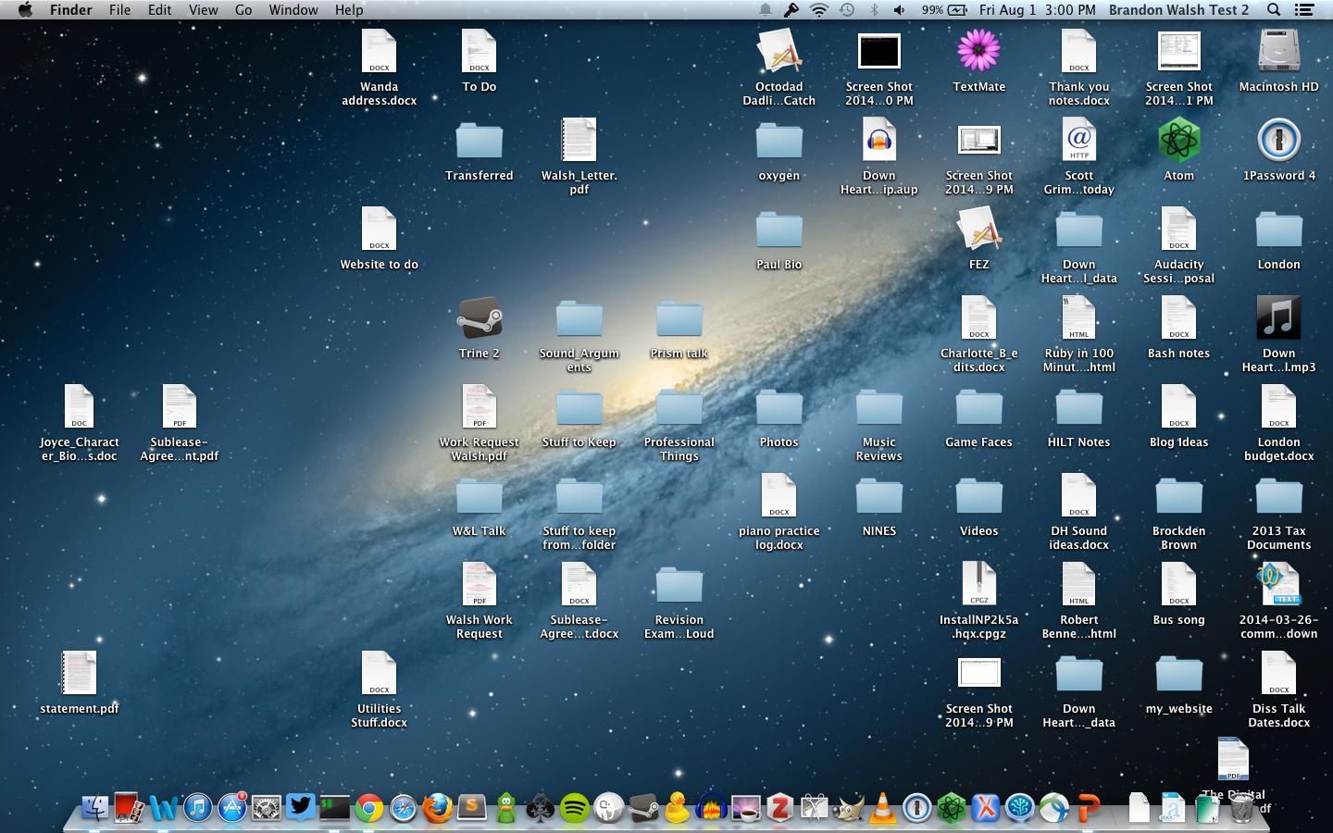
(GUI) Graphical User Interface

Slide 4
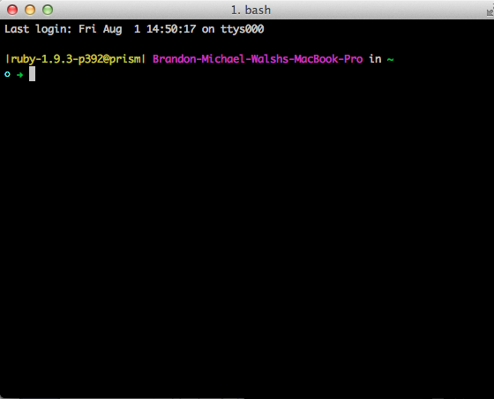
(CLI) Command Line Interface

Slide 5
Command Line Syntax
$ command parameters
Don’t type the “$”
Separate the parts of the command by spaces
command – what to do
parameters – how to do it or what to do it to

Slide 6
Commands We’ll Learn
cd
ls
pwd
touch
rm
mkdir
cp
mv
man

Slide 7
Commands we learned
cd – change directory
ls – list directory contents
pwd – print working directory
touch – create new file
rm – remove file (careful!)
mkdir – make directory
cp – copy file
mv – move file
man – help page
Tips/Tricks
up arrow – previous command
tab – auto completes things in command line

Slide 8
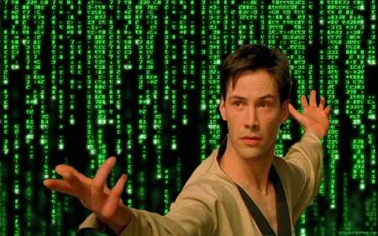
You’re programming!

Slide 9

Where to Go Next
Course exercises
http://cli.learncodethehardway.org/
Even Keanu gets sad.
google if you get stuck

