Slide 1
Intro to Git
HILT 2014

Slide 2
Version Controlling
Save different versions of the project over time.
Can recover any one of those iterations.
Nothing is ever lost.

Slide 3
Git
Distributed Version Control System (DVCS)
Each clone gets the entire project history
Code exists, in full, everywhere.
Allows easy collaboration via Github.

Slide 4
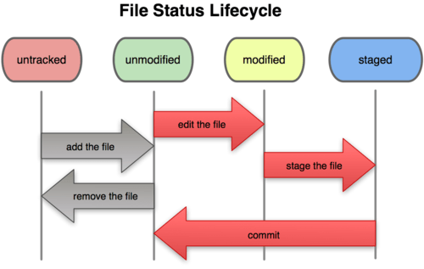

Slide 5
Workflow with commands
Modify a file (in a text editor)
Add that file to the staging area
$ git add file_name
Commit it to the repository
$ git commit
Start process over.

Slide 6
Commands We’ll Learn
git init
git status
git add .
git commit –m
git push
git branch
git checkout
git merge
git diff
git log

Slide 7
Where to go Next
git documentation
http://git-scm.com/doc
git for Ages 4 and Up
http://youtu.be/1ffBJ4sVUb4

