Slide 1
HTML/CSS Slides
HILT 2014

Slide 2
Hypertext Markup Language (HTML)
Cascading Style Sheets (CSS)

Slide 3
Basic HTML Structure
<DOCTYPE! HTML>
<html>
<head> </head>
<body>
</body>
</html>

Slide 4

Tagging syntax
<tagname>My content</tagname>

Slide 5
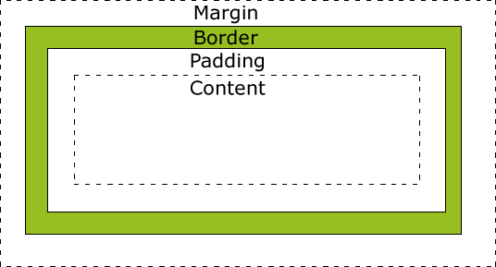
HTML Box Model

Slide 6
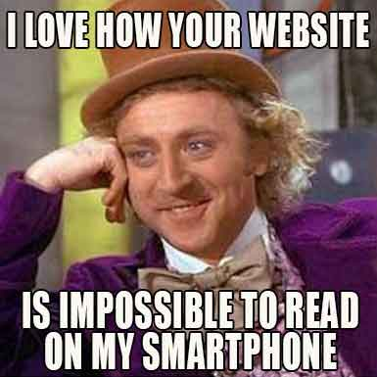
Responsive Web Design

Slide 7
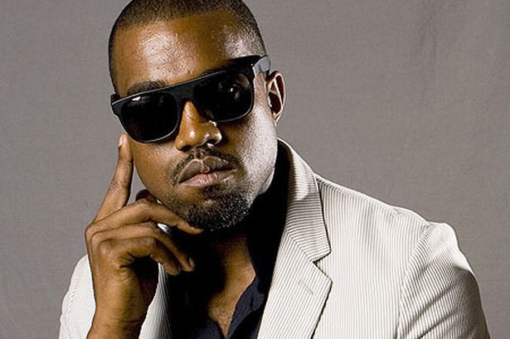
What Would Kanye Do?

Slide 8
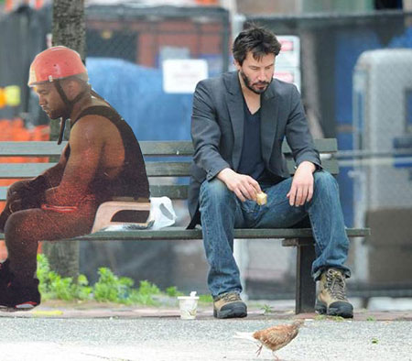
Where to go next
David Kadavy – Design for Hackers
praxis.scholarslab.org
Google

