Slide 1
COMPUTER GRAPHICS FINAL PROJECT
GROUP 6

Slide 2
GROUP MEMBERS
150475
ALISON KIPYEGON
150770
SHIRLEY WETINDI
150472
METABEL KARIRI
ALPHA MUNENE
150198
144376
ASHLEY ADHIAMBO

Slide 3
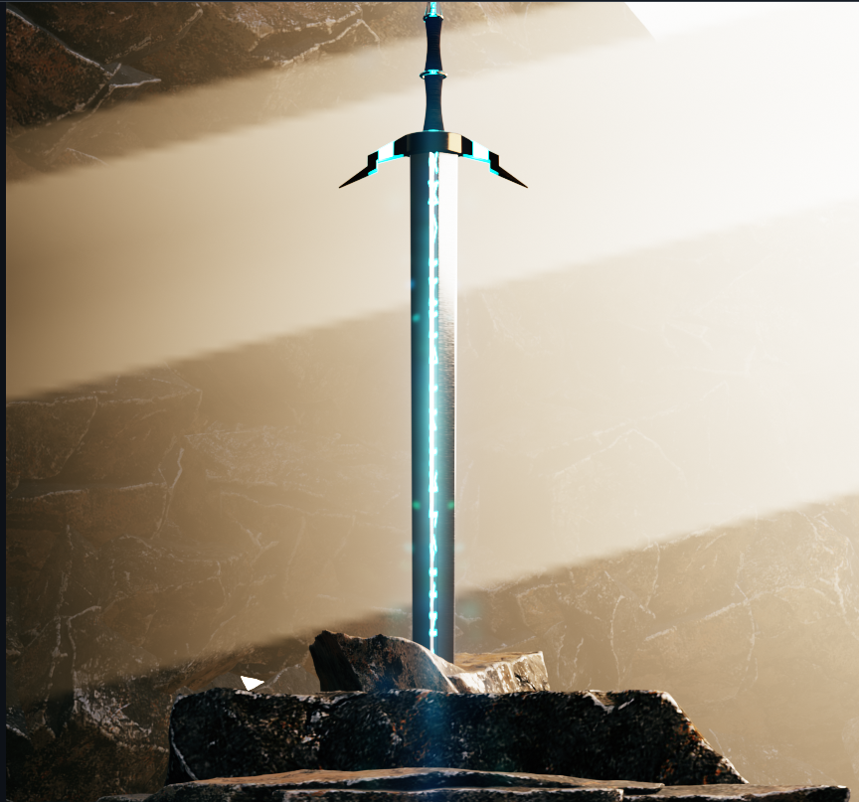
MAIN IDEA
Welcome to the Fantasy Weapon Project, an imaginative 3D design featuring a custom-crafted fantasy weapon integrated with a Mixamo character for animation. This project combines Blender for detailed 3D modeling and Mixamo for character rigging and animation, creating a captivating scene for game development, storytelling, or cinematic use.

Slide 4
GITHUB LINK
https://github.com/AshleyT668/Comp-Graphics-Final-Project.git

Slide 5
Thank
you!

