Slide 1
Return of the Greeps
CS18010
Team Members:
Tomos Fearn
Kamil Cupial
Ashley Evans
Sorres Arslan

Slide 2
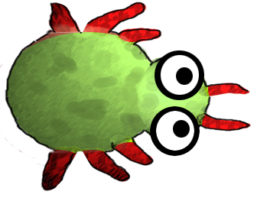
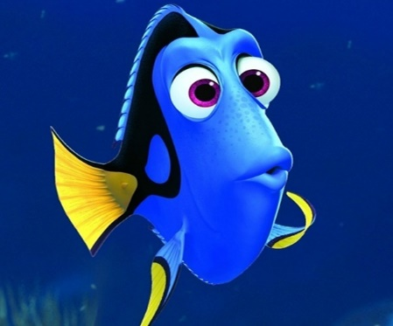

Problems we faced with our Greeps
Biggest Greep problem:
Greeps are very stupid.
Memory:
Greeps would often go back to their known pile of tomatoes. Even if they were all gone they would stick to these coordinates.
Forgetful:
Their ship has its own data bank because the Greeps can only know where one pile is at a time. To be continued..

