Slide 1
Return of the Greeps

Slide 2
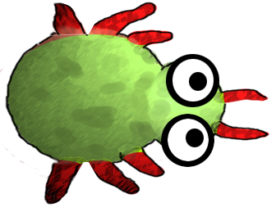
Return of the Greeps

Slide 3
Return of the Greeps
CS18010
Team Members:
Tomos Fearn
Kamil Cupial
Ashley Evans
Sorres Arslan

Slide 4
Temporary Page for Content
GitHub, what it is, how it works, how you found using it
GreenFoot, what it is
Greeps, the modifications you made, the experience had
Demo of greeps
The experience of working in a group

Slide 5
GitHub
GitHub, what it is, how it works, how you found using it
What is it?
How does it work?
How did we find using it?

Slide 6
GreenFoot
What is GreenFoot?

Slide 7
Evolution of our Greeps…
What are the modifications we have made to the Greeps?
The experience we’ve had doing it.

Slide 8
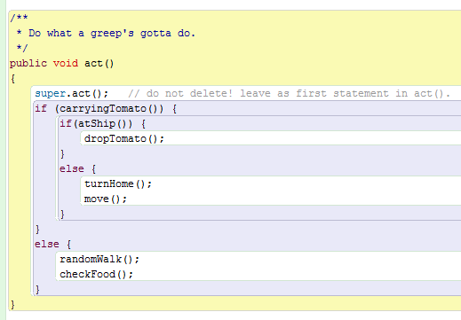
Our Basic Structure
Greeps are born very stupid and understand very little…
3 basic situations
If the Greep is carrying a tomato then run turnHome() and move().
If the Greep has arrived at the ship (Home) then drop the tomato.
Else wonder about looking for tomatoes.

Slide 9
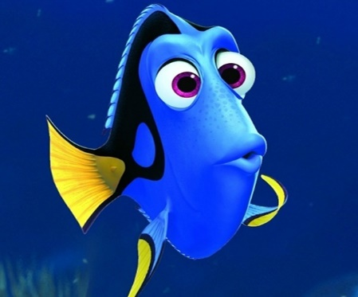
Our Main Problems
?
The memory of the Greeps was one of the biggest problems during the project
Problem:
Greeps are can only remember 1 location at a time.
Solution:
Every time a Greep returns to the Ship it reads the memory bank from the ship where locations of the piles of tomatoes are known
Greeps are forgetfull
?

Slide 10

Our Main Problems
?
The invisible tomatoes
Problem:
Greeps return to the location where they found tomatoes and then stay there even when there are no tomatoes.
Solution:
Every time a Greep returns to the Ship it reads the memory bank from the ship where locations of the piles of tomatoes are known
These tomatoes don’t have an invisibility cloak, the Greeps just return to the location where they last found a tomato.

Slide 11
The Demo
Our Demo!

Slide 12
Our Teamwork
How was the experience of working in a group?

