Slide 1
Air writing application
Guided by presented by
Assis prof. Shehin shams Ashlin babu

Slide 2
Introduction
In the era of digital world, traditional art of writing is being replaced by digital art.
The traditional way includes pen and paper, chalk and board method of writing.
The essential aim of digital art is of building hand gesture recognition system to write digitally.
Digital art includes many ways of writing like by using keyboard, touch-screen surface, digital pen, stylus, using electronic hand gloves, etc.

Slide 3
PROBLEM definition
Today classrooms are full of dust because it consist of blackboards and chalks.
A need for a dustless class room for the students to study in is the main motive of this project.
There are many ways like touch screens and more.
but it is difficult for the schools which can’t afford it to buy such huge large screens and teach on them like a T.V.
So, in this project the fingertip is tracked in real-time and according to the movement of finger the letters are displayed on the screen.

Slide 4
objectives
To develop a system that act as a real time captioning system
Draw in canvas according to the movement of fingertip
Help educational institutions to avoid the charges of smart board.
Help people who are deaf to follow teacher without sign language.
To improve the quality of communication.

Slide 5
Literature review
In 2006, Alpher Yilmaz proposed a system model to detect hand shape using the information from Kinect sensor
In 2010, Yuan Hsiang Chang suggested a method in which LED is mounted on user's finger.
In 2013, Saira beg proposed a system that uses Augmented desk interface approach for interaction.

Slide 6
REQUIREMENT SPECIFICATIONS
FUNCTIONAL REQUIREMENTS
Input video frame by frame.(User draw in screen)
What user draws displayed in canvas.
NON FUNCTIONAL REQUIREMENTS
User friendly (Can easily select colour to draw and erase if any modifications)
Performance Speed
Error handling: Handle error that prevent loss in information

Slide 7
Proposed system
The proposed system has a dataset for the Fingertip Detection Model.
Deep Learning algorithms are used to detect fingertip in every frame, generating a list of coordinates.
Use Single Shot Detector (SSD) and Faster RCNN to train the dataset.

Slide 8
proposed system
The basic functionalities in the system are :
Writing Mode - In this state, the system will trace the fingertip coordinates and stores them.
Colour Mode – The user can change the colour of the text among the various available colours.
Backspace - Say if the user goes wrong, we need a gesture to add a quick backspace.

Slide 9

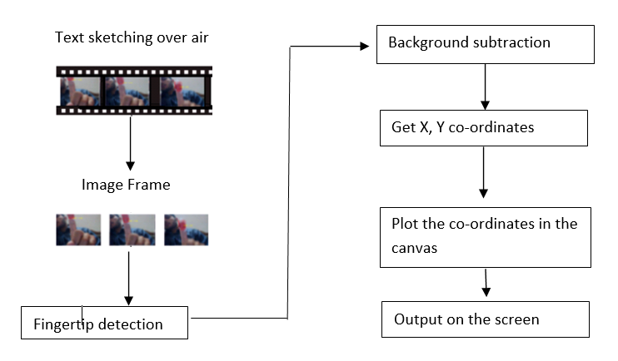
architecture

Slide 10
modules
Design
Dataset Creation
Model creation
Implementation

Slide 11
MODULES
DESIGN
The system will be design in Tkinder. The colour palatte and eraser selection will be designed on the top of the canvas.
DATASET CREATION
Two second video of person's hand motion capture in different environment.
The video then broke to images
Take pictures in distinct background.
Collect 4 distinct hand poses.

Slide 12
MODULES
MODEL CREATION
Once the dataset was ready and labeled, it is divided into train and validation sets
Use Single Shot Detector (SSD) and Faster RCNN to train the dataset.
IMPLEMENTATION
The system detect fingertip in every frame.
Generate list of co-ordinates.
Plot the co-ordinates in the canvas.

Slide 13
Project plan
FEB
MAR
APR
MAY
Project time
System study
Data collection
Design
Coding
Testing
Implementation

Slide 14
Evaluation metrices
Accuracy computes the count of correct predictions.
Precision : Ability of classifier not to label as positive a sample that is negative.
Recall : Ability of the classifier to find all the positive samples.
F1 score is the harmonic mean of precision and recall.

Slide 15
REference
Prof. S.U. Saoji, Nishtha Dua, Akash Kumar Choudhary, Bharat Phogat, "AIR CANVAS APPLICATION USING OPENCV AND NUMPY IN PYTHON", 2021 IRJET, Volume: 08 Issue: 08
Y. Huang, X. Liu, X. Zhang, and L. Jin, "A Pointing Gesture Based Egocentric Interaction System: Dataset, Approach, and Application," 2016 IEEE Conference on Computer Vision and Pattern Recognition Workshops (CVPRW), Las Vegas, NV, pp. 370-377, 2016

Slide 16
Thank you

