Slide 1
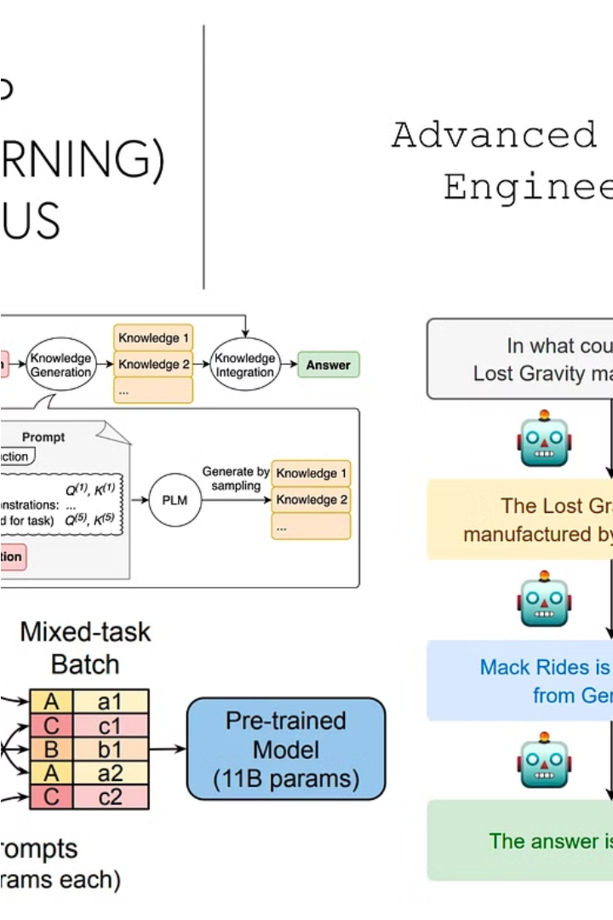
Introduction to Advanced Prompt Engineering
Prompt engineering has become a crucial skill for leveraging the power of large language models. This presentation will explore advanced techniques like zero-shot, few-shot, and chain-of-thought prompting to unlock the full potential of these powerful AI assistants.
By
Ashlin Divya A

Slide 2
Zero-Shot Prompting: Leveraging Pretrained Models
What is Zero-Shot Prompting?
Applications
Challenges
Zero-shot prompting is useful for quickly deploying language models to handle a wide variety of tasks like summarization, sentiment analysis, and text generation.
Ensuring the model's outputs are reliable and aligned with the intended task can be challenging without fine-tuning on relevant data.
Zero-shot prompting involves using a pretrained language model to perform tasks without any fine-tuning or additional training. The model leverages its broad knowledge to adapt to new prompts.

Slide 3
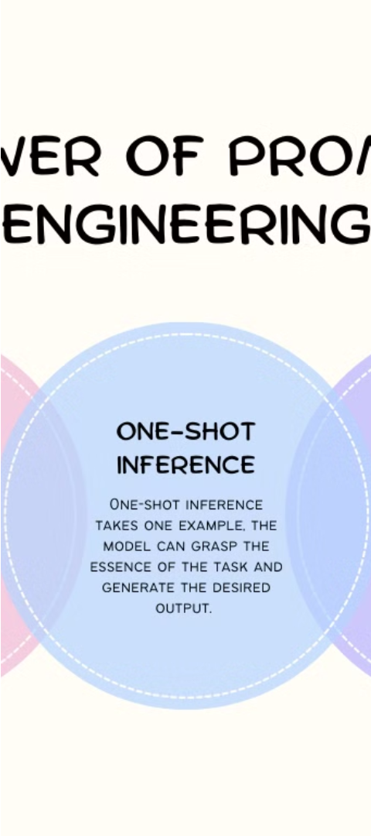
Few-Shot Prompting: Adapting to Limited Data
1
What is Few-Shot Prompting?
Few-shot prompting involves providing the language model with just a handful of relevant examples to adapt its behavior to a specific task or domain.
2
Benefits
Few-shot prompting allows for quick model adaptation without the need for extensive fine-tuning on large datasets.
3
Challenges
Carefully crafting the few-shot examples is crucial to ensure the model learns the desired behavior.

Slide 4

Chain-of-Thought Prompting: Stepwise Reasoning
1
What is Chain-of-Thought Prompting?
2
Applications
3
Benefits
Useful for tasks like math problem-solving, analytical reasoning, and open-ended decision making.
Provides transparency into the model's thought process and can lead to more reliable and trustworthy outputs.
Chain-of-thought prompting encourages language models to break down complex problems into a sequence of logical steps, mimicking human reasoning.

Slide 5
Prompt Optimization Techniques
Prompt Tuning
Prompt Ensembling
Iteratively refining the prompt to elicit the desired behavior from the language model.
Combining multiple prompts to leverage the strengths of different approaches.
Prompt Augmentation
Prompt Visualization
Automatically generating new prompts by introducing variations and transformations.
Analyzing prompt performance through visualizations to identify opportunities for improvement.

Slide 6




Prompt Engineering for Specific Applications
Text Generation
Sentiment Analysis
Question Answering
Code Generation
Crafting prompts for creative writing, story generation, and content production.
Prompting language models to produce working code based on natural language descriptions.
Designing prompts to extract emotional context and opinions from text.
Structuring prompts to elicit informative and coherent responses to queries.

Slide 7




Ethical Considerations in Prompt Engineering
Bias and Fairness
Ensuring prompts do not reinforce harmful biases or discriminate against certain groups.
Safety and Transparency
Developing prompts that produce safe and reliable outputs, with transparency into the model's reasoning.
Alignment with Human Values
Designing prompts that align with ethical principles and societal norms.

Slide 8
Conclusion and Future Directions
1
Ongoing Advancements
2
Importance of Expertise
3
Exciting Possibilities
Prompt engineering is a rapidly evolving field, with new techniques and applications constantly emerging.
Mastering advanced prompt engineering skills is crucial for effectively leveraging the power of large language models.
The future of prompt engineering holds the potential to revolutionize how we interact with and harness the capabilities of AI systems.

