Slide 1
Bachelor Of Engineering In Information Technology Semester Three, Second Year(Odd semester) 14th July 2025 to 22nd November 2025
Padre Conceicao College of Engineering
Verna Goa 403722 India

Slide 2
App Development
SEC-241
22nd July 2025

Slide 3
UNIT 1 :HTML
Sr.No | Title
1 | Elements
2 | Attributes
3 | Tags
4 | Forms
5 | Frames
6 | Tables
7 | Overview and features of HTML5

Slide 4
What is HTML?
HTML stands for Hyper Text Markup Language.
HTML file is a text file containing small markup tags.
The markup tags tell the Web browser how to display the page.
An HTML file must have htm or html file extension
An HTML file can be created using any simple text editor .eg Notepad.
HTML file can be saved in a directory of our choice and then open it in a browser.

Slide 5
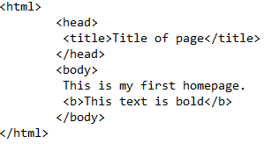
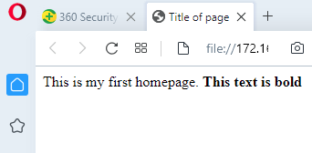
Example of an HTML (web) page
Figure 1 shows an example of a web page
Figure 2 shows an output on the Opera Browser

Slide 6
<html>
Every HTML page must begin with this line.
This line indicates that the current page should be interpreted by the web browser(when we ask the browser to open it) as an HTML page.
Because we enclose the word html inside the characters < and >, it is called a tag.
A tag in HTML conveys some information to the browser .
For example, here, the tag <html> tells the browser that the HTML page starts here.

Slide 7
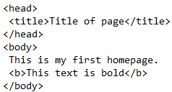

The head section
An HTML page consists of two sections
The head of the page
The body of the page
These lines define the head part of an HTML page.
The title of the page is defined in the head section.
In figure 1 we have defined the title of the page as “Title of page”
If we look at the browser output, we will notice that this value is displayed at the top of the page

Slide 8

The body section
The HTML page contains a body section.
The body section contains the tags that display the output on the browser screen other than the title. Here the body section contains some text, which is displayed as it is.
In figure 1,we have some text inside tags <b> and </b>
This indicates that whatever is enclosed inside these tags should be displayed in bold. b stands for bold
Here, we see that the text enclosed
Inside <b>and </b> tags is displayed in bold
Font in the browser output.

Slide 9
</html>
This tag indicates the end of the HTML document

Slide 10
Elements
An HTML document formally begins with the <!DOCTYPE> element.
All the HTML code resides between <html> and </html> tags.
The <html> element has two subelements inside it: <head> and <body>
The <head> element is used to specify information about the HTML Web page such as title of the Web page, whereas actual contents of the web page are specified inside the <body> element.

Slide 11
The <!DOCTYPE> Element
The <!DOCTYPE> Element is the first element in the HTML document, which specifies the Document Type Definition (DTD) used by the document.
The DTD is a separate file containing formal definition of grammar, such as supported elements and attributes used in markup language.
The browser checks the code of the document against the rules in the <!DOCTYPE> declaration.
The <!DOCTYPE> Element does not have a closing tag.

Slide 12
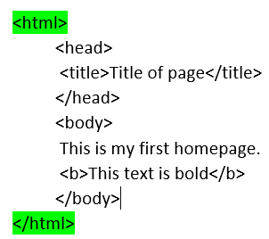
The <html> Element
The <html> Element starts an HTML document and it comes after the <!DOCTYPE> element in an HTML document.
It contains everything an HTML document contains except the <!DOCTYPE> element

Slide 13
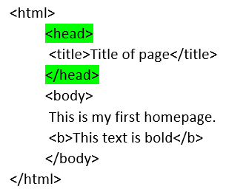
The <head> Element
The <head> Element contains general information about the HTML document, such as its title, keywords for search engines, and a base address for URLs.

Slide 14
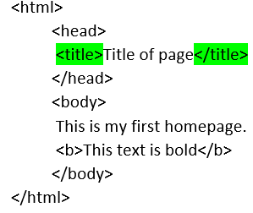
The <title> Element
The <title> element contains the title of the HTML document, which appears in the title bar of the Web browser and is used by search engines to refer the document.
Each <head> element should contain a <title> element.
You should try to keep the title text relatively short and to the point because some browsers face difficulties in handling titles longer than 256 characters.

Slide 15
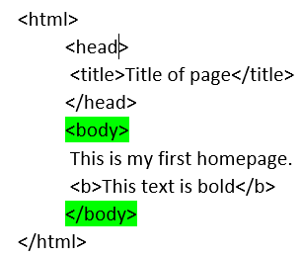
The <body> Element
The <body> element contains the body of the HTML document
The body of the HTML document includes the entire content that will appear in the Web browser.
It can also include text, images, and multimedia elements.

Slide 16
Attributes
Table 1 lists all the attributes of the <html> element
Sr.No | Attribute | Description
1 | class | Represents the class of the element and is used to render the content
2 | dir | Gives the direction to directionally neutral text; you can set this attribute to ltr for left to right text direction or rtl for right to left text direction
3 | id | Represents unique alphanumeric identifier for the element.
4 | lang | Represents base language used for the element
5 | version | Represents the version of the language used. This attribute has been marked as deprecated
6 | xmlns | Declares a namespace for custom tags in an HTML document.

Slide 17
Attributes
Table 2 lists all the attributes of the <head> element
Sr.No | Attribute | Description
1 | class | Represents the class of the element and is used to render the content
2 | dir | Gives the direction to directionally neutral text; you can set this attribute to ltr for left to right text direction or rtl for right to left text direction
3 | id | Represents unique alphanumeric identifier for the element.
4 | lang | Represents base language used for the element
5 | profile | Gives the location of one or more white-space separated metadata profile URLs for the current document.
6 | style | Represents inline style indicating how to render the element.
7 | title | Holds additional information for the element.

Slide 18
Attributes
Table 3 lists all the attributes of the <title> element
Sr.No | Attribute | Description
1 | class | Represents the class of the element and is used to render the content
2 | id | Represents unique alphanumeric identifier for the element
3 | lang | Represents base language used for the element
4 | style | Represents inline style indicating how to render the element

Slide 19
Attributes
Table 4 lists all the attributes of the <body> element
Sr.No | Attribute | Description
1 | alink | Specifies the color of the hyperlinks when they are clicked; you can set this attribute to a predefined color name or value. This attribute has been marked as deprecated
2 | background | Represents the URL of a graphic file, which is used as the background of the browser. This attribute has been marked as deprecated.
3 | bgcolor | Specifies the color of the background of the browser. You can set this attribute to a predefined color name or a color value. This attribute has been marked as deprecated.
4 | bgproperties | Indicates if the background should scroll when the text scrolls. If you set this attribute to fixed, which is the only allowed value, the background will not scroll when the text scrolls.
5 | bottomargin | Specifies the bottom margin, which is the empty space at the bottom of the document, in pixels.
6 | class | Represents the class of the element and is used to render the content
7 | dir | Gives the direction to directionally neutral text; you can set this attribute to ltr for left to right text direction or rtl for right to left text direction
8 | id | Represents unique alphanumeric identifier for the element
9 | lang | Represents base language used for the element
10 | language | Represents scripting language used for the element

Slide 20
Attributes
Table 4 lists all the attributes of the <body> element
Sr.No | Attribute | Description
11 | leftmargin | Specifies the left margin, which is the empty space to the left of the document, in pixels.
12 | link | Specifies the color of the hyperlinks that have not yet been visited. You can set this attribute to a predefined color name or value. This attribute has been marked as deprecated.
13 | marginheight | Gives the height of the top and bottom margins, in pixels.
14 | marginwidth | Gives the widht of the left and right margins, in pixels.
15 | rightmargin | Specifies the right margin, which is the empty space to the right of the document, in pixels.
16 | scroll | Specifies whether a vertical scrollbar appears to the right of the document
17 | style | Specifies whether a vertical scrollbar appears to the document; you can set this attribute to yes(which is the default value for the attribute) or no.
18 | text | Specifies the color of the text in the document. You can set this attribute to a predefined color name or value. This attribute has been marked as deprecated.
19 | title | Holds additional information for the element, such as tooltips.
20 | topmargin | Specifies the top margin, which is the empty space at the top of the document, in pixels.
21 | vlink | Specifies the color of the hyperlinks that have been visited. You can set this attribute to a predefined color name or value. This attribute has been marked as deprecated.

Slide 21
HTML Tags
HTML tags are used to mark-up HTML elements.
HTML tags are surrounded by the two characters < and >
HTML tags normally come in pairs like <b> and </b>
The first tag in a pair is the start tag eg. <b>
The second tag in a pair is the end tag eg. </b>
The text between the start and end tags is the element content.
An ending tag is named in the same way as the corresponding starting tag, except that it has a / character before the tag name.
HTML tags are not case sensitive, <b> means the same as <B>

Slide 22
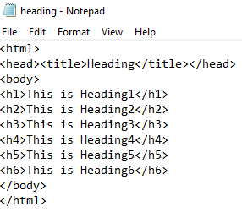
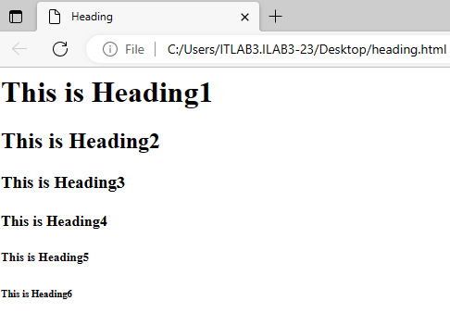
Headings
Headings in HTML are defined with the <h1> to <h6> tags. For example,<h1> defines the largest heading, whereas <h6> defines the smallest heading.HTML automatically adds an extra blank line before and after a heading
output
heading.html

Slide 23
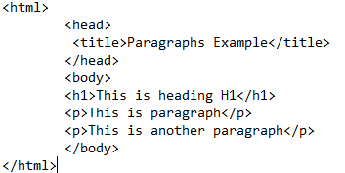
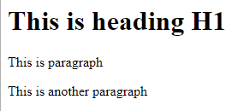
Paragraphs
Paragraphs are defined with the <p> tag.HTML automatically adds an extra blank line before and after a paragraph.
paragraph.html
output

Slide 24
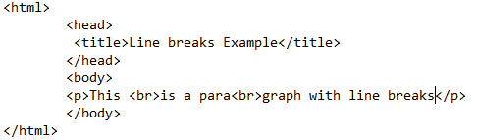
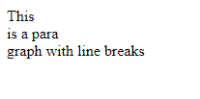
Line breaks
The <br> tag is used when we want to end a line.This tag does not start a new paragraph. The <br> tag forces a line break wherever you place it.
linebreaks.html
output

Slide 25
Creating Links to other pages
The anchor tag can be used to create a link to another document.This is called hyperlink or URL.The tag causes some text to be displayed as underlined.It we click on that text in the Web browser,our browser opens the site/page that the hyperlink refers to.The tag used is <a>.The syntax is <a href=“url”>Text to be displayed</a>
Here a=create an anchor
Href=Target URL
Text=Text to be displayed as substitute for the URL
For example <a href=“http://www.google.com/”>Visit Google!</a>
The result is visit Google!

Slide 26
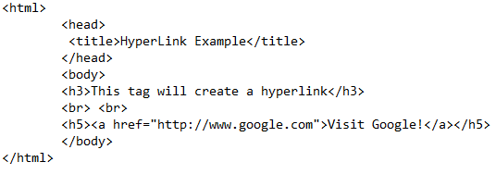
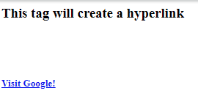
Creating Links to other pages
hyperlink.html
output

Slide 27
Forms
Form is an area containing form elements. A form element allows user to enter information. These form elements must be enclosed inside the opening <form> and closing </form> tags.
The basic purpose of an HTML form is to allow the user to enter data on one end and then send the data on the other end through the web server. It helps the user to purchase goods on the Internet and sign up for newsletters and mail accounts. The controls are the basic parts of an HTML form. The user fills the forms by entering data in the text boxes, clicking the radio button, and clearing the check boxes.
Each form has a submit button that helps to send data through the server to the action URL.

Slide 28
Creating an HTML Form
An HTML form is a web page that contains form elements. A basic form has three parts :
The <form> tag, which includes the URL of the script needed to process the form
The form elements. The various form elements can be text fields, drop-down lists, radio buttons, check boxes, and so on.
The submit button ,which sends the data to the server

Slide 29
Attributes of the <form> Tag
Sr.No | Attributes | Value | Description
1 | action | URL | Defines where to send the data when the submit button is clicked
2 | method | get post | Represents the HTTP method that sends data to the action URL .The default value for the method attribute is get.

Slide 30
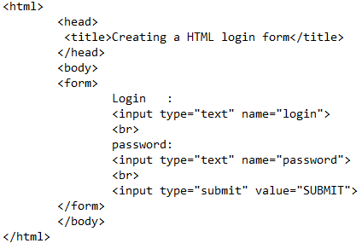
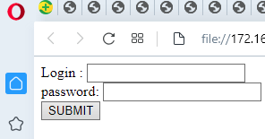
Creating a HTML login form
CreatingaForm.html
output

Slide 31
Specifying the Action URL and Method to send the form
In HTML ,you can direct the data that the user enters in the form to the server. You can do this by specifying the action URL and the method in your HTML code.
Specified inside the <form> tag, action URL is the physical address of the server to which you want the user data to be redirected at the click of the submit button.
You can specify two different submission methods for a form.
The method is specified inside the <form> tag using the method attribute.

Slide 32
Values of the Method Attribute
Sr.No | Value | Description
1 | method=“get” | Indicates that the form data has to be encoded by the web browser into a URL . This is the default method.
2 | method=“post” | Indicates that the form data appears within the message body.

Slide 33
Specifying the Action URL Method

Slide 34
Using the HTML Controls
A user interacts with forms through controls that are the basic element of a web page form. The HTML controls help to make a Web page user friendly. A user can enter data in the Web page form with the help of the HTML controls. There are plenty of controls available in HTML and the controls that provide input to the form are created using the <input> tag and a different value for the type attribute.
The tag used in HTML to add controls is the <input> tag that defines the start of an input field where the user can enter data. The <input> tag prompts the user to enter data on the Web server. In HTML ,the <input> tag as no end tag. The following Table lists a brief description of the attributes of the <input> tag
Using the <input> Tag to Add Controls

Slide 35
Attributes of the <input> tag
Sr.No | Attribute | Value | Description
1 | align | Left rigt top texttop middle absmiddle | Defines the alignment of the text following the image. It is used only with type =“image”
2 | alt | text | Defines an alternate text for the image. It is used only with type=“image”
3 | checked | checked | Indicates that the input element should be checked when it loads on the web server. It is used only with type=“checkbox” and type=“radio”
4 | disabled | disabled | Disables the input element when it loads on the Web server, so that the user cannot write text in it or select it.It cannot be used with type=“hidden”
5 | maxlength | number | Specifies the maximum number of characters allowed in a text field.It can be used only with type=“text”
6 | name | Field_name | Defines a unique name for the input element. This attribute is required with type=“button”,type=“checkbox”,type=“field”, type=“hidden”,type=“image”,and type=“password”,type=“text”,and type=“radio”

Slide 36
Attributes of the <input> tag
Sr.No | Attribute | Value | Description
7 | readonly | readonly | Indicates that the value of this field cannot be modified .It can be used only with type = “text”
8 | src | URL | Defines the URL of the image to display. It can be used only with type = “image”
9 | type | Button Checkbox File Hidden Image Password Radio Reset Submit text | Indicates the type of the input element. The default value is “text”

Slide 37
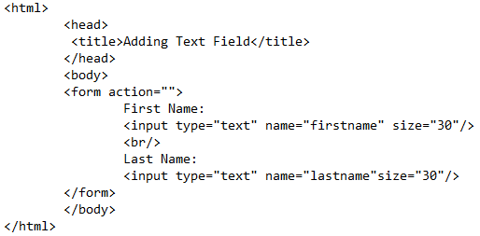
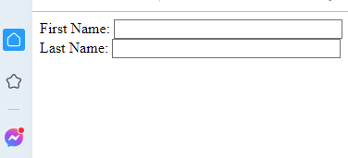
Adding Text Field to a Form
The <input type=“text”> tag is used to add a text field to a form. This tab provides a box to enter text that is transferred to the Web server.
AddingTextField.html
Output

Slide 38
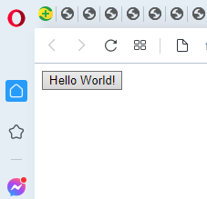
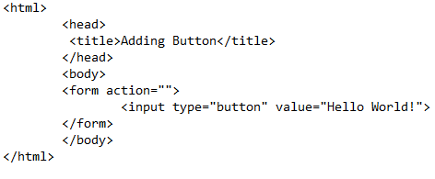
Adding a Button to a Form
A button is a type attribute value of the <input> tag that is used to create a button on the HTML form.
To add a button on your Web page, add the <input type=“button”> tag in your HTML code.
AddingButton.html
output

Slide 39
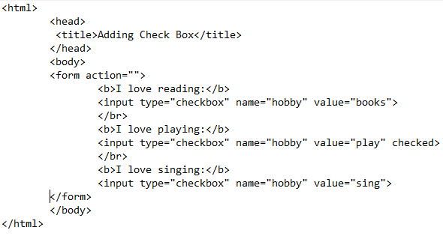
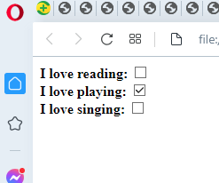
Adding Check Box to a Form
A Check Box is a small box with a check mark in it and a user can either select or clear it by a click. To add a Check Box to your Web page, add the <input type=“checkbox”> tag in your HTML code.
AddingButton.html
Output

Slide 40
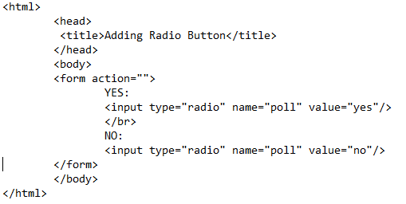
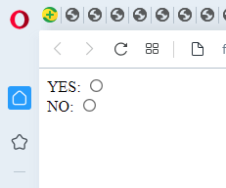
Adding Radio Button to a Form
A radio button is displayed as a circle and displays a dot in the middle when selected. To add a radio button to your Web page, add the <input type=“radio”> tag in your HTML code.
AddingRadioButton.html
Output

Slide 41
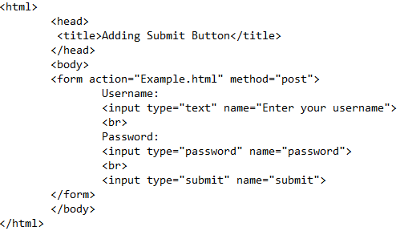
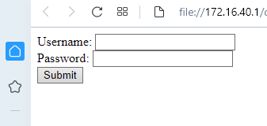
Adding a Submit Button to a Form
A submit button is the most important control in a form because when you click this button ,all the data in the form is sent to the Web server. When the user clicks the submit button, the data in the form is transferred to the URL specified in the <form action> tag. To add a submit button to your Web page, add the <input type=“submit”> tag to your HTML code.
AddingSubmitButton.html
Output

Slide 42
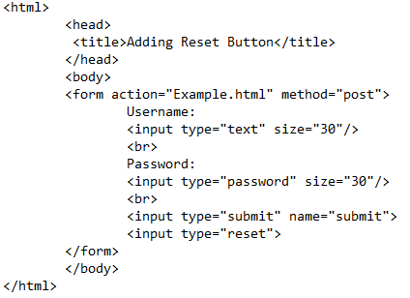
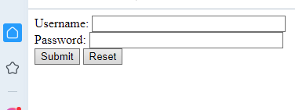
Adding a Reset Button to a Form
A reset button helps the user to clear all the data that they have entered in the text fields and start all over again. When the user clicks the reset button, all the controls in the form are returned to their original state and the values in the form fields are cleared. To add a reset button to your Web page ,add the <input type=“reset”> tag to your HTML code.
AddingResetButton.html
Output

Slide 43
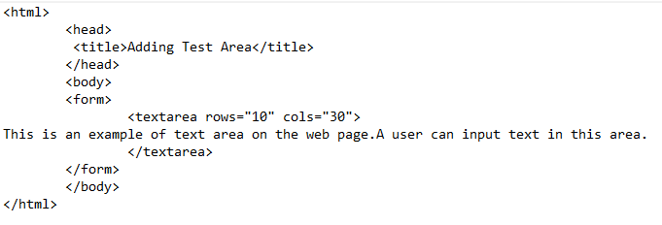
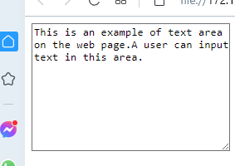
Adding a Text Area to a Form
A text area is a multi-line text input control and displays text entered in it. A user can write unlimited number of characters in the text area. You must set the numbers of rows and columns you want in the text area using the rows and cols attributes.
AddingTextArea.html
Output

Slide 44
Adding a Selection Control to a Form
In HTML, you can add selection controls to your Web page. The selection control includes the <select> , <option> , and <optgroup> tags.
The <select> tag defines the control for the selection of options and creates a drop-down list. You can use this tag in a form to accept a user input from a list of items.
The <option> tag defines an option in a drop-down list. Its most important attribute is the <value> attribute that determines the value being sent to the server.
The <optgroup> tag allows you to group your choices in the form. This tag helps you to group related choices, when you have a long list of options to select from in the drop-down list created by using the <select> tag.

Slide 45
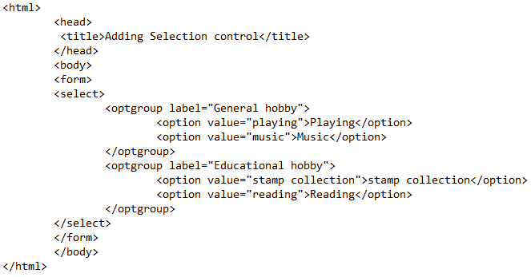
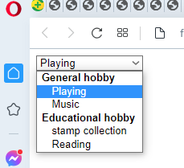
Adding a Selection Control to a Form
SelectionControl.html
Output

Slide 46
Adding a Multiple Selection Control to a Form
In the previous example, you can observe that the selection control allows you to select only a single option from the list. You can also select multiple options from the list at a time by using the same <select> tag. In this case, the <select> tag includes the multiple attribute to specify that multiple options can be selected at a time. To select multiple options from the list, you are required to hold down the CTRL key or the SHIFT key.

Slide 47
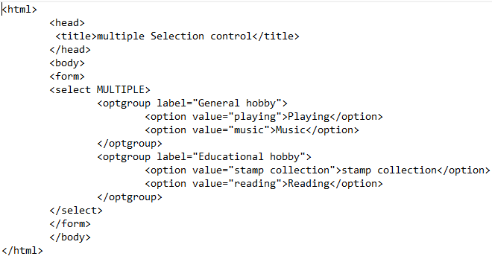
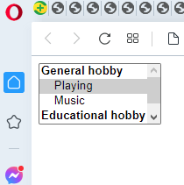
Adding a Multiple Selection Control to a Form
MultipleSelectionControl.html
Output

Slide 48
Frames
Frames allows us to split the HTML page window(i.e., the screen that the user sees) into two or more sections.
Each section of the page contains its own HTML document.
The original HTML page, which splits itself into one or more frames, is also an HTML page . See figure
Main HTML page
Main HTML page
Main HTML page

Slide 49
Creating a Frame
You an create a frame using <frameset> tag.
Inside the <frameset> tag, you have to use <frame> tag.
You must close all of your <frameset> tags after they have been used.
The <frame> tag uses an attribute named as src
The scr attribute takes an html file, as a value, which you want to upload to that frame.
You can create multiple <frame> tag inside a <frameset> tag.
The browser reads the frame src tags for the columns from left to right. Therefore, we should keep everything in the order we want it to appear. Suppose we wanted 3 frames across the page, not 2.We must modify our frameset tag and add another frame src tag for the third frame
<frameset cols="33%,33%,33%">
<frame src="frame1.html"/>
<frame src="frame2.html"/>
<frame src="frame3.html"/>
</frameset>

Slide 50
This covers only 99% of the space on the page. What about the remaining 1%?The browser would fill it up on its own. This may lead to slightly unpredictable results, so it is better to increase one of the 33% by 1 to make it 34%
<frameset cols=“50%,50%”>
This tag indicates to the browser that is loading this HTML page that the HTML page is not like traditional HTML page. It is a set of frames. There are 2 frames, each of which occupies 50% of screen space.
<frame src=“frame1.html”>
This tag tells the browser that in the first 50% reserved area, the contents of the HTML page titled frame1.html should be loaded.
<frame src=“frame2.html”>
This tag tells the browser that in the second 50% reserved area, the contents of the HTML page titled frame2.html should be loaded.

Slide 51
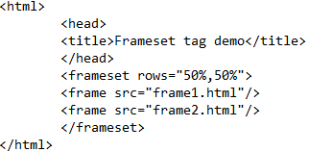
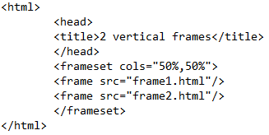
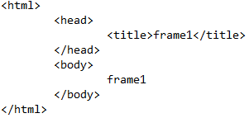
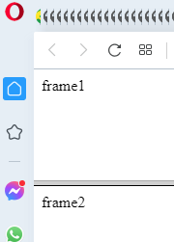
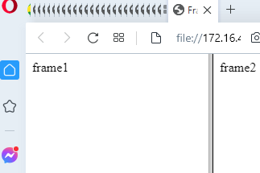
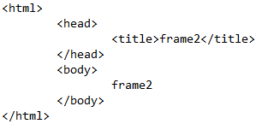
Frame1.html
Two Frames in rows and columns
2horizontalFrames.html
2verticalFrames.html
2Horizontal Frames output
2Vertical Frames output
Frame2.html

Slide 52
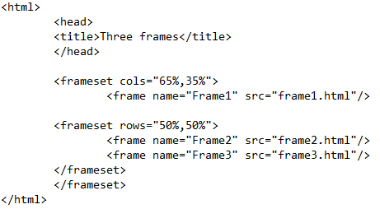
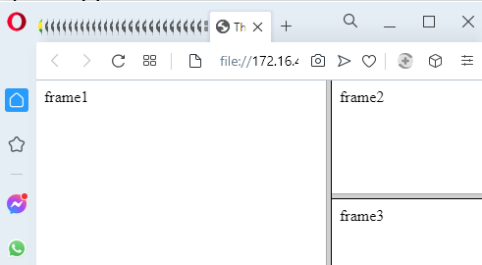
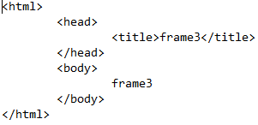
Three Frames: Vertical and Horizontal
3frames.html
3frames.html Output
Frame3.html

Slide 53
Setting Frame Border Thickness
You can apply border to the frame using the frameborder attribute of the <frameset> tag
If you want to set a border to your frame, specify either yes or 1 as a value of the frameborder attribute.
If you do not want to set a border to your frame, specify either no or 0 as a value of the frameborder attribute.
By default, a frame border is applied to the frames.
You can also set the thickness of the frame border using the framespacing attribute of he <frameset> tag

Slide 54
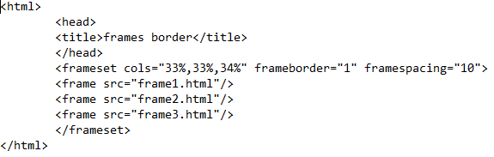
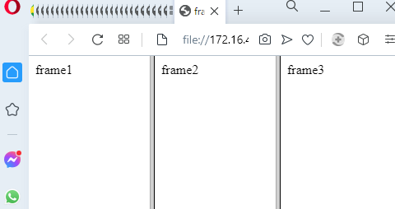
Create a web page ,named FrameBorderThickness.html to learn how to set the frame border thickness.

Slide 55
Applying Hyperlink Targets to a frame
A hyperlink is used to create a link between Web pages. When you click a hyperlink, it takes you to the referenced section on the same web page or another by using the href attribute of the anchor tag <a>
You can specify the target location of the desired web page by using the target attribute inside the <a> tag. You can use a name frame or predefined target name as hyperlink targets

Slide 56
Using a Named Frame as Hyperlink Targets
Named frames are those frames for which names are assigned and they can be used as hyperlink targets by specifying a frame name to the target attribute . Therefore, when you click the hyperlink, the referenced page opens in the target frame specified in the target attribute.

Slide 57
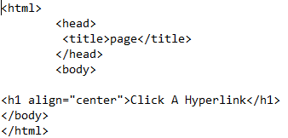
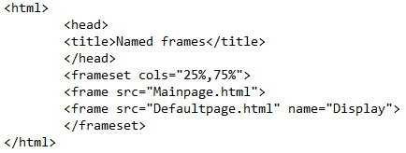
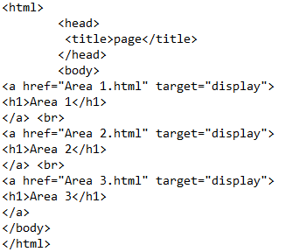
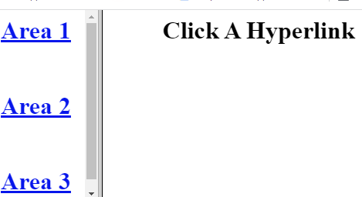
Namedframe.html
Defaultpage.html
Mainpage.html
output

Slide 58
Using a Predefined Target Name as Hyperlink Targets
When you do not want to open a Web page in a named frame,HTML provides the facility to use predefined target names to set the target locations of the desired Web page. Predefined target names take one of the four values : _blank, _self ,_parent, and _top to the target attribute. So when you click the hyperlink, the referenced page opens in the target frame that you assign in the target attribute. For example, if you use _blank , the web page opens in a new blank window.

Slide 59



PredefinedTarget.html
output

Slide 60
Tables
An HTML table allows you to arrange data ,such as texts,links,forms, and other tables. In a table, data is arranged in the form of rows and columns of cells. A table can have an associated caption to provide a short description of the purpose of the table. You can specify headings of a table and set the table border and color. You can also set the width of the table and its columns, as well as alignment and cell content as per the requirement. You can set the distance between cell borders and the content within the cell through Cellpadding attribute of the <table> tag. If you want ,you can also create multiple tables inside a table and combine rows and columns in a table using the rowspan and colspan attributes of the <table> tag respectively.

Slide 61
Creating a Table
A pair of <table> and </table> tags represents an HTML table and a pair of <tr> and </tr> tags represents a row in a table. A pair of <th> and </th> tags is used to add a column heading in a column and pairs of <td> and </td> tags are used to add data values in the column. While creating a table, the number of pairs of <tr> and </tr> tags added between the <table> and </table> tags determines the number of rows in the table.Each pair of <tr> and </tr> tags contains several pairs of <td> and </td> tags (or pairs of <th> and </th> tags for the row containing column headings) to determine the number of columns in the table.

Slide 62


Table.html
output

Slide 63
Specifying a Caption to a Table
A caption is a short description of a table that provides a brief explanation about it and helps you to understand its purpose.
For example, when you create table containing the details about students, you can specify a relevant caption to it, such as Student Details.
A caption is specified to a table with the <caption> tag.

Slide 64


Specifying a Caption to a Table
TableCaption.html
output

Slide 65
Adding a Table Heading
A table heading is used to specify the title of a particular cell.
For example, when you create a student database containing student name, date of birth, and address fields, you can specify these fields as table headers to facilitate better understanding.

Slide 66


Adding a Table Heading
TableHeading.html
output

Slide 67
Setting the Table Border
When you create a table, it appears without border and looks incomplete.
You can add a border to a table with the border attribute of the <table> tag.
In addition to add a border to a table, you can also set the thickness of the border as per the need.

Slide 68


Setting the Table Border
TableBorder.html
output

Slide 69
Aligning a Table and Cell Content
You can align your table with the align attribute of the <table> tag. You can also align the cell content inside a table by specifying the align attribute and its value inside the <th> tag or <td> tag
While creating a Web page, when you have both text and table, you can align your table as per the requirement. Table alignment can be done in one of the three different ways, such as left, right, and center.
Aligning a Table in a Web page

Slide 70


Aligning a Table in a Web page
AlignTable.html
output

Slide 71
Aligning the Cell Content
You can also align cell content similar to a table, in one of the three different ways:
Left
Right
center

Slide 72


Aligning the Cell Content
AlignContent.html
output

Slide 73
Setting the Width of a Table and Table Columns
If you are creating a table with large number of columns, which makes it difficult to see the records clearly, you can increase the table width to enhance visibility. You can also decrease the table width as per the requirement.
If your table contains large values and the small size of columns effects its visibility, you can increase the column width. You can also decrease the column width as per the requirement.
You can specify the width of both table and table columns using the width attribute of <table> , <th>, and <td> tags respectively.

Slide 74
Setting the Width of a Table
A table width can be expressed as an absolute value in pixels or as a percentage of screen width.
If you have a table of graphics, such as a Navigation bar, it is better to define the table width in pixels.
If you have a table of text, such as student record, it is better to define the table width in percentage.

Slide 75


Setting the Width of a Table
TableWidth.html
output

Slide 76
Setting the Width of Table Columns
A table column width can also be expressed as an absolute value in pixels , or as a percentage of screen width.
If the cell content contains graphics, such as a Navigation button, it is better to define the column width in pixels.
If the cell content contains text, such as student name, it is better to define the column width in percentage.

Slide 77


Setting the Width of Table Columns
ColumnWidth.html
output

Slide 78
Changing the Background Color of a Table
If you want to change the Background Color for the entire Table, use the bgcolor attribute in the <table> tag.
You can also change the color for the entire row by inserting the bgcolor attribute inside the <tr> tag.
You can change the color for the individual cell by inserting the bgcolor attribute inside the <td> tag.
To specify a color for the bgcolor attribute, you can use a RGB value, such as #22dd55 and #22ddaa,as well as color name, such as white and yellow.

Slide 79


Changing the Background Color of a Table
BackgroundColor.html
output

Slide 80
Setting Cell Padding and Cell Spacing
If you want extra space between your cell content and cell border, you can specify it by using cell padding.
If you want extra space between cell borders in the table, you can specify it by using cell spacing.

Slide 81


Setting Cell Padding
cellpadding.html
output

Slide 82
Setting Cell Spacing
Cell spacing is used to specify the space between the borders of cells. You can set the cell spacing with the cellspacing attribute of the <table> tag.

Slide 83


Setting Cell Spacing
CellSpacing.html
Output

Slide 84
Spanning Rows and Columns
When you work with tables ,it is sometimes required to combine one or two adjacent cells into one. The process of combining one or more adjacent cells into one is known as spanning cells. The vertical spanning of cells is known as rowspan and the horizontal spanning of cells is known as colspan.

Slide 85
Spanning Rows
You can span cells vertically by using the rowspan attribute with the <td> or <th> tag. The rowspan attribute requires a number that is equal to the number of cells you want to combine vertically in one column.

Slide 86


Spanning Rows
RowSpan.html
output

Slide 87
Spanning Columns
You an span cells vertically by using the colspan attribute with the <td> or <th> tag.
The colspan attribute requires a number that is equal to the number of cells you want to combine horizontally into one column.

Slide 88


Spanning Columns
ColSpan.html
output

Slide 89
Nesting Tables
Nesting refers to the placement of one thing inside another. For example, if you are creating a Web page with different types of tables placed one inside the other, you can nest all the tables.

Slide 90


Nesting Tables
NestingTable.html
output

Slide 91
To insert image in your webpage
<img src="your-image.jpg" alt="A description of the image">

