Slide 1
Bachelor Of Engineering In Information Technology Semester Three, Second Year(Odd semester) 16th July 2025 to 26th November 2025
Padre Conceicao College of Engineering
Verna Goa 403722 India

Slide 2
App Development
SEC-241
2nd September 2025

Slide 3
Unit 2 Building User Interfaces
Sr.No | Topics
1 | Understanding UI/UX design principles for mobile apps
2 | designing layouts with Flexbox
3 | designing layouts with Grid
4 | designing layouts with constraints
5 | Working with widgets
6 | Working with buttons
7 | Working with sliders
8 | Working with text fields

Slide 4
Designing layouts with Flexbox

Slide 5
What is CSS Flexbox?
Flexbox is short for the Flexible Box Layout module.
Flexbox is a layout method for arranging items in rows or columns.
Flexbox makes it easier to design a flexible responsive layout structure, without using float or positioning.

Slide 6
Why Use Flexbox?
1.Responsive Design:
Easily creates layouts that adapt to different screen sizes.
2.Simplified Layouts:
Provides a more flexible alternative to older methods like floats for arranging content.
3.Space Distribution:
Intelligently distributes available space between items, rather than requiring manual calculation.
4.Alignment Control:
Offers precise control over the alignment of items both horizontally and vertically.

Slide 7
Key Concepts of CSS Flexbox
One-Dimensional: Flexbox manages layouts in a single direction (either a row or a column) at a time.
Flex Container: The parent element to which Flexbox properties are applied. - The parent (container) <div> element
Flex Items: The children of the flex container that are arranged by the layout. - The items inside the container <div>
Main Axis: The primary axis along which flex items are laid out (row or column).
Cross Axis: The axis perpendicular to the main axis.

Slide 8
Primary Properties of CSS Flexbox
display: flex;: Applied to the parent element to establish it as a flex container.
flex-direction: Sets the main axis direction (e.g., row, column, row-reverse, column-reverse).
justify-content: Distributes space along the main axis (e.g., flex-start, flex-end, center, space-between, space-around).
align-items: Controls alignment of items along the cross axis.
flex-wrap: Determines if items should wrap onto a new line when they don't fit in the container.

Slide 9
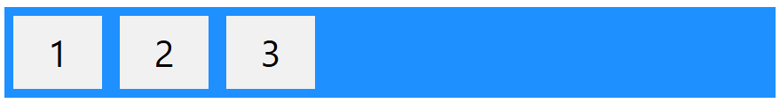
Design a Flex Container with Three Flex Items
To start using CSS Flexbox, you need to first define a flex container.
The flex container becomes flexible by setting the display property to flex.
The element above represents a flex container (the blue area) with three flex items.

Slide 10
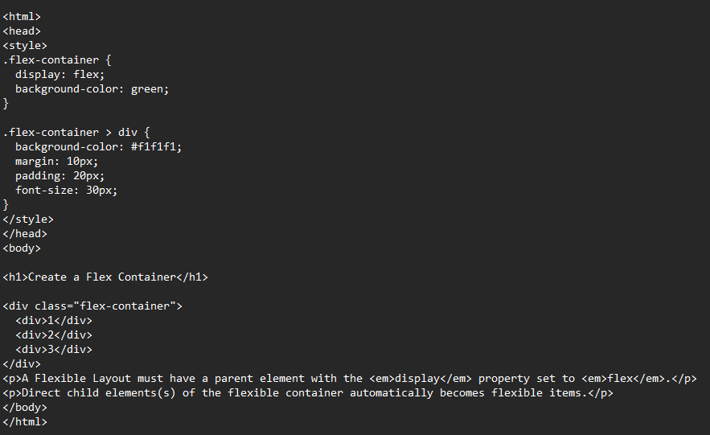

Slide 11
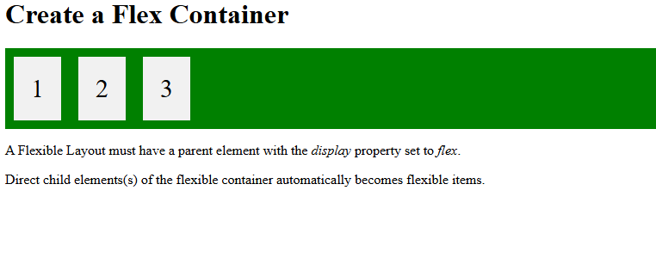
output

Slide 12
The CSS Flex Container
The blue area shown in the figure in the previous slide is a flex container with three flex items.
The flex container becomes flexible by setting the display property to flex:
.flex-container { display: flex; }

Slide 13
The CSS flex-direction Property
The flex-direction property specifies the display-direction of flex items in the flex container.
This property can have one of the following values:
row
column
row-reverse
column-reverse

Slide 14
Display the flex items horizontally(left to right)
The row value is the default value, and it displays the flex items horizontally (from left to right):
.flex-container { display: flex; flex-direction: row; }

Slide 15
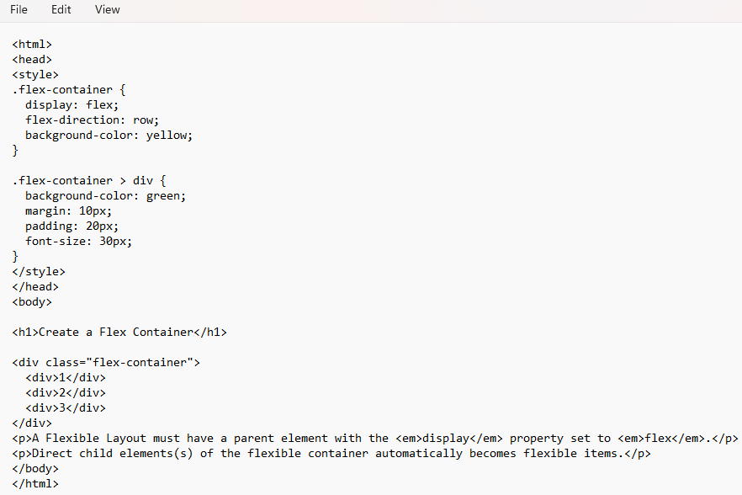
row.html

Slide 16
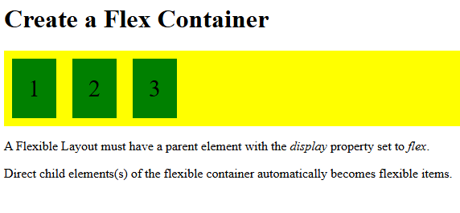

Slide 17
Display the flex items vertically(top to bottom)
The row value is the default value, and it displays the flex items horizontally (from left to right):
.flex-container { display: flex; flex-direction: column; }

Slide 18
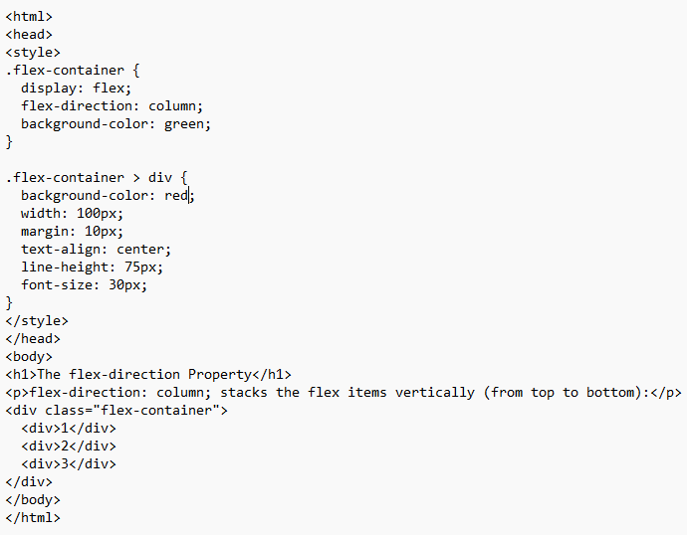
column.html

Slide 19
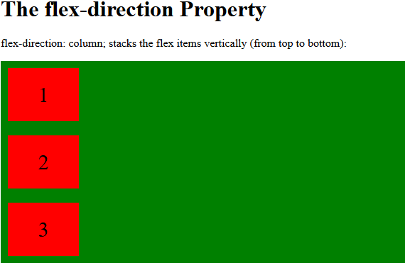
output

Slide 20
Display the flex items horizontally(right to left)
The row-reverse value displays the flex items horizontally (but from right to left):
.flex-container { display: flex; flex-direction: row-reverse; }

Slide 21
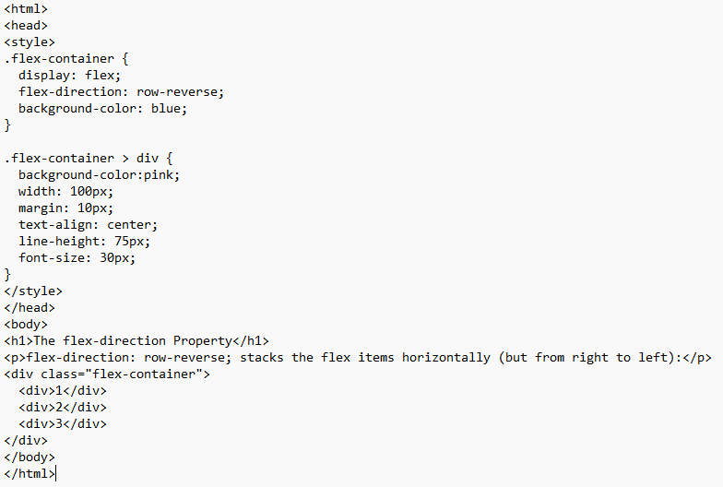
RowReverse.html

Slide 22
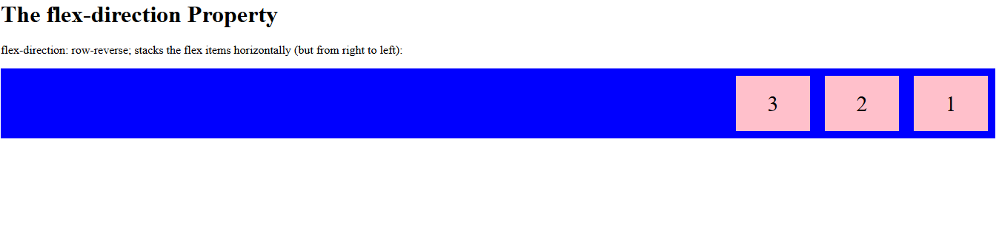
output

Slide 23
Display the flex items vertically(bottom to top)
The column-reverse value displays the flex items vertically (but from bottom to top):
.flex-container { display: flex; flex-direction: column-reverse; }

Slide 24
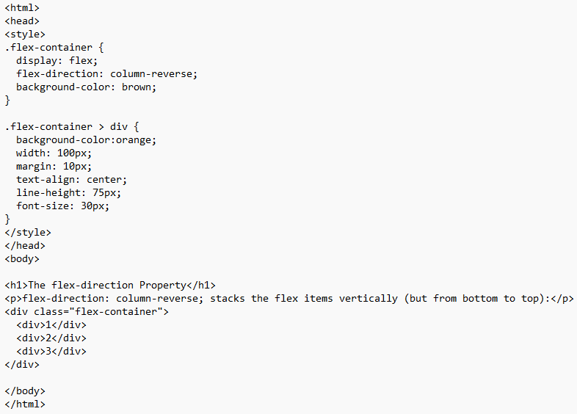
columnReverse.html

Slide 25
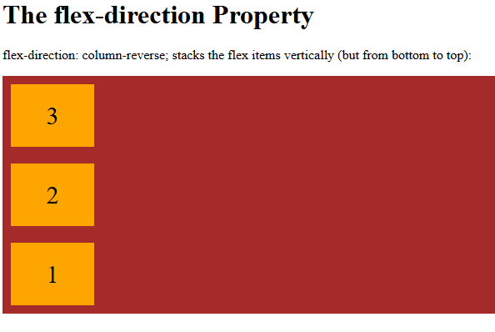
output

Slide 26
The CSS flex-wrap Property
The flex-wrap property specifies whether the flex items should wrap or not, if there is not enough room for them on one flex line.
This property can have one of the following values:
nowrap
wrap
wrap-reverse

Slide 27
The CSS flex-wrap Property-nowrap
The nowrap value specifies that the flex items will not wrap (this is default):
.flex-container { display: flex; flex-wrap: nowrap; }

Slide 28
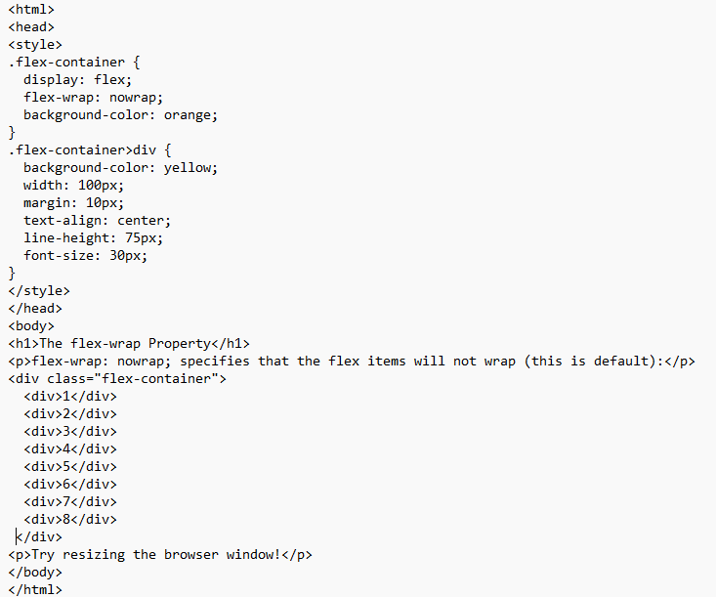
nowrap.html

Slide 29
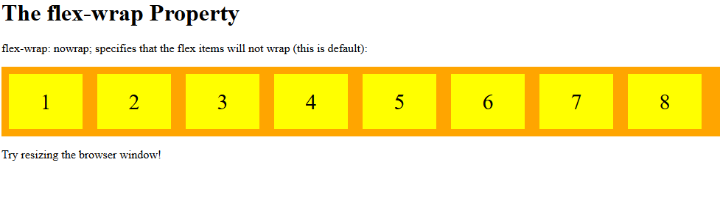
output

Slide 30
The CSS flex-wrap Property-wrap
The wrap value specifies that the flex items will wrap if necessary:
.flex-container { display: flex; flex-wrap: wrap; }

Slide 31
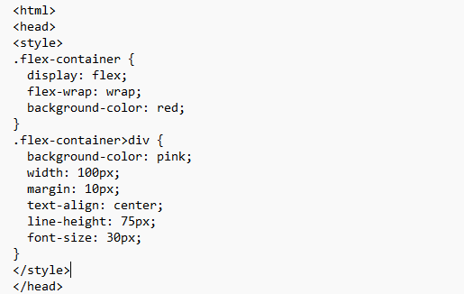
Wrap.html

Slide 32
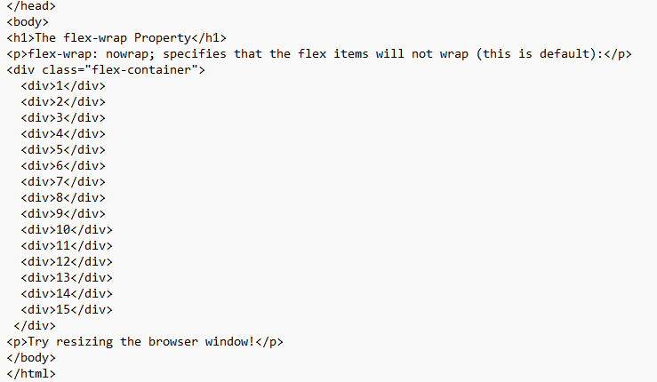

Slide 33
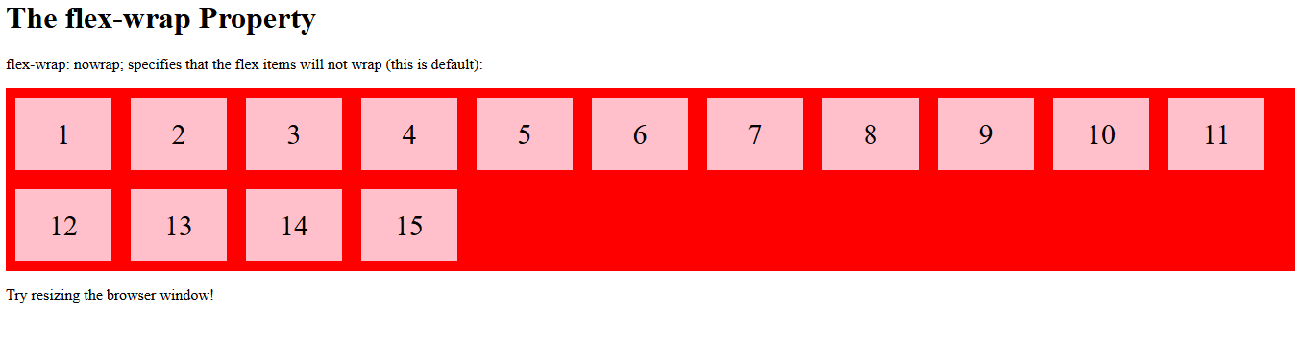
output

Slide 34
The CSS flex-wrap Property-wrap-reverse
The wrap-reverse value specifies that the flex items will wrap if necessary, in reverse order:
.flex-container { display: flex; flex-wrap: wrap-reverse; }

Slide 35
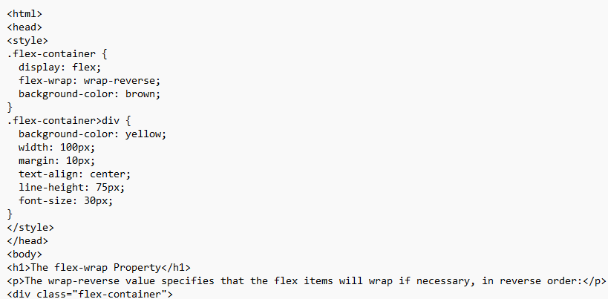
wrapReverse.html

Slide 36
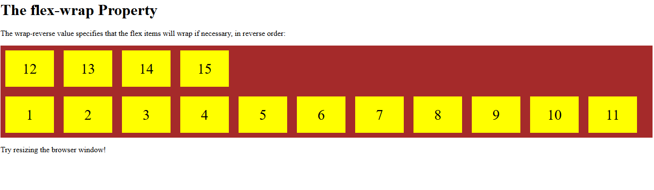
output

Slide 37
The CSS flex-flow Property
The flex-flow property is a shorthand property for setting both the flex-direction and flex-wrap properties.
.flex-container { display: flex; flex-flow: row wrap; }

Slide 38
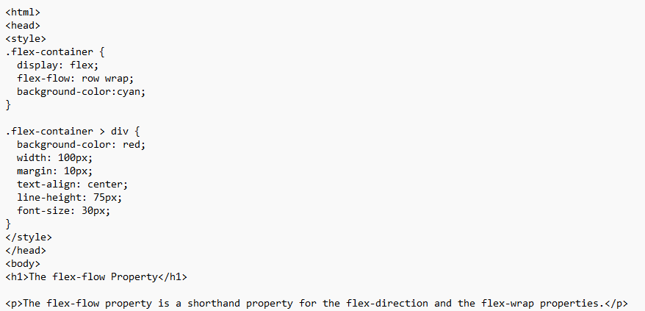
flexflow.html

Slide 39
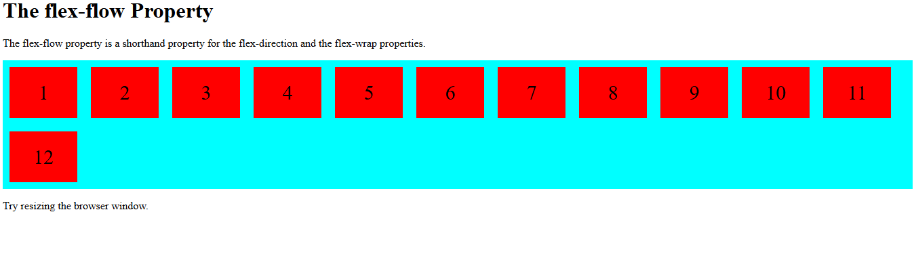
output

