Slide 1
Cover Page
Make big IP bigger
Transforming Audience Insights into Creative and Commercial Success

Slide 2
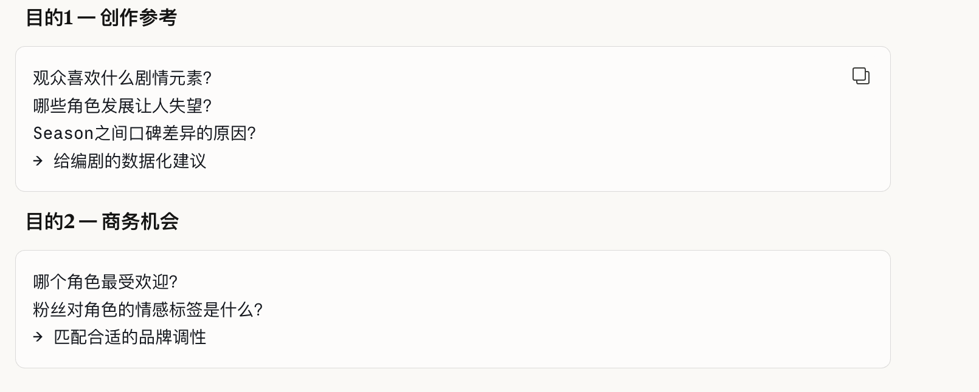
Problem Statement
The High Cost of "Guesswork" in Entertainment
The Pain Point: Studios and Brands often make million-dollar decisions based on Lagging Indicators (Ratings/Box Office) or "Gut Feeling."
The Risk: 1. Narrative Risk: Plot twists that alienate the core fanbase, leading to a drop in viewership. 2. Commercial Risk: Signing celebrities based on "Fame" rather than the Real-time Persona-Brand Fit identified by the community.
The Need: A data-driven system to de-risk investments by listening to what the audience is actually saying during the journey.

Slide 3
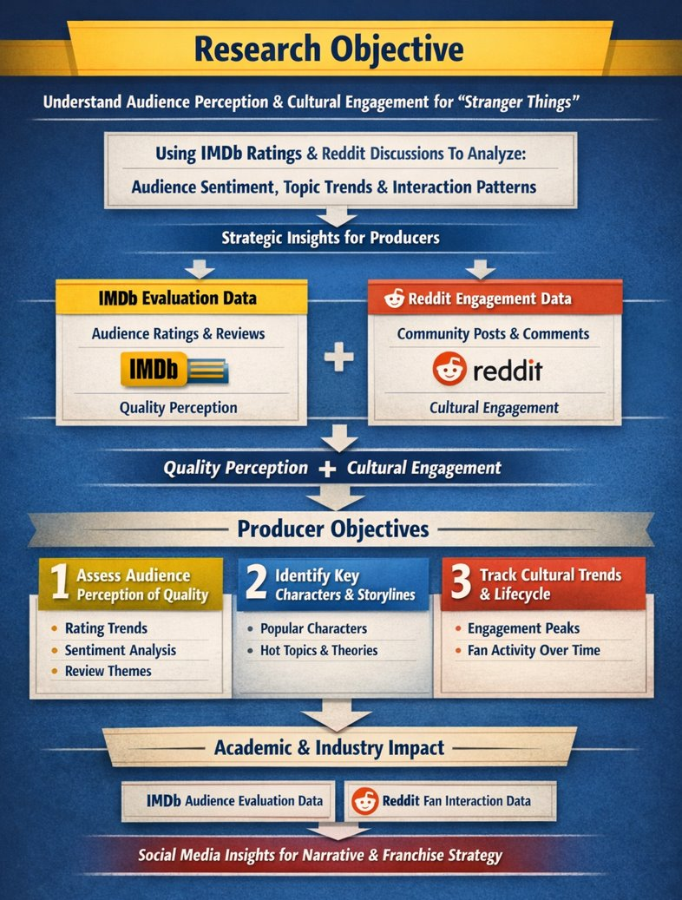
What we need for extracting insights:
Lens 1: Content creation
Lens 2: Marketing enhancement

Slide 4
Research Roadmap
IP Sourcing
Research Gap
Scrap Data
Seeking a blockbuster IP suitable for research
1 – Beyond Surface Sentiment
From “How they feel” to “What to build”
There is a lack of Structural Analysis that connects specific plot points and character traits to creative and commercial decisions.
2 – Solving Data Bias
Professional Critics + Passionate Fans = Objectivity
Research rarely combines Expert Reviews with Community Discussions to get a 360-degree view.
Data Analysis
Result
Business Implication

Slide 5
Know About Stranger Things
a science fiction and horror TV series set in the 1980s. It follows a group of kids in a small town who discover secret experiments, supernatural forces, and a mysterious girl with special powers. Together, they try to stop dangerous creatures from another dimension called the Upside Down. 🎬👾
Eleven – nosebleed; telekinesis; Eggo waffles
Mike Wheeler – walkie-talkie leader; stripped shirts
Dustin Henderson – curly hair; baseball cap
Lucas Sinclair – slingshot; bandana
Will Byers – “vanished” / trapped in Upside Down
Max Mayfield – red hair; skateboard
Jim Hopper – rugged police hat; father
Joyce Byers – Christmas lights on wall
Big global fan reactions
Mixed sentiment and fan culture
Ongoing cultural impact
🌍 Huge global viewership - The entire series has now crossed over 1.2 billion total views, all five seasons have simultaneously ranked in Netflix’s global Top 10
🏆 Awards and industry recognition - the series has earned over 80 awards from more than 250 nominations worldwide, including Emmys® and Screen Actors Guild Awards.
📈 Cultural and economic impact - the franchise has generated billions of social impressions and sold millions of books, comics, and merchandise, even contributed over $1.4 billion to the U.S. economy and created thousands of production jobs.
Notes:
Source:
Total view - https://www.imdb.com/news/ni65632156/
Award and nomination - https://en.wikipedia.org/wiki/List_of_awards_and_nominations_received_by_Stranger_Things
Economic impact -
https://about.netflix.com/en/news/made-in-america-how-stranger-things-electrified-the-us-economy
https://www.georgiaentertainment.com/2026/01/stranger-things-generated-over-650m-for-georgias-economy-netflix-reports/#:~:text='Stranger%20Things'%20Generated%20Over%20$650,Hawk%20Theater%20in%20downtown%20Hawkins.

Slide 6
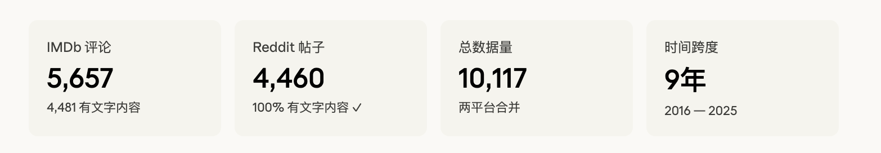
Data
Source of data (IMDb，Reddit）
Process details: scrap, variables, clean, what each dataset is designed for?......
Tools: Python
需要说明下两个平台数据爬虫的规则逻辑（尤其是Reddit的第五季数据，可以两个平台都有个data overview)
Data Screenshot

Slide 7
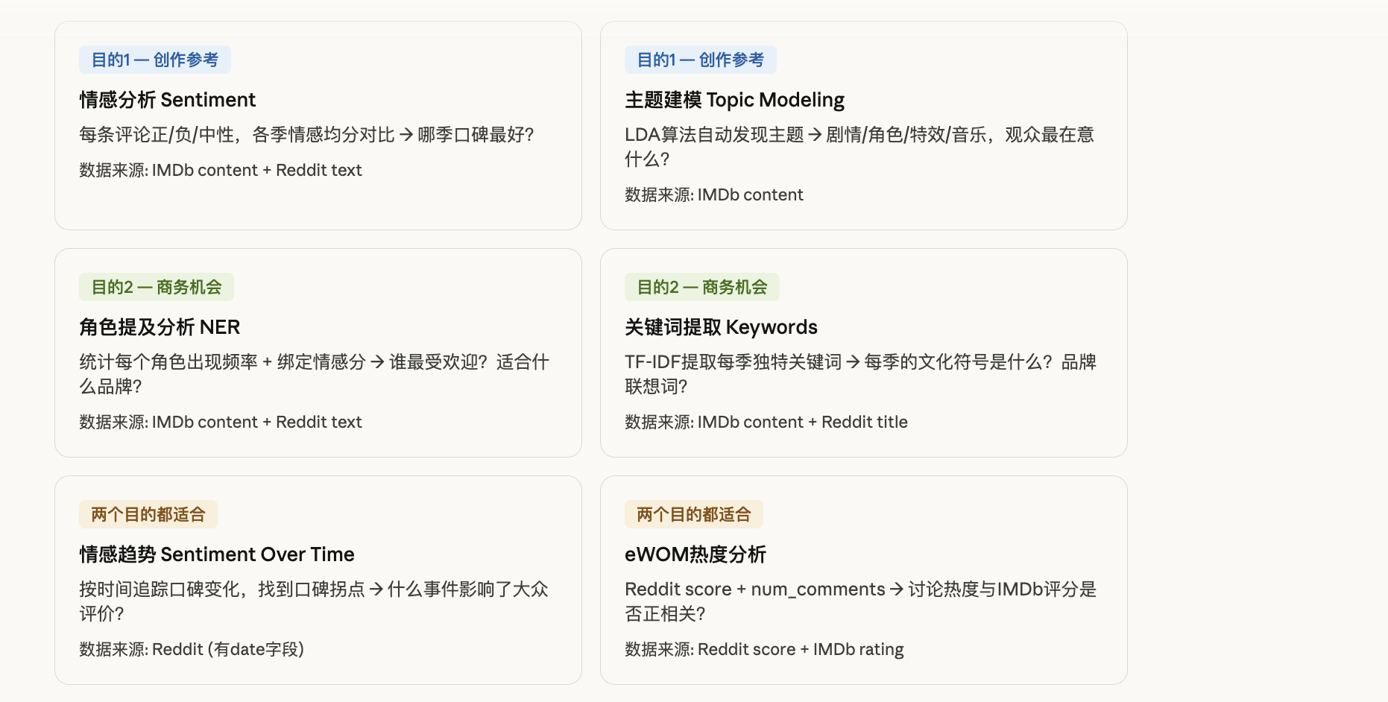

Slide 8
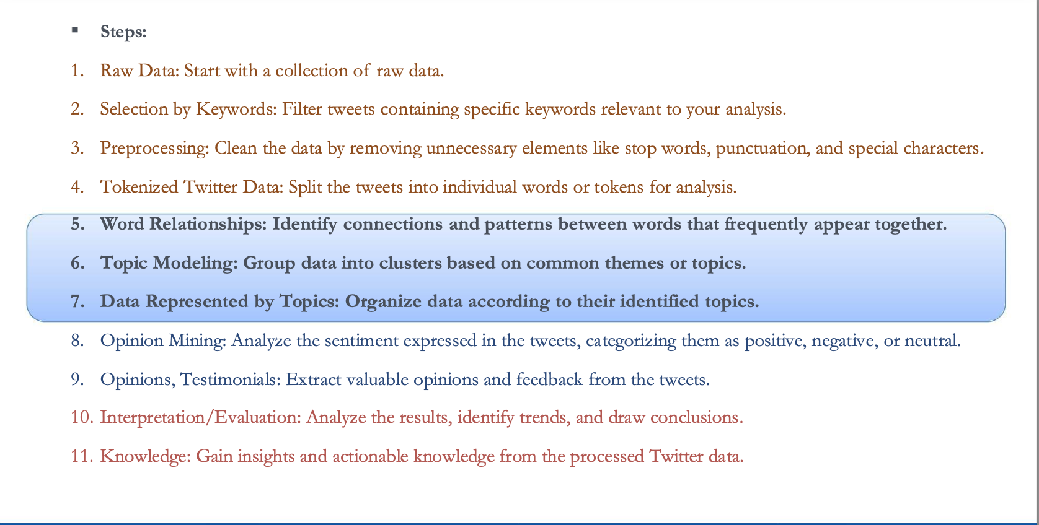

Slide 9
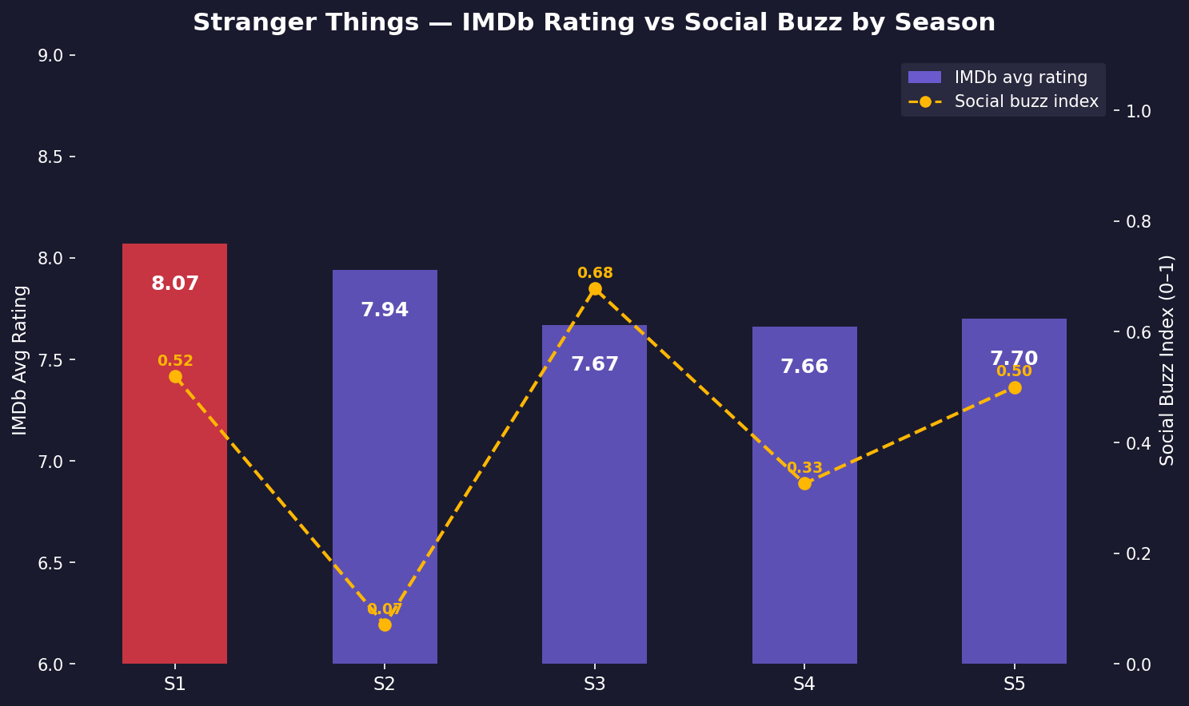
Level1: Rating Trend vs. Social Buzz
1.数据全部用的IMDb平台，这样打分vs social buzz保持同一维度
2. Social buzz index：用了评论数量和互动点赞数量（helpful+unhelpful），把两个指标分别归一化到 0-1，再加权平均
每一季用1-2句话概括下核心剧情？不然这个数据看了也没有意义
To prove high rating doesn’t mean high buzz, but for business, buzz is more important

Slide 10
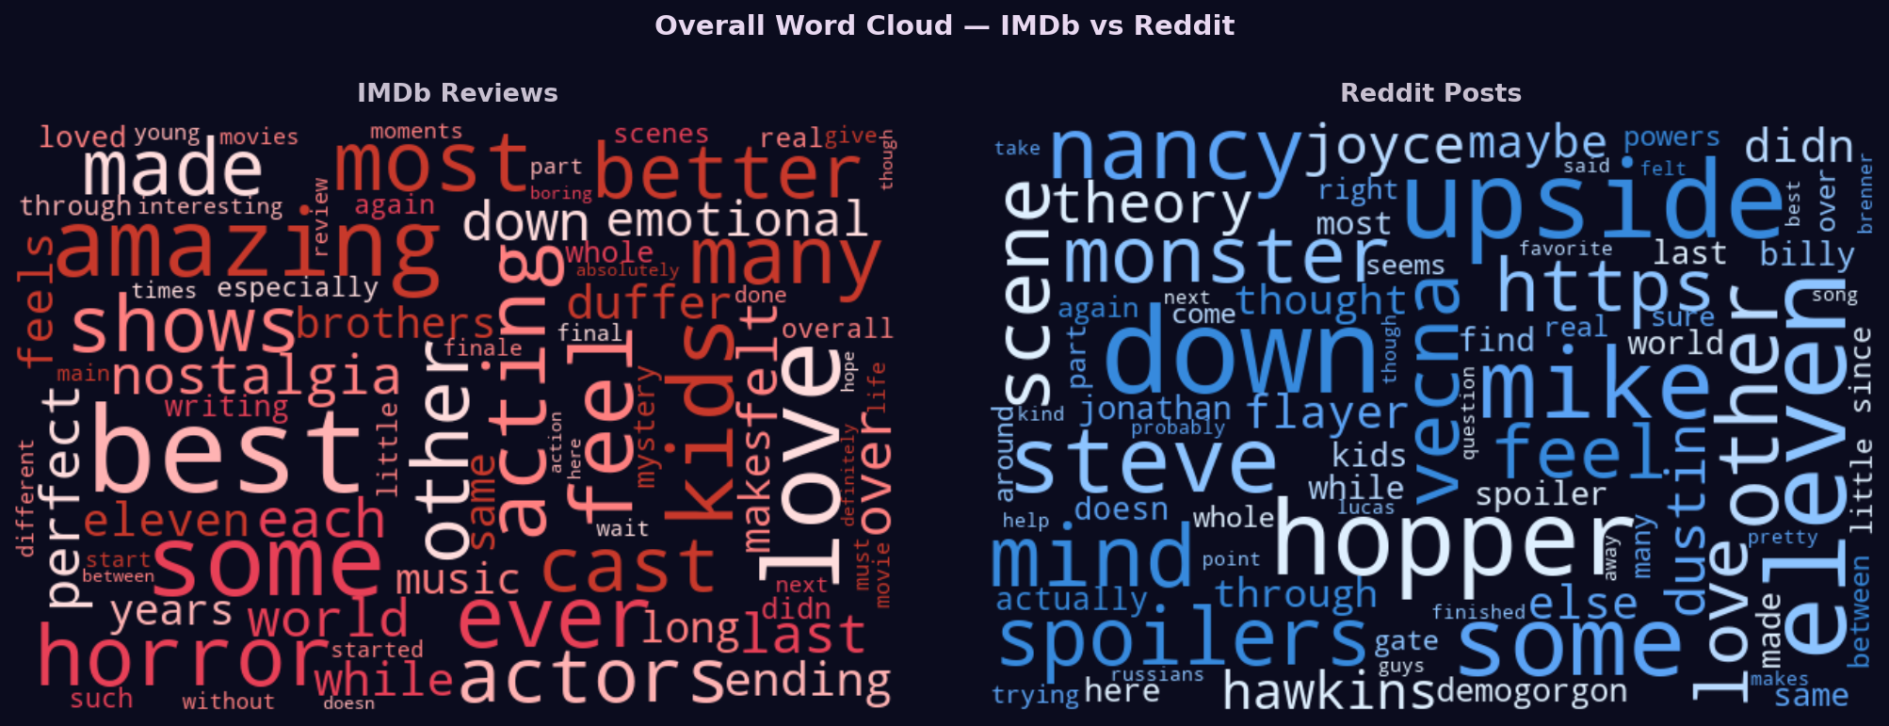
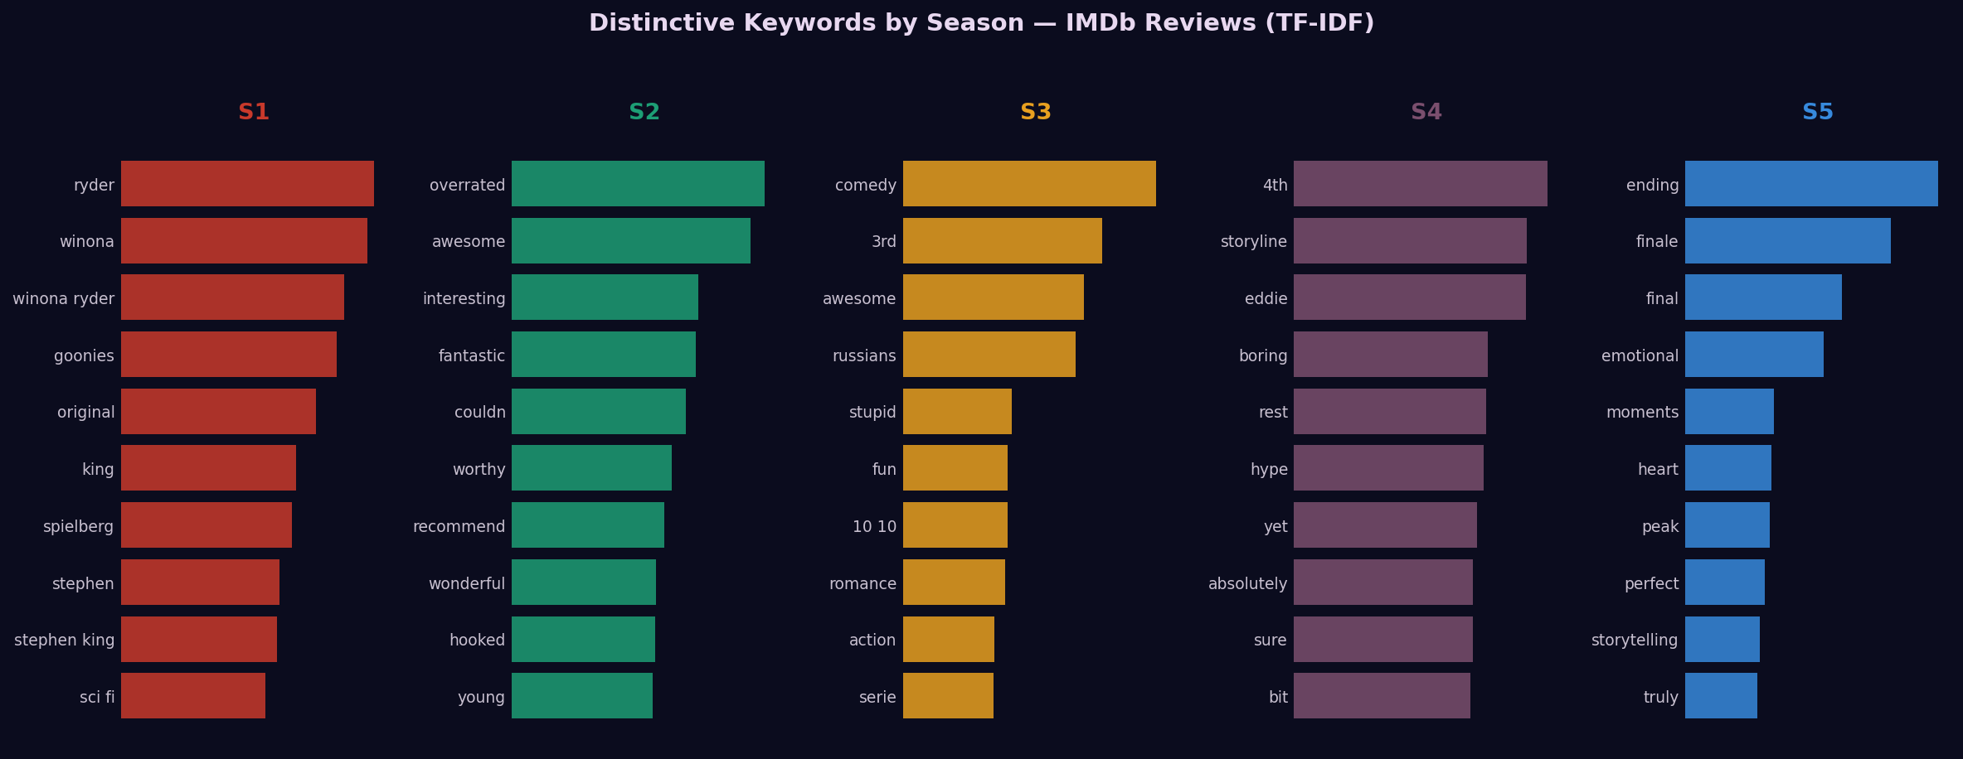
Season Wordcloud&Frequency
第一张是整体讨论氛围的词云图（双数据集），可以展示两个平台关注焦点差异。
各季作品的词频图。IMDB的数据，已经剔除了噪音词。我也尝试普通的imdb的，但是这个平台的词比较泛，比如kids, actor，属于影评的通用词汇，不是各季的特点，个人感觉参考意义不大。用TF-IDF的话图里每一季的词会比较独特。​
​

Slide 11
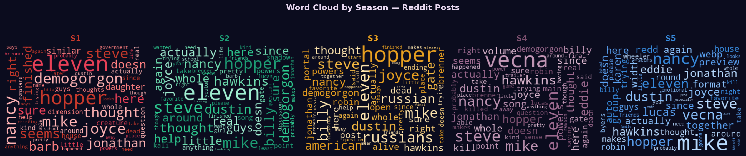
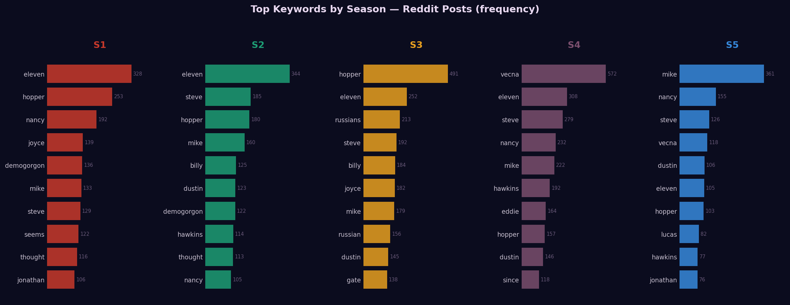
第三张是Reddit的词云图可以衔接我们上一个Social Buzz板块
Reddit的Keywords趋势图，已经去掉噪音词。这张图记录了一些角色名的词频变换，有几个角色表现非常突出。我想着可以用它来衔接后面“寻找商业机会”的部分，看看能不能从角色热度变化里挖出一些商业切入点。

Slide 12
Sentiment: Season
Positive/Negative/Neutral
Specific emotions: such as disappointed/surprised…

Slide 13
Topic Modelling

Slide 14
Character: sentiment + Keyword

Slide 15
Business Implication
Plot Creative
Notes:
Producer Perspective:
1. Creative Risk Mitigation
Insight: Leverages IMDb reviews and Reddit discourse to move beyond "gut feeling" by identifying which narrative elements—such as specific character arcs, thematic tones, or world-building rules—resonate most with the audience.
Production Action: Producers can adjust the narrative weight of subplots or pivot story directions in upcoming seasons based on data-driven "Creative Advice".
Value: Minimizes "Narrative Risk" by preventing plot twists that might alienate the core fanbase.
2. High-Efficiency Content Promotion
Insight: Identifies "Social Buzz" and organic hashtags to pinpoint which specific scenes or characters have the highest viral potential.
Production Action: Informs the selection of "hooks" for trailers and teaser content to ensure the show’s own promotional resources are allocated to the most shareable assets.
Value: Transforms eWOM (electronic Word-of-Mouth) into a measurable metric of "Buzz" that guides the timing and focus of official announcements.
3. Strategic IP & Franchise Expansion
Insight: Uses Sentiment Analysis and Topic Modeling over a long-term horizon (e.g., the 9-year span of Stranger Things data) to evaluate the "stickiness" of the IP.
Production Action: Provides evidence for greenlighting spin-offs by identifying characters with high engagement scores or "cultural symbols" that can sustain a standalone series.
Value: Ensures the long-term commercial success of the franchise by building structural links between audience passion and future "blockbuster" potential

Slide 16
Business Implication
Celebrity Commercial Value

Slide 17


