Slide 1

EARTHQUAKE PREDICTION MODEL USING PYTHON
TEAM:
ASHMI SHARON
ASLIN SELJA
ASHMA SB
ASHLIN JESHMA
CHRISTALIN SHEMY

Slide 2

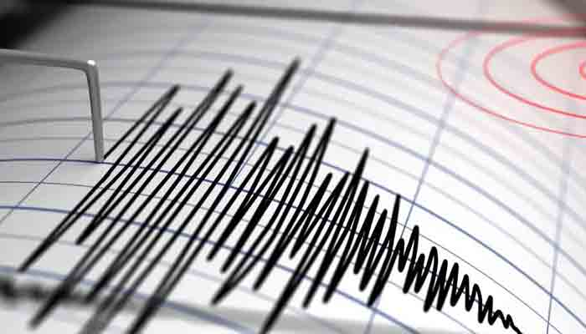
INTRODUCTION
Predicting earthquakes with high accuracy is a complex and challenging task. While there is ongoing research in this area, it's important to note that earthquake prediction remains uncertain. However, you can build a basic earthquake prediction model using Python that can help analyze historical earthquake data and identify patterns or trends.

Slide 3
SOME PYHTON LIBRARIES
DATA COLLECTION
Obtain earthquake data from reliable sources. The United States Geological Survey (USGS) provides earthquake data through their API.
DATA PREPROCESSING
Clean and preprocess the data to make it suitable for analysis. This includes removing duplicates, handling missing values, and converting data types.

Slide 4
Machine Learning Model Train a machine learning model to identify patterns in earthquake data. You can use libraries like Scikit-learn for this purpose. Here's a simple example using a Decision Tree classifier:
Feature Engineering:
Create relevant features that might be useful for prediction. Common features include date, time, location (latitude and longitude), depth, magnitude, and more.
Exploratory Data Analysis (EDA):
Use libraries like Matplotlib or Seaborn to visualize the data and gain insights into earthquake patterns.

Slide 5
SAMPLE CODE
from sklearn.model_selection import train_test_split
from sklearn.tree import DecisionTreeClassifier
from sklearn.metrics import accuracy_score
# Assuming you have a DataFrame 'earthquake_data' with relevant features
X = earthquake_data.drop("target_column", axis=1) # Features
y = earthquake_data["target_column"] # Target variable
# Split the data into training and testing sets
X_train, X_test, y_train, y_test = train_test_split(X, y, test_size=0.2, random_state=42)
# Create and train a Decision Tree classifier
model = DecisionTreeClassifier()
model.fit(X_train, y_train)
# Make predictions on the test set
y_pred = model.predict(X_test)
# Evaluate the model
accuracy = accuracy_score(y_test, y_pred)
print(f"Accuracy: {accuracy}")

Slide 6
MODEL EVALUATION
Use appropriate metrics to evaluate the model's performance. In the example above, we used accuracy as a metric, but for earthquake prediction, you may need different metrics depending on the problem formulation.
DEPLOYMENT
If you want to make predictions based on real-time data, you can create a web application or an API using frameworks like Flask or Django.

Slide 7
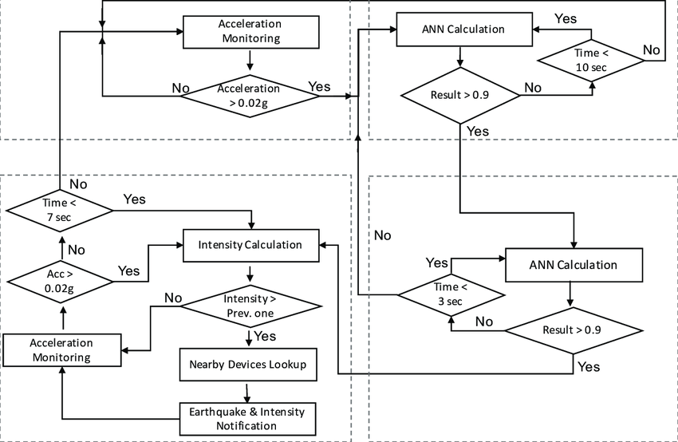
FLOW CHART

Slide 8
CONCLUSION
Predicting earthquakes is a challenging task, and while there are various models and techniques used for earthquake prediction, it's important to note that no model can accurately predict the exact time, location, and magnitude of future earthquakes with high precision. However, you can build a basic earthquake prediction model using historical earthquake data and machine learning techniques to identify areas with a higher likelihood of seismic activity

Slide 9
THANK YOU

