Slide 1
Online Movie tickets booking
WEB PROGRAMMING FINAL PROJECT
BY ASHMIL AND KALYANI

Slide 2
PROBLEM STATEMENT
Create a virtual online movie booking site.
Customer should be able to search for current movies and book tickets
Customer should also be able to select seating area of his/her choice (if available)

Slide 3
LETS SEE A DEMO OF the online book store

Slide 4
DataBAse dEsign
Users – stores user data
Movies – stores data about movies
Shows – stores data about different shows including seats available. One movie may have multiple stores
Screen – stores information about different screens – total seats, screen name
Coupons
Orders – stores all the orders

Slide 5
Seat selection code explanation

Slide 6
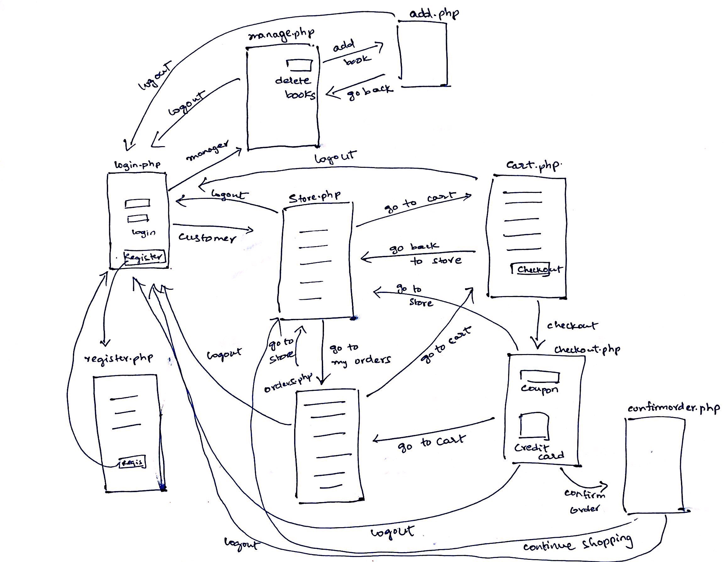

Slide 7
Extra features
Credit card type detection
Managing the book store – store manager
Checking orders

Slide 8
Any questionS?

Slide 9
  THANK
  YOU

