Slide 1

CSE101-Lec#22
Pointers in C

Slide 2
Outline
Introduction
Pointer Variable Definitions and Initialization
Pointer Operators
Pointer expressions and arithmetic

Slide 3
Introduction
Pointers
Powerful, but difficult to master
Simulate call-by-reference
Close relationship with arrays and strings

Slide 4

Let’s look to something interesting
Which one to go and grab first?
Compare:
Address1 :: Address2 => Nearness
Value1 :: Value2 => Quantity
Assess:
Need of quickness or more food
Object1
Address1
Value1
Object2
Address2
Value2

Slide 5
Pointer Variable Definitions and Initialization
Pointer variables
Contain memory addresses as their values
Normal variables contain a specific value (direct reference)
Pointer is a variable that contains address of a another variable that has a specific value (indirect reference)
Indirection – referencing a pointer value
count
7
countPtr
count
7

Slide 6
Pointer Variable Definitions and Initialization
Pointer definitions
* used with pointer variables
int *myPtr;
Defines a pointer to an int (pointer of type int *)
Multiple pointers require using a * before each variable definition
int *myPtr1, *myPtr2;
Can define pointers to any data type
Initialize pointers to NULL or an address

Slide 7

Pointer Operators
& (address operator)
Returns address of operand
int y = 5;
int *yPtr;
yPtr = &y; /* yPtr gets address of y */
yPtr “points to” y
Quick yak:
Discuss on some routine tasks need address:
Content of book has the address of the chapter/topic
y
yptr
y
yPtr
5
500000
600000
600000
5
Value of yptr is the address of y

Slide 8
Pointer Operators
* (indirection/dereferencing operator)
Returns the value of the variable that it points to.
*yptr returns value of y (because yptr points to y)
* can be used for assignment
*yptr = 7; /* changes y to 7 */

Slide 9
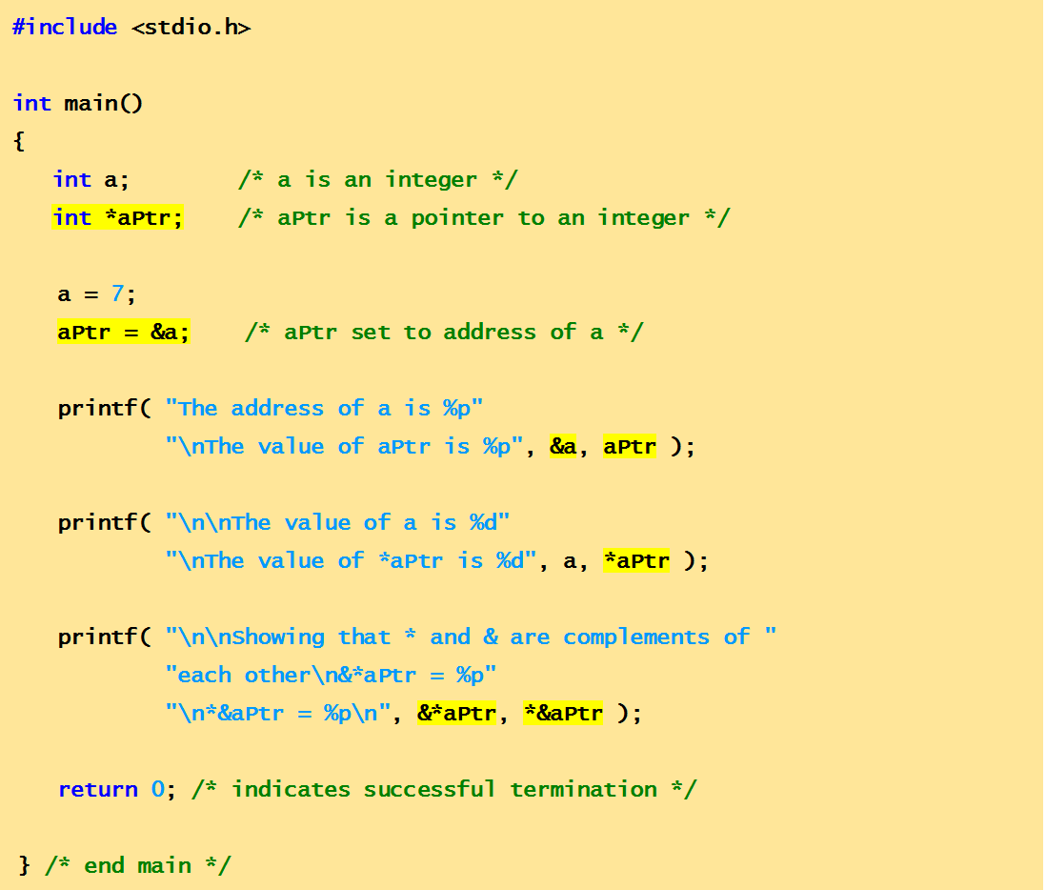
Example Code
This program demonstrates the use of the pointer operators: & and *

Slide 10
Output
The address of a is 0012FF7C
The value of aPtr is 0012FF7C
The value of a is 7
The value of *aPtr is 7
Showing that * and & are complements of each other.
&*aPtr = 0012FF7C
*&aPtr = 0012FF7C

Slide 11
Pointer Expressions and Pointer Arithmetic
Arithmetic operations can be performed on pointers
Increment/decrement pointer (++ or --)
Add an integer to a pointer( + or += , - or -=)
Pointers may be subtracted from each other
Operations are meaningless unless performed on an array.

Slide 12
Pointer Expressions and Pointer Arithmetic
An array int v[5] has been defined on machine with 2 byte integers.
int *vPtr;
vPtr = v;
vPtr points to first element v[0]
at location 3000 (vPtr = 3000)
vPtr += 2; sets vPtr to 3004
vPtr points to v[2] (incremented by 2), but the machine has 2 byte ints, so it points to address 3004
location
3000
3002
3004
3006
3008
v[0]
v[1]
v[2]
v[3]
v[4]
pointer variable vPtr

Slide 13
Pointer Expressions and Pointer Arithmetic
Subtracting pointers
Returns number of elements from one to the other. If
vPtr2 = v[2]; //address 3004
vPtr = v[0]; //address 3000
x = vPtr2 - vPtr
assign to x the number of array elements from vPtr to vPtr2, in this case 2.
Pointer comparison ( <, == , > )
See which pointer points to the higher-numbered element of the same array.
Pointer comparison is used to determine whether pointer is NULL

Slide 14
Pointer Expressions and Pointer Arithmetic
Pointers of the same type can be assigned to each other
If not the same type, a cast operator must be used
Exception: pointer to void (type void *)
Generic pointer, represents any type
No casting needed to convert a pointer to void pointer
void pointers cannot be dereferenced.

Slide 15
Pointer Expressions and Pointer Arithmetic
Increment/decrement
Increments the pointer to point next location in array.
++ vPtr; or
vPtr++;
vPtr = 3000;
++vPtr; //points to 3002
Decrements the pointer to point the previous element.
--vPtr; or
vPtr--;
vPtr = 3002;
--vPtr; //points to 3000

Slide 16
Types of pointers
Void pointer
Wild pointer
Const pointer

Slide 17
Void pointer
Is a pointer that can hold the address of variables of different data types at different times also called generic pointer.
The syntax for declaring a void pointer is
void *pointer_name;
Here, the keyword void represents that the pointer can point to value of any data type.
But before accessing the value through generic pointer by dereferencing it, it must be properly typecasted.
To Print value stored in pointer variable:
*(data_type*) pointer_name;

Slide 18
Limitations of Void pointers:
Void pointers cannot be directly dereferences. They need to be appropriately typecasted.
Pointer arithmetic cannot be performed on void pointers.

Slide 19
#include<stdio.h>
void main()
{
int a=10;
char c=‘R’;
void *ptr;
ptr=&a; // assigns address of int variable a to ptr
printf(“\n value pointed to by generic pointer is %d”, (*(int *)ptr));
ptr=&c; // assigns address of char variable a to ptr
printf(“\n value pointed to by generic pointer is %d”, (*(char *)ptr));
getch();
}
Program to show use of void pointer.

Slide 20
Wild pointer
Pointer which are not initialized during its definition holding some junk value( a valid address) are Wild pointer.
Example of wild pointer:
int *ptr;
Every pointer when it is not initialized is defined as a wild pointer.
As pointer get initialized, start pointing to some variable its defined as pointer, not a wild one.

Slide 21
Constant Pointers
A constant pointer, ptr, is a pointer that is initialized with an address, and cannot point to anything else.
But we can use ptr to change the contents of variable pointing to
Example int value = 22; int * const ptr = &value;

Slide 22
Constant Pointer
Constant pointer means the pointer is constant.
Constant pointer is NOT pointer to constant.
For eg: int * const ptr2
indicates that ptr2 is a pointer which is constant. This means that ptr2 cannot be made to point to another integer.
However the integer pointed by ptr2 can be changed.

Slide 23
#include<stdio.h>
void main()
{
int i = 100,k;
int * const ptr = &i;
*ptr = 200; // value of i is changed.
ptr = &k; //won't compile .
getch();
}
Program on constant pointer

Slide 24
Next Lecture
What if we want a function to return more than one values …??
Pointer as a parameter
Notes:
We cannot use multiple return statement in a function, so we use pass by address to get multiple values.

