Slide 1
CSE101-Lec#23 - 24
Pointers in C

Slide 2
Outline
Passing pointer to a Function
Pointer and one dimensional Array

Slide 3
Introduction
There are two ways to pass arguments to a function
call-by-value and
call-by-reference.
All arguments in C are passed by value.
Return may be used to return one value from a called function to a caller (or to return control from a called function without passing back a value).
Many functions require the capability to modify one or more variables in the caller or to pass a pointer to a large data object to avoid the over- head of passing the object by value.

Slide 4
Calling Functions by Reference
Pointer arguments are used in call by reference.
When calling a function with arguments that should be modified, the addresses of the arguments are passed.
Pass address of argument using & operator in function call.
Allows you to change actual location in memory
Arrays are not passed with & because the array name is already a pointer

Slide 5

Calling Functions by Reference
When the address of a variable is passed to a function, the indirection operator (*) may be used in the function to modify the value at that location in the caller’s memory.
* operator
Used as alias/nickname for variable inside of function
void double( int *number ) {
*number = 2 * ( *number );
}
*number used as nickname for the variable passed
Quick yak:
When a customer puts the request in Vending machine for a particular drink , then he has to pass the address of drink as an argument to function.

Slide 6
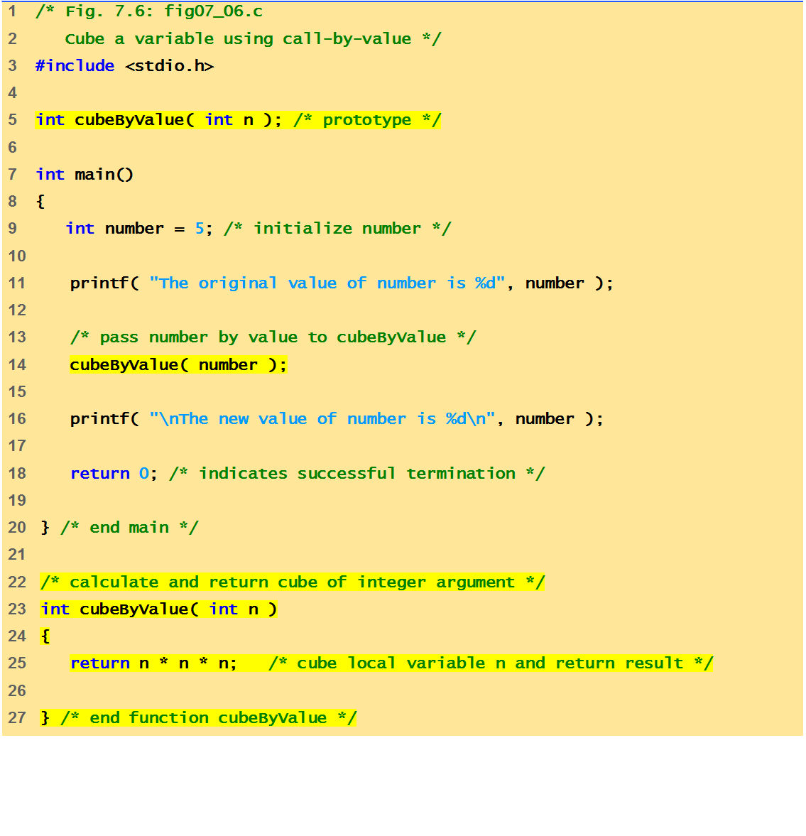
Program to call function by value
The original value of number is 5
The new value of number is 5

Slide 7
Before function call
int
main()
number
int
cubeByValue(
int
n )
{
{
int
number =
5
5
;
return
n * n * n;
}
number=cubeByValue(number);
n
}
undefined
After function receives call
int
main()
number
int
cubeByValue(
int
n )
{
{
int
number =
5
;
5
return
n * n * n;
}
number = cubeByValue( number );
n
}
5
After function computes n and before it returns to main
int
main()
number
int
cubeByValue(
int
n )
{
{
125
int
number =
5
;
5
return
n * n * n;
}
number = cubeByValue( number );
n
}
5
Fig. Analysis of a typical call-by-value. (Part 1 of 2.)

Slide 8
After function returns to main and before assigning result to number
int
main()
number
int
cubeByValue(
int
n )
{
{
int
number =
5
5
;
return
n * n * n;
125
}
number = cubeByValue( number );
n
}
undefined
After main completes the assignment to number
:
int
main()
number
int
cubeByValue(
int
n )
{
{
int
number =
5
125
;
return
n * n * n;
125
125
}
number = cubeByValue( number );
n
}
undefined

Slide 9
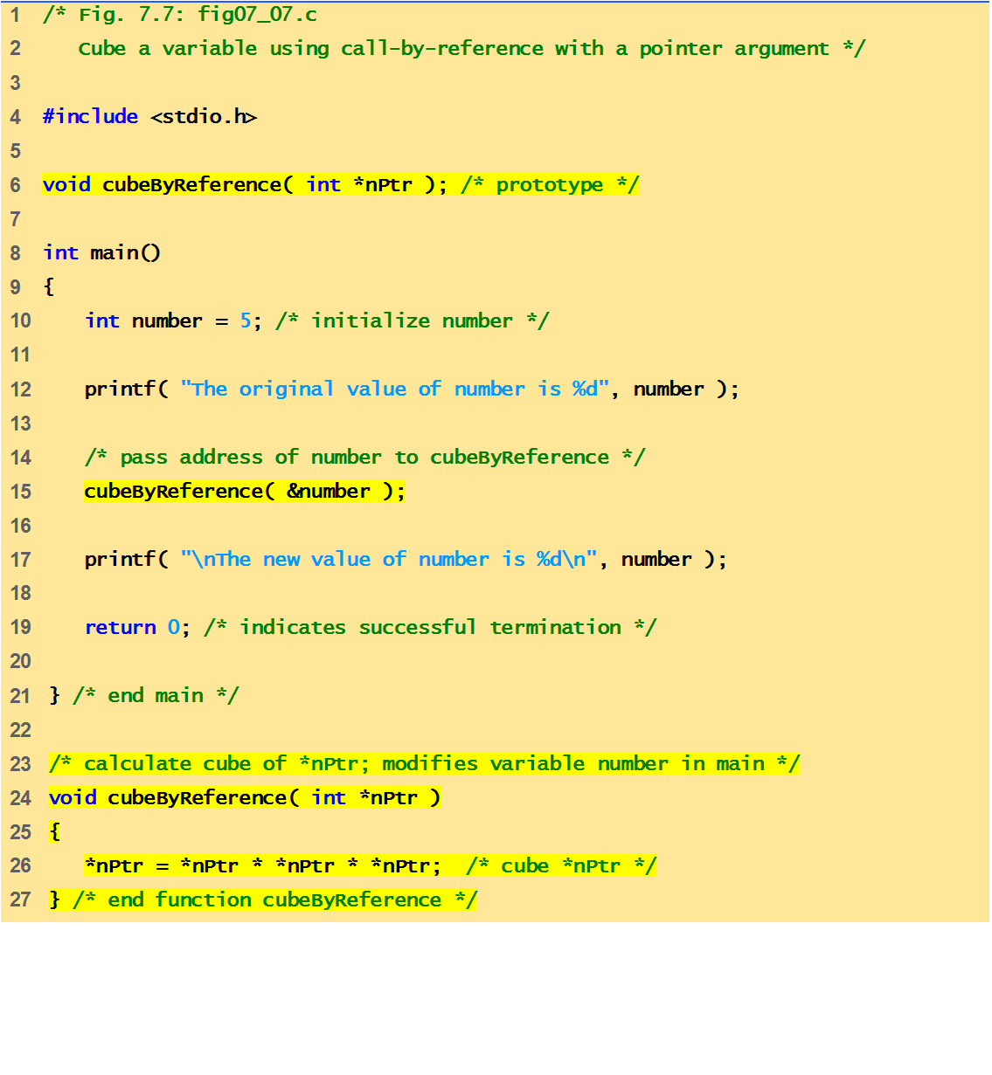
Notice that the function prototype takes a pointer to an integer.
Program to call a function by reference.
Notice how the address of number is given - cubeByReference expects a pointer (an address of a variable).
Inside cubeByReference, *nPtr is used (*nPtr is number).
The original value of number is 5
The new value of number is 125

Slide 10
Before function call
int
main()
number
void
cubeByReference(
int
*nPtr )
{
5
{
int
number =
5
;
*nPtr = *nPtr * *nPtr * *nPtr;
}
cubeByReference( &number );
nPtr
}
undefined
After function receives the call and before function computes
int
main()
number
void
cubeByReference(
int
*nPtr )
{
5
{
int
number =
5
;
*nPtr = *nPtr * *nPtr * *nPtr;
}
cubeByReference( &number );
nPtr
}
call establishes this pointer
After *nptr is cubed and before program control returns to main
:
int
main()
number
void
cubeByReference(
int
*nPtr )
{
125
{
125
int
number =
5
;
*nPtr = *nPtr * *nPtr * *nPtr;
}
cubeByReference( &number );
called function modifies
caller’s variable
nPtr
}
Fig. Analysis of a typical call-by-reference with a pointer argument.

Slide 11
The Relationship Between Pointers and Arrays
Arrays and pointers closely related
Array name is like a constant pointer
Pointers can do array subscripting operations
Define an array b[5] and a pointer bPtr
To set bPtr to point to b[5]:
bPtr = b;
The array name (b) is actually the address of first element of the array b[5] which is equivalent to
bPtr = &b[0]
Explicitly assigns bPtr to address of first element of b

Slide 12
The Relationship Between Pointers and Arrays
Element b[3]
Can be accessed by *(bPtr + 3)
Where 3 is the offset. Called pointer/offset notation
Can be accessed by bptr[3]
Called pointer/subscript notation
bPtr[3] same as b[3]
Can be accessed by performing pointer arithmetic on the array itself
*(b + 3)

Slide 13
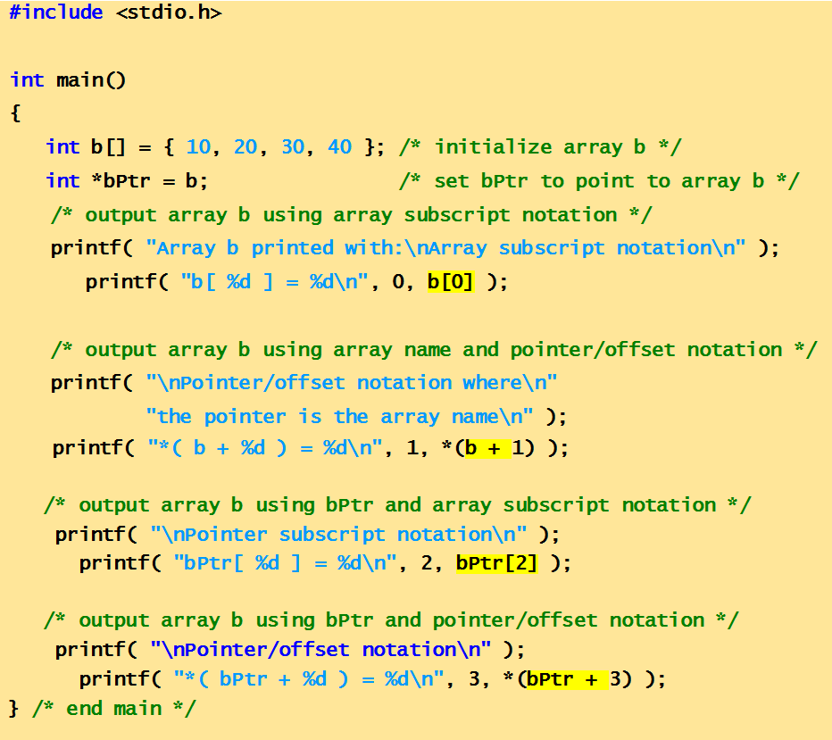
Program to show subscripting and pointer notation with arrays.

Slide 14
Array b printed with:
Array subscript notation
b[ 0 ] = 10
Pointer/offset notation where
the pointer is the array name
*( b + 1 ) = 20
Pointer subscript notation
bPtr[ 2 ] = 30
Pointer/offset notation
*( bPtr + 3 ) = 40

Slide 15
Character arrays and pointers
What’s the difference between char s[] and char* s?
char s[] = “hello”
Allocates the string in modifiable memory, and defines s to be a pointer to the head of the string.
Can change the contents, but s will always point to the same place
Can’t write: s = p; an array name is not a variable (i.e., can’t be used as an l-value)
char* s = “hello”
Allocates a pointer (freely modifiable)
Allocates a string (not modifiable)
s points to the beginning of the string, but modifications to the string (e.g., *s = ‘x’) is undefined
s can be reassigned to point to other strings

Slide 16
Next Class: Array of pointers

