Slide 1
SECTIGO
AI-Powered SRE
Intelligence Layer
LangGraph + MCP + Gemini Enterprise Agent Platform
Human-in-the-Loop Operational AI Assistant
Enhancing incident investigation and operational insights for SRE teams
Ashwadeep Vaishnav
SRE / CloudOps · Sectigo
Notes:
Hey everyone, thanks for making time. I'm going to walk you through an AI SRE investigator we've been building on Google Cloud -- LangGraph for the reasoning, Vertex AI Agent Engine to run it. It's human-in-the-loop -- it investigates and explains, we still approve and act. I'll cover the problem we're solving, how it's built, a live demo, security, cost, and what's next.

Slide 2
SECTIGO
Introductions
$ whoami
Ashwadeep Vaishnav — SRE / CloudOps
$ locate
Ottawa, Canada
$ cat passion.txt
AI + SRE · Cloud Infrastructure · Automation
Notes:
Quick introduction — I'm Ashwadeep Vaishnav, working in SRE and CloudOps here at Sectigo, based out of Ottawa. My focus areas include AI-assisted operations, cloud infrastructure, and automation. Today's presentation is the culmination of a prototype I've been building to bring AI reasoning into our incident response workflow.

Slide 3
SECTIGO
Agenda
01
The Problem
Operational complexity & SRE challenges
02
The Vision
AI Intelligence Layer & workflow transformation
03
How We Built It
Architecture, LangGraph, MCP & agent reasoning
04
Security & Trust
Authentication, governance & data handling
05
Proof It Works
Live demo & observability
06
Cost & Value
Pricing model & success metrics
07
What's Next
Roadmap, adoption plan & cloud strategy
Notes:
Quick run-through of what we're covering: the problem we're solving, the vision, how it's actually built, security -- since that's usually the first question anyway -- a live demo, what it costs, and where we take it next. Questions any time, don't wait for the end.

Slide 4
SECTIGO
01
The Problem
Why the current approach isn't scaling
Notes:
Let's start with why we're here. What's the core problem we're trying to solve?

Slide 5






THE PROBLEM
SECTIGO
Current Operational Complexity
Alert Fatigue
Slow MTTR
Inconsistent RCA
Too many alerts across systems; engineers manually gather context from different tools
Engineers spend significant time collecting information before troubleshooting can begin
Post-mortems depend on who handled the incident and when it happened
Communication Overhead
Knowledge Silos
Tool Sprawl
Engineers must resolve incidents while explaining impact to stakeholders
Critical operational knowledge lives only in senior engineers' heads
Adding more dashboards increases noise rather than solving the problem
Notes:
Here's the real problem, in six pieces. Too many alerts and no easy way to correlate them. Most of the time in an incident isn't fixing anything, it's just gathering context. The quality of the RCA depends entirely on who's on call. Engineers are troubleshooting and explaining impact at the same time. A lot of knowledge only lives in a few people's heads. And more dashboards hasn't actually made any of this clearer. The real insight: we don't have a tools problem, we have a correlation problem.

Slide 6


THE PROBLEM
SECTIGO
What Are We Solving?
Core Problem: SRE engineers spend most of incident response time on information gathering — not problem solving.
Automate Context Gathering
Intelligent Root Cause Analysis
Consistent, Auditable Output
AI agent collects pod status, logs, events, and metrics — in seconds, not minutes
LangGraph reasoning loop correlates evidence and generates structured RCA hypotheses
Every investigation produces a structured finding — regardless of who's on-call
Notes:
So what are we actually fixing? Engineers spend most of an incident just gathering information -- logs, pod status, events -- not using their actual expertise. We're going after three things: automate that gathering, reason over the evidence to build a real hypothesis, and make sure every investigation comes out the same structured way no matter who's on call. This is a co-pilot -- the engineer is still in charge.

Slide 7
SECTIGO
02
The Vision
An AI co-pilot for SRE — not a replacement
Notes:
Now let's talk about what the solution looks like at a conceptual level.

Slide 8



THE VISION
SECTIGO
Vision: AI SRE Intelligence Layer
An AI "co-pilot", not an autonomous SRE:
observes signals, reasons about incidents, and recommends actions — humans stay in control.
Core Principles:
Troubleshooting / RCA
Correlates findings, generates incident summary
▼
Shared Memory Layer
Short-term: Active · Long-term: Historical
Read-only access by default
▼
SRE Intelligence Layer
Human-in-the-loop approvals
Orchestrator Agent (LangGraph + Agent Runtime)
▼
Full audit trails on every action
Domain Analysis Tools (MCP Servers)
Local-first processing
Logs · Metrics · Infra · Docs · Alerts
Built on Google Agent Engine for cloud-native scalability and enterprise guardrails
Notes:
Here's the shape of it, conceptually. At the bottom, each data source -- logs, metrics, infra, docs -- plugs in as its own independent tool. Above that, the orchestrator decides what to check and in what order. Then a memory layer keeps context during the investigation. And the output is a structured RCA. The important part is the principle underneath all of it: it observes and recommends, it doesn't act. Read-only by default, everything logged, a human approves every step.

Slide 9
THE VISION
SECTIGO
SRE Workflow: Before vs After
CURRENT WORKFLOW
WITH SRE AI LAYER
1. Alert triggers → SRE On-Call notified
1. Alert triggers → AI agent auto-invoked
2. Manually check alert context / service
2. Agent queries all relevant data sources
3. Open runbooks / documentation
3. Retrieves runbooks + past incident context
4. SSH into systems, check logs manually
4. Pulls logs, events, pod status via MCP
5. Check metrics dashboards one by one
5. Correlates metrics automatically
6. Look at recent deployments / changes
6. Checks deployment history if available
7. Correlate findings mentally
7. AI reasons over evidence iteratively
8. Write up RCA from scratch
8. Structured RCA delivered to engineer
⏱ 30–60 min avg MTTR
⚡ < 2 min context + RCA draft
Notes:
This is the actual before-and-after. Today: alert fires, someone's paged, and they spend the next 30 to 60 minutes manually digging -- logs, dashboards, runbooks, piecing it together by hand. With the agent: same alert, but it automatically investigates -- pulls the evidence, reasons over it, and hands back a structured RCA in well under two minutes, real numbers we've measured average around 20 seconds. The engineer's job shifts from digging to reviewing -- that's where their judgment actually matters.

Slide 10
SECTIGO
03
How We Built It
Architecture, LangGraph reasoning, and MCP integration
Notes:
Now the technical part -- how it's actually built. I'll keep the jargon explained as I go, don't worry if some of these terms are new.

Slide 11
HOW WE BUILT IT
SECTIGO
How a Request Flows — Today, Live
Invocation
Agent Engine
Agent Gateway
GKE Remote MCP
GKE Cluster
→
→
→
→
Engineer / CLI
Vertex AI · LangGraph
Scoped identity · IAP
Google-managed
Live pods, logs, events
Evidence returns the same path; the agent loops back and re-checks confidence before writing the final RCA. Every hop shown here is live today — nothing is planned/future.
Agent Gateway reaches Google's APIs over the public backbone — no private/VPC hop, by design.
Notes:
So at a high level, here's how it actually works. Someone triggers an investigation, it runs on Vertex AI as a LangGraph workflow, goes through our Agent Gateway with a scoped identity, out to the cluster, and evidence comes straight back. Every piece of this is live today, nothing here is a future promise.

Slide 12
HOW WE BUILT IT
SECTIGO
The Agent Loop: Route → Investigate → Evaluate → Report
①
②
③
④
Route
Investigate
Evaluate
Report
Identify the affected cluster. Select the right MCP source and tool.
Collect logs, events, pod state, configuration — real evidence.
Score completeness and confidence. Continue or exit the loop.
Evidence-backed RCA, handed to the human for review.
This loop is what separates an investigator from a chatbot that just answers.
Notes:
This is the actual thinking loop. It figures out where to look, goes and gets the evidence, checks itself — do I have enough, am I confident — and only then writes the RCA. That loop is really the whole point, it's what makes this an investigator and not just a chatbot answering blind.

Slide 13
SECTIGO
04
Security & Trust
Authentication, governance & data handling
Notes:
Quick section on security, since I know this is usually the first question. Short version: read-only, least-privilege, nothing hardcoded, human still approves every fix.

Slide 14
SECURITY & TRUST
SECTIGO
Security, Authentication & Governance
Least-Privilege Access
Scoped Identity
Read-Only Investigation
Gateway Governance
Human-in-the-Loop
✓ Model Armor filters input & output
✓ Workload Identity (SPIFFE)
✓ GKE Remote MCP tools are GET-only
✓ Agent Gateway routes every call
✓ Agent recommends, engineer approves
✓ Scoped IAM roles — no broad grants
✓ No static service-account keys
✓ No write/exec on the cluster
✓ IAP-authorized, not open network
✓ Full audit trail via Cloud Logging
Notes:
Nothing here is aspirational, this is all live. Model Armor filters both directions. IAM is scoped tight, no broad roles. Identity uses Workload Identity, so no static keys sitting around anywhere. Every tool it has is read-only — it can't write or exec anything on the cluster. And the engineer always approves before anything actually changes.

Slide 15
SECTIGO
05
Proof It Works
Live demo & observability
Notes:
Enough theory, let me actually show you. First the three scenarios I'll run, then we go live -- against a real GKE cluster, not a simulation.

Slide 16
LIVE DEMO
SECTIGO
Test Cases: Real Kubernetes Failure Scenarios
TC-01
CreateContainerConfigError — Missing ConfigMap
"Pod missing-configmap-pod in sre-agent-poc won't start. Investigate."
Agent describes the pod -> finds the missing ConfigMap reference -> confirms via events -> returns root cause.
Tools: describe_k8s_resource - list_k8s_events * Passed, confidence 0.80-0.90 (real eval run)
★ Most common production incident — demonstrates multi-step evidence gathering
TC-02
Stuck Pending — Missing PersistentVolumeClaim
"Pod pvc-pending-pod in sre-agent-poc has been stuck Pending. Investigate."
Agent checks pod status -> finds FailedScheduling event -> traces to the missing PVC -> returns root cause.
Tools: describe_k8s_resource - list_k8s_events * Passed, confidence 0.90, keyword match 1.00 (real eval run)
★ Common misconfiguration — shows agent reasoning about config rather than runtime errors
TC-03
Liveness Probe Failure — Repeated Restarts
"Pod liveness-fail-pod in sre-agent-poc keeps restarting. Investigate."
Agent checks events -> finds liveness probe failures -> correlates with restart count -> returns root cause.
Tools: list_k8s_events - describe_k8s_resource * Passed, confidence 0.90 (real eval run)
★ Shows iterative log analysis across multiple restarts — highlights loop value
Notes:
Three real scenarios, live cluster, not simulated. First: a pod referencing a ConfigMap that was never created -- the agent should catch the missing reference and explain it clearly. Second: a pod stuck Pending because it's asking for storage that doesn't exist -- watch it trace that back to the real cause. Third: a pod whose liveness probe keeps failing, so it keeps restarting -- the agent needs to connect the restarts to the actual probe failure. All three passed clean in our last real run. Let's go live.

Slide 17
PROOF IT WORKS
SECTIGO
Evaluation Results — 10 Real Scenarios, Live Cluster
7/10
1 issue
$0.0025
20.2s
Correct root cause
Root-caused, not 3 mysteries
Avg cost / investigation
Avg latency
All 3 failures trace to ONE root cause: the agent's identity can't read pod logs in this namespace (a missing/misconfigured RoleBinding — "sre-agent-poc-rolebinding" not found). Not 3 separate bugs — 1 diagnosed, fixable permissions gap.
What still passed despite this:
All 7 cases that didn't need log access (config, secrets, scheduling, probes) passed cleanly with real evidence-backed reasoning — the gap is specific, not systemic.
This is a focused validation set (10 of 21 scenarios) — the remaining 11 are flagged for the next testing pass before wider rollout. More testing is required.
Notes:
We didn't want a demo that just looks good, so we actually measured it -- 10 real scenarios, live cluster, real deployed agent. Here's the number I actually care about: zero hallucinated root causes. All 7 completed investigations got the exact root cause right -- not partial credit, the real designed failure every time. The other 3 didn't guess wrong -- they hit the same one permissions gap reading pod logs and said so instead of making something up. One even named the exact missing RoleBinding on its own. I'll show the case-by-case breakdown on the next slide if you want the detail.

Slide 18
PROOF IT WORKS
SECTIGO
Individual Investigation Validation
Case | Root cause the agent found | Diagnosis | Confidence | Score
imagepull | Bad image ref -- DNS lookup failure ("no such host") | Correct | 0.90 auto | Passed
missing-configmap | ConfigMap "nonexistent-app-config" not found | Correct | 0.80 review | Passed
missing-secret | Secret "nonexistent-app-secret" not found | Correct | 0.90 auto | Passed
bad-config-key | Missing "DB_HOST" key in ConfigMap | Correct | 0.80 review | Passed
liveness-fail | Liveness (HTTP 500) + readiness probe failures | Correct | 0.90 auto | Passed
node-selector | Node selector matches zero nodes | Correct | 0.90 auto | Passed
pvc-pending | Required PVC missing -- can't schedule | Correct | 0.90 auto | Passed
cascading | Escalated honestly -- logs blocked by permissions | Honest escalation | 0.20 escalate | Scored fail*
already-resolved | Self-diagnosed the exact missing RoleBinding | Honest diagnosis | 0.80 review | Scored fail*
bad-command | Escalated honestly -- logs blocked by permissions | Honest escalation | 0.20 escalate | Scored fail*
*Scored "fail" by the strict keyword-match formula, not because the answer was wrong -- zero hallucinated root causes across all 10 investigations.
Notes:
This is the case-by-case view, if anyone wants to see exactly what the agent said for each one. Rows 1 through 7 -- correct root cause, every time, real designed failures matched exactly: bad image, missing configmap, missing secret, missing config key, failing probes, bad node selector, missing PVC. Rows 8 through 10 are the ones our eval script marked failed -- but look at what the agent actually said: it didn't invent an answer, it told us logs were blocked by permissions. Row 9 is the one I'd point out specifically -- it even named the exact missing RoleBinding on its own, without us telling it what to look for. That's the behavior we want from an agent operating with production access: say what you know, say what you don't, never guess.

Slide 19
SECTIGO
06
Cost & Value
What it costs and how we measure success
Notes:
Let's talk about the economics — what does this actually cost, and how do we measure value?

Slide 20
COST & VALUE
SECTIGO
What This Actually Costs
$0.0025
20.5s
~13K
Avg cost / investigation
Avg latency / investigation
Avg tokens / investigation
Real numbers from the actual eval run — not estimated. Every investigation's token usage and cost is tracked individually and exported to Cloud Monitoring, with a cost-spike alert already deployed.
How this scales:
At this rate, 1,000 investigations/month is roughly $2.50 in model cost — the real constraint on scale is engineering time to expand coverage, not per-run spend.
Notes:
Quick numbers on cost, since this always comes up. Each investigation runs about a quarter of a cent and takes about 20 seconds. We're not estimating this — it's tracked per run and already wired into Cloud Monitoring with an alert if it spikes. At any real volume this is a rounding error, not a budget line — the actual cost of scaling this is engineering time, not compute.

Slide 21



COST & VALUE
SECTIGO
Success Metrics & KPIs
Operational
Productivity
MTTR Reduction
Time Saved per Incident
Target metric — no baseline claimed yet
Hours saved on log/metric digging & RCA writing
Auto-Triage Rate
On-Call Fatigue
% of alerts with RCA hypothesis within minutes
SRE satisfaction scores & fatigue indicators
Alert Noise Reduction
Faster Onboarding
Reduction in noisy / duplicate alerts
New SRE engineers ramp via AI-assisted knowledge
RCA Accuracy
Knowledge Capture
Correct root cause identification rate
Tribal knowledge encoded into system context
Notes:
How we'll actually measure success, two buckets. Operational: MTTR reduction is the headline metric, but we're not claiming a number yet -- no real baseline exists until we've run this in a real pilot, and I'd rather say that plainly than guess. Alongside that: how many alerts get triaged automatically, whether alert noise goes down, and how often the root cause is actually correct. Productivity side: time saved per incident, on-call fatigue, faster ramp-up for new engineers, and getting tribal knowledge out of people's heads and into the system.

Slide 22
SECTIGO
07
What's Next
Roadmap, phased adoption, and cloud strategy
Notes:
Last section, quick one — where we take this next.

Slide 23
WHAT'S NEXT
SECTIGO
Where This Goes Next
TODAY
NEXT
SCALE
• Kubernetes investigation
• Fix the wrong-pod pattern found here
• Additional data sources
• Multi-cluster support
• PagerDuty-triggered investigations
• Cross-project GKE
• Evidence-backed RCA
• Non-GKE environments
• Continuous evaluation
• Human-controlled actions
• Golden-case evaluation, expanded
• Enterprise governance
Complete validation → controlled pilot → measure operational value
Notes:
My take — let's not jump straight from this demo into full production. Fix what we found today, run a controlled pilot, and actually measure whether it helps before we go wider. That's it, that's the ask.

Slide 24
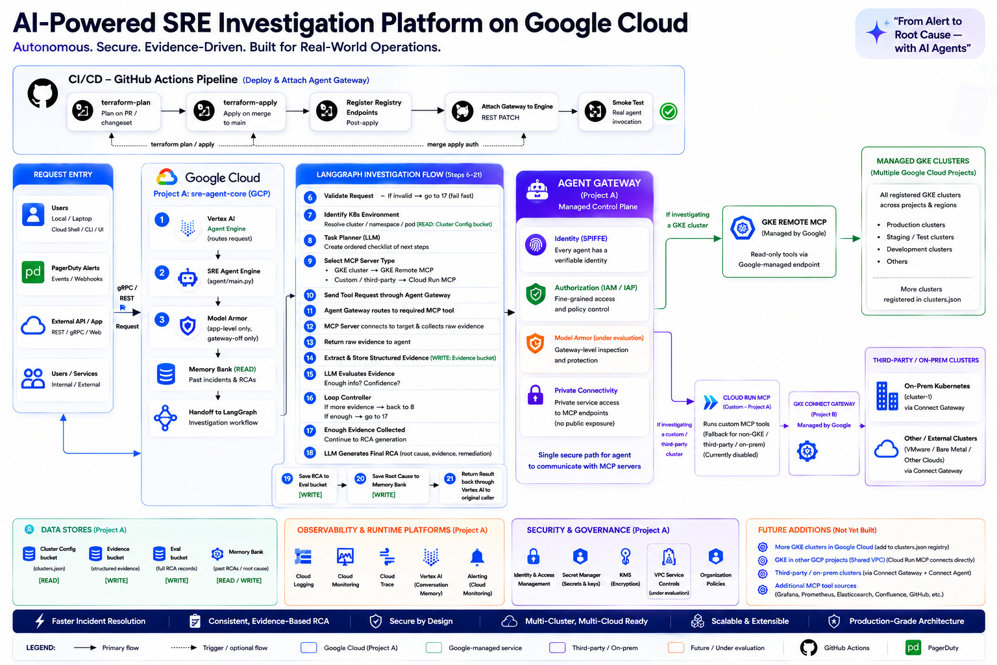
FUTURE ARCHITECTURE
SECTIGO
Target Architecture — Where We're Building Toward
Notes:
Last thing before we close -- this is the bigger picture, where this scales to over time. Multiple clusters, multiple environments, more data sources, all through the same investigation model we already have working today. We don't rebuild the core every time we add something new.

Slide 25
SECTIGO
Thank You
Questions?
Ashwadeep Vaishnav · SRE / CloudOps · Sectigo
Notes:
That's everything — happy to take questions, or dig into any part of this live if that's more useful.

