Slide 1

Marketing Model
Deep Learners

Slide 2
Agenda
Introduction
Team
Process
Results
Learning
Presentation Title

Slide 3
Introduction
In recent years, the convergence of AI and ML technologies with the dynamic realm of cryptocurrency trading has ushered in a new era of innovation and opportunity. This powerful combination allows traders to harness data-driven insights, adapt to market fluctuations, and make informed decisions in real-time. This presentation tries to explain the processes used while building a basic model for the competition which predicts the parameters like profits, loses, etc. and ultimately redefine the way we approach financial markets.
We thank IIT Kharagpur and Zelta Labs to provide an opportunity to be a part of the competition.

Slide 4
Our Team
Mr. Ashmit Srivastava
Team Leader
Mr. Yash Pandey
Member
Mr. Vansh Agrawal
Member
Mr. Piyush Chanduka
Member

Slide 5


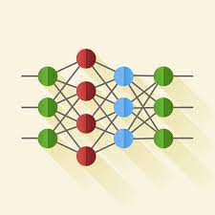


Process We Applied
Data Collection
Preprocessing
Building Model
Training the Model
Outcomes

Slide 6
Data Collection and Preprocessing
As we were advised to use historical price and trading volume data for the BTC/USDT trading pair from January 1, 2018, to January 31, 2022, for model development and testing.
We have dataset with different time attributes like 15 minutes gap, one hour gap, etc.
We then preprocessed the data to handle missing data and to ensure its quality and compatibility. We performed this by adjusting the splits and using regression.
The link to the data - https://drive.google.com/drive/folders/1yyRhVZFZmwG4rja4vgQ6sVshjwM2tnZO

Slide 7
Building the Model
Here comes the crazy part, building the model!
The model outlines a Long Short-Term Memory (LSTM) neural network where the 4 LSTM layers are stacked, each with 50 units, allowing the network to capture sequential dependencies in the input data.
The return_sequences parameter is set to True for the first three layers, indicating they return the full sequence of outputs. The input shape is specified only in the first layer as (X_train.shape[1], 1), where X_train is the training data. It's a 3D array with dimensions (number of samples, time steps, features).
Dropout Layers (between each LSTM layer) with a rate of 0.2 are applied after each LSTM layer to prevent overfitting during training.
The final layer is a Dense layer with one unit, typical for regression tasks where the goal is to predict a continuous output.
In essence, this LSTM architecture is tailored for regression, aiming to model sequential patterns in the input time series data while incorporating dropout regularization to enhance generalization and prevent overfitting. The network is structured to learn and predict continuous values.

Slide 8
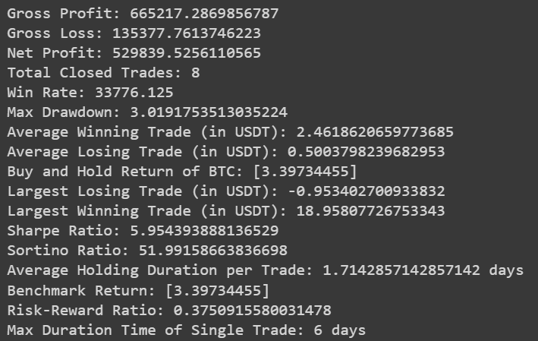
Results

Slide 9
