Slide 1

Chatbot Builder Application
A No-Code Platform for AI Chatbot Creation and Deployment
Notes:
My project, the Chatbot Builder Application. is a no-code platform for AI chatbot creation and deployment, designed to make chatbot development easier and more accessible for users without a strong technical background.

Slide 2

Problem
Building AI chatbots requires programming knowledge
Not accessible to non-technical users
Difficult to integrate knowledge sources
No simple way to deploy and test chatbots
Notes:
The problem we identified is that building AI chatbots usually requires programming knowledge, which makes the process difficult for non-technical users. Many existing tools are not beginner-friendly, and users often struggle with integrating knowledge sources, testing chatbot responses, and deploying the chatbot for real use. Because of these barriers, chatbot technology is not as accessible as it could be.

Slide 3

Solution
Proposed Solution: Chatbot Builder Platform
No-code chatbot creation system
Supports multiple knowledge sources:
Website URLs
Text input
Built-in chatbot testing interface
One-click publishing with shareable link
Designed for ease of use and rapid deployment!
Notes:
To solve this problem, we developed the Chatbot Builder Platform. Our solution is a no-code system that allows users to create chatbots without any programming knowledge. The platform supports multiple knowledge sources, such as website URLs and text input, and includes a built-in interface for testing chatbot responses. It also provides one-click publishing, which generates a shareable public link for easy deployment.
The goal is to make chatbot creation simple, fast, and accessible. This platform can be used by companies to support employees or customers with FAQs, by professors to assist students, or by websites to provide instant responses to users.

Slide 4

Key Features
Core Features of the System
User authentication and dashboard
Step-by-step chatbot creation wizard
Knowledge ingestion (URL & text)
Real-time chatbot testing
Publish chatbot with public access
Analytics dashboard for performance tracking
Notes:
The system includes several core features.
First, it provides user authentication and a dashboard for managing bots.
Second, it offers a step-by-step chatbot creation wizard that guides users through the process.
Third, it supports knowledge ingestion from URLs and text.
Fourth, users can test the chatbot in real time before deployment.
Fifth, they can publish the chatbot for public access.
Finally, the system includes an analytics dashboard to track chatbot performance and usage.

Slide 5
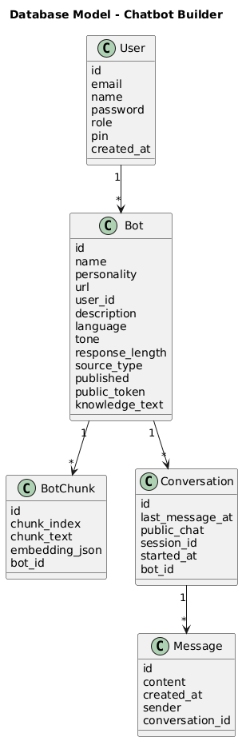
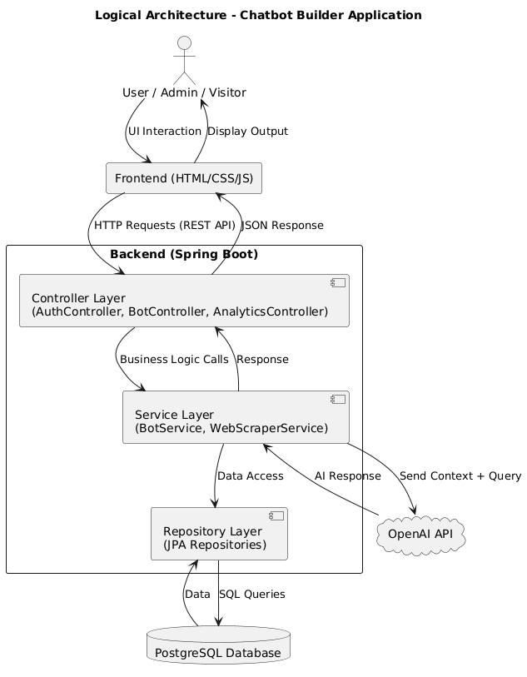
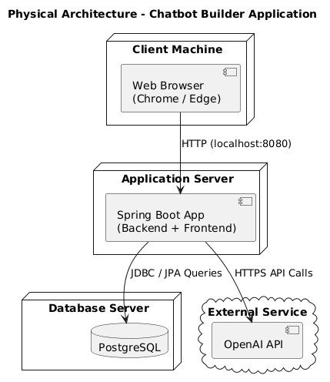
Architecture Diagram
Layered Architecture: Frontend → Backend → Database → OpenAI API
Notes:
This slide shows the overall architecture of our system, along with the logical and physical database models, which together define how the system is designed and implemented.
At a high level, the system follows a layered architecture.
At the top, we have the frontend, built using HTML, CSS, and JavaScript. This layer handles all user interactions, such as creating chatbots, selecting knowledge sources, testing responses, and viewing analytics. It acts as the interface between the user and the system.
Next is the backend, developed using Spring Boot. This layer is responsible for processing requests, handling business logic, managing chatbot creation, and coordinating data flow between the frontend, database, and external services like OpenAI.
Below that is the database layer, where we store structured data such as users, bots, and processed knowledge chunks. These chunks contain both text and embeddings, which allow the system to efficiently retrieve relevant information during chatbot interactions.
From a logical model perspective, the system is organized around key entities like User, Bot, and BotChunk. The relationships between these entities define how data flows through the system - for example, one user can have multiple bots, and each bot can have multiple knowledge chunks.
From a physical model perspective, these entities are implemented as tables in a PostgreSQL database. Each table stores specific attributes, such as bot details, chunked content, and embeddings, ensuring efficient storage and retrieval.
Finally, we integrate with the OpenAI API, which is responsible for generating chatbot responses and embeddings. This allows the system to provide intelligent, context-aware answers based on the stored knowledge.
Overall, this combination of layered architecture and well-defined data models ensures scalability, efficient data handling, and maintainability of the system.

Slide 6
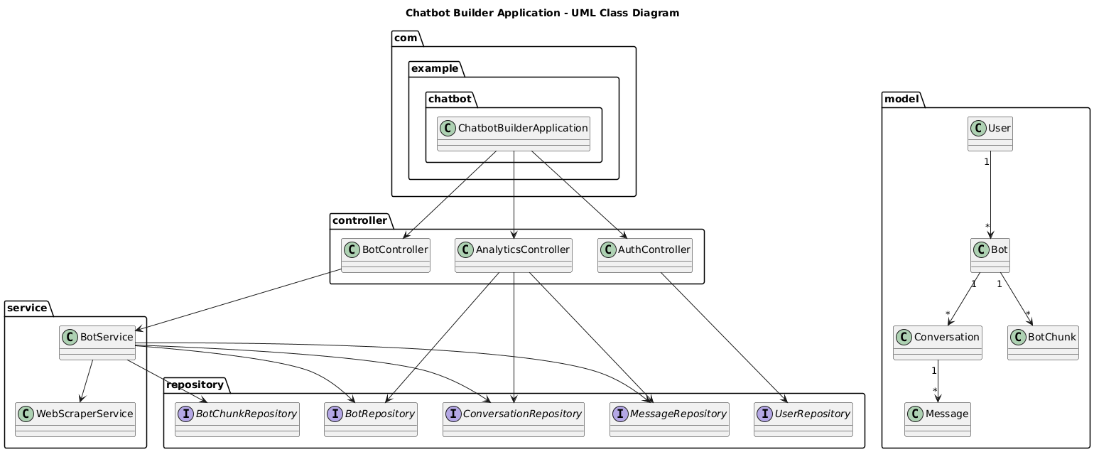
UML Class Diagram
Represents Controllers, Services, Models, and Repositories
Notes:
This diagram represents the core structure of our backend system.
We have four main components:
Controllers, which handle incoming API requests from the frontend
Services, which contain the main business logic, such as chatbot response generation and knowledge processing
Models, which define entities like User, Bot, and BotChunk
Repositories, which interact with the database using JPA
For example, the Bot entity is linked to multiple BotChunks, which store processed knowledge data. The service layer connects everything by coordinating between controllers and repositories.
This design follows the MVC pattern, making the code modular, maintainable, and easier to extend.

Slide 7
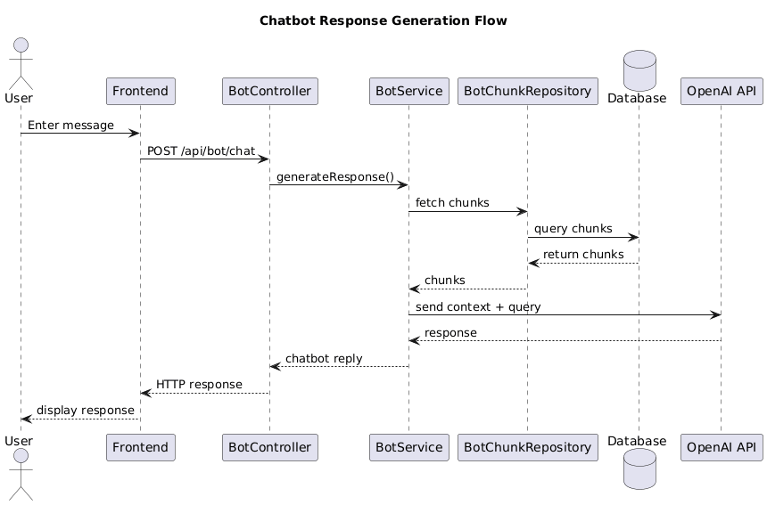
Sequence: Chatbot Response Flow
User sends message
Backend retrieves knowledge chunks
OpenAI generates response
Notes:
This diagram explains how a chatbot generates a response.
First, the user sends a message through the frontend interface. That request is sent to the backend.
The backend then retrieves the relevant knowledge chunks associated with that bot from the database. These chunks are preprocessed pieces of content extracted from the knowledge source.
Next, the system sends the user’s question along with the relevant chunks to the OpenAI API.
The OpenAI model generates a response based on that context, and the backend returns the final answer to the user.
This process ensures that responses are both context-aware and relevant to the bot’s knowledge base.

Slide 8
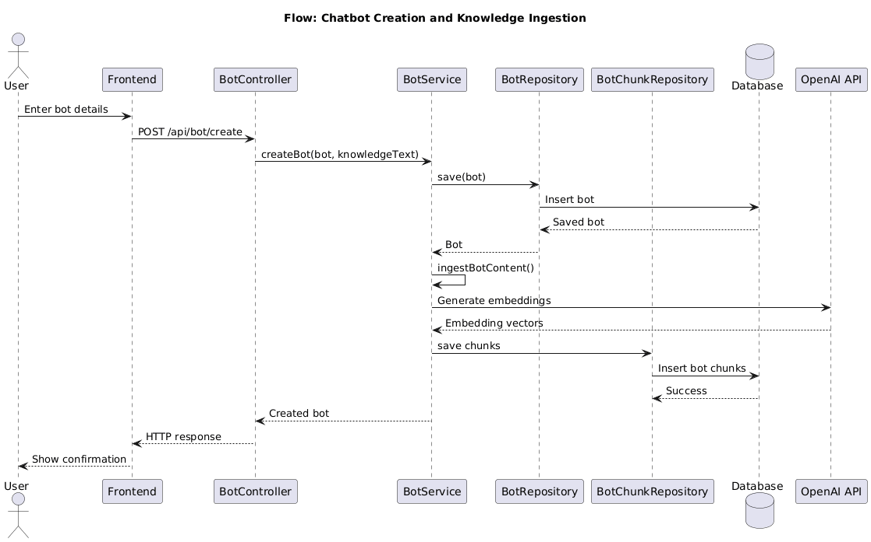
Sequence: Chatbot Creation Flow
User creates bot
Knowledge is processed
Data stored in database
Notes:
This diagram shows how a chatbot is created.
The process begins when the user enters basic information and selects a knowledge source.
If the source is a website or text, the backend extracts the content and processes it.
The content is then broken into smaller pieces called chunks, which are easier to manage and retrieve.
Each chunk is converted into an embedding using the OpenAI API, allowing us to perform semantic search later.
Finally, both the chunks and embeddings are stored in the database.
This preprocessing step is critical because it allows the chatbot to retrieve relevant information quickly during conversations.

Slide 9
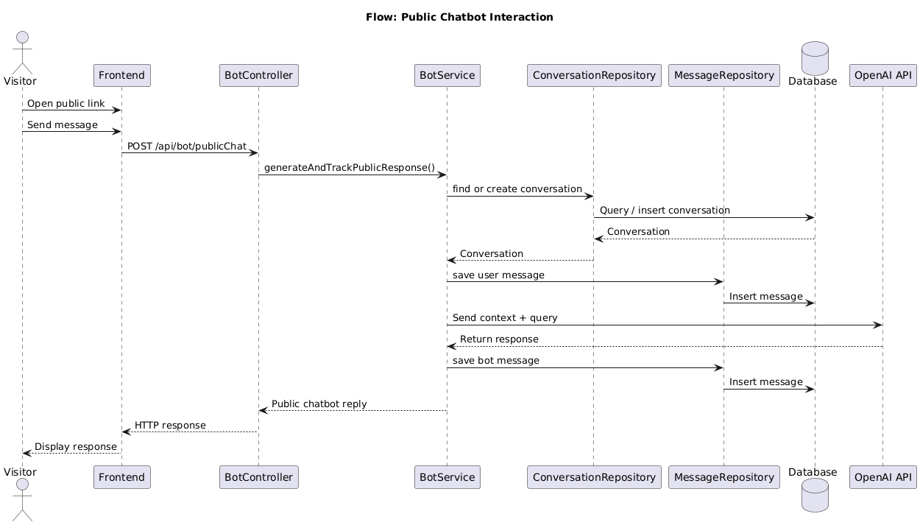
Sequence: Public Chat Flow
Visitor accesses public link
Conversation tracked
Response generated
Notes:
This diagram represents how a public user interacts with a deployed chatbot.
A website visitor accesses the chatbot through a public link that contains a unique token.
When the visitor sends a message, the backend uses the token to identify which bot is being accessed.
The system then retrieves the associated knowledge chunks and sends the request to the OpenAI API.
A response is generated and returned to the visitor, just like in the internal chat flow.
The key difference is that this process does not require user authentication, making it accessible to anyone with the link.

Slide 10
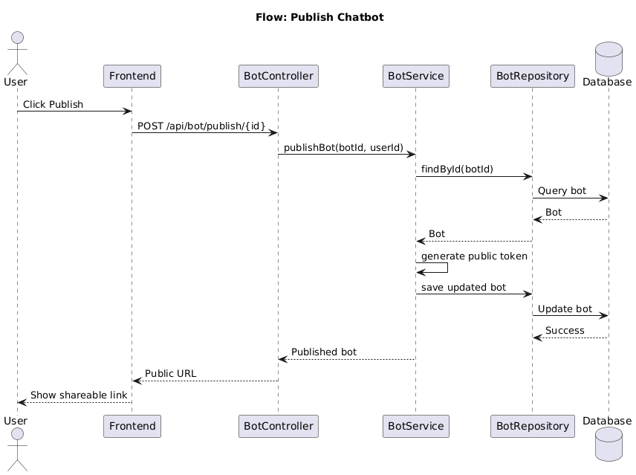
Sequence: Publish Flow
Bot marked as published
Public token generated
Shareable link created
Notes:
This diagram explains the publishing process.
When a user clicks the publish button, the backend updates the bot’s status to indicate that it is now publicly available.
A unique public token is generated for that bot. This token acts as an identifier and ensures secure access.
Using this token, the system creates a shareable public URL.
This link can then be distributed to users or embedded into websites, allowing external users to interact with the chatbot.
This step effectively transitions the bot from a private tool to a publicly accessible application.

Slide 11
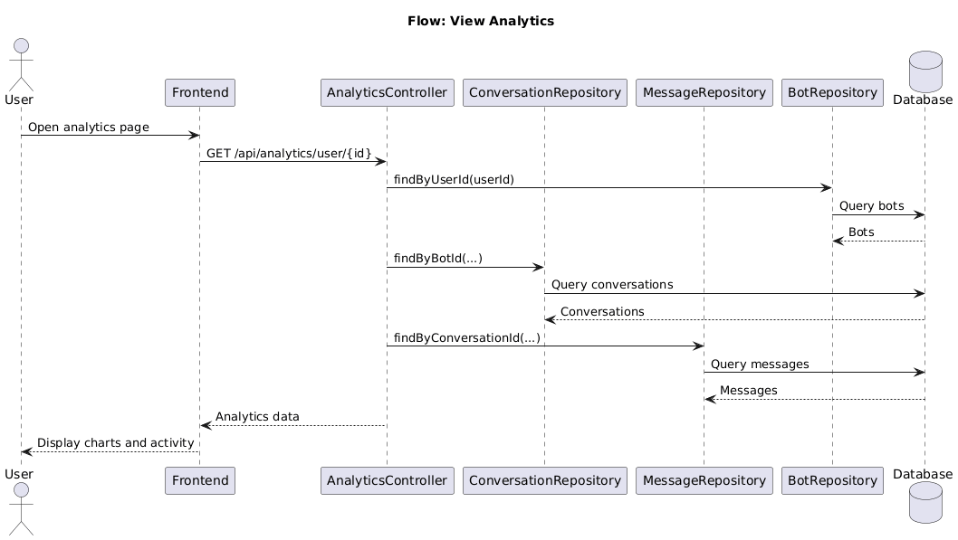
Sequence: View Analytic
Analytics request sent from frontend
Data retrieved and aggregated from bots, conversations, and messages
Charts and activity displayed to user
Notes:
This diagram shows how analytics are generated and displayed.
When the user or admin requests analytics, the frontend sends a request to the backend.
The backend collects data from multiple sources, including bots, conversations, and messages.
This data is then processed and aggregated into meaningful metrics, such as total conversations, active users, and response trends.
Finally, the frontend displays this information using charts and tables.
These analytics help users understand how their chatbot is performing and identify areas for improvement.

Slide 12

Demo Flow
Live Demo Steps
User login
Create chatbot
Add knowledge source
Test chatbot responses
Publish chatbot
Access public chatbot link
Demonstrates full end-to-end workflow
Notes:
For the demo, we walk through the full end-to-end workflow of the application. First, the user logs in. Then the user creates a chatbot and adds a knowledge source. After that, the user tests the chatbot to verify the responses. Once satisfied, the user publishes the chatbot. Finally, the chatbot can be accessed through its public link. This demonstrates the complete lifecycle from creation to deployment.

Slide 13
Challenges
Key Challenges Faced
Chunking limitations in response generation
Dependency on OpenAI API
Data extraction issues from websites/PDFs
Handling multi-topic queries
System performs best for single-chunk queries; multi-chunk queries may produce partial responses
Notes:
During development, we faced several important challenges. One issue was chunking limitations in response generation, since the chatbot performs best when the answer is found in a small number of relevant chunks. Another challenge was dependency on the OpenAI API, including response quality and API constraints. We also faced data extraction issues when scraping websites and PDFs, especially when content structure was inconsistent. Finally, handling multi-topic queries was difficult because responses could become incomplete when the information was spread across many chunks.

Slide 14

Future Work
Planned Enhancements
Hybrid search (keyword + embeddings)
Chat Interface on Landing Page
Multi-language chatbot support
Cloud deployment (AWS/Azure)
Improved chunk ranking and retrieval
Advanced analytics dashboard
Notes:
There are several enhancements we would like to add in the future. One is hybrid search, which combines keyword search with embeddings for more accurate retrieval. Another is adding a chatbot interface directly on the landing page. We also want to improve support for multiple languages, explore cloud deployment options such as AWS or Azure, improve chunk ranking and retrieval, and expand the analytics dashboard with more advanced insights.

Slide 15

Conclusion
Project Summary
Developed a complete chatbot builder platform
Covers full software development lifecycle
Successfully integrates AI for response generation
Ready for demonstration and further enhancement
Bridging the gap between AI capabilities and user accessibility
Notes:
In conclusion, we developed a complete chatbot builder platform that covers the full software development lifecycle, from planning and design to implementation and testing. The system successfully integrates AI for response generation and provides a usable no-code solution for chatbot creation and deployment. Our project helps bridge the gap between powerful AI capabilities and everyday user accessibility, and it is ready for demonstration and future improvement.

Slide 16
Thank You
Notes:
Thank you for listening to our presentation. We appreciate your time and attention, and we would be happy to answer any questions you may have.

