Slide 1
Slide 1 / 8
CSE440 · NORTH SOUTH UNIVERSITY
Group -09
Adventure Quest:
A Factor Graph-Driven Interactive Narrative RPG built as a static browser game
“Where every choice rewrites probability.”
◈
Application type
Σ
Core algorithm
✦
Game loop
Browser RPG
Sum-product style
12 turns
Ashmit Ebne Nur : 2031157642 · Samiul Alim : 1731883642 · Margia Hossain Mukti : 2011675042 · Nusrat Jahan : 2415267650 · Nazia Tasnim : 2212439042

Slide 2
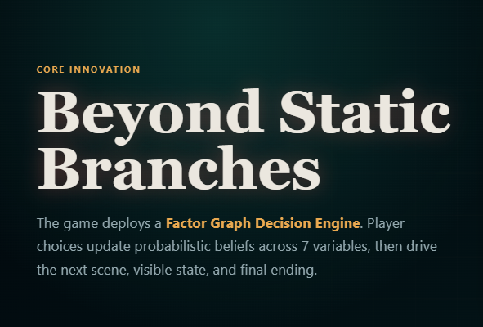
CSE440
Slide 2 / 8
CORE INNOVATION
01
Choice cards
Beyond Static Branches
Three options per turn
The game deploys a Factor Graph Decision Engine. Player choices update probabilistic beliefs across 7 variables, then drive the next scene, visible state, and final ending.
Binary messages
02
Variable and factor updates
03
Local scene generation
No API dependency
Σ
Static single-page game: HTML5, CSS3, Vanilla JavaScript, Canvas, Web Audio API

Slide 3
CSE440
Slide 3 / 8
THE 7 ARCANE VARIABLES
Shaping Reality Through Probability
These beliefs appear both in the live canvas graph and the Arcane Measures sidebar, making probabilistic state changes visible to the player.
V1
V2
V3
V4
Courage
Trust
Karma
Wisdom
Willingness to face danger
Reputation among NPCs
Moral alignment
Knowledge and insight
V5
V6
V7
Chaos
Health
Wealth
World instability
Physical condition
Resources and supplies

Slide 4
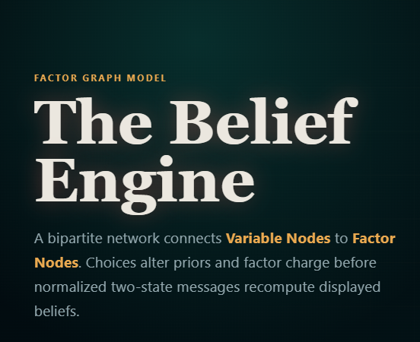
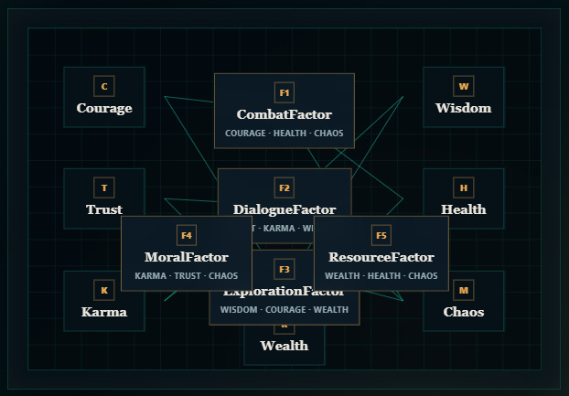
CSE440
Slide 4 / 8
The Belief Engine
C
F1
W
Courage
Combat
Wisdom
A bipartite network connects Variable Nodes to Factor Nodes. Choices alter priors and factor charge before normalized two-state messages recompute displayed beliefs.
T
F2
H
Trust
Dialogue
Health
F4
F5
Moral
Resource
K
F3
M
Karma
Exploration
Chaos
R
Wealth

Slide 5
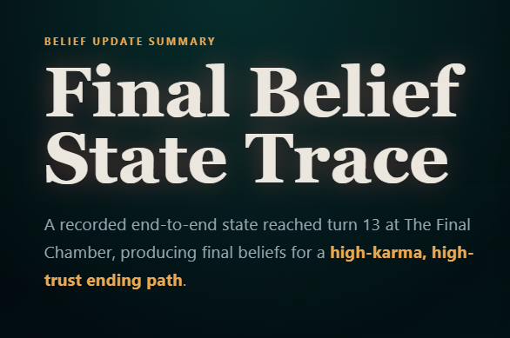
CSE440
Slide 5 / 8
Variable
Final
V1 · Courage
0.98
A recorded end-to-end state reached turn 13 at The Final Chamber, producing final beliefs for a high-karma, high-trust ending path.
V2 · Trust
0.99
V3 · Karma
0.97
V4 · Wisdom
1.00
V5 · Chaos
0.48
V6 · Health
0.76
V7 · Wealth
0.78

Slide 6
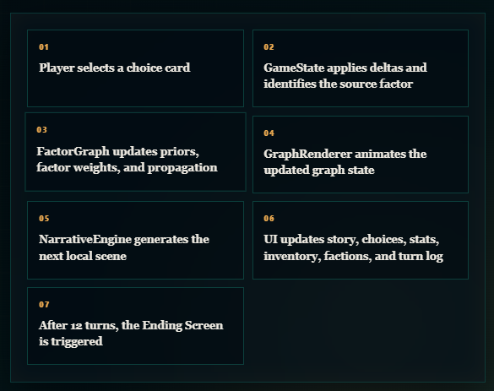
CSE440
Slide 6 / 8
THE GAME LOOP
01
Player selects a choice card
02
GameState applies deltas and identifies the source factor
The Cycle of Choice and Consequence
03
FactorGraph updates priors, factor weights, and propagation
04
GraphRenderer animates the updated graph state
Each turn converts player agency into state deltas, belief propagation, narrative output, and visible interface feedback across the three-panel game layout.
05
NarrativeEngine generates the next local scene
06
UI updates story, choices, stats, inventory, factions, and turn log
07
After 12 turns, the Ending Screen is triggered

Slide 7
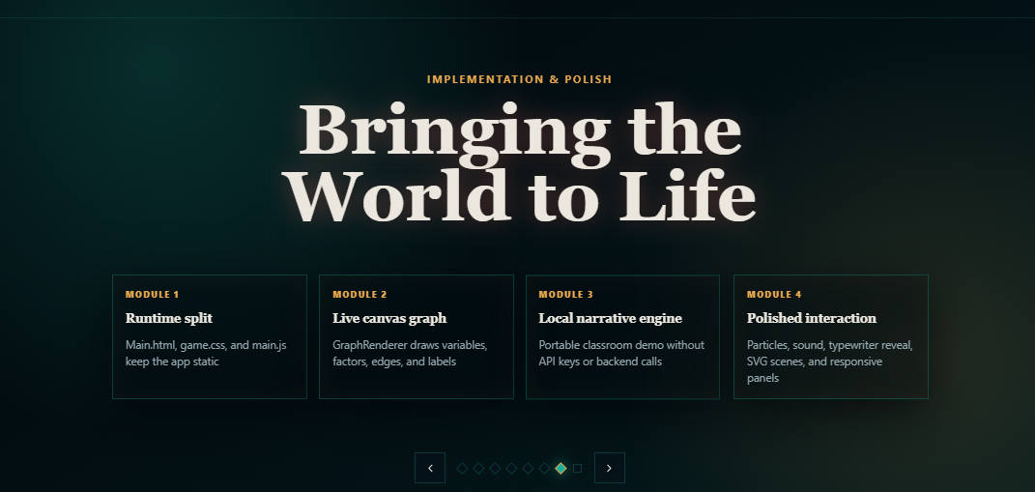
CSE440
Slide 7 / 8
Bringing the World to Life
Module 1
Module 2
Runtime split
Live canvas graph
Main.html, game.css, and main.js keep the app static
GraphRenderer draws variables, factors, edges, and labels
Module 3
Module 4
Local narrative engine
Polished interaction
Portable classroom demo without API keys or backend calls
Particles, sound, typewriter reveal, SVG scenes, and responsive panels

Slide 8
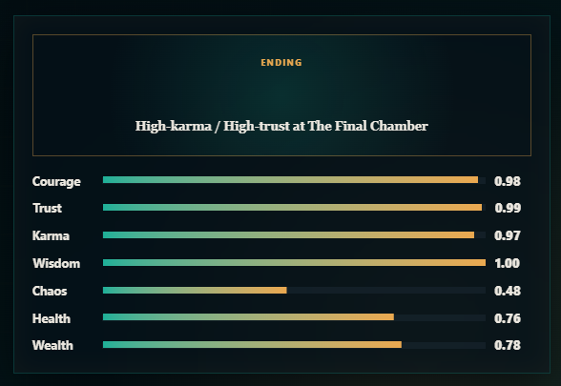
CSE440
Slide 8 / 8
RESULTS & ENDINGS
Ending
Where Beliefs Lead
High-karma / High-trust at The Final Chamber
Courage
0.98
The system results in one of five primary endings plus an emergent sixth path. Testing confirmed a complete 12-turn playthrough and ending modal activation.
Trust
0.99
Karma
0.97
Wisdom
1.00
Chaos
0.48
Health
0.76
Wealth
0.78

