Slide 1
A Tank Game
Submitted in the partial fulfillment for the award of the degree of
BACHELOR OF ENGINEERING
IN
Computer Science & Engineering
Submitted by:
Ashmit Bhardwaj: 22BCG10045
Albin John: 22BCG10008
Pulkeet Singh: 22BCG10011
Ayush John: 22BCG10051
Under the Supervision of:
Harun
Department of AIT-CSE
DISCOVER . LEARN . EMPOWER
1

Slide 2
Outline
Introduction to Project
Problem Formulation
Objectives of the work
Methodology used
Results and Outputs
Conclusion
Future Scope
References
2

Slide 3
Introduction To Project
This project named “A Tank Fight Game” is an ambitious project is aimed towards creating a tank fight game as the name specified with multiple game mechanics that many of the previous games have used, like capturing, destroying, shooting, and many other mechanics.
This project encapsulates the essence of strategic gameplay, presenting players with the challenge of navigating a tank through a maze like village to capture the central military stronghold. Drawing inspiration from the harsh realities of desolation, the dynamic environment provides a canvas for intense tank battles against a variety of enemy units, ranging from infantry to strategically positioned snipers.

Slide 4
This project isn't just another tank-based game, it's an immersive experience that unfolds within the intricate puzzle of a village. We've set out to create a game that not only challenges your gaming skills but also immerses you in a environment, exploring the delicate balance between realism and entertainment.
In a sea of games, This project distinguishes itself by adding depth to the tank-based shooter genre. We're not looking to redefine, we're here to enhance and enrich. It's an immersive experience, a puzzle waiting to be solved, and a narrative waiting to be crafted by you, the player.

Slide 5
Project Formulation

Slide 7
Objectives of Work
Goals
Targets
Create an engaging tank fight game in Unity.
Design a desert village environment for the game.
Implement challenging army units for the player to face.
Develop a base camp for the player to destroy.
Design network towers as obstacles for the player to overcome.
Complete the game development within the specified timeline.
Ensure smooth navigation for the player through the desert village.
Implement realistic tank mechanics and controls.
Create visually appealing graphics for the game.
Test and debug the game to ensure a seamless gaming experience.

Slide 8
Methodology Used
Conceptualization
Defining the core concept, which in this case is capturing an army camp between a village via navigation the village
Prototyping
We have created a prototype of the game that, is an example of what mechanics will the game have, in the below slides in output’s.
Iterative Development
Implementing more features with multiple features with user feedback
Playtesting
Conducting regular playtesting sessions at key milestones.

Slide 9
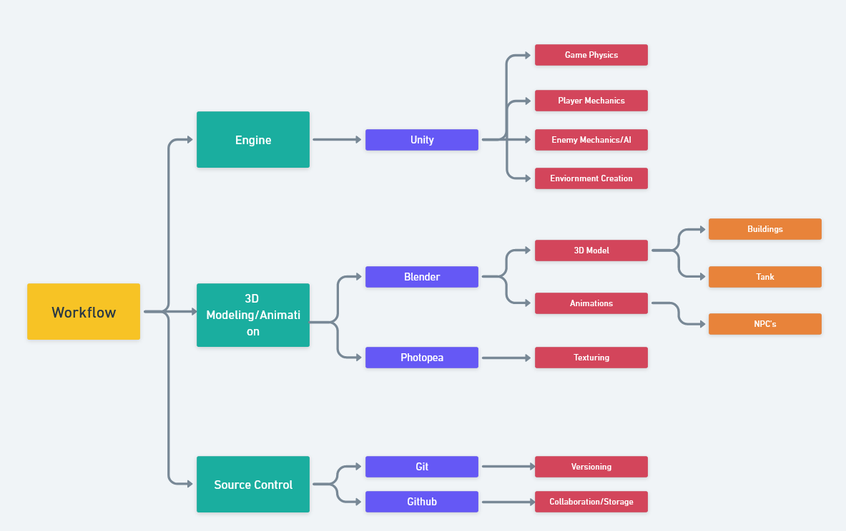

Slide 10
Results and Outputs

